Slide 1
Developed under the CyberEast Project framework
First Responder training for Investigators on Cybercrime and Electronic Evidence
LEPL Academy of the Ministry of Finance of Georgia
Session 1
Notes:
Added for opening of course

Slide 2
Course Opening and Introductions
Course Agenda and Objectives
Session 1.1.1

Slide 3

Health and Safety
Emergency Exits
Fire Alarms
Toilets
Smoking
Mobile Phones & Devices
Coffee and Lunch Breaks
Notes:
1-4 To be established on site
Phones on silent, regular breaks for telephone calls/coffee etc.
Coffee/Lunch times to be added and location served.

Slide 4
Course Background
The underlying course is entitled “First Responder Training for Law Enforcement”.
It has been developed as an output of the European Union/Council of Europe Joint Project on Regional Cooperation on Cybercrime in the IPA region.
Notes:
Instrument for Pre-Accession Assistance (IPA)

Slide 5
Session Aim
Provide delegates with information about the need for the training course and its aim and objectives.
Ensure that they have sufficient information about the programme of activities and the timetable.
Provide information about the health, safety and administrative details of the course.
Introduce the delegates to the trainers and other delegates.

Slide 6
Session Objectives
At the end of this session participants will be able to:
Identify the trainers and fellow delegates
Discuss the overall aim of the course
Explain why this course is necessary
List the component parts of the timetable and activities of the course
List the health and safety procedures for the venue

Slide 7
Why is This Training Necessary
Electronic evidence plays a part in almost any type of criminal investigation. The role of the first responder is crucial in recognising and dealing with this type of evidence in such a way that it is admissible within the criminal justice system.
The Council of Europe has developed a good practice guide for electronic evidence to support countries in developing their practices and procedures.
This course seeks to assist countries in developing training relevant to first responders in this context.
Additionally this course provides an introduction to on-line financial investigations.

Slide 8
Course Aim
This course is designed to provide law enforcement first responders with the knowledge and skills to enable them to recognise and deal with electronic evidence in such a manner that the evidence is preserved for future examination, while retaining its integrity.
To identify on-line criminal assets and put in place procedures to seize and confiscate the assets.
The course will provide procedural as well as practical information about the subject matters and concentrate on how these issues impact on the day-to-day work of the delegates.

Slide 9
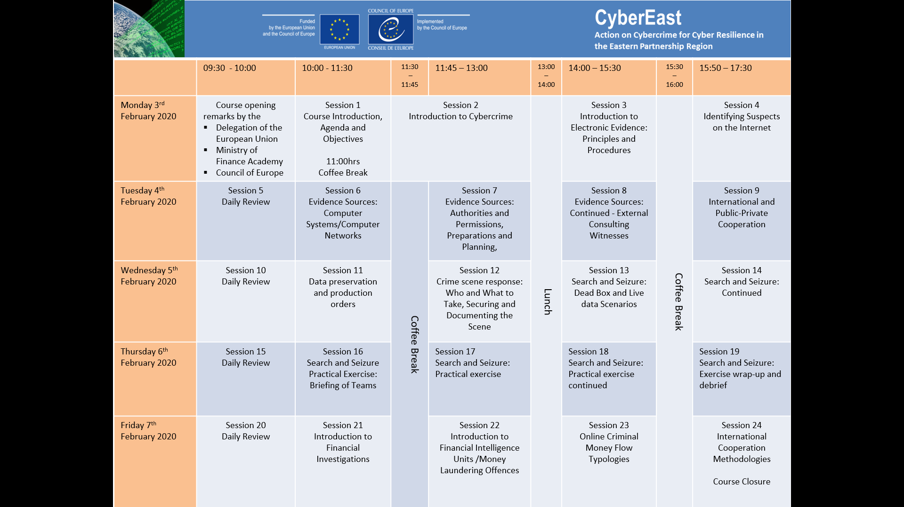
Notes:
Non amendable

Slide 10



 | 09:30 - 10:00 | 10:00 - 11:30 | 11:30 – 11:45 | 11:45 – 13:00 | 13:00 – 14:00 | 14:00 – 15:30 | 15:30 – 16:00 | 15:50 – 17:30
Monday 3rd February 2020 | Course opening remarks by the Delegation of the European Union Ministry of Finance Academy Council of Europe | Session 1 Course Introduction, Agenda and Objectives 11:00hrs Coffee Break | Session 2 Introduction to Cybercrime |  | Lunch | Session 3 Introduction to Electronic Evidence: Principles and Procedures | Coffee Break | Session 4 Identifying Suspects on the Internet
Tuesday 4th February 2020 | Session 5 Daily Review | Session 6 Evidence Sources: Computer Systems/Computer Networks | Coffee Break | Session 7 Evidence Sources: Authorities and Permissions, Preparations and Planning, |  | Session 8 Evidence Sources: Continued - External Consulting Witnesses |  | Session 9 International and Public-Private Cooperation
Wednesday 5th February 2020 | Session 10 Daily Review | Session 11 Data preservation and production orders |  | Session 12 Crime scene response: Who and What to Take, Securing and Documenting the Scene |  | Session 13 Search and Seizure: Dead Box and Live data Scenarios |  | Session 14 Search and Seizure: Continued
Thursday 6th February 2020 | Session 15 Daily Review | Session 16 Search and Seizure Practical Exercise: Briefing of Teams |  | Session 17 Search and Seizure: Practical exercise |  | Session 18 Search and Seizure: Practical exercise continued |  | Session 19 Search and Seizure: Exercise wrap-up and debrief
Friday 7th February 2020 | Session 20 Daily Review | Session 21 Introduction to Financial Investigations |  | Session 22 Introduction to Financial Intelligence Units /Money Laundering Offences |  | Session 23 Online Criminal Money Flow Typologies |  | Session 24 International Cooperation Methodologies Course Closure
Notes:
Amendable Version

Slide 11
 | 09:30 - 10:00 | 10:00 - 11:30 | 11:30 – 11:45 | 11:45 – 13:00 | 13:00 – 14:00 | 14:00 – 15:30 | 15:30 – 16:00 | 15:50 – 17:30
Monday 3rd February 2020 | Course opening remarks by the Delegation of the European Union Ministry of Finance Academy Council of Europe | Session 1 Course Introduction, Agenda and Objectives 11:00hrs Coffee Break | Session 2 Introduction to Cybercrime |  | Lunch | Session 3 Introduction to Electronic Evidence: Principles and Procedures | Coffee Break | Session 4 Identifying Suspects on the Internet
Tuesday 4th February 2020 | Session 5 Daily Review | Session 6 Evidence Sources: Computer Systems/Computer Networks | Coffee Break | Session 7 Evidence Sources: Authorities and Permissions, Preparations and Planning, |  | Session 8 Evidence Sources: Continued - External Consulting Witnesses |  | Session 9 International and Public-Private Cooperation
Wednesday 5th February 2020 | Session 10 Daily Review | Session 11 Data preservation and production orders |  | Session 12 Crime scene response: Who and What to Take, Securing and Documenting the Scene |  | Session 13 Search and Seizure: Dead Box and Live data Scenarios |  | Session 14 Search and Seizure: Continued
Thursday 6th February 2020 | Session 15 Daily Review | Session 16 Search and Seizure Practical Exercise: Briefing of Teams |  | Session 17 Search and Seizure: Practical exercise |  | Session 18 Search and Seizure: Practical exercise continued |  | Session 19 Search and Seizure: Exercise wrap-up and debrief
Friday 7th February 2020 | Session 20 Daily Review | Session 21 Introduction to Financial Investigations |  | Session 22 Introduction to Financial Intelligence Units /Money Laundering Offences |  | Session 23 Online Criminal Money Flow Typologies |  | Session 24 International Cooperation Methodologies Course Closure
Notes:
Amendable Version spare

Slide 12

Questions

Slide 13

Introductions

Slide 14

Ice Breaker

Slide 15
Introductions
Pair with someone you do not know.
Take 10 minutes to find out about them and tell us:
Their Name;
Where they work;
What they do;
Their experience as a trainer;
Something Interesting about them;
Answers to the Computer User and Cybercrime Knowledge questions.
Notes:
TRAINER: Consider Printing questions on sheet of paper.
Consider handing out randomly paired numbers so as candidates do not pick someone they are next to or know.
Remove question 4 if no TOT.

Slide 16
Computer User
1 = Complete Beginner
2 = Can turn PC on
3 = Type with both hands
4 = Have seen inside a PC
5 = Have upgraded a PC
6 = Sound user of software packages
7 = Have built a PC
8 = Built & used macros
9 = Linked 2 PC’s together in a network
10 = Systems Administrator, Programmer & designer of Microsoft products
Cybercrime Knowledge
1 = Complete Beginner
2 = Seen forensic software
3 = Employed in forensic unit
4 = Used forensic software
5 = Conducted a cybercrime investigation
6 = Made a statement concerning Cybercrime
7 = Given evidence in Court on Computer Evidence/Cybercrime
8 = Written program or code to aid an examination
9 = Written own software package for forensics
10 = Programmed forensic software for a vendor, have cybercrime related degree & are a cybercrime guru

Slide 17
Questions
Their Name;
Where they work;
What they do;
Their experience as a trainer;
Something Interesting about them;
Answers to the Computer User and Cybercrime Knowledge questions.
Computer User
1 = Complete Beginner
2 = Can turn PC on
3 = Type with both hands
4 = Have seen inside a PC
5 = Have upgraded a PC
6 = Sound user of software packages
7 = Have built a PC
8 = Built & used macros
9 = Linked 2 PC’s together in a network
10 = Systems Administrator, Programmer & designer of Microsoft products.
Cybercrime Knowledge
1 = Complete Beginner
2 = Seen forensic software
3 = Employed in forensic unit
4 = Used forensic software
5 = Conducted a cybercrime investigation
6 = Made a statement concerning Cybercrime
7 = Given evidence in Court on Computer Evidence/Cybercrime
8 = Written program or code to aid an examination
9 = Written own software package for forensics
10 = Programmed forensic software for a vendor, have cybercrime related degree & are a cybercrime guru.
Notes:
Added amalgamated slide

Slide 18
Questions

Slide 19
Course Content

Slide 20
Session #2 Introduction to Cybercrime
Introduction to:
Different types of cybercrime and their impact.
The threats, trends and tools of cybercrime and responses to the phenomenon.
Concepts of cybercrime as it relates to legislation and international standards.
The needs and advantages from the harmonisation between national legislation and the international instruments, in particular the Budapest Convention.

Slide 21
Session #3 – Introduction to Electronic Evidence Principles and Procedures
This session will introduce:
Electronic evidence;
The CoE Electronic Evidence Guide;
The principles and best practice of dealing with electronic evidence;
The unique characteristics of electronic evidence.
Notes:
Explain the relevance of electronic evidence
Explain how electronic evidence is identified, seized and handled.
Explain how electronic evidence is analysed.

Slide 22
Session #4 - Identifying Suspects on the Internet
Introduction to:
Internet terminology;
Know what is an IP address;
Describe how you can find a suspect IP address;
Describe how you can associate a suspect IP address with a real person;
List three technical challenges to identification of suspects on the Internet.
Notes:
Explain the relevance of electronic evidence
Explain how electronic evidence is identified, seized and handled.
Explain how electronic evidence is analysed.

Slide 23
Session #5, #10, #15 & #20 -
Daily Reviews
Each morning we will have a review of the previous day:
These daily review sessions will be led by you. You will be divided into groups of five with a group having responsibility for a particular day.
Summarise the previous days session, identifying key areas of the previous days activities.
The purpose:
Ensure the sessions have been understood.
Identify areas where the course material may need to be reviewed to impart knowledge at the required level.
Provide an opportunity for questions and clarification.
Notes:
Trainer: This can be interactive by having different groups of delegates, each day providing the feedback, this ensures they are attentive and the feedback also identifies areas that may not have been understood.

Slide 24
Session #6, #7 and #8 - Evidence Sources
  These three sessions will introduce and enable you to recognise:
  Evidence Sources.
  Computer Networks.
  Identify network devices.
  Authorities and permissions in the process of search and seizing electronic evidence.
  Best Practice for preparation and planning of the search and seizing electronic evidence.
  Equipment required for search and seizing electronic evidence.
  The role of the external specialist witnesses.

Slide 25
Session #9 – International Cooperation
This session will look at:
Organisation’s, international legal instruments, legislation and standards for International cooperation in;
  Investigations;
  Acquisition and exchange of information, intelligence and evidence;
  Proceeds of crime, identification and seizure;
  Mutual Legal Assistance (MLA);
  Identify relevant provisions of the Budapest and Warsaw conventions.

Slide 26
Session #11 – Procedural Rules under the Budapest Convention
This session will have three parts:
Part One – Procedural provisions of the Budapest Convention in particular to Articles 14 – 21.
Part Two – Conditions and safeguards
Part Three – Procedural provisions of the Budapest Convention Aligned to legislation in Georgia as it relates to Articles 14 – 21.

Slide 27
Session #12 – Search & Seizure
This session examines the :
Planning and preparation of a search raid where digital evidence may be found;
The tools and items that may be required for a scene search where digital evidence may be found;
Securing a crime scene;
Documenting evidence and actions from a digital crime scene.

Slide 28
Sessions #13 and #14 – Search & Seizure
This two sessions will introduce technical terms and methods for the safe handling and preservation of electronic devices and evidence at a crime or search scene:
Identify sources of electronic evidence;
Standard Operation Procedures and best practice for seizure, packaging, transport and storage of electrical devices and electronic evidence;
Discuss techniques to check the power status of a computer system and networks;
Dead box v Live data;
“Volatile Data“, “Transient Data“ and “Live Data Forensics“;
Cloud computing and storage.

Slide 29
Sessions #16 to #19 -
Search and Seizure exercise
Divided into three investigation teams you will undertake an investigation into a reported crime:
You will investigate using the principles and learning from this week, together with your own team’s skills and national policies and practices.

Slide 30
Sessions #21 and #22 - Introduction to Search, Seizure and Confiscation of Online Crime Proceeds
These two sessions will identify:
Functions, responsibilities and powers of a Financial Intelligence Unit (FIU).
Information that an FIU has access to.
How FIUs exchange information.
International organisations, co-operation and standards.
Money laundering offence.
The relevance of money laundering to a financial investigation.
How FIU’s can help with cases involving online crime proceeds.

Slide 31
Sessions #23 - Online Criminal Money Flow Typologies
This session will identify the criminal use and challenges from:
  Money Mules;
  International Transfers;
  Virtual Currencies.

Slide 32
Sessions #24 – Financial Crime Exercise
Divided into the same three investigation teams you will undertake a further investigation into the financial elements of a reported crime:
You will investigate using the principles and learning from this week, together with your own team’s skills and national policies and practices.

Slide 33
Course Closure
Representatives from:
Ministry of Finance Academy
Council of Europe

Slide 34
Questions

Slide 35
Summary

Slide 36

Summary of Session Objectives
At the end of this session participants will be able to:
Provided the health and safety procedures for the venue;
Identified the trainers and fellow delegates;
Explained why this course is necessary
Discussed the overall aim of the course;
Provided an introduction to the component parts of the timetable and activities of the course

Slide 37
Questions

