Slide 1
First Responder training for Investigators on Cybercrime and Electronic Evidence
Session 2. Introduction to Cybercrime

Slide 2
Agenda
Part One
Information society and cybercrime
Part Two
What is cybercrime?
Part Three
Some illegal activities online
Part Four
Contemporary and emerging trends of cybercrime
Part Five
Summary
Notes:
Part One of the presentation will describe the new realities of the information society and will refer to the emerging illegal activities on the networks.
Part Two will recover some of the historic approaches to cybercrime, by some international organisations.
Part Three will try to arrive to the reality covered by the eventual concept of cybercrime.
Part Four will explain what the Budapest Convention on Cybercrime is and will underline the importance of this single binding international instrument in fighting cybercrime.
Part Five will refer to some of the more important illegal activities online, nowadays.
Part Six will briefly touch upon major vectors of contemporary and emerging trends of the cybercrime.
Part Seven will recover the major topics of all the presentation.

Slide 3
Session Objectives
At the end of this session, delegates will be able to:
Identify different types of cybercrime and their impact.
List the threats, trends and tools of cybercrime and responses to the phenomenon.
Explain the concepts of cybercrime that are considered types of crime under most legislation and international standards.
Notes:
The purpose of this session is to present, from a general perspective or as an introduction, the matters relating to cybercrime.
The concept of cybercrime will be explained, while discussing the reasons to be worried about. We will discuss here some of the major threats, trends and tools of cybercrime and also some responses to the phenomenon.
An overview of what is covered under the expression “cybercrime” will be provided. Furthermore a description of some of the concepts that are considered types of cybercrime under most legislation and according to international standards will be discussed.
One of the most important themes to be discussed relates to the substantive criminal law provisions, and some of the key factors used to describe cybercrimes, based on the Budapest Convention and on relevant European Union legal frameworks.
It will be also important to underline the need and the advantage of the harmonisation between national legislation and the international instruments, in particular the Budapest Convention.

Slide 4

Information society and cybercrime

Slide 5

Information Society
A new reality - 21st Century
Information society
Less boundaries and limits
More personal freedoms
More business opportunities
Notes:
An information society is a society where the creation, distribution, use, integration and manipulation of information is a significant economic, political, and cultural activity. Its main drivers are digital information and communication technologies, which have resulted in an information explosion and are profoundly changing all aspects of social organization, including the economy, education, health, warfare, government and democracy. The People who have the means to partake in this form of society are sometimes called digital citizens. This is one of many dozen labels that have been identified to suggest that humans are entering a new phase of society. (Hilbert, M. (2015). Digital Technology and Social Change, Beniger, James R. (1986). The Control Revolution: Technological and Economic Origins of the Information Society).

Slide 6
Information Society
A part of the daily life of the citizens:
  workplace
  home
  most of the leisure moments
There is no physical distances between people in different places in the world
Political frontiers are indifferent to the cyber world
Information and knowledge can be democratically and freely obtained
Competition
Notes:
Information society, a social and economic development model, based on the acquisition and diffusion of information by the means of communication networks, pervaded the daily life of citizens, their workplace, their home and many of their leisure activities.
In this social and economic environment, there are no physical distances between people in different places in the world. With some very well-known exceptions, in this new “open world”, potentially, there are no political frontiers (of the States), between Internet surfers. Here, everybody can obtain democratically information and knowledge, no matter where it is stored. This means also competition between all the economic operators.

Slide 7
Information Society
Information is open and available to everybody
No States sovereignty (..?)
“Cyberspace is independent, anarchic and ungovernable”
It is everywhere and it is nowhere
Any person can express himself or herself
Notes:
Information is available to everybody, in a free and open way. Internet users feel that there is no sovereignty over the networks.

Slide 8
Internet
Criminals have more opportunities
Crimes can be committed remotely
  Evidence (data) is volatile
  National law enforcement agencies are limited to their geographical borders?
    International assistance in criminal investigations require proper legal channels?
    No jurisdiction online, if outside national borders?
    International cooperation deals with very distant countries with different cultures, with different legal tradition and different criminal law frameworks.
    Need for expedited mutual legal assistance is a fact in contemporary fight against cybercrime!
Notes:
As the use of the Internet arrives to every place and to every people in the world, crime increases and criminals discover new possible illegal activities. The crimes committed by the means of the networks are the most transnational of all crimes.
This nature raises particular difficulties to those who investigate these criminal activities: on the other side of the world, evidence can disappear if it is not preserved immediately and law enforcement agents must respect political borders. Besides, they need to follow legal proceedings and public channels to request international assistance in criminal investigations.
However, over past years it became pristine clear that new forms of expedited and swift mutual legal assistance in criminal matters regarding cybercrime is a must.

Slide 9
Cybercrime
A global crime
requires international focus in growing number of the cases
  if so, it is the only adequate approach to address the borderless nature of this global phenomenon
  international cooperation can give more effectiveness to domestic efforts
Notes:
In this context, the international approach is essential. The multinational or international approach is richer than a mere national or even regional approach and global comprehension of the phenomenon gives a wider dimension. International cooperation between law enforcement agencies – within police or between prosecution services - is crucial to achieve results in criminal investigations.

Slide 10
Cybercrime
A global crime
multiple territorial connections
  the action of the criminals reach computers and victims in countries other than their countries
  inherent to the nature of cybercrime
  because of the expansion of the networks it is very hard, to each country, to act alone against this problem.
Notes:
All observers agree that cybercrime is a global phenomenon and the only adequate approach to address the borderless nature of global networks is a common approach, where domestic efforts are complemented by specific forms and channels of international cooperation that can face the issue of cybercrime being facilitated globally, with potential consequences in any part of the world.
It is very clear that cybercrime is a global phenomenon with global dimensions. Each illegal activity, typically, has multiple territorial connections: normally, perpetrators are based in a certain country’s jurisdiction, but their actions reach computers and victims in many other countries.
This is a common characteristic to other modern forms of criminality, but concerning cybercrime and e-evidence in general, it is inherent to its nature. Due to the expansion of communication networks, particularly the Internet, it is impossible for any country in the world to act alone against this crime problem.

Slide 11
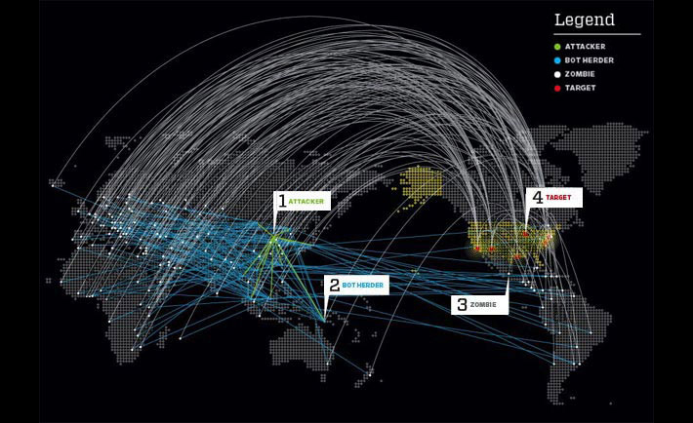
Notes:
Example 1: DDOS attack. Transnational from its origin to the target. Includes attacker, “bot herder” and “zombie” computers and target (victim) of the attack, which are most often using computer systems across the globe.
image: http://westendsolution.com/wp-content/uploads/2013/04/DDoS-network-map.jpg
How DDOS attack works will be explained later in the course, this example wants to only show the international dimension that an attack can have.

Slide 12
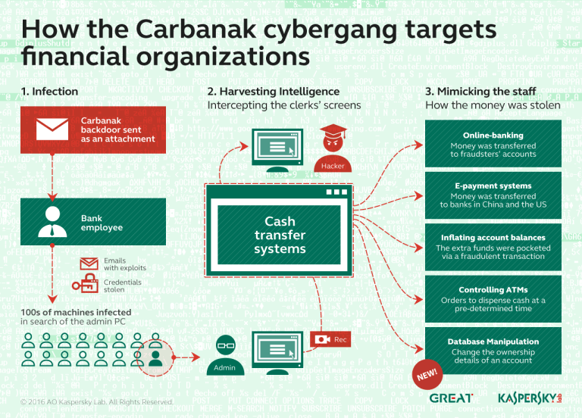
Notes:
Example 2: Implementation of the ZEUS malware for the purpose of the banking account hijacking. Scheme includes 6 steps: sending massive numbers of infected e-mails, opening of e-mails and triggering of the malware, recording of the banking account data, take-over of the actual accounts, money transfer and money withdrawal by the so called “money mules” and handing over illegal gain to the organizers while keeping percentage as fee.

Slide 13

https://www.youtube.com/watch?v=6Vhs0qb6kJE

Slide 14
Modern Challenges
States, citizens and economies depend and rely on communication networks and technologies.
All the countries in the world are currently connected to the Internet.
New illegal activities are being “invented” everyday
  within the networks
  using the networks
  against the networks.
Notes:
Modern societies depend on information technologies. States, citizens and economies are currently connected to the Internet. This is a very fertile field for new emerging illegal activities, within the communications networks, using the networks, or against the networks.

Slide 15
Most Common Cybercrime Phenomena
General approach:
  hacking
  diffusion of viruses, worms and other forms of malware
  computer attacks – DoS, DDoS
Profit oriented crime:
  Business E-mail Compromise, Ransomware
Utilisation of the networks to commit or facilitate a crime.
Notes:
Everywhere, cybercrime is identified with phenomena like hacking, or the diffusion of malware (mainly viruses or worms), or the popular, within the media, computer attacks (DoS or DDos). However, nowadays, even the common citizen is aware of many other criminal activities on the networks, most of them with profit purposes (vg. regular frauds and computer frauds). And also everybody knows about the great possibilities of utilisation of the cyber environment, or cyber ecosystem, to commit or facilitate common crimes.
Business email compromise (will be explained later) - The attacker uses the identity of someone on a corporate network to send spoofed email and trick the target or targets into sending money to the attacker’s account.
Ransomware (will be explained later) – Specific malicious code that encrypts content on the computer and asks to pay a ransom to be able to recover the encrypted data.

Slide 16
“Digital” or “Cyber” Environment
Traditional computers
  but also
    many other modern devices that can communicate
    or keep transfer or record data
    Internet of the Things
Notes:
This expression, “cyber environment”, even if it still remains not defined, both in law and academic literature, is each day richer and more complex. Technology is increasing the number and type of devices that can communicate on the networks and that are able to transfer data or just to record them.
Internet of Things (will be explained later) - The Internet of things (IoT) is the inter-networking of physical devices, vehicles (also referred to as "connected devices" and "smart devices"), buildings, and other items embedded with electronics, software, sensors, actuators, and network connectivity which enable these objects to collect and exchange data (Wikipedia)

Slide 17
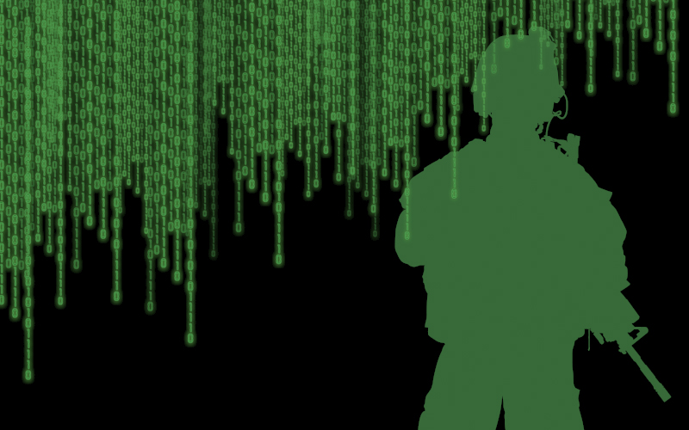
The challenges of Cyber security and criminality
Cyber Warfare is a Reality
A wave of politically-motivated cyber offensives this year – such as attacks on the White House and the US Department of Homeland Security – show that the international arms race is now moving online, a study claims.
Increasingly, defence and military are involved in “cyber” the latest trend is the mix of informational and traditional warfare, combined. The use of the internet to influence “hearts and minds” in combination with sabotage (network intrusion attacks) and the traditional “kinetic” means of warfare is also known as “hybrid warfare”.
Notes:
Cyber space is becoming even more complicated with the emerging trends of cyber security overlapping with cyber criminality. It is important to keep these worlds separated but with consciousness that some cyber security issues can emerge as cybercrimes on the end.
http://www.argentconsulting.nl/tag/cyber-warfare-2/

Slide 18
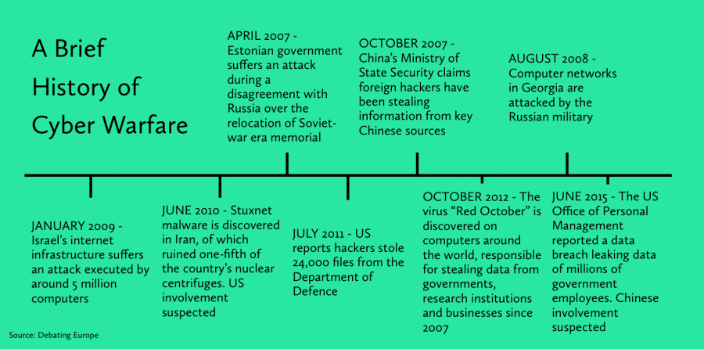
The challenges of Cyber security and criminality
Notes:
Brief example of fast development of events which are not proven but suspicious of foreign government level involvment.
https://thecybersolicitor.files.wordpress.com/2016/05/a-brief-history-of-cyber-warfare.png?w=900

Slide 19
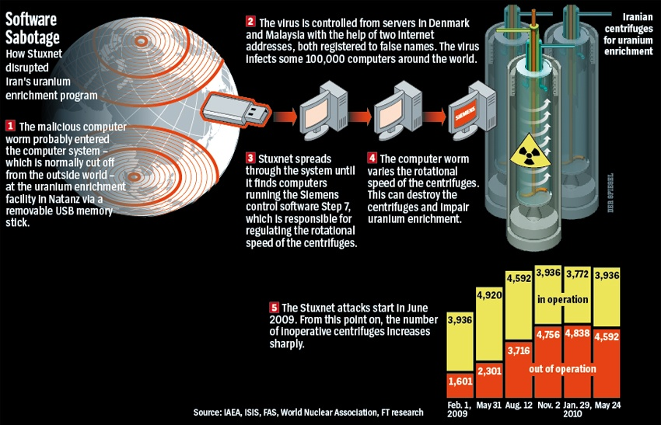
The challenges of Cyber security and criminality
Stuxnet, the World's First Digital Weapon, was designed to disrupt Iran’s uranium enrichment program
Notes:
Stuxnet is recorded as the first detected cyber warfare payload. It was specifically designed to work with specific hardware and software of nuclear power plants.
https://en.wikipedia.org/wiki/Stuxnet

Slide 20

Questions
Notes:
The trainer should give participants an opportunity to ask any questions that they may have in relation to part One of the lesson.

Slide 21
What is cybercrime?

Slide 22
Why “cybercrime”?
Moral/political reasons
  Political: spreading a message
  Terrorism: recruitment, messaging
For wealth/income
  Phishing
  Ransomware
  Banking trojans
State interest and geopolitical conflict
  State actors
  Part of Hybrid warfare
  Elections
Notes:
Phishing (“fishing for passwords”) is a technique used to attempt to convince someone to send personal information that other people. That information can be used later to theft or fraud. Normally, the perpetrators use email messages to trick the victims, from who they obtain personal information, including passwords or other access credentials. Sometimes, the technique used is to redirect users to a malicious and fake website.
https://en.wikipedia.org/wiki/Phishing

Slide 23
How Criminals use Technology
It is important to explain at the outset that there are many terms used to describe the criminal use of technology and it may assist the reader if a brief explanation is provided.
The terms “computer crime”, “high-tech crime”, “IT crime” and “cybercrime” are often intermingled and create confusion and misunderstanding.
The use of computers and other devices by criminals and the value of recoverable data to the police investigator can be broken down as follows:
Notes:
How criminals use technology.
The trainer should slowly read the text.

Slide 24
How Criminals use Technology
Technology as a Victim
Technology as a target of crime:
– is traditionally considered to be true “computer crime” and involves such offences as hacking, denial of service attacks and the distribution of viruses.
Notes:
Technology as a victim
Technology as a target of crime – is traditionally considered to be true “computer crime” and involves such offences as hacking, denial of service attacks and the distribution of viruses.

Slide 25
How Criminals use Technology
Technology as an aid to crime
Technology as an aid to crime:
– is where computers and other devices are used to assist in the commission of traditional crimes, for example, to produce forged documents, to send death threats or blackmail demands or to create and distribute illegal material such as images of child abuse.
Notes:
Technology as an aid to crime
Technology as an aid to crime – is where computers and other devices are used to assist in the commission of traditional crimes, for example, to produce forged documents, to send death threats or blackmail demands or to create and distribute illegal material such as images of child abuse.

Slide 26
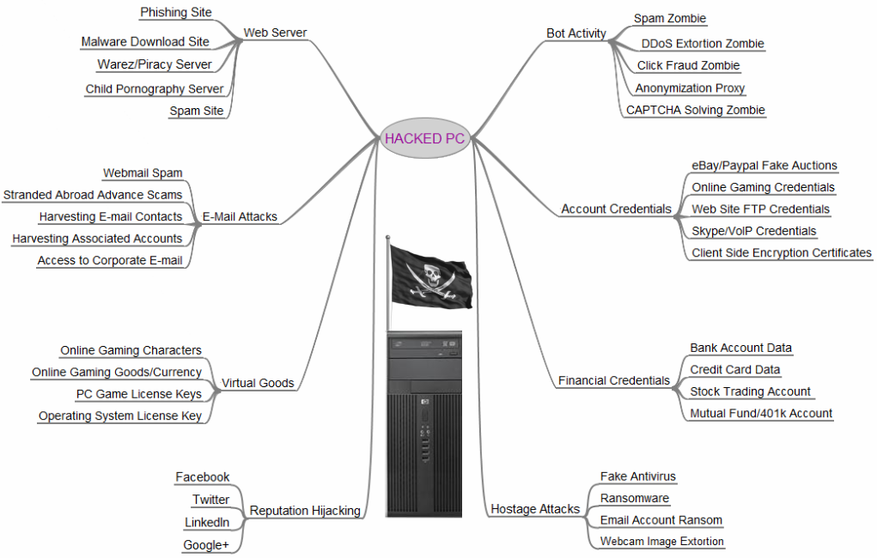
A Hacked PC ..
Krebsonsecurity.com
Notes:
Technology as a victim
Technology as a target of crime – is traditionally considered to be true “computer crime” and involves such offences as hacking, denial of service attacks and the distribution of viruses.

Slide 27
How Criminals use Technology
Technology as a communication tool
Technology as a communications tool:
– is where criminals use technology to communicate with each other in ways which reduce the chances of detection, for example by the use of encryption technology.
Notes:
Technology as a communication tool
Technology as a communications tool – is where criminals use technology to communicate with each other in ways which reduce the chances of detection, for example by the use of encryption technology.

Slide 28
How Criminals use Technology
Technology as a storage device
Technology as a storage medium:
– is the intentional or unintentional storage of information on devices used in any of the other categories and typically involves the data held on computer systems of victims, witnesses or suspects.
Notes:
Technology as a storage device
Technology as a storage medium – is the intentional or unintentional storage of information on devices used in any of the other categories and typically involves the data held on computer systems of victims, witnesses or suspects.

Slide 29
How Criminals use Technology
Technology as a witness to crime
Technology as a witness to crime:
– can be found when evidence contained in IT devices can be used to support evidence to which it is not obviously related, for example to prove or disprove an alibi given by a suspect or a claim made by a witness.
Notes:
Technology as a witness to crime
Technology as a witness to crime – can be found when evidence contained in IT devices can be used to support evidence to which it is not obviously related, for example to prove or disprove an alibi given by a suspect or a claim made by a witness.

Slide 30
In Real Life
Crime on cyber environments is already an important reality
Specific investigation units at the police level
International public organisations and private companies have each time more concern by the consequences of the illegal and harmful acts committed by the means of the communication networks or inside those networks
Part of Cyber diplomacy discussions
Notes:
However, sociologically speaking, crime on cyber environments is already an important and autonomous reality. There are, all over Europe and in the majority of the countries in the rest of the world, specific investigation units at the police level and some special prosecution services, too. International public organisations and private companies have each time more concern by the consequences of the illegal and harmful acts committed by the means of the communication networks or inside those networks.

Slide 31
Cybercrime: Narrow and Broader Sense
Normally used to describe a criminal activity in which a computer or a network are an essential part of a crime
However cybercrime is also used to include other traditional crimes in which those same computers or networks are used to make the illicit activity possible
Notes:
Cybercrime is commonly defined in both a narrow and a broader sense: normally, the expression is used, on a restricted way, to describe a criminal activity in which a computer or a network are an essential part of a crime; however cybercrime is also used to include other traditional crimes in which those same computers or networks are used to make the illicit activity possible.

Slide 32
In Real Life
Often, several cybercrime categories will be present together
Increase in “typical” cybercrimes (phishing, botnets)
Increase in child pornography diffusion on the Internet
Increase in cybercrimes with the purpose of profit
Increase in software (and other) piracy
Increase in the use of cyber facilities by organised crime
Increase in cyber money laundering
Increase in hate, racism, violence websites
Notes:
Often, in a “real” crime scenario, several of these categories will be present together. A criminal might, for instance, threaten a company with a denial of service attack against the company website (crime against the computer system) unless they get paid money (a new version of blackmail using computers as tools), and the threat is communicated via email but could of course just as well been send in a traditional letter).
In real terms, however, there is a wide range of increasing criminal modalities: typical cybercrimes as phishing or the use of botnets are increasing, as well as a great and creative collection of cybercrimes with profit purposes. There is also a significant piracy of software and other issues with intellectual property rights. The diffusion of child pornography material is increasing, so is the value of money laundering over Internet. In general, each day there is an increase in the use of cyber facilities by organised crime and illegal organisations, like terrorist organisations.

Slide 33
Questions
Notes:
The trainer should give participants an opportunity to ask any questions that they may have in relation to part Three of the lesson.

Slide 34
Illegal activities online
Notes:
Part Five - Some illegal activities online
The goal of this part is to describe very briefly some of the criminal activities developed in the networks.

Slide 35
Phishing
Phishing is the attempt to obtain sensitive information such as usernames, passwords, and credit card details (and, indirectly, money), often for malicious reasons, by disguising as a trustworthy entity in an electronic communication.
Communications purporting to be from social web sites, auction sites, banks, online payment processors or IT administrators are often used to lure victims. Phishing emails may contain links to websites that are infected with malware.
Notes:
Phishing (“fishing for passwords”) is a technique used to attempt to convince someone to send personal information that other people. That information can be used later to theft or fraud. Normally, the perpetrators use email messages to trick the victims, from who they obtain personal information, including passwords or other access credentials. Sometimes, the technique used is to redirect users to a malicious and fake website.
https://en.wikipedia.org/wiki/Phishing

Slide 36
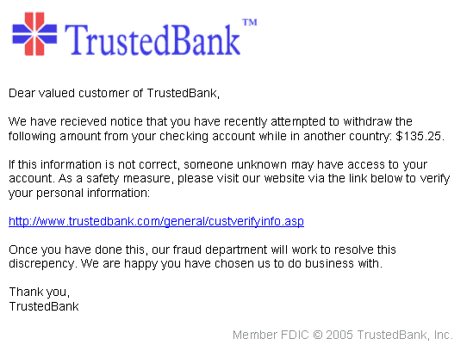
Phishing
Notes:
Example of phishing site or e-mail.

Slide 37
Malware
“malicious" + "software“
Software designed with the aim of accessing or otherwise compromising a computer system or data without the consent of the owner or user
Can be contained in email attachments or in images in the message
Virus, worms, adware, Trojans
Notes:
The merger of the terms “malicious" and "software” led “malware”, a term that generically refers to software designed with the aim of accessing a computer system without the consent of the owner or user, or with the aim to damage it. The victim can obtain malware without knowledge, through email attachments or images in messages.
This software is normally hostile software and it is inserted in the victim’s computer without consent and is built to perform hostile functions or activities.
Cybercrime Convention Committee (T-CY) issued Guidance Note no. 7 on Malware https://rm.coe.int/CoERMPublicCommonSearchServices/DisplayDCTMContent?documentId=09000016802e70b4

Slide 38
Viruses
Software with the ability to replicate itself from one file to another and lodging in a particular system
Without the consent (or knowledge) of its user / administrator
With the aim of causing damage in this system
Notes:
Viruses are a specific example of malware. Typically, a virus is software with the ability to replicate itself from one file to another and lodging in a particular system – a hard disk or other data storage medium. Normally, just spreads when the infected file is copied or executed. Of course, all this is performed without the consent or even knowledge of the victim and with the aim of causing damage in the computer system.

Slide 39
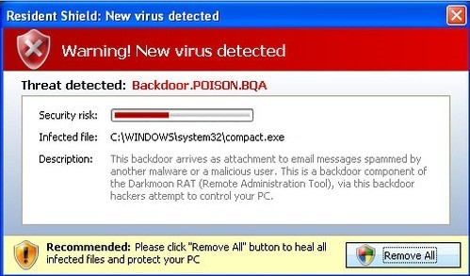
Computer Viruses/Trojans
Notes:
Example of virus intrusion using mimicking, also known as Rogue Anti-virus. The pop-up is presented while browsing the Internet and clicking on “Remove All” will effectively trigger infection instead cleaning non-existent one.

Slide 40
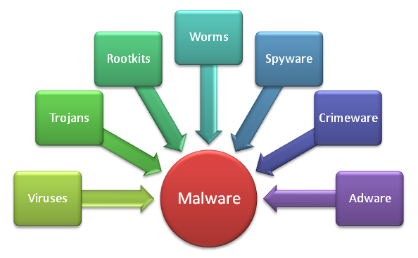
Malware
Notes:
Example of Malware scope.
http://techliveinfo.com/wp-content/uploads/2015/09/How-to-identify-Malware-from-computer.jpg

Slide 41
Worms
A computer worm is a standalone malware computer program that replicates itself in order to spread to other computers. Often, it uses a computer network to spread itself, relying on security failures on the target computer to access it.
Worms almost always cause at least some harm to the network, even if only by consuming bandwidth, whereas viruses almost always corrupt or modify files on a targeted computer.
Notes:
A worm is very similar to a virus. As the virus, a worm is software that has the ability to replicate itself and to install into a particular system and consume its resources. But it is different from a virus because it spreads itself through a network and does not need to attach to any file.
https://en.wikipedia.org/wiki/Computer_worm

Slide 42
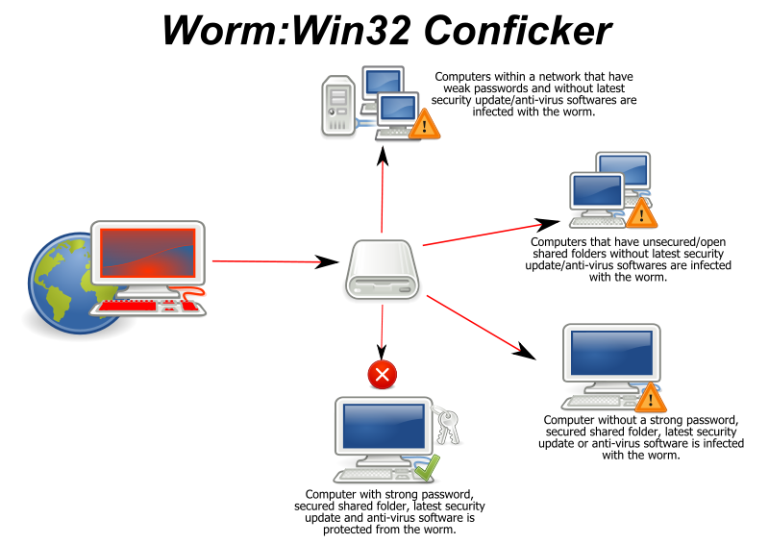
Notes:
Example of typical computer worm Win32 Conficker.

Slide 43
Spyware
Spyware is software that aims to gather information about a person or organization without their knowledge, that may send such information to another entity without the consumer's consent, or that asserts control over a device without the consumer's knowledge.
"Spyware" examples of other notorious types include digital rights management capabilities that "phone home", keyloggers, rootkits, and web beacons.
Whenever spyware is used for malicious purposes, its presence is typically hidden from the user and can be difficult to detect.
Notes:
One of the most intrusive forms of malware is spyware, or software installed on a system without user's consent, with the aim of monitoring the use of the system by the user. Spyware collects information about the user of the system. After that monitoring activity, automatically, the software sends this information to third parties – its specific objective is to hide in the computer of the victim and to report information to someone.
https://en.wikipedia.org/wiki/Spyware

Slide 44
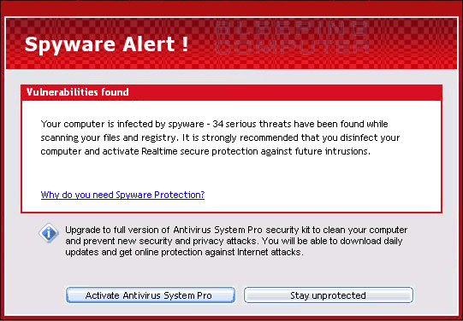
Notes:
Exampe of spyware. In this case Antivirus System Pro is a rogue anti-spyware that uses false scan results, fake security alerts, and Internet Explorer hijacking in order to have you purchase this program. It is because of these actions that we classify Antivirus System Pro as a rogue anti-spyware program. When installed, Antivirus System pro will be configured to start automatically when you log into Windows.
Once running it will scan your computer and display numerous infections that do not actually exist. Furthermore, it will state it will not remove these infections unless you first purchase the program. This method of stating there are infections, but not removing it until you purchase it, is just another tactic to have you purchase the software.

Slide 45
Ransomware
Ransomware is a type of malicious software that blocks access to the victim's data or threatens to publish or delete it until a ransom is paid.
More advanced malware uses a technique called cryptoviral extortion.
Ransomware attacks are typically carried out using a Trojan that is disguised as a legitimate file that the user is tricked into downloading, or opening when it arrives as an email attachment.
However, one high profile example, the "Wannacry worm", traveled automatically between computers without user interaction.
Notes:
Ransomware attacks are typically carried out using a Trojan, entering a system through, for example, a downloaded file or a vulnerability in a network service. The program then runs a payload, which locks the system in some fashion, or claims to lock the system but does not (e.g., a scareware program). Payloads may display a fake warning purportedly by an entity such as a LEA, falsely claiming that the system has been used for illegal activities, contains content such as pornography and IPR.
https://en.wikipedia.org/wiki/Ransomware

Slide 46
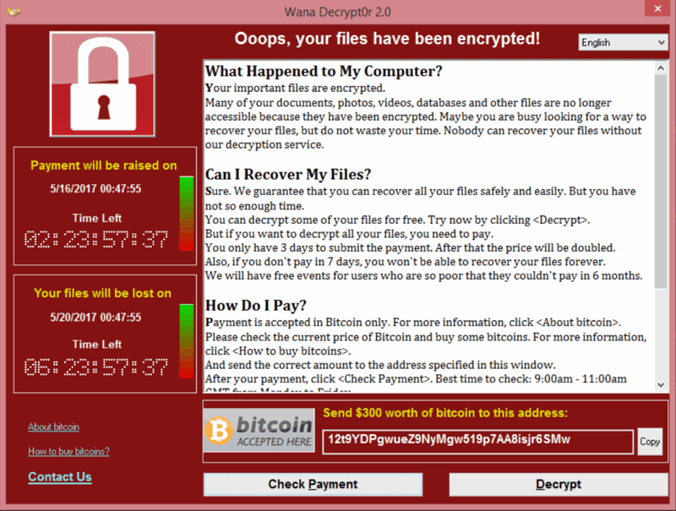
Ransomware – WannaCry
Notes:
Example of contemporary ransomware.
The WannaCry ransomware attack was a worldwide cyberattack by the WannaCry ransomware cryptoworm, which targeted computers running the MS Windows OS by encrypting data and demanding ransom payments in the Bitcoins.
The attack began on Friday, 12 May 2017,[and within a day was reported to have infected more than 230,000 computers in over 150 countries.] Shortly after the attack began, a web security researcher who blogs as "MalwareTech" discovered an effective kill switch by registering a domain name he found in the code of the ransomware. This greatly slowed the spread of the infection, effectively halting the initial outbreak on Monday, 15 May 2017, but new versions have since been detected that lack the kill switch. Researchers have also found ways to recover data from infected machines under some circumstances.
https://en.wikipedia.org/wiki/WannaCry_ransomware_attack

Slide 47
Ransomware – WannaCry
https://blockchain.info/address/13AM4VW2dhxYgXeQepoHkHSQuy6NgaEb94
https://blockchain.info/address/12t9YDPgwueZ9NyMgw519p7AA8isjr6SMw
https://blockchain.info/address/115p7UMMngoj1pMvkpHijcRdfJNXj6LrLn
Notes:
Example of contemporary ransomware.
The WannaCry ransomware attack was a worldwide cyberattack by the WannaCry ransomware cryptoworm, which targeted computers running the MS Windows OS by encrypting data and demanding ransom payments in the Bitcoins.
The attack began on Friday, 12 May 2017,[and within a day was reported to have infected more than 230,000 computers in over 150 countries.] Shortly after the attack began, a web security researcher who blogs as "MalwareTech" discovered an effective kill switch by registering a domain name he found in the code of the ransomware. This greatly slowed the spread of the infection, effectively halting the initial outbreak on Monday, 15 May 2017, but new versions have since been detected that lack the kill switch. Researchers have also found ways to recover data from infected machines under some circumstances.
https://en.wikipedia.org/wiki/WannaCry_ransomware_attack

Slide 48
Trojans (Trojan Horses)
Malicious software that performs undesirable functions to the user, without his knowledge
  destruction of data
  disabling security software
  remote access / backdoors (to give someone unauthorised access to a computer)
  download and installation of other malware
Notes:
Trojans (Trojan horses) is a name inspired in by the famous horse built by Odysseus, the Greek, and offered to the city of Troy in order to open the gates of Troy from within. It is also the name of malicious software that performs undesirable functions to the user, without his knowledge. This kind of malware can cause destruction of data, disabling security software, facilitating remote access to the computer (to allow someone unauthorised access to the computer) or download and install other malware.
Like the original famous horse of the Trojan War, this software is designed to secretly open the computer for penetration from outside.

Slide 49
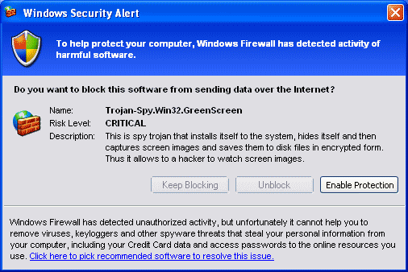
Trojans (Trojan Horses)
Notes:
Example of Trojan Horse malware.

Slide 50
Botnets
Networks of compromised computers (zombies)
Controlled by one person or organisation
Intended to be used for illicit activities
Infected computers are controlled by software that allows automation of operations across the network
Inactive until it is necessary
Notes:
Botnet is also an acronym (robot networks) used to give a name to networks of compromised computers (zombies), controlled by one person or organisation, with the intention of being used for illicit activities.
A botnet is built by the infection with malware, sent by the owner of the botnet. All the infected computers are controlled by software that allows automation of operations across the network. The owner of the network controls its activity and may instruct it to remain inactive until it is necessary.
A botnet may consist of millions of zombie computers that are instructed to send spam or malware to individuals or to attack infrastructure. Botnets serve multiple criminal purposes and are thus also called the “Swiss army knife of cybercrime”.
Cybercrime Convention Committee (T-CY) issued Guidance Note no. 2 on Botnets
https://rm.coe.int/CoERMPublicCommonSearchServices/DisplayDCTMContent?documentId=09000016802e7094

Slide 51
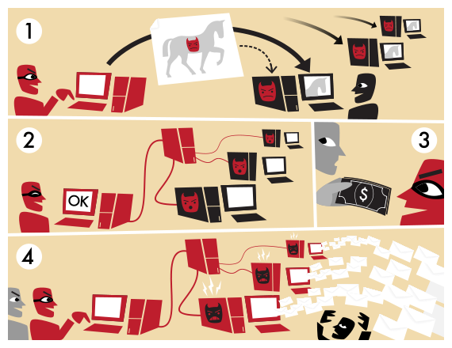
Botnets
Notes:
Graphical explanation of how the botnet is set up and can be provided as a service to to deliver targeted attacks on commission.

Slide 52
DarkNet
DarkNet (or Dark Net) is a network that can only be accessed with specific software, configurations, or authorization, it is not reachable through standard browsers and/ or search engines, and is often using non-standard communications protocols.
Originally coined in the 1970s to designate networks which were isolated from ARPANET (which evolved into the Internet) for security purposes, darknets were able to receive data from ARPANET but had addresses which did not appear in the network lists and would not answer any inquiry.
Notes:
An overlay network (in this case DarkNet), is computer network that is built on top of another network. Nodes in the overlay network can be thought of as being connected by virtual or logical links, each of which corresponds to a path, perhaps through many physical links, in the underlying network.
https://en.wikipedia.org/wiki/Darknet

Slide 53
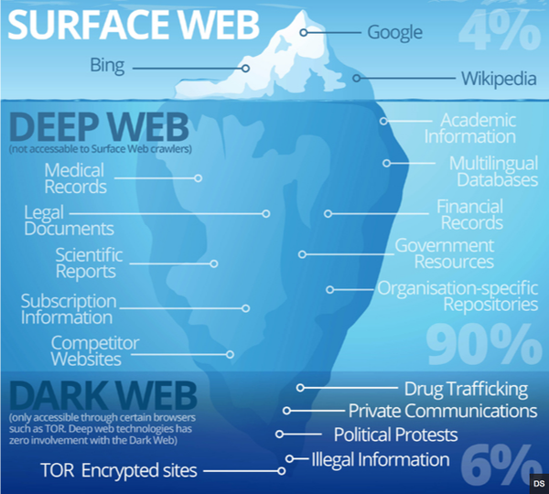
DarkNet and Dark Web
Notes:
Graphical example of DarkNet.
https://irdeto2.files.wordpress.com/2015/10/irdeto_persepctive_internet_sections.png

Slide 54
TOR
TOR is free software for enabling anonymous communication.
The name is an acronym derived from the original software project name The Onion Router. Tor directs Internet traffic through a free, worldwide, volunteer network consisting of thousands relays to conceal a user's location and usage from anyone conducting network surveillance or traffic analysis.
Onion routing is implemented by encryption, nested like the layers of an onion, used to anonymize communication. Tor encrypts the original data, including the destination address, multiple times and sends it through a virtual circuit comprising successive, randomly selected Tor relays.
Notes:
Tor enables its users to surf the Internet, chat and send instant messages anonymously, and is used by a wide variety of people for both licit and illicit purposes. Tor has, for example, been used by criminal enterprises, hacktivism groups, and law enforcement agencies at cross purposes, sometimes simultaneously.
https://en.wikipedia.org/wiki/Tor_(anonymity_network)

Slide 55
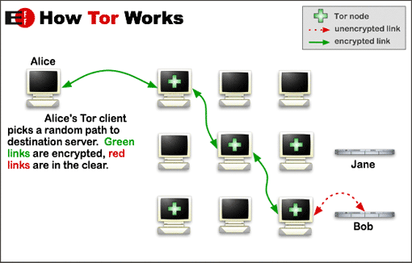

Notes:
Graphical explanation of Tor workflow.

Slide 56
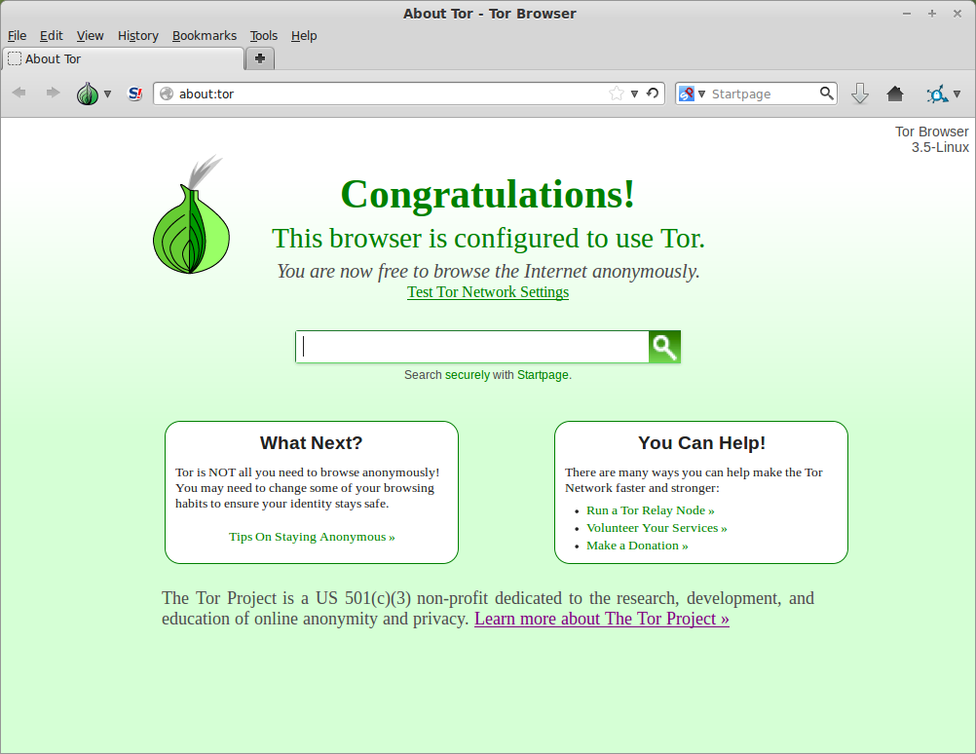
Notes:
Actual download site for Tor.

Slide 57
Tor enables access to the dark web.
This is a part of the internet that is only accessible through anonymous TOR access.
It includes websites and services that are run using the anonymity enhancing features of TOR.
Notes:
Actual download site for Tor.

Slide 58
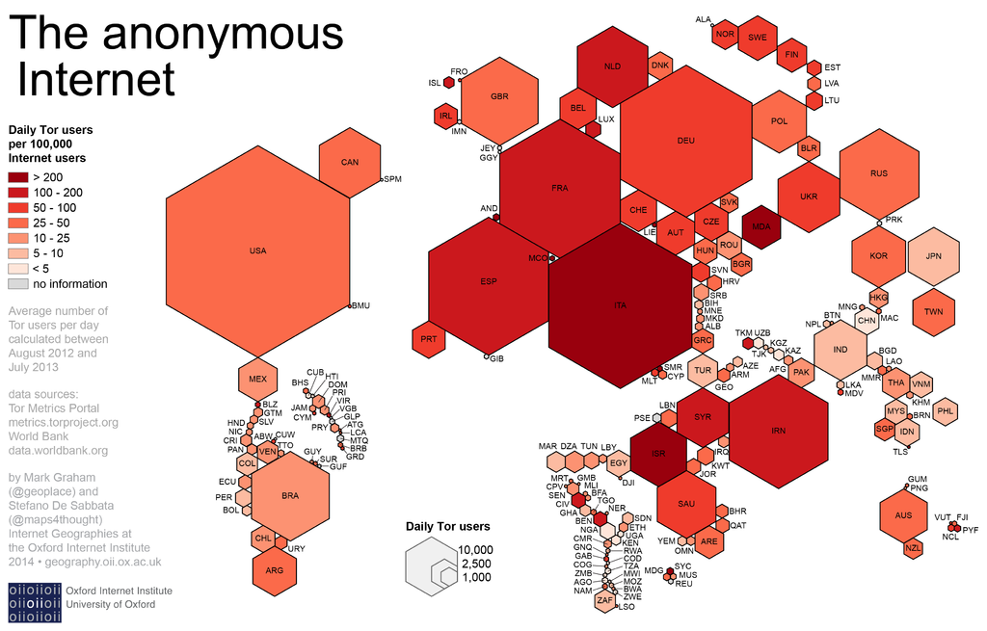
Notes:
Cartogram of daily Tor usage in the world by countries.
https://en.wikipedia.org/wiki/Tor_(anonymity_network)#/media/File:Geographies_of_Tor.png

Slide 59
Questions
Notes:
The trainer should give participants an opportunity to ask any questions that they may have in relation to part Five of the lesson.
59

Slide 60
Contemporary and emerging trends of cybercrime

Slide 61


Trend #1: Business Email Compromise
Contemporary and emerging trends of cybercrime
Businesses are tricked into making payments into foreign bank accounts controlled by fraudsters
Often involves targeted hacking email accounts of crucial individuals inside a company
Examples:
  A French cinema chian in NL paid into a French account it believed to belong to its mother company: € 19M damages. The attack was done through email
  A Dutch museum paid € 2.66M into an account in Hong Kong after their email negotiations were hacked and observed by criminals
Notes:
Contemporary trends in cybercrime. Mobile platforms such mobile (smart phones) are used more and more not only for communication but for criminal activity as well.
Installing unverified applications from unofficial markets (example in the picture) could easily lead to installing malicious code on the phone, which could be used in several ways (to implement a ransomware, to spy on personal data, to intercept credentials of mobile banking applications, to record voice/ video of the owner without his consent, to launch attacks towards other devices/ computer systems, etc.)

Slide 62
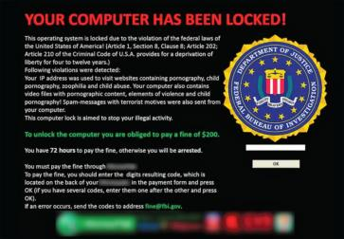
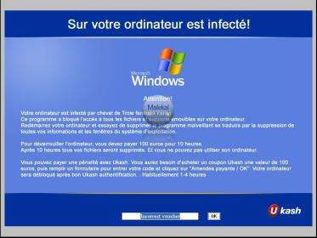
Trend #2: Banking malware, ransomware
Contemporary and emerging trends of cybercrime
Banking malware
  Zeus and Zeus based Trojans,
  Citadel,
  SpyEye, etc.)
Ransomware
Credit Card Fraud
Notes:
Banking malware and trojans are participating with great extent within modern vectors of cybercrime. Some previous slides covered this section.
In the slide some of the most known families of banking malware are cited (Zeus, Citadel, SpyEye)
Ransomware has already been explained before
Credit Card Fraud must be intended as the fraudulent gathering of credit card information through the web, which could happen either with techniques of social engineering (luring the user to reveal his credentials by presenting spoofed requests) or through the installation of a suitable malicious code, and the consequent unauthorized use on the Internet to acquire goods and services.
Business Email compromise – The attacker uses the identity of someone on a corporate network to send spoofed email and trick the target or targets into sending money to the attacker’s account.

Slide 63
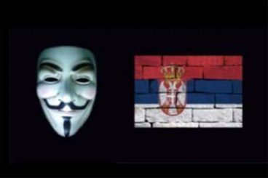
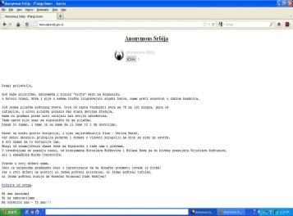
Trend #3: Hactivims and abuse of social networks
Contemporary and emerging trends of cybercrime
„Anonymous“ and other groups
  Attacks to the availability of online services of the target
Threats, cyber bullying, false news for the purpose of causing panic and disorder
State sponsored..?
Notes:
In Internet activism, hacktivism or hactivism (a portmanteau of hack and activism) is the subversive use of computers and computer networks to promote a political agenda. With roots in hacker culture and hacker ethics, its ends are often related to the free speech, human rights, or freedom of information movements.
Anonymous is the well-known name given to a group of hacktivists, who distinguished themselves for a series of demonstrative actions undertaken online, mostly making the target’s service unavailable.
Doxing (from dox, abbreviation of documents), or doxxing, is the Internet-based practice of researching and broadcasting private or identifiable information (especially personally identifiable information) about an individual or organization.

Slide 64

Trend #4: Contemporary
IPR infringements
Contemporary and emerging trends of cybercrime
On-line download instead of CD and DVD buying
On-line distribution of counterfeited merchandise
Illegal distribution or re-distribution of radio and TV programmes (cable networks)
Medicines and drugs – increasing percentage of illegal on-line market
Notes:
Pharmaceutical crime involves the manufacture, trade and distribution of fake, stolen or illicit medicines and medical devices. It encompasses the counterfeiting and falsification of medical products, their packaging and associated documentation, as well as theft, fraud, illicit diversion, smuggling, trafficking, the illegal trade of medical products and the money laundering associated with it.

Slide 65
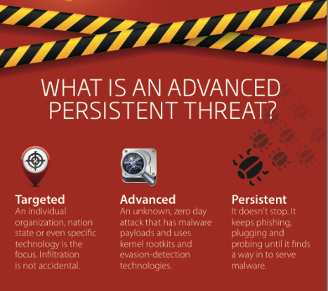
New Trend #1: Increase of APT
Contemporary and emerging trends of cybercrime
Targeting of specific victims or groups – Advanced Persistent Threat (APT)
Abuse of “social engineering”
Psychological manipulation for data disclosure and retrieval
Advanced Persistent Threat is most commonly used with “social engineering” techniques were by use of psychological manipulation victims are encouraged to take certain steps or disclose confidential data
Notes:
An advanced persistent threat (APT) is a network attack in which an unauthorized person gains access to a network and stays there undetected for a long period of time. The intention of an APT attack is to steal data rather than to cause damage to the network or organization.

Slide 66
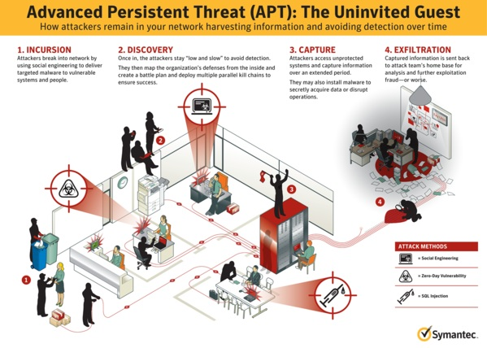
New Trend #1: Increase of APT
Notes:
Graphical explanation of typical APT.

Slide 67

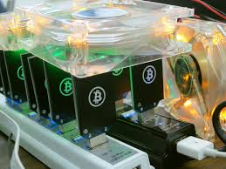
New Trend #2: Mobile transactions and currencies
Contemporary and emerging trends of cybercrime
Mobile transactions
Mobile applications
Mobile crypto-currencies
600.000$ unlawfully acquired bitcoins and dogecoins with one hacker attack by “harvest“ method
Notes:
A cryptocurrency (or crypto currency) is a digital asset designed to work as a medium of exchange using cryptography to secure the transactions and to control the creation of additional units of the currency. Cryptocurrencies are a subset of alternative currencies, or specifically of digital currencies.
They must be considered as real cash, although only digital. That’s to say that virtual currencies, unlike credit cards and other forms of electronic money, can provide anonymity to the payer and to the payee. This is why cybercriminals are gradually moving to using virtual currencies to rule any of their fraudulent transactions.

Slide 68

New Trend #3: Internet of Things - IoT
Contemporary and emerging trends of cybercrime
IoT:
„Internet development by which ordinary everyday objects have network capability making possible sending and receiving data”
New appliances and Internet connectivity
Possible abuse: cameras, cars, house appliances, biometrical systems on smart phones, Google glasses etc.
Notes:
The Internet of things (IoT) is the inter-networking of physical devices, vehicles (also referred to as "connected devices" and "smart devices"), buildings, and other items embedded with electronics, software, sensors, actuators, and network connectivity which enable these objects to collect and exchange data.

Slide 69
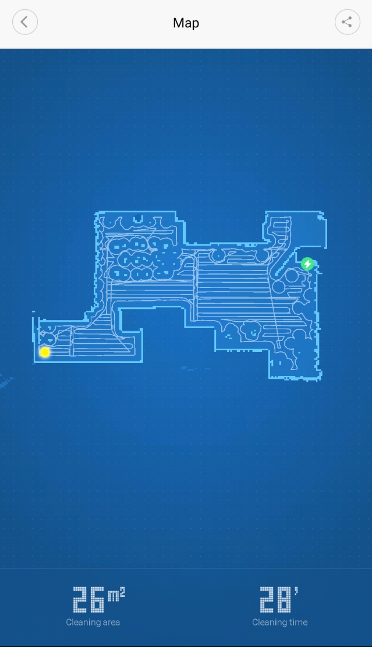
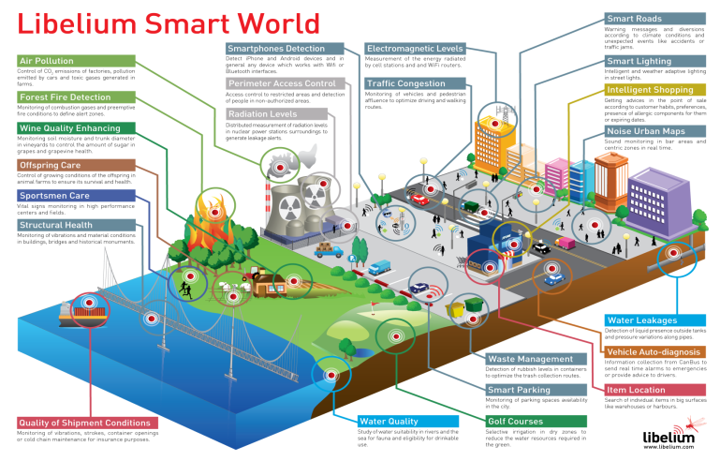
New Trend #3: IoT
Contemporary and emerging trends of cybercrime
Notes:
Graphical example of one of the IoT solutions.

Slide 70
International organisations and Cybercrime

Slide 71





Initiatives of International Organisations
    1. UN
    2. G8
    3. European Union
    4. OSCE
    5. Council of Europe
    6. Local initiatives
Notes:
Many international organisations have been dealing, for many years, with the question of cybercrime and electronic evidence.

Slide 72
United Nations General Assembly
Resolutions on Combating the Criminal Misuse of Information Technologies (Resolutions 55/63 and 56/121)
  the need to ensure that each State adopts a proper law on cybercrime – to eliminate safe heavens
  the need of exchange of information, of cooperation and of coordination among all the States related to some concrete criminal investigation on international cases of criminal misuse of information technologies.
Notes:
United Nations is one of the fora discussing cybercrime. The United Nations General Assembly adopted, since 2000, formal resolutions on Combating the Criminal Misuse of Information Technologies (the first one of them was the Resolution adopted by the General Assembly 55/63, on combating the criminal misuse of information technologies, adopted by the 81st plenary meeting, on 4 December 2000).
These formal resolutions point out the need to ensure that a Member State adopts domestic regulations, in view of criminalising certain activities and eliminate the so called safe heavens for cyber criminals.

Slide 73
United Nations General Assembly Resolution 64/211 (March 2010)
“Voluntary self-assessment tool for national efforts to protect critical information infrastructures”.
13. Review and update legal authorities (including those related to cybercrime, privacy, data protection, commercial law, digital signatures and encryption) that may be outdated or obsolete as a result of the rapid uptake of and dependence upon new information and communications technologies, and use regional and international conventions, arrangements and precedents in these reviews. Ascertain whether your country has developed necessary legislation for the investigation and prosecution of cybercrime, noting existing frameworks, for example, General Assembly resolutions 55/63 and 56/121 on combating the criminal misuse of information technologies, and regional initiatives, including the Council of Europe Convention on Cybercrime.
Notes:
UN General Assembly Resolution 64/211 (March 2010) on the “creation of a global culture of cybersecurity” contains a voluntary self-assessment tool for national efforts to protect critical information infrastructure. The Resolution recommends, among other things, that States adopt criminal legislation taking into account frameworks such as the Budapest Convention on Cybercrime.

Slide 74
United Nations – UNODC
Capacity building
Regional offices
Also deals with AML
Open-ended working group on Cybercrime
Open to all UN members.
Initially backed by Russia
Governmental Group of Experts
25 members chosen by SG
Backed by US
Notes:
Proposals to develop new treaties have not found consensus.
The Budapest Convention remains the only International Treaty on Cybercrime.
UN General Assembly tasked an open-ended intergovernmental expert group, to conduct a comprehensive study of the problem of cybercrime and responses to it by Member States, the international community and the private sector, including the exchange of information on national legislation, best practices, technical assistance and international cooperation, with a view to examining options to strengthen existing and to propose new national and international legal or other responses to cybercrime.
https://www.unodc.org/unodc/en/organized-crime/open-ended-intergovernmental-expert-group-meeting-on-cybercrime.html

Slide 75
G8 High-tech Crime Sub-group
More proactive options
G8 created a network of contact points
  became a reference in the international co-operation scenario (50+ countries)
  a directory of names, that can be reached and facilitate immediate action where needed
Notes:
The approach of the Sates of the Group of Eight (G8) goes some steps further, choosing more proactive options. G8 created a network of contact points that became a reference in the international cooperation scenario. Essentially, it is a directory of names that can be reached and could facilitate immediate action where needed.
G8 was a pioneer, enfacing cybercrime subjects and, besides the Council of Europe, this is the most important work developed at the international level, combating cybercrime, until these days.

Slide 76
European Union – Substantive Provisions
Adopted legal instruments referring to cybercrime
Directive 2013/40/EU of the European Parliament and of the Council of 12 August 2013 on attacks against information systems and replacing Council Framework Decision 2005/222/JHA
Notes:
Framework Decision Attacks against Information Systems
Adopted in 2005, “EU version of the Budapest Cybercrime Convention”
Scope: illegal access, illegal system/data interference, liability, jurisdiction and EU information exchange (24/7 contact points)
Directive on Attacks against Information Systems
Proposed in 2010, abrogates Framework Decision
Adopted 22.7.2013, published 14.8.2013 as Directive 2013/40/EU
Must be transposed by 4 September 2015
Largely the same as Framework Decision
But some innovations as well:
Criminalisation of tools and illegal interception
Aggravating circumstances for crimes committed through organised crime, botnets, identity theft, causing serious damage, or against critical infrastructure
Response time of 8 hours for urgent requests
Statistical data collection obligations
http://eur-lex.europa.eu/legal-content/EN/TXT/?qid=1484312184142&uri=CELEX:32013L0040.

Slide 77
European Union – Substantive Provisions
Adopted legal instruments referring to cybercrime
Directive 2011/93/EU of the European Parliament and of the Council of 13 December 2011 on combating sexual abuse and sexual exploitation of children, and child pornography, replacing the Council Framework- Decision 2004/68/JHA.
Notes:
This Directive harmonises throughout the European Union (EU) criminal offences relating to sexual abuse committed against children, the sexual exploitation of children and child pornography. It also lays down the minimum sanctions. The new rules also include provisions aimed at combating child pornography on-line and sex tourism. Furthermore, it aims to prevent paedophiles already convicted of an offence from exercising professional activities involving regular contact with children.
Offences and sanctions
Some twenty criminal offences are identified by the Directive divided into four categories:
sexual abuse, such as engaging in sexual activities with a child who has not reached the age of sexual consent or forcing them to submit to such activities with another person;
sexual exploitation, such as, for example, coercing a child to engage in prostitution or to participate in pornographic performances;
child pornography: , possessing, accessing, distributing, supplying or producing child pornography;
the solicitation of children on-line for sexual purposes: , proposing, via the Internet, to meet a child for the purpose of committing sexual abuse and, through the same means, soliciting the child to provide pornographic material of themselves.
http://eur-lex.europa.eu/legal-content/EN/TXT/?uri=URISERV%3Ajl0064

Slide 78
European union - AML
The European Union has a harmonized AML regime
Frequent updates as the naturel of ML changes
5th AML directive
  Cryptocurrency exchanges
  Beneficial ownership data
Notes:
Phishing (“fishing for passwords”) is a technique used to attempt to convince someone to send personal information that other people. That information can be used later to theft or fraud. Normally, the perpetrators use email messages to trick the victims, from who they obtain personal information, including passwords or other access credentials. Sometimes, the technique used is to redirect users to a malicious and fake website.
https://en.wikipedia.org/wiki/Phishing

Slide 79

European Union – Law Enforcement
The European Cybercrime Centre (EC3 or EC³) is the body of the Police Office (Europol) of the European Union (EU), headquartered in The Hague, that coordinates cross-border law enforcement activities against computer crime and acts as a centre of technical expertise on the matter.
Notes:
Europol set up the European Cybercrime Centre (EC3) in 2013 to strengthen the law enforcement response to cybercrime in the EU and thus to help protect European citizens, businesses and governments from online crime.
https://www.europol.europa.eu/about-europol/european-cybercrime-centre-ec3

Slide 80
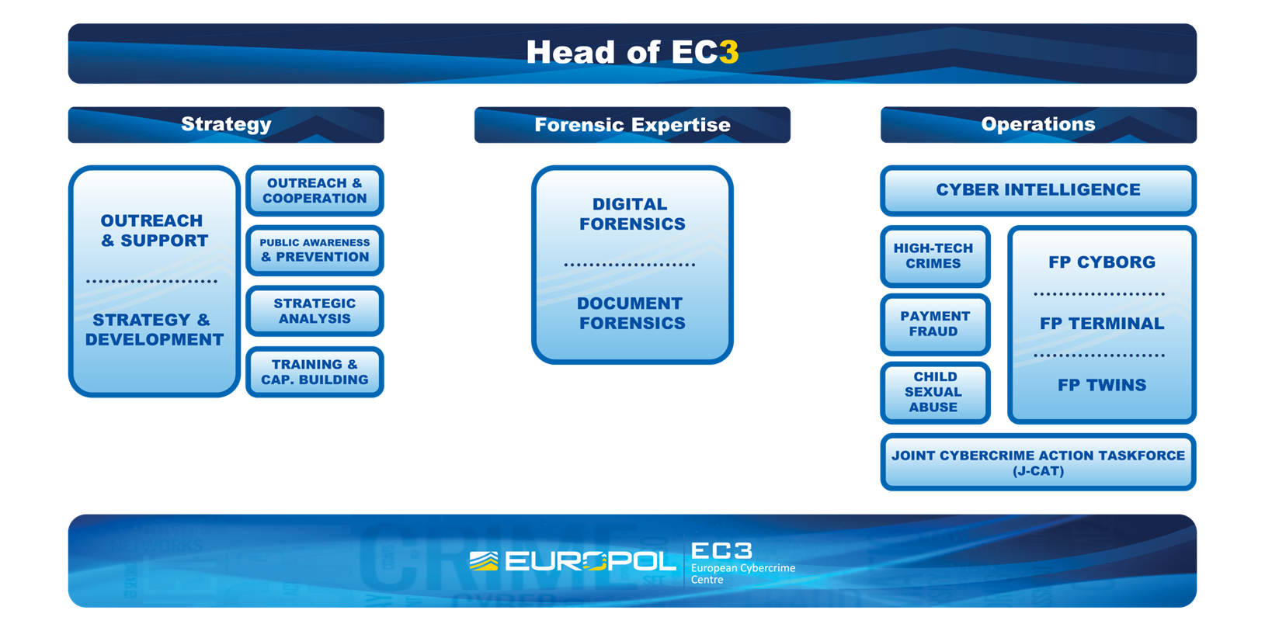
European Union – Law Enforcement
Notes:
Organizational setup the European Cybercrime Centre (EC3).
https://www.europol.europa.eu/about-europol/european-cybercrime-centre-ec3

Slide 81

European Union
Joint Cybercrime Action Taskforce J-CAT
European Union Cybercrime Task Force
It consists of a standing operational team of cyber liaison officers from several EU Member States and non-EU cooperation partners, who are based in Europol headquarters and complemented with EC3 staff. The cyber liaison officers come from:
committed and closely involved EU Member States (Austria, France, Germany, Italy, the Netherlands, Spain and the United Kingdom);
non-EU law enforcement partners (Australia, Canada, Colombia and the United States, which is represented by two agencies: the Federal Bureau of Investigation and Secret Service);
EC3.
The Europol Strategy 2016–2020 :
“Technological developments have led to an ever-increasing volume of available data while the internet, social media and mobile technologies are changing the inter-connectivity of the world including its criminal landscape. In this climate, stepped up efforts are needed to devise European solutions to address European problems.”
Notes:
The Joint Cybercrime Action Taskforce (J-CAT), which was launched in September 2014. J-CAT’s objective is to drive intelligence-led, coordinated action against key cybercrime threats and targets by facilitating the joint identification, prioritization, preparation and initiation of cross-border investigations and operations by its partners.
https://www.europol.europa.eu/activities-services/services-A/joint-cybercrime-action-taskforce
https://www.europol.europa.eu/publications-documents/europol-strategy-2016-2020

Slide 82
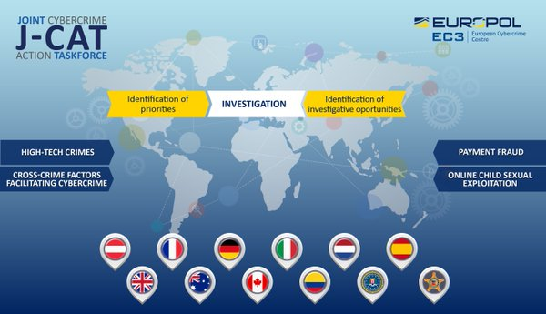
European Union
Joint Cybercrime Action Taskforce J-CAT
Notes:
J-CAT organization and field of operations.
https://www.europol.europa.eu/activities-services/services-A/joint-cybercrime-action-taskforce

Slide 83
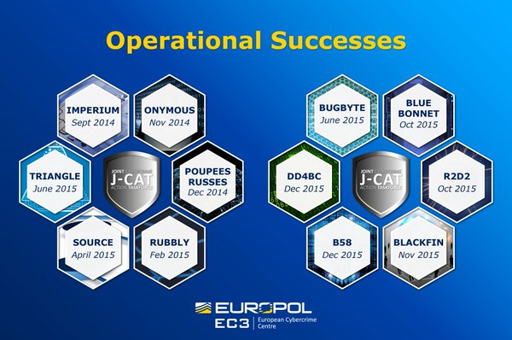
European Union
Joint Cybercrime Action Taskforce J-CAT
Notes:
J-CAT recent operations.
https://www.europol.europa.eu/activities-services/services-A/joint-cybercrime-action-taskforce

Slide 84
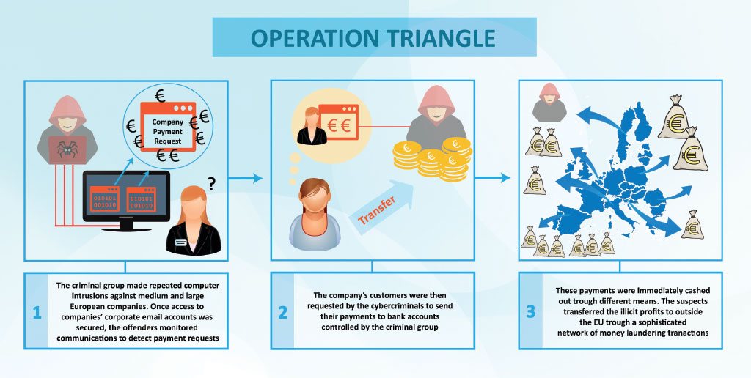
European Union
Joint Cybercrime Action Taskforce J-CAT
Notes:
J-CAT operation “TRIANGLE”.
https://www.europol.europa.eu/activities-services/services-A/joint-cybercrime-action-taskforce

Slide 85
European Union – EUROJUST EJCN
Eurojust may ask the competent authorities of the Member States concerned:
to investigate or prosecute specific acts;
to coordinate with one another;
to accept that one country is better placed to prosecute than another;
to set up a Joint Investigation Team; or
to provide Eurojust with information necessary to carry out its tasks.
On 24 November 2016, representatives of the European Judicial Cybercrime Network met at Eurojust.
Chair of the Eurojust Task Force on Cybercrime, stressed that the networking of specialized experts is essential for enhancing judicial cooperation in cybercrime investiga-tions and prosecutions and for sharing expertise, knowledge and best practice.
Notes:
EUROJUST launches European Judicial Cybercrime Network.
http://www.eurojust.europa.eu/press/PressReleases/Pages/2016/2016-11-25.aspx

Slide 86
OSCE
Decision No. 7/06
  participating States should consider becoming a party to the Budapest Convention
  participating States should join the G8 24/7 Computer Crime Network
    and nominate an appropriate contact point for the purpose of streamlining international law enforcement co-operation on combating the criminal misuse of cyberspace and in criminal cases that involve electronic evidence
Decision no. 991 OSCE Conference on a Comprehensive approach to cyber security: exploring the future OSCE role
Notes:
It is also important to consider the work developed by OSCE, the Organisation for Security and Cooperation in Europe, on cybercrime.
OSCE issues recommendations to the members of the organisation. By Decision No. 7/06, OSCE said that participating States should consider becoming parties to the Budapest Convention on Cybercrime. This decision also encouraged participating States to join the 24/7 Computer Crime Network, managed by the G8 States and to nominate an appropriate contact point for the purpose of streamlining international law enforcement cooperation on combating the criminal misuse of cyberspace.
OSCE continues to contribute to the fight against cybercrime, considering a comprehensive approach to cyber security, exploring its own future role, for example at the Conference held on 9 and 10 May 2011, in Vienna.
Recalling Ministerial Council Decision No. 7/06 on countering the use of the Internet for terrorist purposes, which voices the participating States’ concern over continued hacker attacks and calls on them to take appropriate measures to protect vital and critical information infrastructures and networks against the threat of cyber attacks - tasks the Secretary General to organise an OSCE Conference on a Comprehensive Approach to Cyber Security: Exploring the Future OSCE Role – held on 9 and 10 May 2011, in Vienna.

Slide 87
Council of Europe
Approach:
The Council of Europe helps to protect societies worldwide from the threat of cybercrime through the Convention on Cybercrime and its Protocol on Xenophobia and Racism, the Cybercrime Convention Committee (T-CY) and the technical cooperation programmes on cybercrime.
Convention:
The Convention on Cybercrime of the Council of Europe (CETS No.185), known as the Budapest Convention, is the only binding international instrument on this issue. It serves as a guideline for any country developing comprehensive national legislation against Cybercrime and as a framework for international cooperation between State Parties to this treaty.
Notes:
The Convention on Cybercrime of the Council of Europe (CETS No.185), known as the Budapest Convention, is the only binding international instrument on this issue. It serves as a guideline for any country developing comprehensive national legislation against Cybercrime and as a framework for international cooperation between State Parties to this treaty.
The Budapest Convention is supplemented by a Protocol on Xenophobia and Racism committed through computer systems.

Slide 88
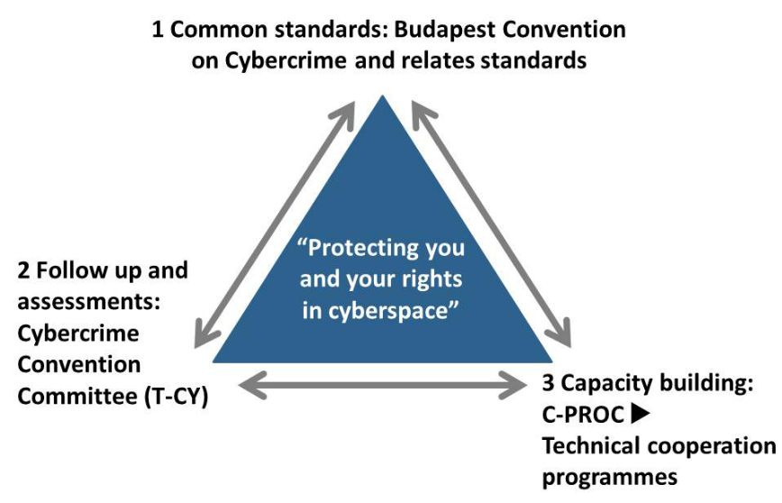
Council of Europe
Cybercrime Prevention and Criminal Justice
to protect you and your rights in cyberspace
Notes:
The Council of Europe has been dealing with the question of cybercrime since the 1980s. Preparatory work and soft-law recommendations then lead to the decision to negotiate a legally binding international treaty: the Budapest Convention on Cybercrime (this treaty will be discuss later).
The approach of the Council of Europe consists of a triangle with:
Standards such as the Budapest Convention
Follow up and “monitoring” of implementation by the Cybercrime Convention Committee (T-CY)
Technical cooperation programmes to assist countries in establishing criminal justice capacities (Cybercrime Programme Office - C-PROC).

Slide 89
FATF
Set up by the G7 in 1988
Guidelines in AML
  40 recommendations
Guidelines in CTF
  8 recommendations
Extensive monitoring and review of the regime in practise
Local chapters
  Georgia: Moneyval
Blacklist, Greylist
Notes:
It is also important to consider the work developed by OSCE, the Organisation for Security and Cooperation in Europe, on cybercrime.
OSCE issues recommendations to the members of the organisation. By Decision No. 7/06, OSCE said that participating States should consider becoming parties to the Budapest Convention on Cybercrime. This decision also encouraged participating States to join the 24/7 Computer Crime Network, managed by the G8 States and to nominate an appropriate contact point for the purpose of streamlining international law enforcement cooperation on combating the criminal misuse of cyberspace.
OSCE continues to contribute to the fight against cybercrime, considering a comprehensive approach to cyber security, exploring its own future role, for example at the Conference held on 9 and 10 May 2011, in Vienna.
Recalling Ministerial Council Decision No. 7/06 on countering the use of the Internet for terrorist purposes, which voices the participating States’ concern over continued hacker attacks and calls on them to take appropriate measures to protect vital and critical information infrastructures and networks against the threat of cyber attacks - tasks the Secretary General to organise an OSCE Conference on a Comprehensive Approach to Cyber Security: Exploring the Future OSCE Role – held on 9 and 10 May 2011, in Vienna.

Slide 90
Questions
Notes:
The trainer should give participants an opportunity to ask any questions that they may have in relation to part Two of the lesson.

Slide 91
Summary

Slide 92
Summary
At the end of this session, delegates will be able to:
Identify different types of cybercrime and their impact
List the threats, trends and tools of cybercrime and responses to the phenomenon.
Explain the concepts of cybercrime that are considered types of crime under most legislation and international standards.
Notes:
What is cybercrime and why worry about it.
Threats, trends and tools of cybercrime and responses to the phenomenon.
Realities covered under the expression cybercrime and concepts that are considered types of crime under most legislation and on international standards.
Need and advantage of the harmonisation between national legislation and the international instruments, in particular the Convention of Budapest.

Slide 93
Questions
Notes:
The trainer should give participants an opportunity to ask any questions that they may have in relation to the lesson.
Practical Exercises (if applicable)
No practical exercises are envisaged for this particular session as there is no guarantee that the level of technology and Internet access to deliver such exercises will be available at all venues.
Trainers may in the future seek to supplement to learning by adding exercises, where the training is delivered in an environment where the facilities are suitable.
Knowledge Check
No specific knowledge check in addition to that listed above is currently envisaged for this course. No official assessment has been requested.
93

