Slide 1
First Responder training for Investigators on Cybercrime and Electronic Evidence
Session 6
Evidence Sources: Computer Systems and Networks

Slide 2
Session Objectives
At the end of this session participants will be able to:
  Recognize which evidence sources are of evidential value
  Differentiate between computer networks
  Identify the network devices

Slide 3
Evidence Sources
Electronic Evidence can be related with almost any kind of investigation
Type and number of electronic devices increase daily
Electronic Evidence should be handled correctly in order to have value.
Notes:
Q&A Is your knowledge challenged ? In court maybe ?

Slide 4

Knowledge Test
This Photo by Unknown Author is licensed under CC BY-SA
Notes:
Trainer can encourage a group discussion regarding where there may be Electronic Evidence, list devices etc.

Slide 5
Computer Systems
Computer Systems usually consists of hardware and software
Also Computer Parts can usually be categorized into the Main Unit and Peripherals
Notes:
Explain what is consider hardware and what software
In our days most of the components have been compacted into one. (laptops, tablets)

Slide 6
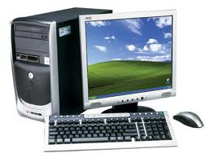
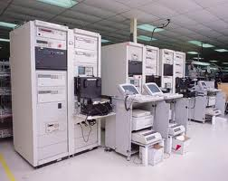
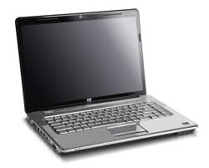
Computer Systems
Desktop/Tower System
Mainframe Computer
Laptop Computer
Notes:
Q&A Mainframe – Servers : Proportionality – How much is enough ?

Slide 7
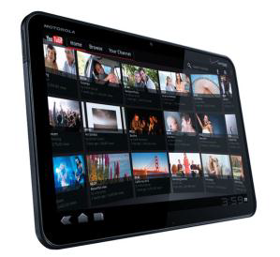
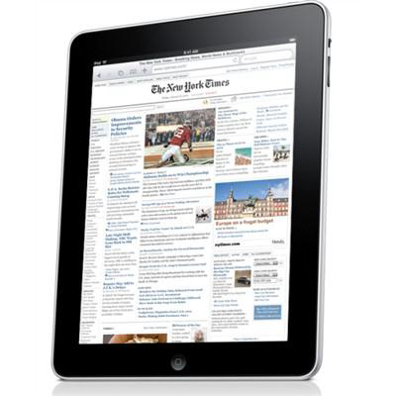
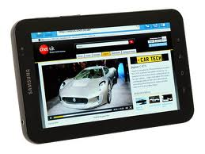
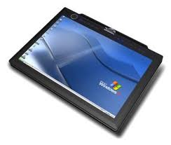
Tablet Devices
A tablet computer is a device that is operated by touching the screen rather than using a keyboard or mouse
Tablet PCs

Slide 8

Storage Devices

Slide 9
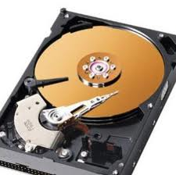
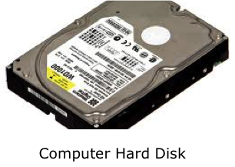
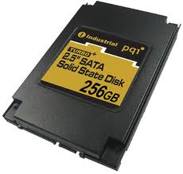
Hard Disks and Solid State Disks
Hard drives are the major storage device within computer systems
Solid State Disk
Computer Hard Disk
Internal View
Notes:
Q&A What is the difference between traditional hd and SSD ?
Whereas hard disks store data on platters, solid state disks store data using microchips that have no moving parts.
As such they are less likely to be damaged by shock and they offer faster access to the data.
These devices may hold valuable evidence.

Slide 10

SSD VS HDD
Notes:
Show Video clip Samsung, is there a version in Georgian?

Slide 11
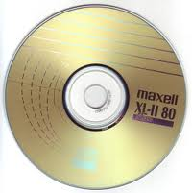
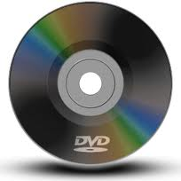
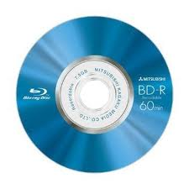
Removable Media
Compact Disk (CD)
Digital Versatile Disk (DVD)
Blu-ray Disks (BD)
Compact
Disk (CD)
Digital Versatile
Disk (DVD)
Blu-ray
Disk (BD)
Notes:
They may however hold large amounts of other data that may be of evidential value.
Although they look very similar the storage capacities vary greatly.

Slide 12
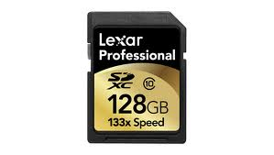
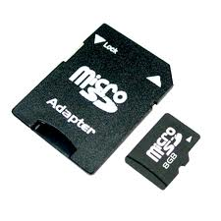
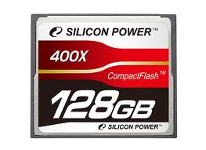
Memory Cards
Memory cards, also known as flash cards are devices for storing digital information
Secure Digital
Card (SD)
Micro SD Card
And Adapter
Compact Flash
Card (CF)
Notes:
They are able to retain data without power
They can store huge amounts of data
Very small and easy to hide from view.

Slide 13
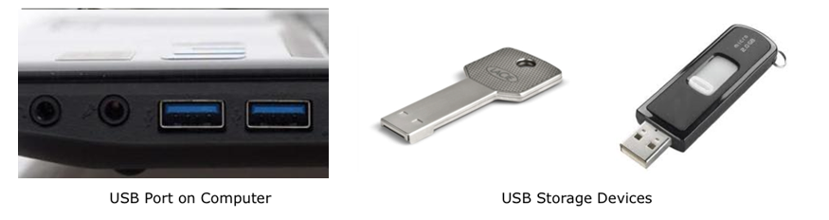
USB Data Storage Devices
Is a standard that defines the protocols for communication, connection and power supply for devices that are to be connected
Notes:
They are able to retain data without power
They can store huge amounts of data
Very small and easy to hide from view.

Slide 14

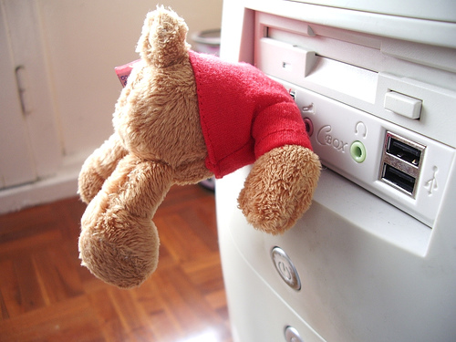
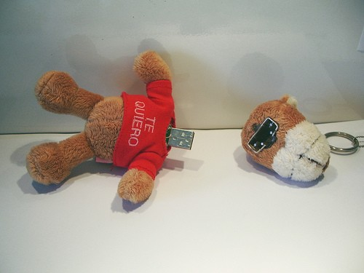
USB Data Storage Devices
Not all devices are what they seem !!!!

Slide 15
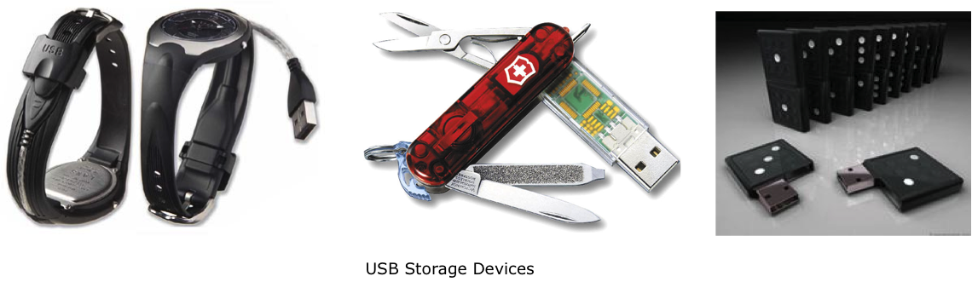
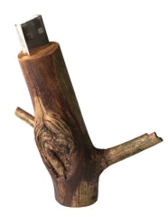
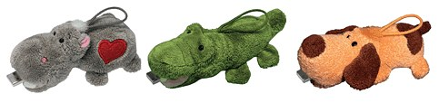


USB Data Storage Devices
Not all devices are what they seem !!!!

Slide 16
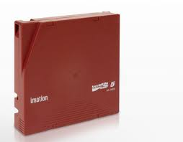
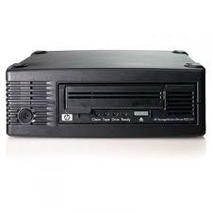
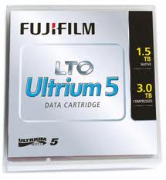
Data Storage Tape Disks
Data stored on tape is more likely to be encountered is a business
Tapes are normally used for backup
Linear Tape-Open (LTO) Storage Tapes
LTO Tape Drive
Notes:
They are able to retain data without power
They can store huge amounts of data

Slide 17
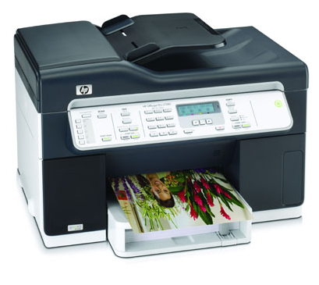
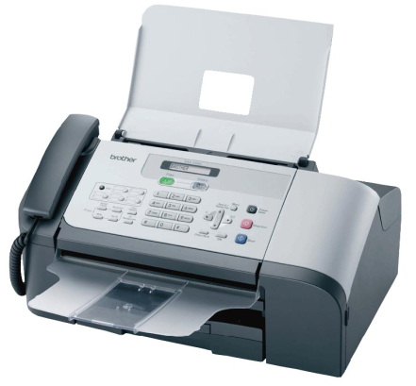
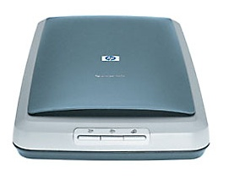
Peripheral Devices
Peripherals are devices are not an integral part of the computer but connect to it to improve its capabilities
Printer
Fax Machine
Scanner
Notes:
Q&A – Do you know any other Peripheral Devices ?
Examples of peripheral devices are: scanners, printers, tape drives, webcams, loudspeakers, microphones, calculators, fax, answering machines and card readers.
Many of these devices have their own data storage capacity
E.X. the presence of a card reader may be relevant in a credit card cloning investigation

Slide 18
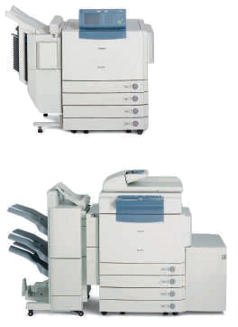
Photocopiers
A photocopier is a machine that makes paper copies of documents and other visual images quickly and cheaply
Found in businesses
Internal or removable memory
Notes:
They can even have hard disks
A good place to hide second ledger

Slide 19
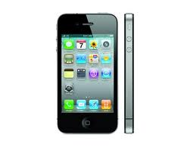
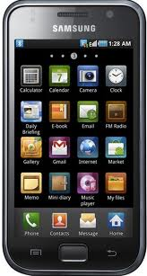
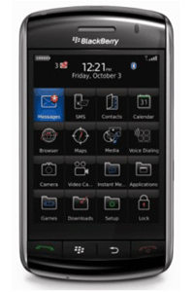
Mobile Telephones
Mobile Telephones are used for many tasks and can hold a large amount data often very important.
Mobile Phones
Notes:
Q&A Can you name some tasks that a Mobile Telephone can perform ?
Photos
Video
Call
SMS
Internet via 3G
Internet via WLAN
Chatting
Just for data storing
Games
GPS
Various other Apps

Slide 20
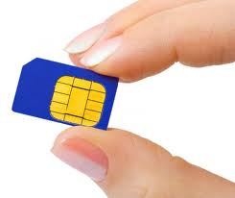
Mobile Telephones
Sim Card: A subscriber identity module (SIM) is an integrated circuit that securely stores the international mobile subscriber identity (IMSI) and the related key used to identify and authenticate subscribers on mobile telephony devices
Notes:
Q&A : SIM-Card Evidence that can be found:
card issuer (`talkline´)
Cardnumber (ICC-ID)
current state PIN/ PUK
IMSI (International Mobile Subscribers Identity)
Phone book
called numbers
SMS
Last registered position
fingerprint traces
DNS traces

Slide 21
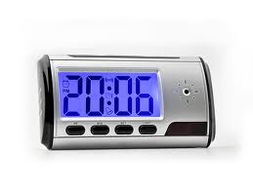
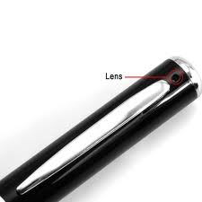
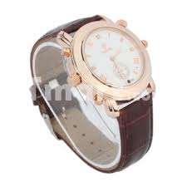
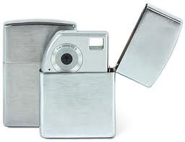
Photo and Video Recording
Digital cameras can hold photos and video either in embedded memory or memory cards
“Spy” Digital Cameras
Notes:
Photos may be able to determine from which Camera was Taken.
Memory Cards can hold all kinds of Data NOT only Photos and Video

Slide 22
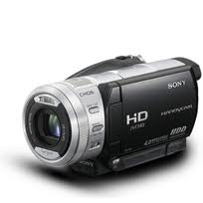
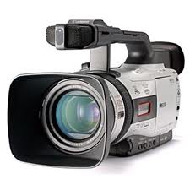
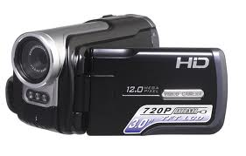
Digital Video Cameras
Digital Video Cameras can hold photos and video either in embedded memory or memory cards
Its important to tell the difference
Digital Video Cameras
Notes:
Bigger Storage Capacity and Better Quality

Slide 23
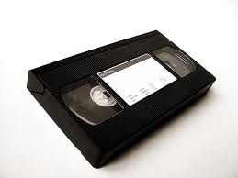
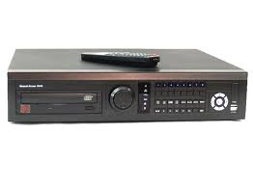
Video Recorders
VHS Recorders
Digital Video Recorders
VHS Video Tape
Digital Video Recorder
Notes:
VHS – Video Home System is older and rarely found
Digital Video Recorders can use CD, DVD, Blu-ray even build in Hard Disks.

Slide 24
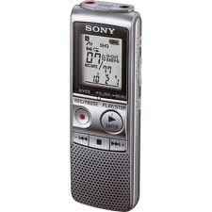
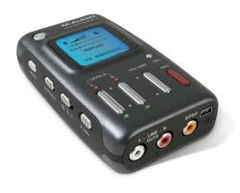
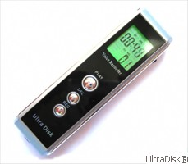
Digital Audio Recorders
Recording of voice memos
Play the memos back
Recording of presentations or conversations
Upload to computer capability
Digital Audio Recorders
Notes:
Recording conversations is subject to legal authority in most countries.

Slide 25
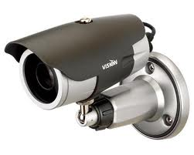
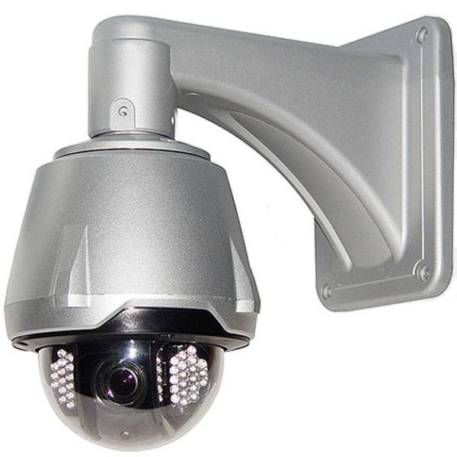
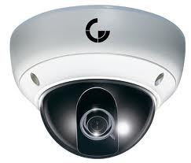
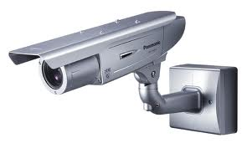
CCTV Cameras
Used for security
Used as evidence in a variety of cases
Record on storage media or live monitoring
IP Cameras
Close Circuit Television (CCTV) Cameras
Notes:
CCTV is relatively hard to examine since a lot of them have their own custom made Operating System
IP Cameras as told before can be access from anywhere even from Cell Phones

Slide 26
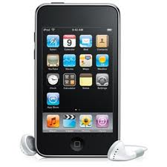




Portable Media Players
Used for storing and playing audio, images and video files
Usually internal flash memory or even hard disk
Portable Media Players
Notes:
Any kind of file can be stored
In our days Portable Media Players can do much more
E.g.
Apps
Internet
GPS
Documents Editing/Viewing

Slide 27








Video Games Consoles
Used for playing games
They use onboard flash storage or hard disks
More than just playing games ….
Video Games Consoles
Notes:
Some Video Games Consoles have the ability to connect to internet and play video, photos and music as well as just browsing.
Their “locked” operating system can be changed and then we have a computer camouflaged as a Game Console.

Slide 28


GPS Receivers
The Global Positioning System (GPS) is a space-based satellite navigation system that provides location and time information.
GPS Receivers
Notes:
They usually have internal memory card or embedded memory.

Slide 29
Potential Evidence
What evidence can be found on these devices?

Slide 30
Potential Evidence
Documents
Photos
Emails and attachments
Databases
Financial Information
Internet Browsing History
Chat Logs
Event Logs
GPS Locations

Slide 31

Questions

Slide 32
Computer Networks

Slide 33
Computer Networks
A network consists of connections between two or more computers that are linked by data cables or by wireless connectivity
Network enables computers to share data and other resources between them
Notes:
Some key definitions will be explained after

Slide 34
Network Types
Local Area Network (LAN) – is a computer network covering a small geographic area, like a home, office, or group of buildings e.g. a school.
Wide Area Network (WAN) – is a computer network that covers a broad area (i.e., any network whose communication links cross metropolitan, regional, or national boundaries).
The largest and most well-known example of a WAN is the INTERNET.
Notes:
Contrast these with
personal area networks (PANs),
campus area networks (CANs), or
metropolitan area networks (MANs)
, which are usually limited to a room, building, campus or specific metropolitan area (e.g., a city) respectively

Slide 35
Terminology and Devices
Ports – are an endpoint or "channel" for network communications.
Bandwidth – is the amount of information that can be carried through a cable or wireless feed
Media Access Control (MAC) address – is a quasi-unique identifier assigned to most network adapters or network interface cards (NICs) by the manufacturer
Notes:
Port numbers allow different applications on the same computer to utilize network resources without interfering with each other. Ports are ‘virtual’ – NOT the socket you plug into! A common analogy to ports is the doors of a house.
The greater the bandwidth, the greater the speed of your connection and the more your Internet experience approaches a more instant-download, TV-style experience.
In a local network IP addresses get resolved to MAC addresses for the packets to know which NIC to flow to.

Slide 36



Network Attached Storage (NAS)
NAS is similar to external hard-drives with the difference that they offer their disk space for a whole network instead of just a single PC
NAS’s with RAID Array
Notes:
Hard Disk from Computers on the Network can be shared but the computer has to be on.
They sometimes can be used as automatic downloading servers (e.g. uTorrent) and even as small webservers
RAID usage - Redundant Array of Independent Disks (RAID) is a storage configuration that allows multiple disk drives to be connected together in a logical framework.

Slide 37



Network Interface Controller (NIC)
NIC is a circuit board or card installed into a computer that allows it to connect to a network.

Slide 38

Network Hub
Network Hub is a device for connecting multiple twisted pair or fibre optic ethernet devices together, making them act as a single network segment
Network Hub

Slide 39

Network Switch
Network Switch is a computer-networking device that are mainly used to connect groups of network devices with each other
Similar to Hub
Network Switch
Notes:
The main difference to a switch is that a hub broadcasts all packets to all ports while a switch sends it only to the target port.

Slide 40

Network Router
Router is a device that determines the next network point that a packet should be forwarded towards its destination
It must be connected to at least 2 networks
Router
Notes:
Routers are commonly used in domestic settings to connect a house to the ISPs broadband. The boxes then often serve multiple purposes such as switch, access point, firewall, router and gateway all together.
Although it is located at the gateway to a network it does not necessarily have to be the networks gateway to the Internet. The term ‘layer 3 switch’ often is used interchangeably with router, but a switch is really a general term without a rigorous technical definition

Slide 41

Server
Server is a computer or device that provides information or services to other computers on a network
A Server can run several services – e.g. web server, email server, file server, print server etc
Notes:
Given the right software, any network-connected computer can be configured as a server. In most cases, a dedicated powerful computer designed to be “always available”.
In a business reality it often makes sense to run different services on different machines for reasons of security and to minimise the impact of any failure.

Slide 42



Firewall
Firewall is a hardware device or software service used to increase the security of a network.
The task of a firewall is to either block or allow certain traffic from or to the network
Hardware Firewalls
Notes:
Block the traffic trying to enter a network through all ports except for those ports that are configured to allow incoming traffic
Firewall logs can be very useful to an investigation

Slide 43



Access Point
Access Points create a network for WLAN devices and connect them to the rest of the network
Notes:
Modern routers often include Access Point functionality
NIC of computer or even a mobile phone can be configured as Access Point

Slide 44

Things are not always straight forward …

Slide 45



Things are not always straight forward …

Slide 46

Things are not always straight forward …

Slide 47

Things are not always straight forward …

Slide 48
Session Objectives
At the end of this session participants will be able to:
  Recognize which Evidence Sources are of evidential value
  Differentiate between Computer Networks
  Identify the network devices

Slide 49
Questions

