Slide 1
First Responder training for Investigators on Cybercrime and Electronic Evidence
Session 12
Search & Seizure

Slide 2
Session Objectives
At the end of this session participants will be able to:
Explain the proper planning and preparation of a search raid where digital evidence may be found.
List the tools and items maybe needed for a search raid where digital evidence may be found.
Explain how they would secure and document a crime scene where digital evidence occur.

Slide 3

Who and what to take to the scene

Slide 4
Planning and Preparing
The Head of the operation should identify the level of support needed.
The local Digital Forensic Department should be informed.
Any other external specialist.
Notes:
------
The information regarding electronic evidence might not be clear.
Careful with external specialists because they might be also involved or inform the suspect.

Slide 5
Types of seizure
There are three options regarding which type seizure should be performed:
Seizure of electronic evidence (Dead Box).
Live examination and/or capture of live data.
A combination of both.
Notes:
Such decision will be finalized at the scene (things are clearer)
However as much information we have is always better.

Slide 6
Examples of useful types of information
Computer Hardware information.
Computer Software information.
Communication and Network information.
Who is responsible for the Computer System and network?
How much equipment is expected to be encountered?
How much data may be copied ?
Is there a system backup available on storage media?
Notes:
Communication and Network information (ISP, phone, facsimile, modem, LAN network equipment, etc.)
Responsible : ISP, phone, facsimile, modem, LAN network equipment, etc.)

Slide 7
Preparation Phase
Ensure that the seizure of e-evidence is correctly authorised.
Obtain as much information as possible about the IT system.
Choose the team members.
Assign individual tasks to the team members.
Brief the team members about how to perform their tasks .
Supply the necessary seizure tools and equipment.
Notes:
Warrant for Entrance, Search and Personal Data if necessary
As possible
Include external specialists if necessary
---
they should have passed the corresponding basic training
Digital Evidence Operation pack/bag
Remember that all activities should be in compliance with agency policy and state and local laws.

Slide 8
Team Members Tasks
Team Leader
Exhibit officer
Event Logger
Photographer
Digital Evidence Examiners
Physical Evidence Examiners
Person(s) for Suspect(s)
Evidence carrier and safety
Notes:
Backup Tasks should be assigned for everyone in case they are done with their work earlier or needed elsewhere

Slide 9
Preparation Phase
If necessary consult an independent specialist.
At least two-persons team for seizing electronic evidence.
Electronic evidence might need special handling.
Specialist Unit contact information.
Notes:
if the system is administered by an external company or administrator, you might consider involving him/her as an expert witness (if he/she is not considered to be a suspect).
Two witness for every action. Some actions need two persons anyway.
Ex. No powder for fingerprints,
The search might occur after hours so they might need a specialist stand-by

Slide 10
Preparation Phase - Exercise
In groups, list the equipment you would consider taking to a crime scene search when collecting electronic evidence?
Notes:
if the system is administered by an external company or administrator, you might consider involving him/her as an expert witness (if he/she is not considered to be a suspect).
Two witness for every action. Some actions need two persons anyway.
Ex. No powder for fingerprints,
The search might occur after hours so they might need a specialist stand-by

Slide 11

Equipment and Basic Toolkit
Special tools and equipment may be needed to collect e-evidence.
Advances in technology may dictate changes in the tools and equipment required.
Notes:
Will see in detail next
Information prior the search would help us define if we need something extraordinary

Slide 12





Disassembly and removal tools
  Screwdrivers
  Drivers
  Pliers
  Wire cutters
  Small tweezers
Notes:
flathead and crosshead, and manufacturer-specific, e.g., Hewlett Packard, Apple
hex-nut, star-type nut and secure-bit
standard and needle-nose
for removal of cable ties

Slide 13

Documentation
  Search and seizure record
  Labels and tape
  Cable tags
  Exhibit labels
  Other necessary forms for completion at the scene
  Indelible coloured marker pens
  Camera and/or video camera
Notes:
(property register)
(to mark and identify component parts of the system, including leads and sockets)
------
(tie-on and adhesive)
-----
(to code and identify removed items)
(to photograph scene and any on-screen displays) – A certified photographer might be needed ?

Slide 14

Package and transport
  Antistatic bags
  Antistatic bubble wrap
  Cable ties
  Evidence bags and tape
  Boxes for packaging external storage media such as USB devices DVDs, or CDs
  Packing materials
  Flat pack assembly boxes or sturdy boxes of various sizes
Notes:
(for protection of equipment being removed such as circuit boards; materials that can produce static such as polythene bags should be avoided)
------
(for securing cables)
------
-----
(materials that can produce static electricity such as Styrofoam or Styrofoam peanuts should be avoided)
(original packaging should be used whenever available)

Slide 15

Communication tools
  Mobile phone or other communication devices for obtaining advice.
  Contact information for assistance.
Notes:
(should not be used in the proximity of computer equipment)
(e.g., phone numbers of the specialist unit)

Slide 16






Other items
  Small torch with a bracket
  Gloves
  Hand truck
  Large rubber bands
  Magnifying glass
  Printer paper

Slide 17
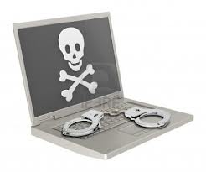


Other items cont.
  A laptop computer including all standard forensics tools
  Network cables
  Sufficient Hard-Drive capacity
  Hardware Write-Blockers
  Forensic Boot-DVDs
  Transport
Notes:
-----
(Twisted Pair and Crossover)
(e.g., some TB external HDDs)
(so triage evidence at your laptop)
(if trained to use it for forensic purposes)
(to and from the scene, for team members, seizure tools and equipment, and the seized evidence)

Slide 18
Securing the Scene

Slide 19
Preparation Phase - Exercise
In groups, discuss what elements you would consider when undertaking a search to secure the crime scene when collecting electronic evidence?
List the issues.
Notes:
if the system is administered by an external company or administrator, you might consider involving him/her as an expert witness (if he/she is not considered to be a suspect).
Two witness for every action. Some actions need two persons anyway.
Ex. No powder for fingerprints,
The search might occur after hours so they might need a specialist stand-by

Slide 20

  Things may not be as what we expect them to be
  Quickly – Readjust
Notes:
E.g.
15 persons instead of 1
2 Big Dogs
A newborn baby

Slide 21

Securing the Scene
  Safety of persons
  Integrity of all evidence
  Electronic Evidence can be easily altered, deleted or destroyed

Slide 22
Steps to Secure the Scene
Follow jurisdictional policy for securing the crime scene.
Move all persons away from the immediate area from which evidence is to be collected.
Secure all electronic devices including personal and portable devices.
Refuse offers of help or technical assistance from any unauthorized persons.
Leave a computer or electronic device off if it is already turned off.
Notes:
------
(including equipment and power supply)
-----
------
-----

Slide 23
Steps to Secure the Scene cont.
We will see later if a computer is on or the state cannot be determined
Protect volatile data physically and electronically
Identify and document related electronic components that will not be collected
Identify telephone and network lines attached to devices, document and label them
Notes:
-----
-----
-----
------

Slide 24
Steps to Secure the Scene cont.
Decide if any other evidence is required from a device to be seized
  If so, follow the general handling procedures
  Postpone destructive techniques until after electronic evidence recovery is done
    Collect latent prints after e-evidence recovery is complete
    Do not use aluminium powder to collect fingerprints from the scene as this may damage equipment and data.
Notes:
10. (e.g., DNA, fingerprints, drugs, accelerants);(including equipment and power supply)
1.----
2.-----
1. (since keyboards, computer mouse, diskettes, CDs, or other components may have latent fingerprints or other physical evidence that should be preserved);
2. -----

Slide 25
Scene Search
Search the scene for non-electronic but related evidence, such as
  written passwords and other handwritten notes.
  blank pads of paper with indented writing.
  hardware and software manuals.
  calendars or diaries.
  text or graphical computer printouts.
  photographs, or
  information about personal interests that may be useful for later password /passphrase cracking.
Notes:
-------
------
------
-----
-----
-----
----
(most passwords are directly related to the personal environment, such as, e.g., licence plates, partners/children, phone numbers, hobbies, etc.)

Slide 26

Preliminary interviews
Separate and identify all persons at the scene and record their location at time of entry
Use a checklist to collect and record information from these individuals such as …..
Notes:
(witnesses, subjects, or others)
------

Slide 27
Preliminary interviews cont.
  Purpose of the device/system.
  Owners and/or users of devices/systems found at the scene, as well as passwords (see below), user names, and Internet Service Provider.
  Any passwords required to access the system, software, or data.
  Any unique security schemes or destructive devices.
  MySpace, Facebook, or other online social networking Web site account information.
  Any offsite data storage.
  Any documentation explaining the hardware or software installed on the system.
  Any other relevant information.
Notes:
e.g., bookkeeping
-----
(An individual may have multiple passwords, e.g., BIOS, system login, network or ISP, application files, encryption pass phrase such as for PGP or TrueCrypt, e-mail, access token, scheduler, or contact list.);
-----
----
----
----
-----

Slide 28
Documenting the Scene

Slide 29
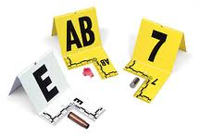
Documenting the Scene
  Documenting starts and finishes with the search of:
    Physical Scene
    Electronic Evidence
    Persons

Slide 30
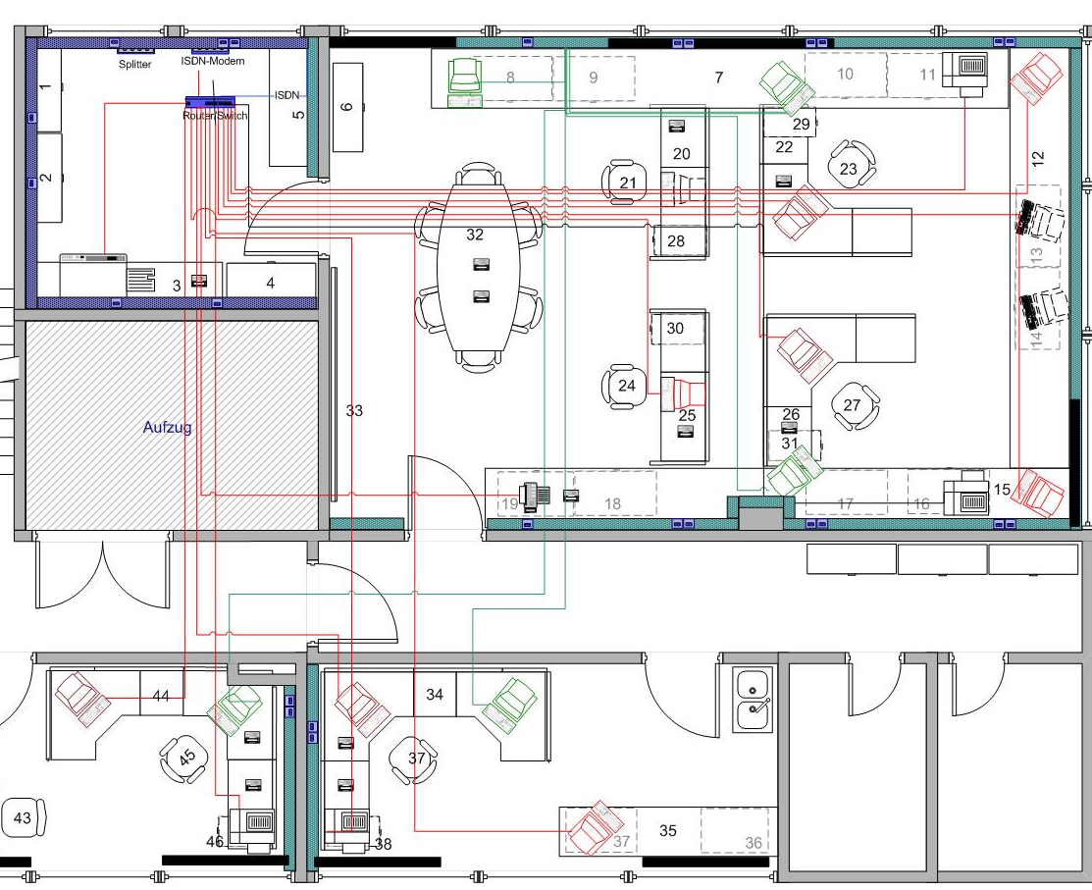
Physical Scene
  Draw a sketch plan of the system including, e.g., the position of the mouse and the location of the components
  Photograph/video/document the entire scene
  Computer systems and electronic components/devices/equipment
Notes:
----
(360 degrees of coverage, if possible)
-----

Slide 31
Electronic Evidence
  Details of all relevant equipment found
  Condition and location of each computer system containing or presenting electronic evidence, including power status of the computer
  Document all connections (cable or wireless) to and from the computer system or other devices
  Label all ports and cables to allow for exact reassembly at a later time
  Label unused connection ports as "unused." Identify laptop computer docking stations in an effort to identify other storage media.
Notes:
e.g., make, model, serial number
(on, off, or in sleep mode)
-----
(including connections to peripheral devices)
------

Slide 32
Electronic Evidence cont.
  Document the details of the monitor at the time of intervention.
  Photograph the front of the computer as well as the monitor screen and other components
  Make written notes of what appears on the monitor screen
  Video active programs or create more extensive documentation of monitor screen activity.
  Document relevant electronic components that will not be collected
Notes:
------
-----
-----
-----
------

Slide 33
Persons
  Details of all persons present on the premises searched.
  Details of all persons who used the relevant computer system/equipment.
  Remarks, comments, and information offered by the computer users/owners/witnesses.
  Actions taken at the scene.
  Create audit trail/seizure log with the description of the action taken and the exact date and time.
Notes:
------
-----
-----
-----
------

Slide 34
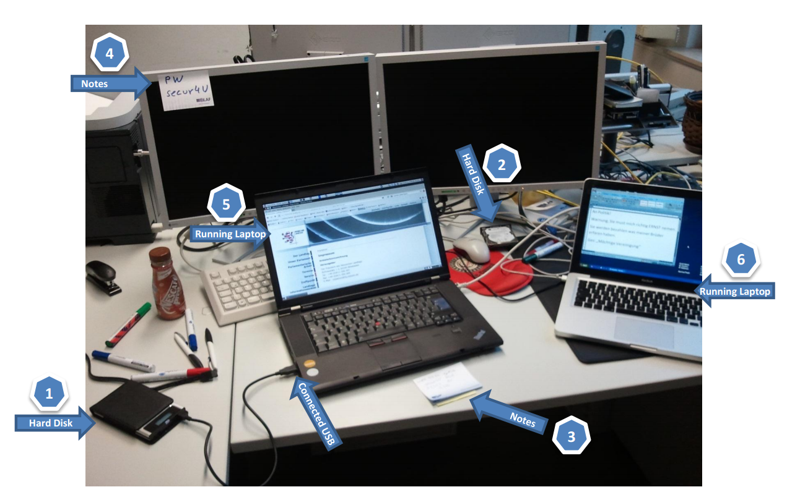

Slide 35
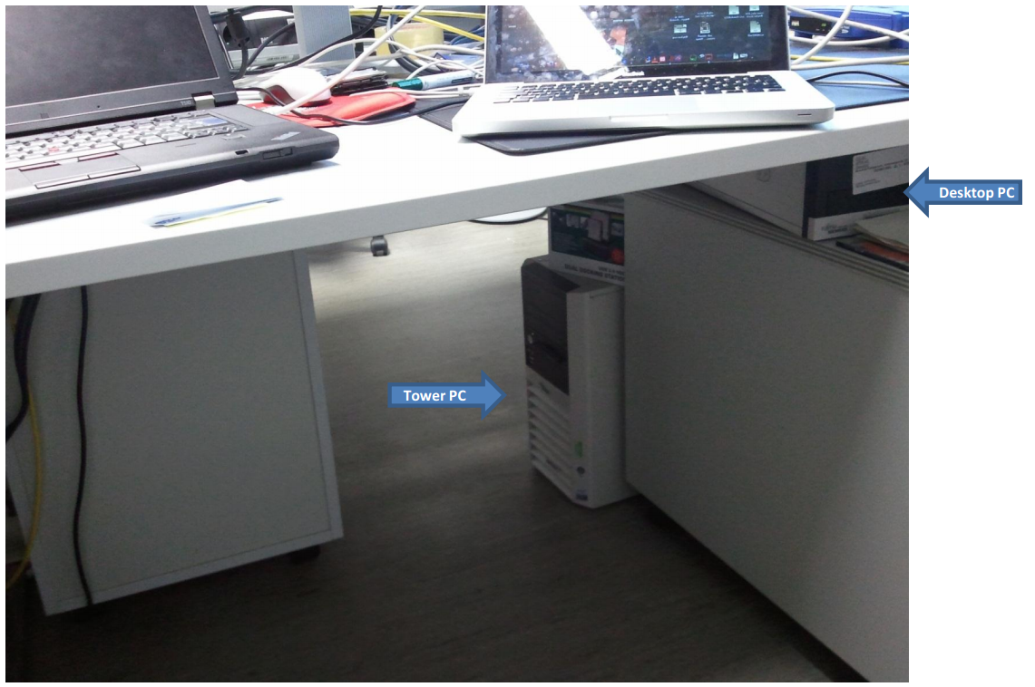

Slide 36
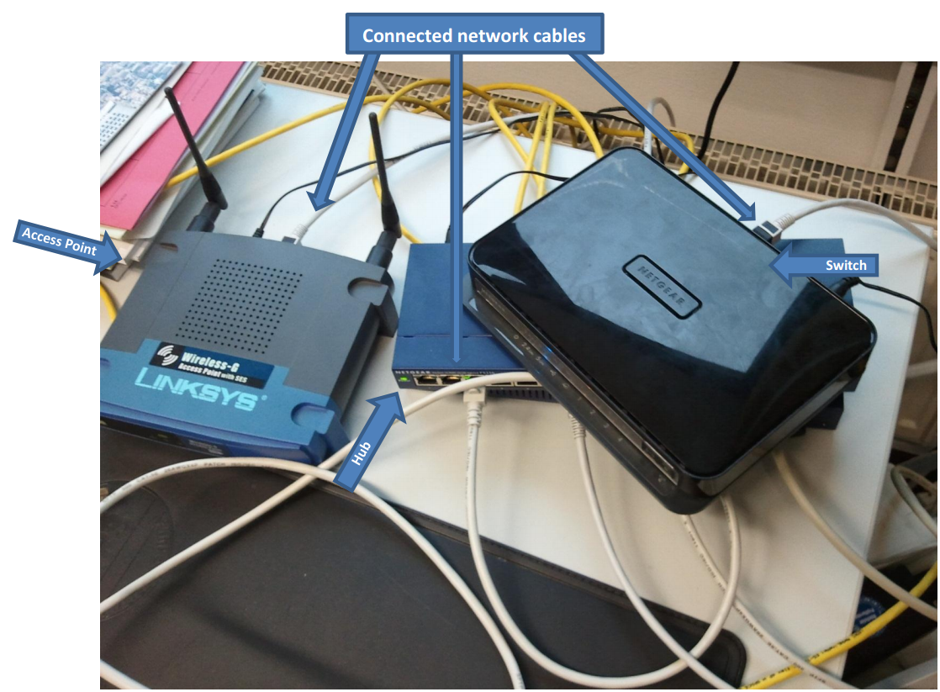

Slide 37
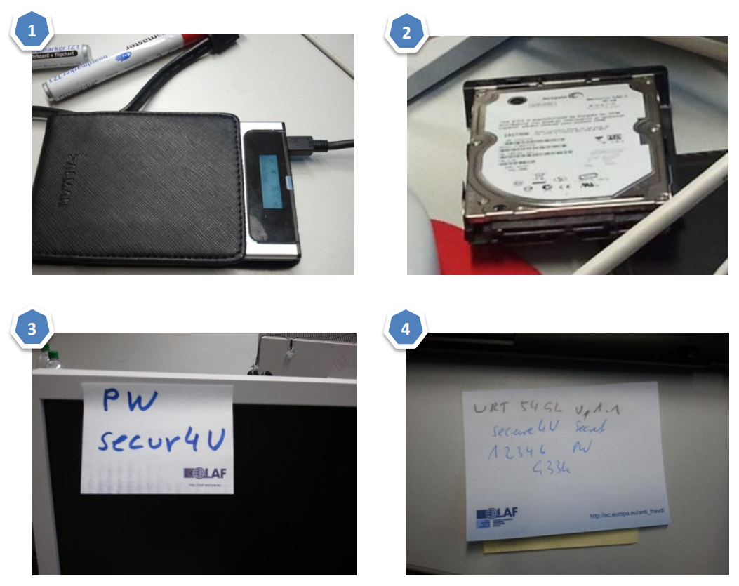

Slide 38
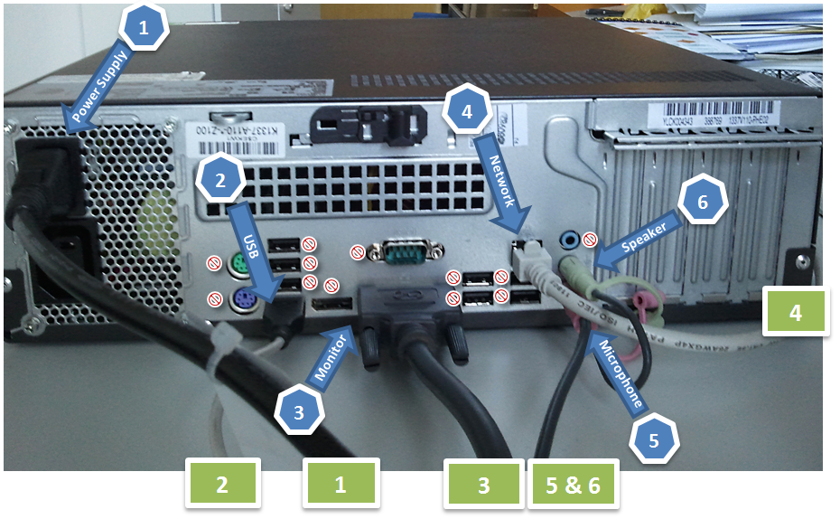

Slide 39
Exercise
You will be provided with handouts of a crime scene.
In your groups view the scenarios and list:
The electronic evidence that is available.
The action you would consider or undertake.
Notes:
if the system is administered by an external company or administrator, you might consider involving him/her as an expert witness (if he/she is not considered to be a suspect).
Two witness for every action. Some actions need two persons anyway.
Ex. No powder for fingerprints,
The search might occur after hours so they might need a specialist stand-by

Slide 40
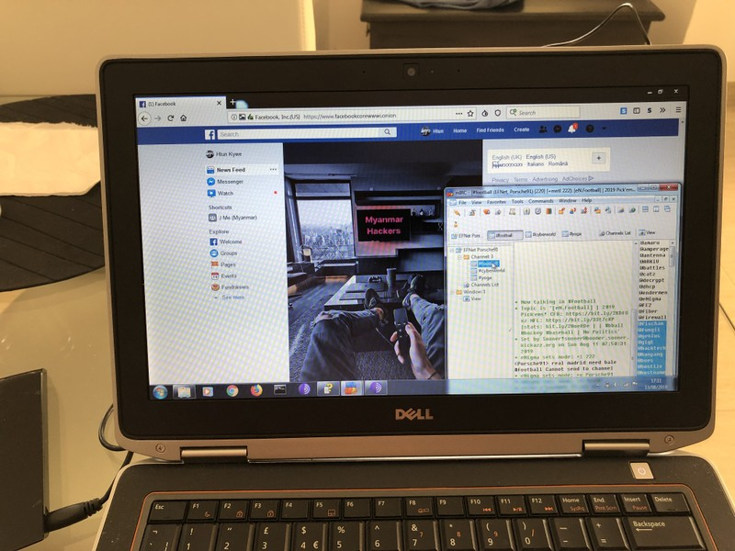

Slide 41
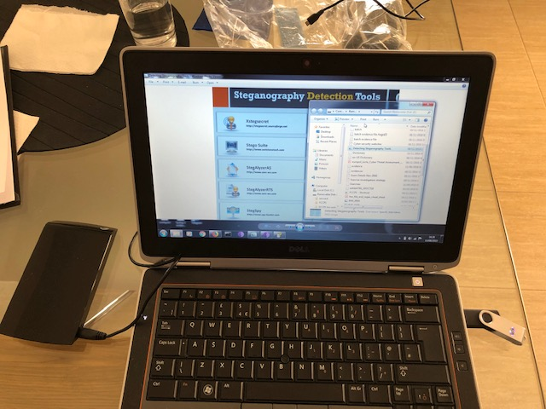

Slide 42
Summary of Session Objectives
At the end of this session participants will be able to:
Explain the proper planning and preparation of a search raid where digital evidence may be found.
List the tools and items maybe needed for a search raid where digital evidence may be found.
Explain how they would secure and document a crime scene where digital evidence occur.

Slide 43

Questions

