Slide 1
First Responder training for Investigators on Cybercrime and Electronic Evidence
Session 13
Search & Seizure. Dead Box Scenarios

Slide 2
Session Objectives
At the end of this session participants will be able to:
Identify sources of electronic evidence based on shown scenarios
Describe Standard Operation Procedures for packaging, transport and storage of electronic evidence
Differentiate different SOPs based on the type of the device
Discuss techniques to check the power status of a computer system
Apply general seizure instructions for electronic devices

Slide 3

Handling of Electronic Evidence

Slide 4
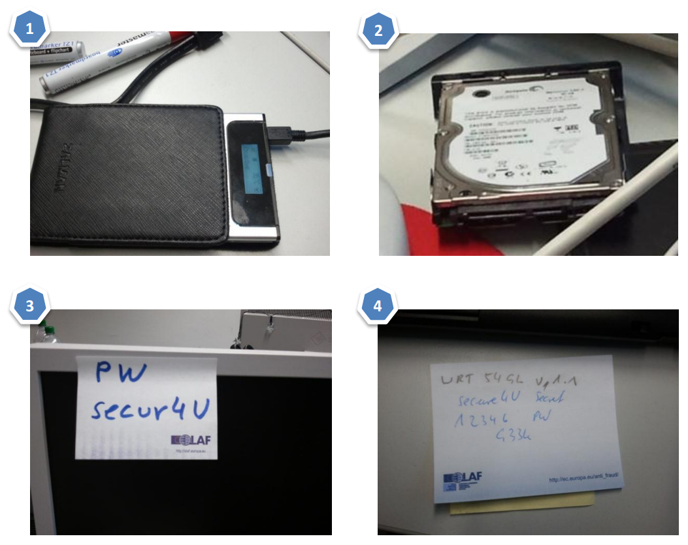
Handling of Electronic Evidence
Electronic evidence must be handled carefully and in a manner that preserves its evidential value.
Certain types of e-evidence require special collection, packaging, and transportation.
Do not forget traditional
evidence: fingerprints, DNA,
written notes, printouts, etc..

Slide 5
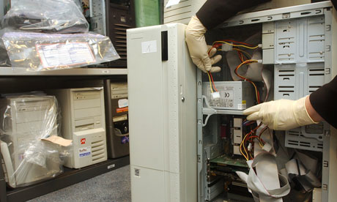
Tagging
Tag all devices and cable connections
Do not affix adhesive labels on the surface of storage media. Use boxes, bags and envelopes for packaging and tagging of storage media

Slide 6
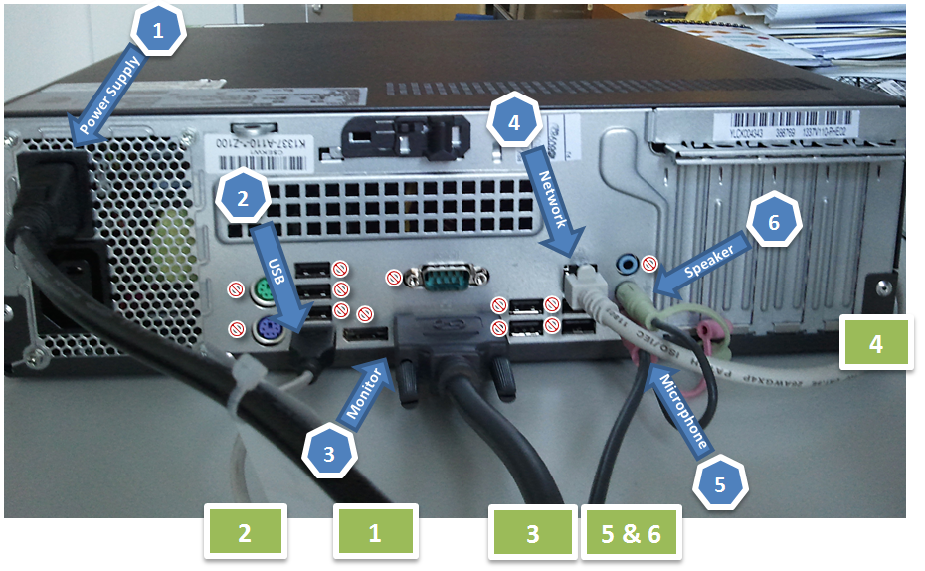

Slide 7

Packaging and Transport
Electronic Evidence can be sensitive to temperature, humidity, physical shock, static electricity, magnetic sources, and even to some actions (e.g., switching on/off).
E-Evidence must be handled with care and appropriate bags und boxes must be used to seize the devices.

Slide 8
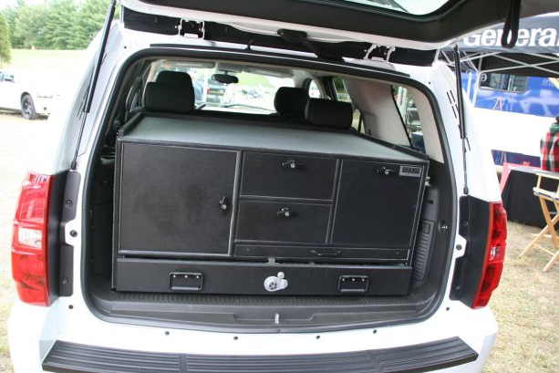
Transport
Keep electronic evidence away from magnetic sources (e.g. Radio transmitters, speaker magnets, heated seats)
  Ensure that the equipment is protected from shock and bumps (i.e., mechanical damage), heat, and humidity.

Slide 9
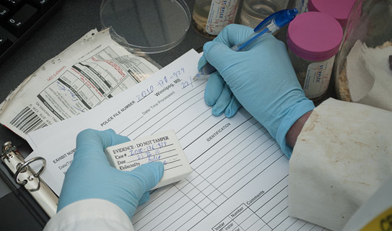
Storage
  Ensure that evidence is inventoried in accordance with the relevant policies.
  Store evidence in a secure area, away from extreme temperature and humidity.
  Protect it from magnetic sources, moisture, dust, and other harmful particles or contaminants.

Slide 10
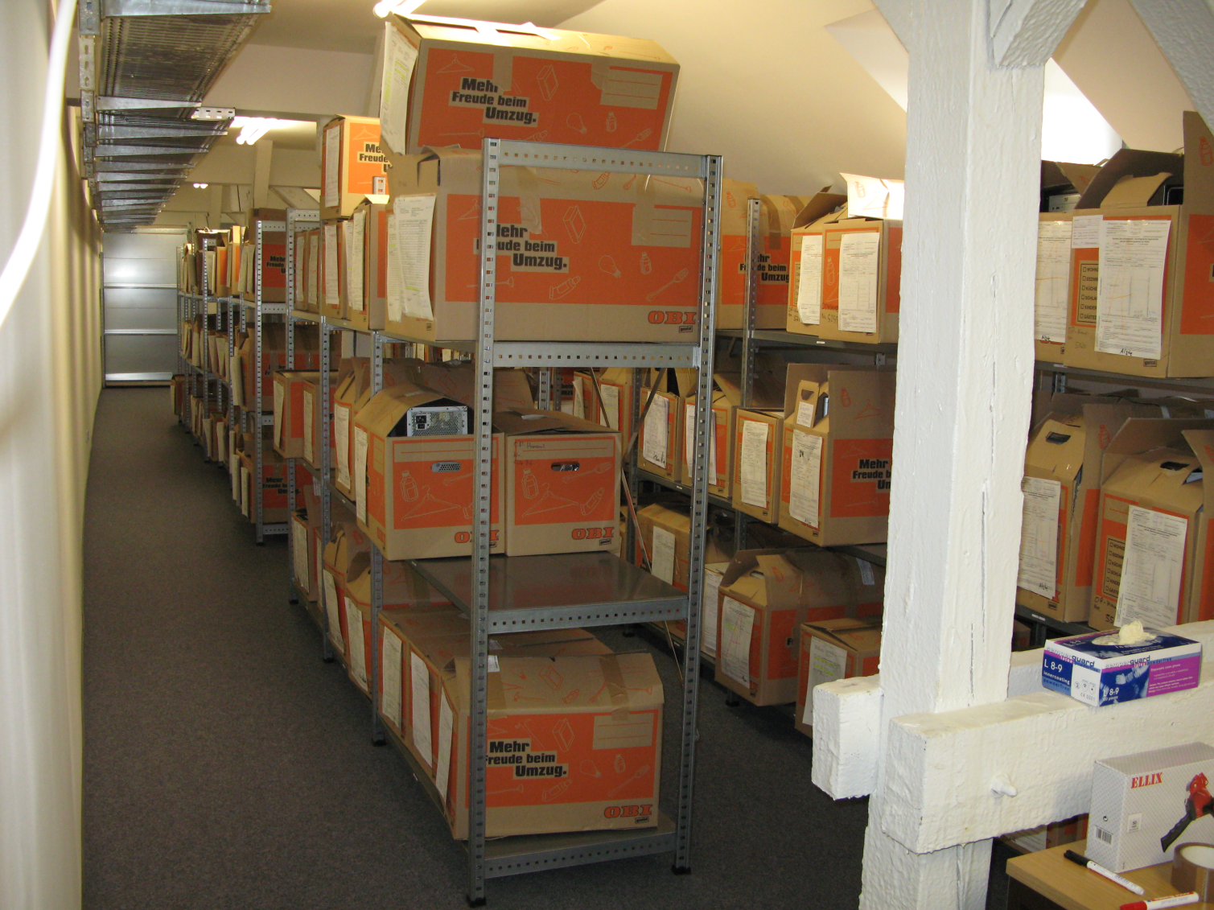
Storage facilities
  Use an adequately secure store
  room with appropriate
  access control,
  fire protection (e.g., alarm, fire extinguishers, no smoking in the storage area or in the vicinity),
  temperature and humidity, and
  protection from magnetic sources (e.g., far from directional radio devices).

Slide 11
Seizing Electronic Evidence

Slide 12

Computer Systems
Computer Systems consist of:
a main unit,
a monitor,
a keyboard,
a mouse,
cables,
power supply units (e.g., power packs, and spare batteries),
possibly additional components and
network devices

Slide 13
Computer Systems
When seizing a computer system
Observe the computer system and determine whether it is on or off
Document the computer system, all connections and the scene continuously and record all actions you take and any changes that you observe in the monitor, computer, printer, or other devices as a result of your actions a monitor,
Do not follow any unverified advice from a potential suspect.
If a computer network is encountered, contact a forensic computer specialist in your agency or an external expert identified by your agency for assistance.

Slide 14


Group Task
How to determine that a computer is on/off?
What to do when PC is OFF?
What should you be doing when the PC is ON?
  as First Responder
  as Forensic Specialist
20
Min

Slide 15
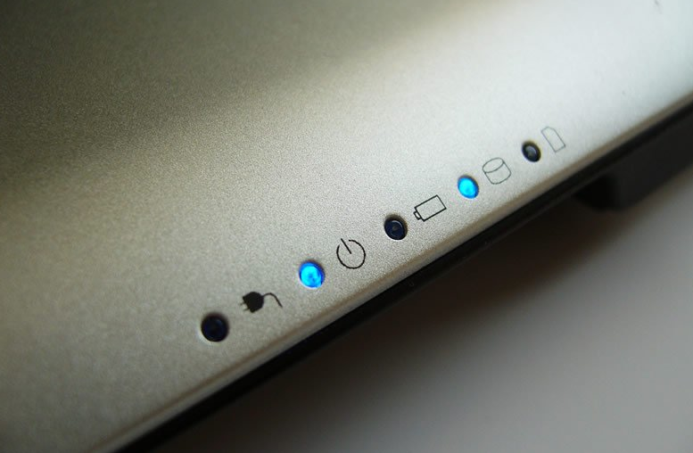
Checking the power status
Check for indicator lights
Check for noise
Check the temperature
Consider standby mode, especially for portable computers

Slide 17
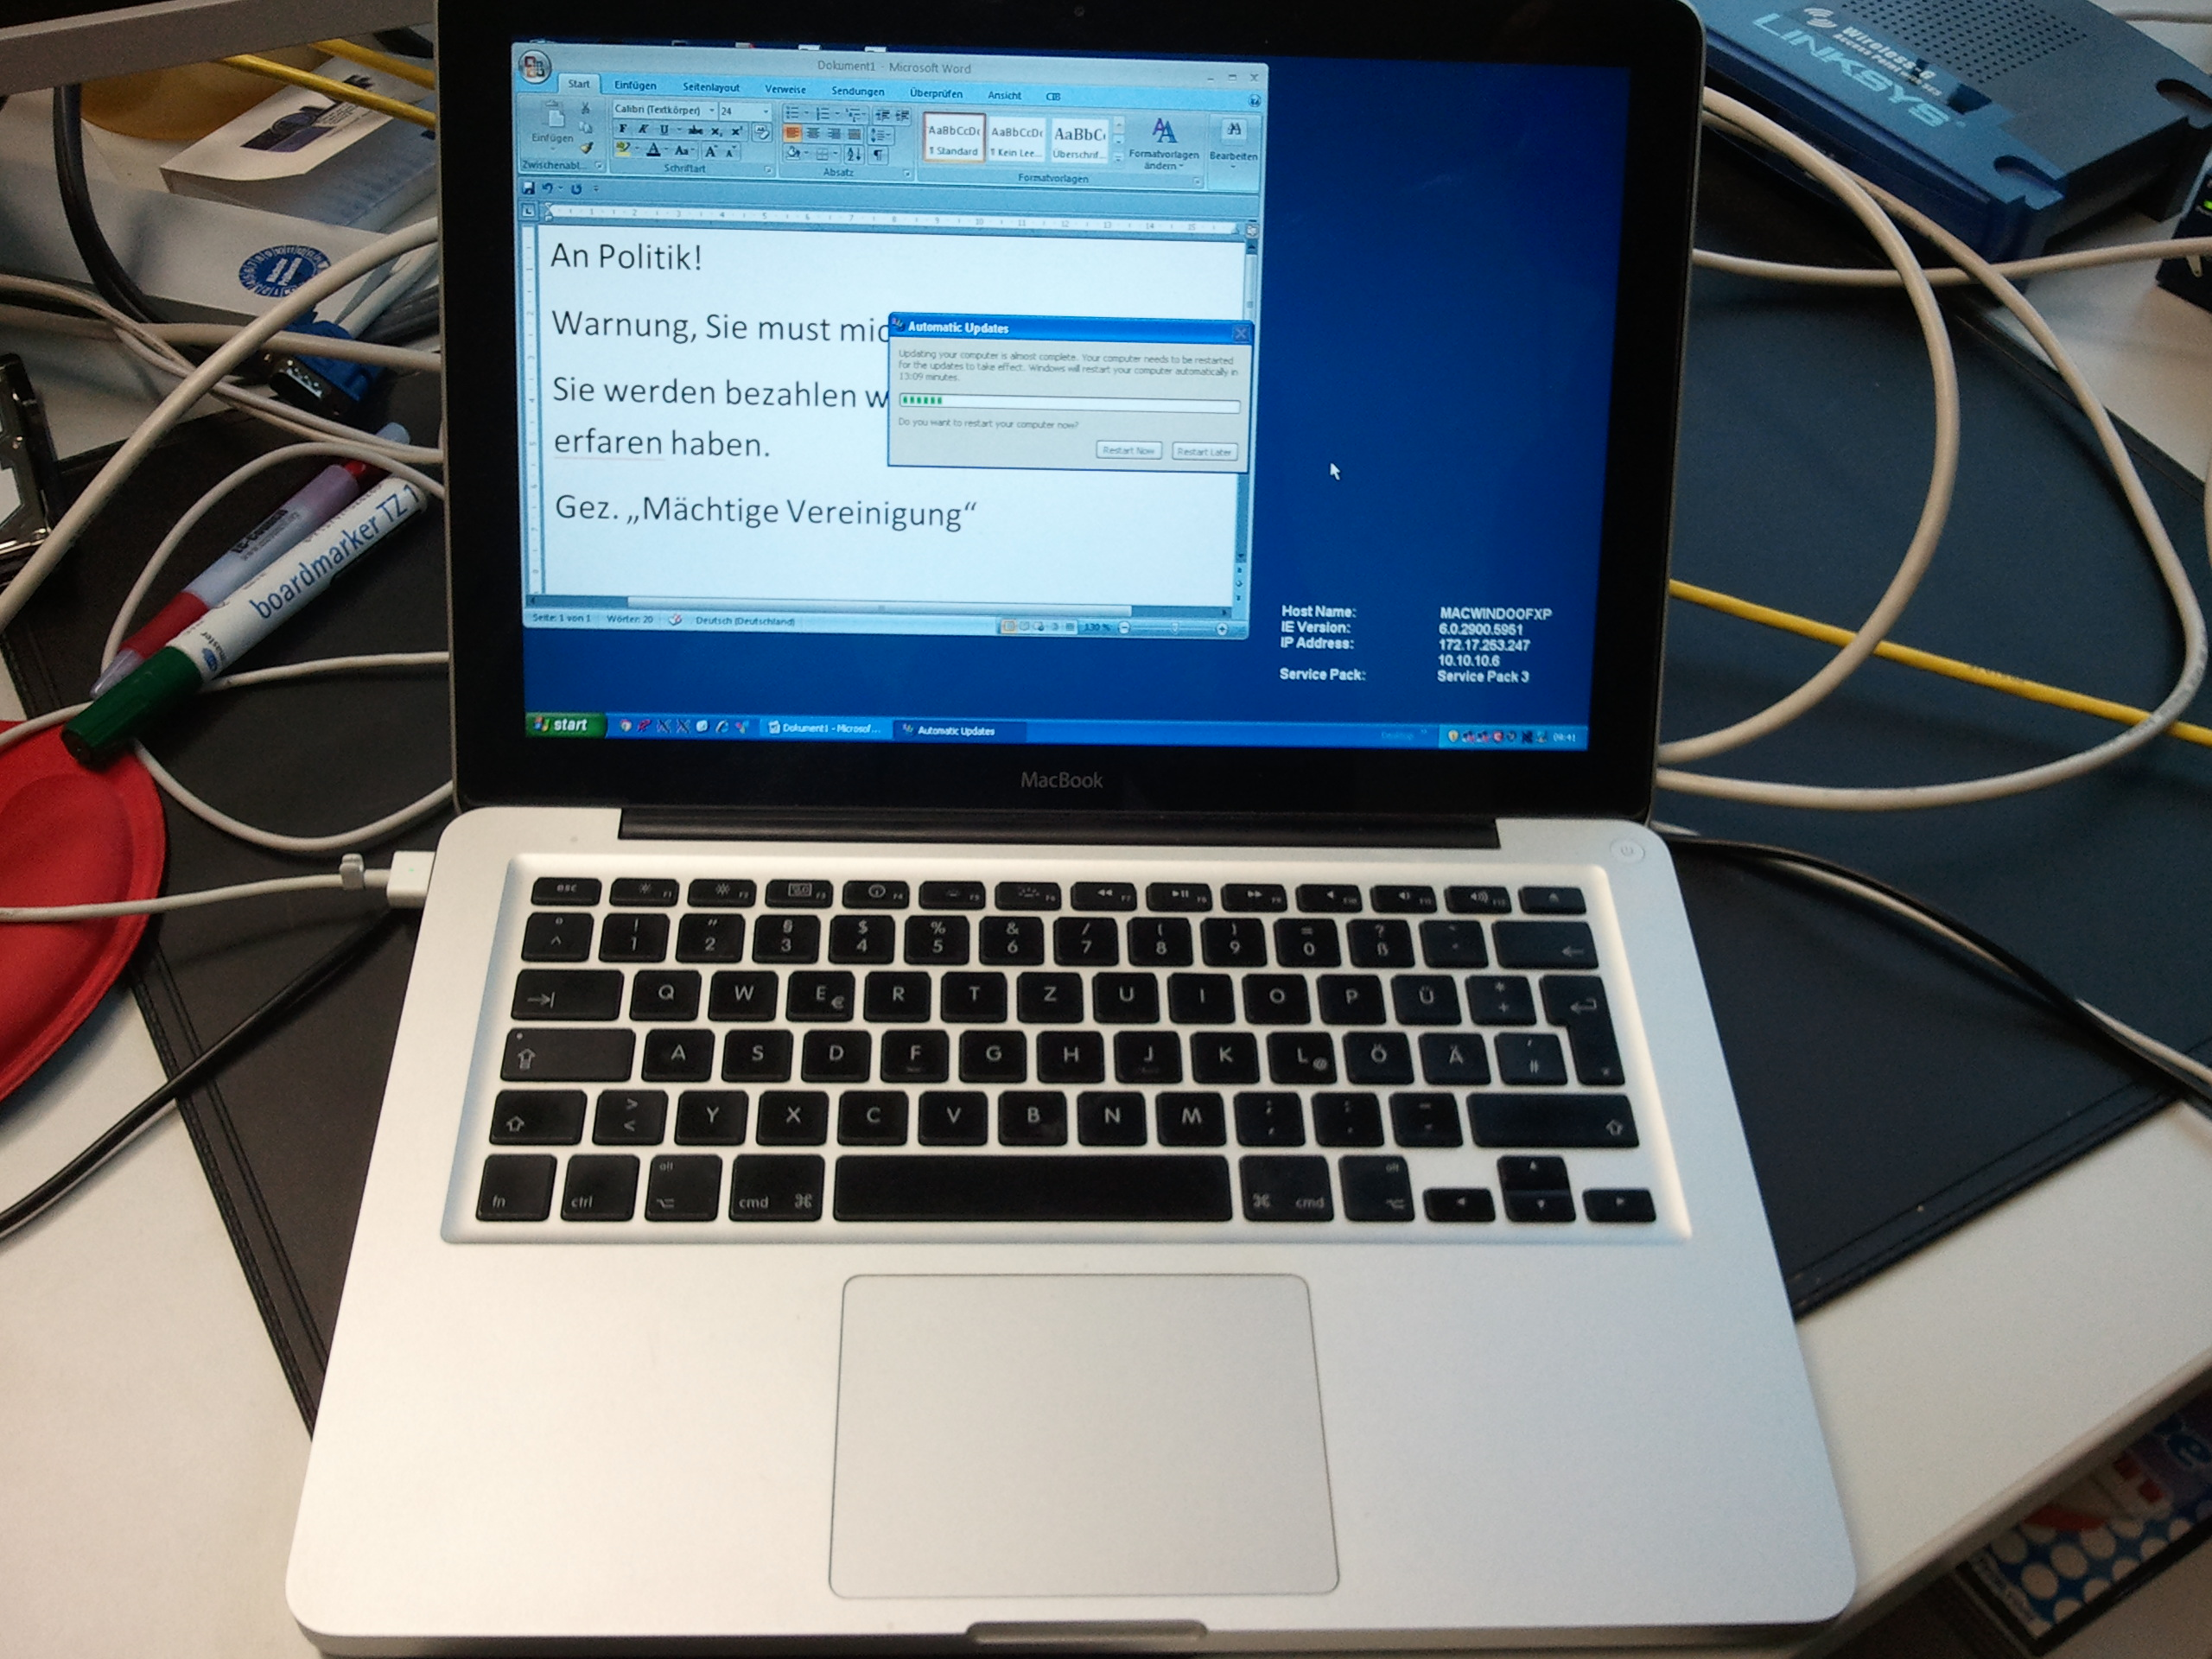
Observing the monitor
Situation 1:
Monitor is on and work product and/or desktop is visible.
  Document the details of the monitor at the time of intervention
  Proceed to “Situation B” on the next slides.

Slide 18
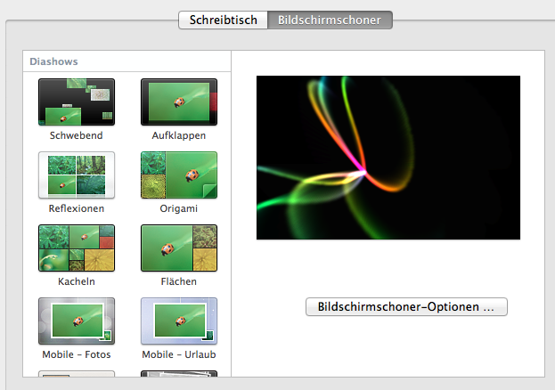
Observing the monitor
Situation 2:
Monitor is on and screen is blank (sleep mode) or screen saver (e.g., a picture) is visible.
  Move the mouse slightly (without pushing buttons). The screen should change and show work product or request a password.
  If mouse movement does not cause a change in the screen, do not perform any other keystrokes or mouse operations.
  Document the details of the monitor at the time of intervention
  Proceed to “Situation B” on the next slides.

Slide 19

Observing the monitor
Situation 3:
Monitor is off.
  Make a note of "off" status.
Turn the monitor on, then determine if the monitor status is as described in either Situation 1 or 2 above and follow those steps.

Slide 20

Situation A – Computer is Off
You have determined that system is
switched off; do not switch it on!
Remove the power supply cable from the target equipment (do not switch it off at the wall socket) and record the time of doing so.
If dealing with a portable device, also remove the battery pack.

Slide 21
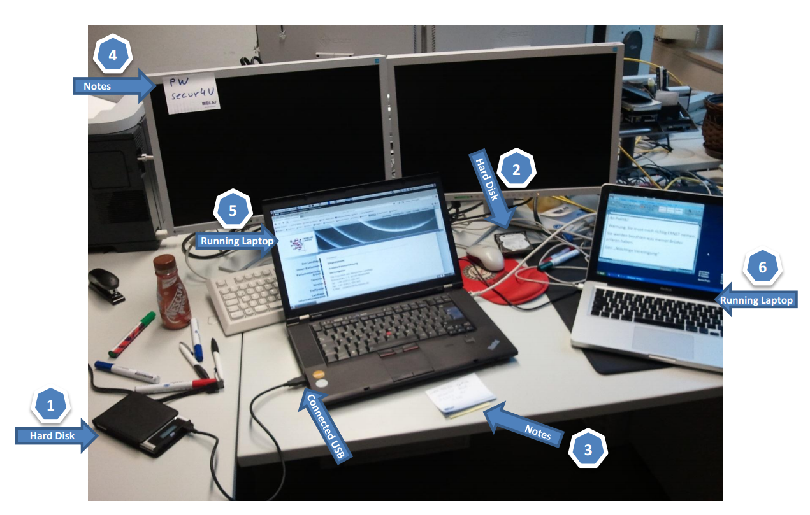
Situation B – Computer is On
You have determined that the system is switched on; do not switch it off!
Try to contact a specialist.
  If a specialist is available, follow their advice.
  If no specialist is available, continue with the next instruction.
Do not touch the keyboard or other input devices.
Proceed with steps described in in the “Live Data Part” of the presentation

Slide 22
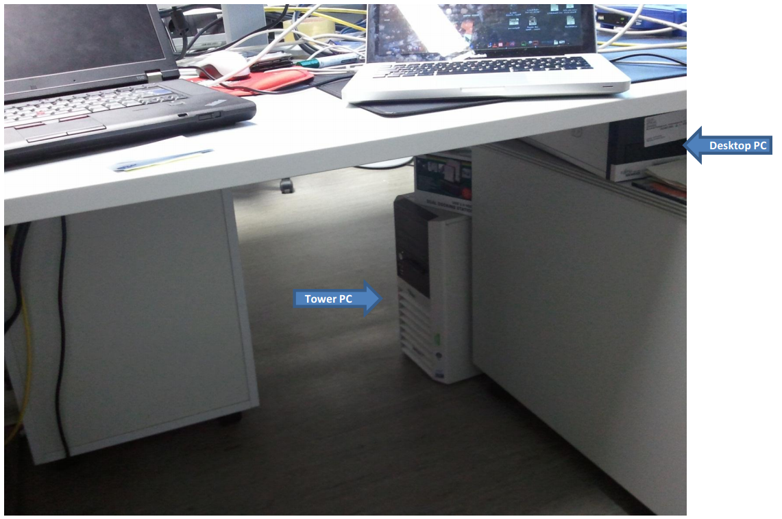
Situation C – You cannot determine
You cannot determine whether the system is switched on or off.
Assume that it is switched off. Do not press the switch.
Remove the power supply cable from the target equipment (do not switch it off at the wall socket) and record the time of doing so.
If dealing with a portable device, also remove the battery pack.

Slide 23
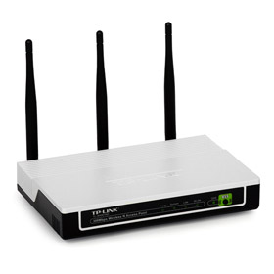
Computer Networks
If you encounter a computer network, contact a forensic computer specialist in your agency or an external specialist recommended by your agency for assistance.
Indications for networks:
  multiple computer systems
  network components (router, hubs, switches, etc.)
  network interface cards
  network cables
  antennas of Wi-Fi devices
  servers
Label all cables and devices and document the connections

Slide 24
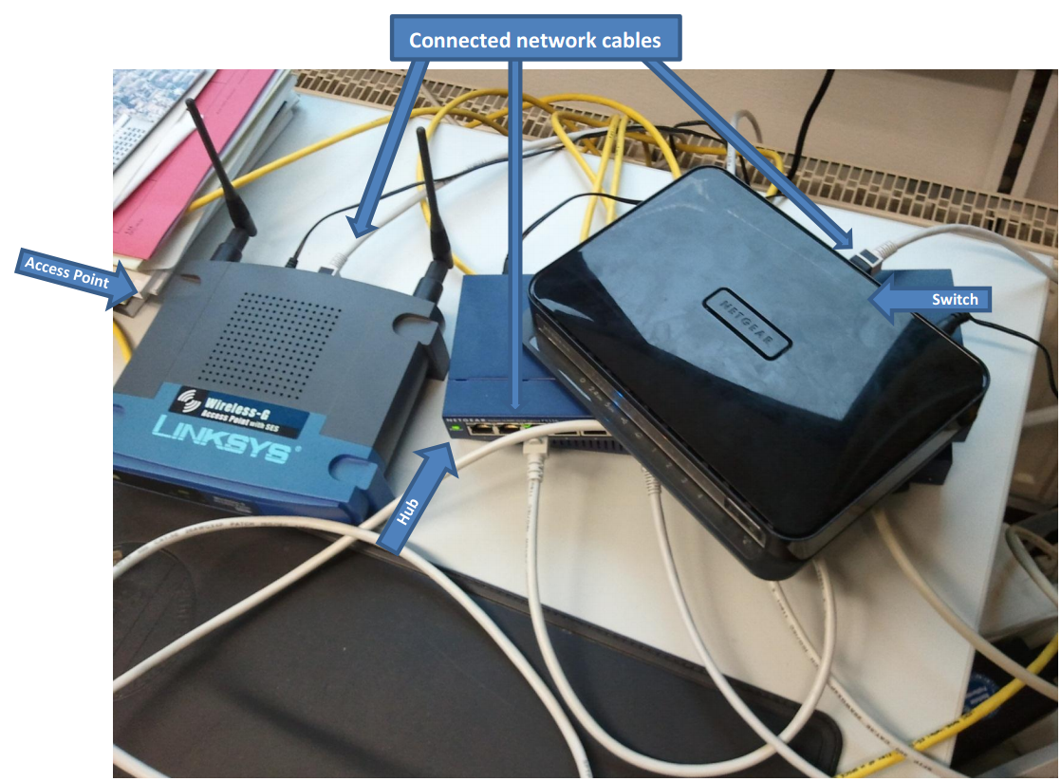

Slide 25

Mobile Phones / Tables
If powered on
  do not turn off the device
  document the screen
  if applicable turn device into flight-mode
  consider using a faraday bag
If powered off
  do not turn on the device
Search for further information regarding the device (manual, power supply, etc) and the SIM card (letter from telecom company, PIN, PUK, etc)

Slide 26
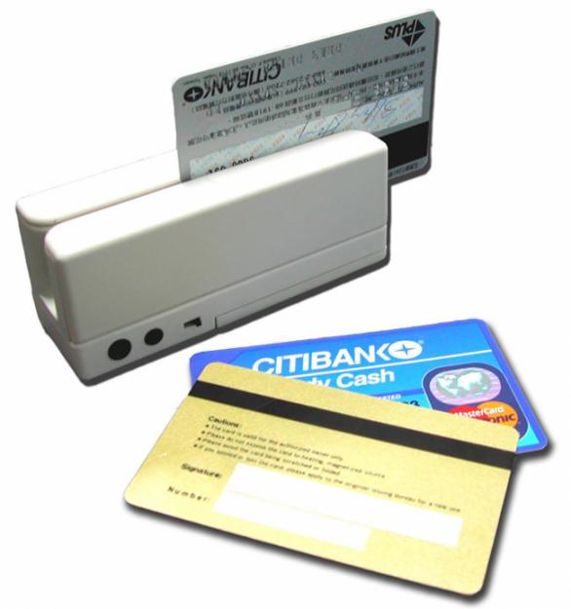
Smart / magnetic stripe cards
Do not fold the card.
Do not expose it to extreme temperatures.
Do not touch the electrical contact plate.
Protect from scratches, liquids, magnetic influences, etc..
Try to get hold of the PIN. Do not attempt to gain access to the data/functions on the card.
Photograph/note/copy the information from the imprint on the card body.
If applicable, seize smart card readers too.

Slide 27
Other electronic evidence
Seizure instructions for electronic evidence:
If the device is switched on, do not switch it off
  Photograph the display (if applicable) and record the information displayed.
  Remove all power supply cables.
  Do not try to access the internal memory or any storage media.
If it is switched off, do not switch it on
Collect/record important information
  Collect manuals and other instructions if available.
Record the relevant data (e.g., phone number).

Slide 28
Summary of Session Objectives
At the end of this session participants are able to:
Identify sources of electronic evidence based on shown scenarios
Describe Standard Operation Procedures for packaging, transport and storage of electronic evidence
Differentiate different SOPs based on the type of the device
Discuss techniques to check the power status of a computer system
Apply general seizure instructions for electronic devices

Slide 29

Questions

