Slide 1
First Responder training for Investigators on Cybercrime and Electronic Evidence
Session 14
Search & Seizure
Live Data Scenarios

Slide 2
Session Objectives
At the end of this session participants will be able to:
Define the terms “Volatile Data“, “Transient Data“ and “Live Data Forensics“
Explain the value of volatile data for investigations
List at least four types of data that would get lost without Live Data Forensics
Perform measures of first response when facing a running computer system.
Name at least four tools to acquire volatile data including Live Response and Boot-DVDs
Describe the challenges of encryption and the chances of Live Data Forensics in scenarios involving encryption
Discuss the challenges and different legal frameworks in scenarios where data is stored remotely, e.g. cloud services.
Define the term „Cloud Computing“
Compare at least three cloud services

Slide 3

Live Data Forensics

Slide 4
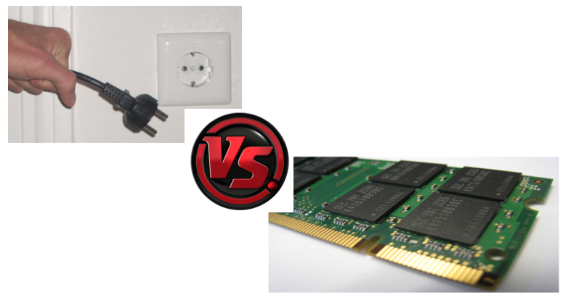
Notes:
Compared to

Slide 5
What is Live Data Forensics?
Live Data Forensics deals with situations where it is necessary to capture volatile data from devices before they are turned off or disconnected from networks or power supplies.
It requires a higher level of specialism than the procedure in the search and seizure of dead boxes because the possibility of altering or even overwriting evidence is very high.

Slide 6

What is volatile data?
Volatile Data is data, digitally stored in a way that the probability is very high for the contents to be deleted, overwritten or altered in a short amount of time by human or automated interaction.

Slide 7

Examples for volatile data?
Notes:
Board blast Q&A session or group task

Slide 8
Examples for volatile data
Caches (e.g. arp- and dns-caches)
Unsaved documents
Running processes
Passwords and encryption keys
Open network connections
System information
Logged in users
Temporarily connected remote storage
Malware binaries only stored in RAM

Slide 9
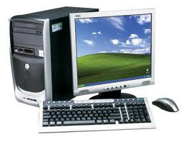
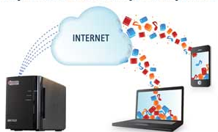
Two types of volatile data
Volatile Data on the Physical Computer like open network connections, running processes and services, arp- and dns caches.
Transient Data that are not volatile in their nature but are only accessible on scene. Encrypted volumes as well as remote resources are examples for this kind of data. The characteristic of these data is that the contents of the data might get inaccessible, altered or deleted after the search, if the investigator is not be able to acquire them.

Slide 10
Requirements
Requirements for Live Data Forensics:
Specialist with specific training for Live Data Forensics
Hands-on practical experience
A set of validated forensic tools for Live Data Forensics
If no specialist is available, pulling the plug makes more sense than tampering with the evidence resulting in a possible contamination of the evidence and making it unfeasible for use in court.

Slide 11
If you have physical access to the data…

Slide 12

First Responder
As a first responder you can protect volatile data by running the following steps:
Identify, secure, document, and photograph each device containing volatile data
Observe potential suspects and other persons to prevent them from altering or destroying the evidence
Preserve the running state by preventing screensaver, standby and sleep modes
Observe IT components to prevent altering or destroying the evidence.

Slide 13

Indications on the screen
Check the display screen for signs that digital evidence is being destroyed. E.g. "delete," "format," "remove," "copy," "move," "cut," or "wipe“
Document which windows are opened
Look for indications of encryption being used (see next slides).
Look for indications of cloud services being used (see next slides).
Look for signs of active or ongoing communications with other computers or users such as instant messaging windows or chat rooms.
Look for signs that cameras or Web cameras (Web cams) are active.

Slide 15
Let us
see some examples…

Slide 16
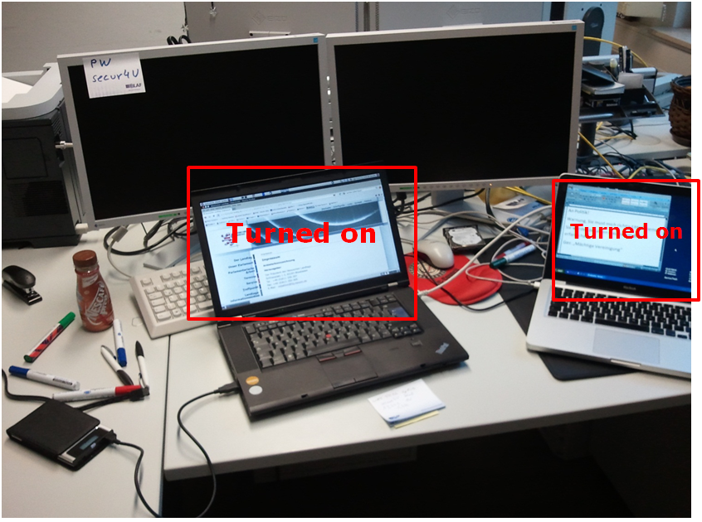

Slide 17
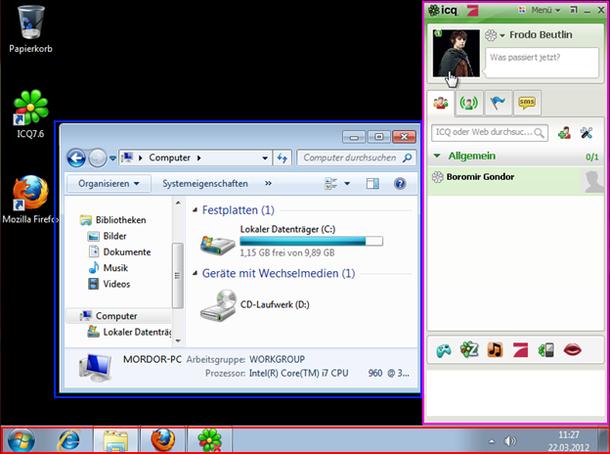

Slide 18
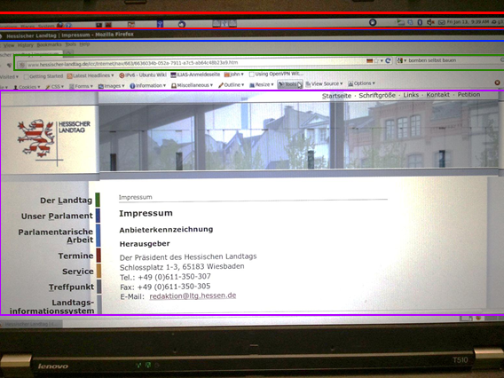

Slide 19
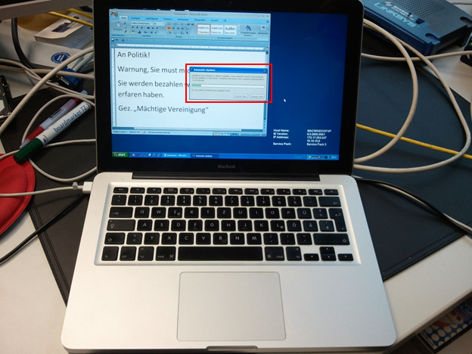
(Slide Heading)

Slide 20
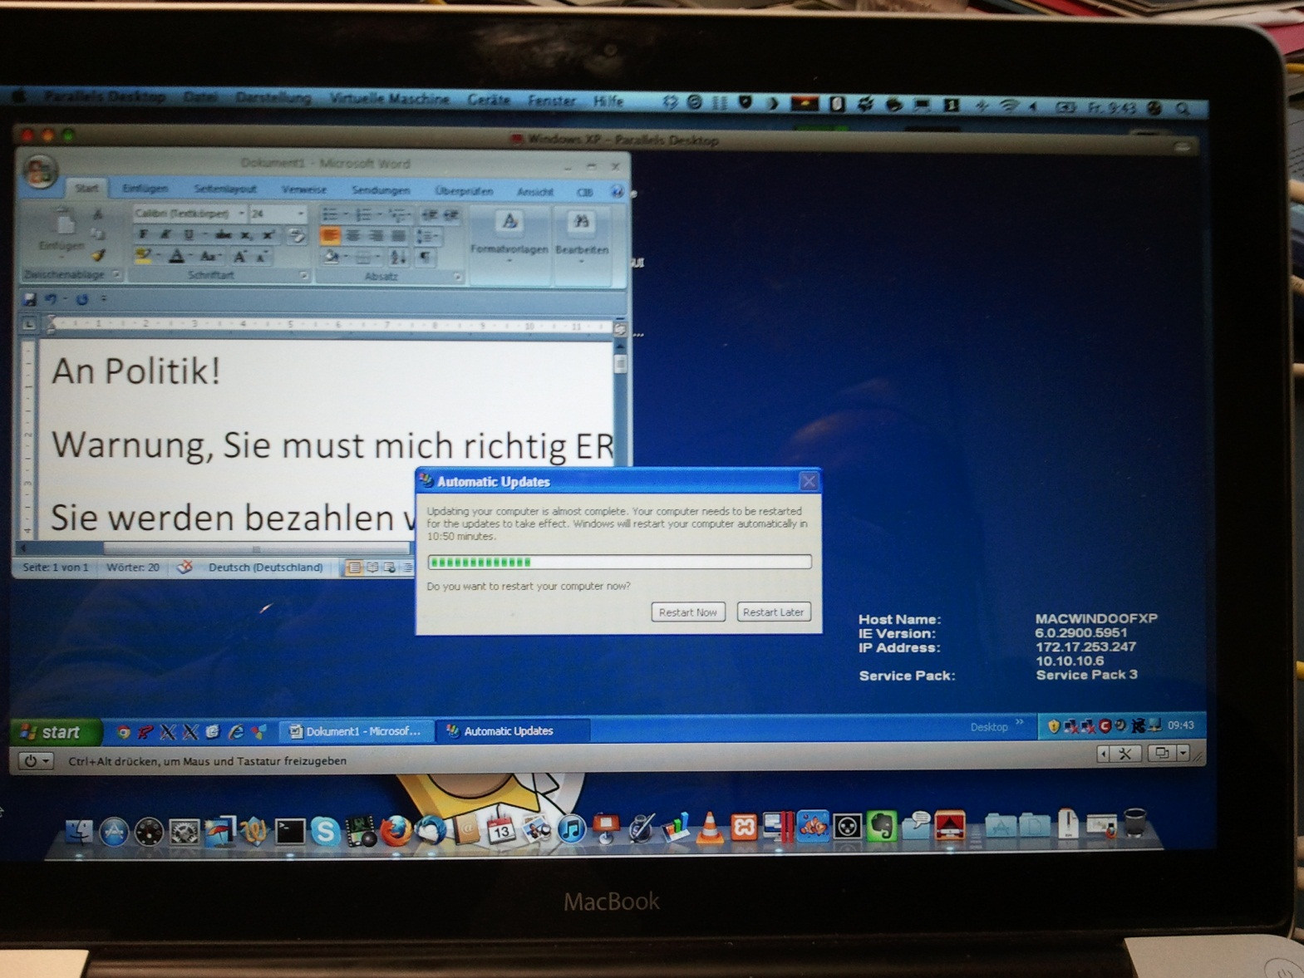
(Slide Heading)

Slide 21

Tools for more experienced users
When composing a set of live data forensics tools the investigator should consider:
Only select tools with the least impact on the system.
The tool should come with its’ own executable and libraries.
Only use tools and scripts whose functionality you can explain in court.
The tool/script should be automated.
Consider triage functionality for urgent cases or security incidents.
The tool should only gather data that are volatile.

Slide 22
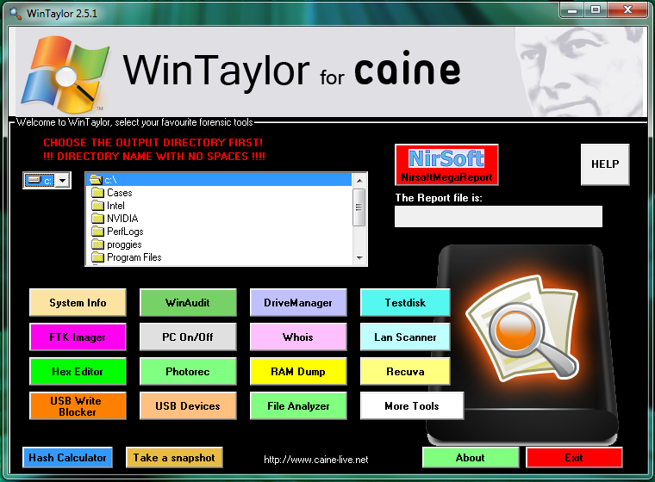
Live Forensics DVDs

Slide 23
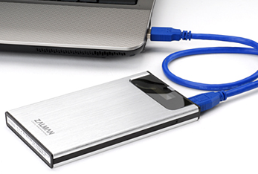
External storage media
USB Sticks: Very fast and reliable, big capacities needed as the amount of RAM is growing quickly
External Hard Disks: Whenever acquisition of a large amount of files is needed. Search for models with a range of possible connectors (USB/eSATA/FW).
Live DVDs: Ideal for live data forensics tools. The write protection of DVD-Rs protects the trusted binaries from being altered.
External HDDs with virtual DVDs:
Combine advantages of both: fast
accessible, reliable storage of external
hard-drive and write protection of DVD-Rom.

Slide 24




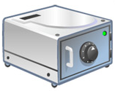
Encryption
Examples for encryption software:
Microsoft Bitlocker
TrueCrypt
Steganos Safe
PGP
FileVault
More: http://en.wikipedia.org/wiki/Comparison_of_disk_encryption_software

Slide 25
Remote Storage

Slide 26
Remote Storage
Data is not always stored locally
Especially in companies you find data stored remotely in other offices, collocated at hosting companies, etc
It is important to acquire remotely stored data
Acquisition is dependent on your legislation

Slide 27
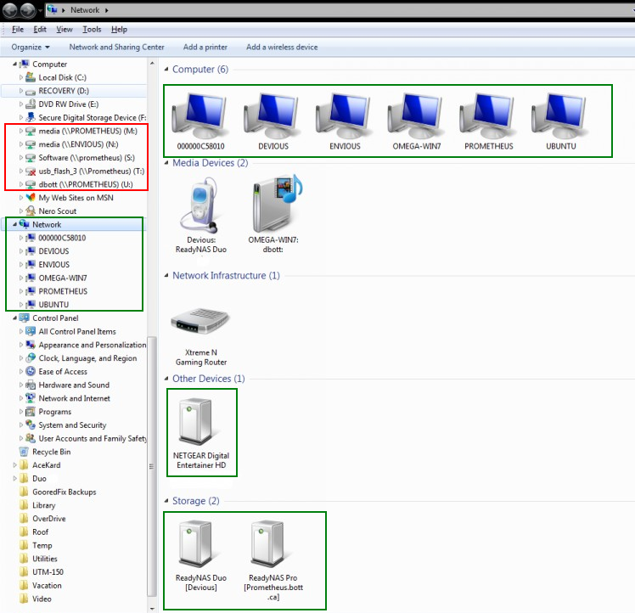
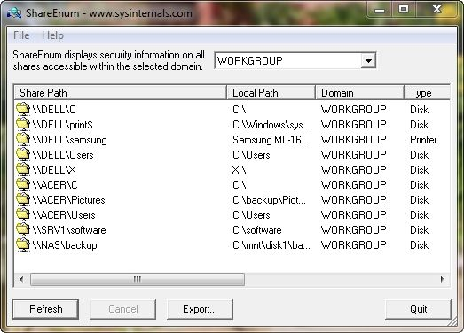
Examples of remote storage
Shared folders on other
network computers
Mapped network drives from
a server
E-Mails stored on an IMAP
or Exchange server
Cloud services and
online storage

Slide 28
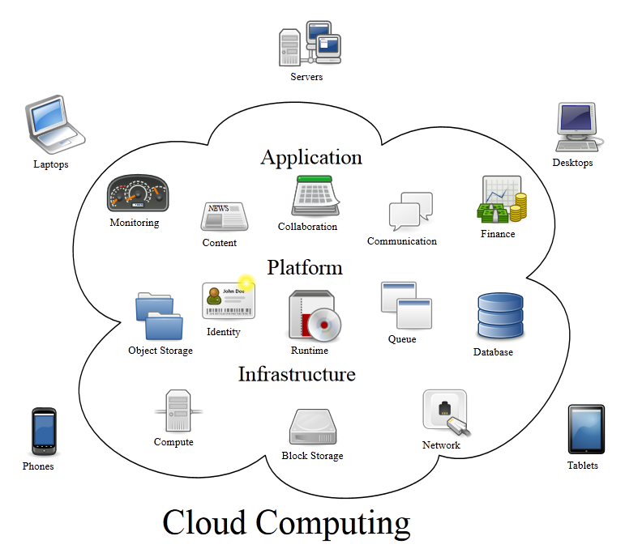
Data stored in the cloud
Source: Created by Sam Johnston, Wikipedia.com

Slide 29
Cloud computing
Cloud computing is a model for enabling ubiquitous, convenient, on-demand network access to a shared pool of configurable computing resources (e.g., networks, servers, storage, applications, and services) that can be rapidly provisioned and released with minimal management effort or service provider interaction.[…]
Source: Mell and Grance, NIST, 2011, http://csrc.nist.gov/publications/PubsSPs.html#800-145

Slide 30
Common cloud providers
More: http://en.wikipedia.org/wiki/Comparison_of_online_backup_services

Slide 31
What to do with remote storage?
Identification:
Tray icons
Control the installed software
Process list
Network shares and mapped network drives
Observe the network traffic
List open and listening sockets for suspicious activity.
Acquire any data that appears to be stored remotely.

Slide 32
Session Summary
At the end of this session participants are able to:
Define the terms “Volatile Data“, “Transient Data“ and “Live Data Forensics“;
Understand the value of volatile data for investigations and the types of data that would get lost without Live Data Forensics;
Perform measures of first response when facing a running computer system.
Understand the challenges of encryption and the chances of Live Data Forensics in scenarios involving encryption
Awareness of the challenges and different legal frameworks in scenarios where data is stored remotely, e.g. cloud services.
Define the term “Cloud Computing“ and identify cloud services.

Slide 33

Questions

