Slide 1
First Responder training for Investigators on Cybercrime and Electronic Evidence
Session 22b
Remarks on the nature of FI in Cybercrime cases

Slide 2
Session Aim
Provide delegates with information about the specific challenges to FI in Cybercrime cases
What type of wealth is typically found?
What is the nature of the underground economy?
What are relevant sources of evidence in all phases of the investigation.

Slide 3
“Crime Proceeds on the Internet”?
Money Laundering
Criminal Activity
(Cybercrime)
Crime Proceeds
Search, Seizure, Confiscation

Slide 4
Online Wealth
Traditional financial system
“Modern” Fintech
eMoney, Mobile money
Cryptocurrencies
  Wallets
  Exchanges
  Mixers and tumblers
Underground economy

Slide 5
Traditional Financial System
Cybercrime: Where is the money

Slide 6
Banks
eBanking
  Bank accounts can be accessed through various channels
  Websites are used to control transactions and authenticate acct. holders
Evidence sources:
  Internet history
  Mobile phone apps
  Transactions from other accounts, or linked accounts (think: Paypal)

Slide 7
“Fintech”
Cybercrime: Where is the money

Slide 8
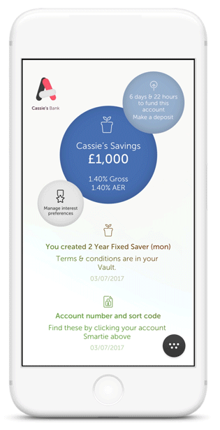
UK: Atom bank

Slide 9
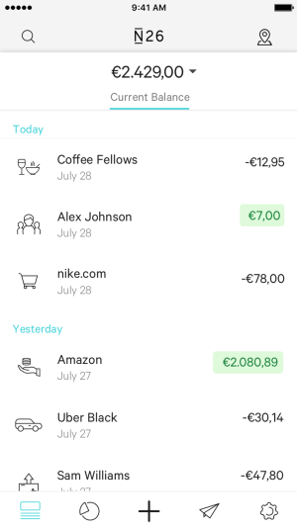
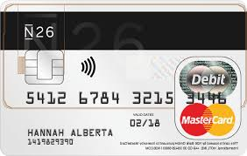
Germany: N26

Slide 10
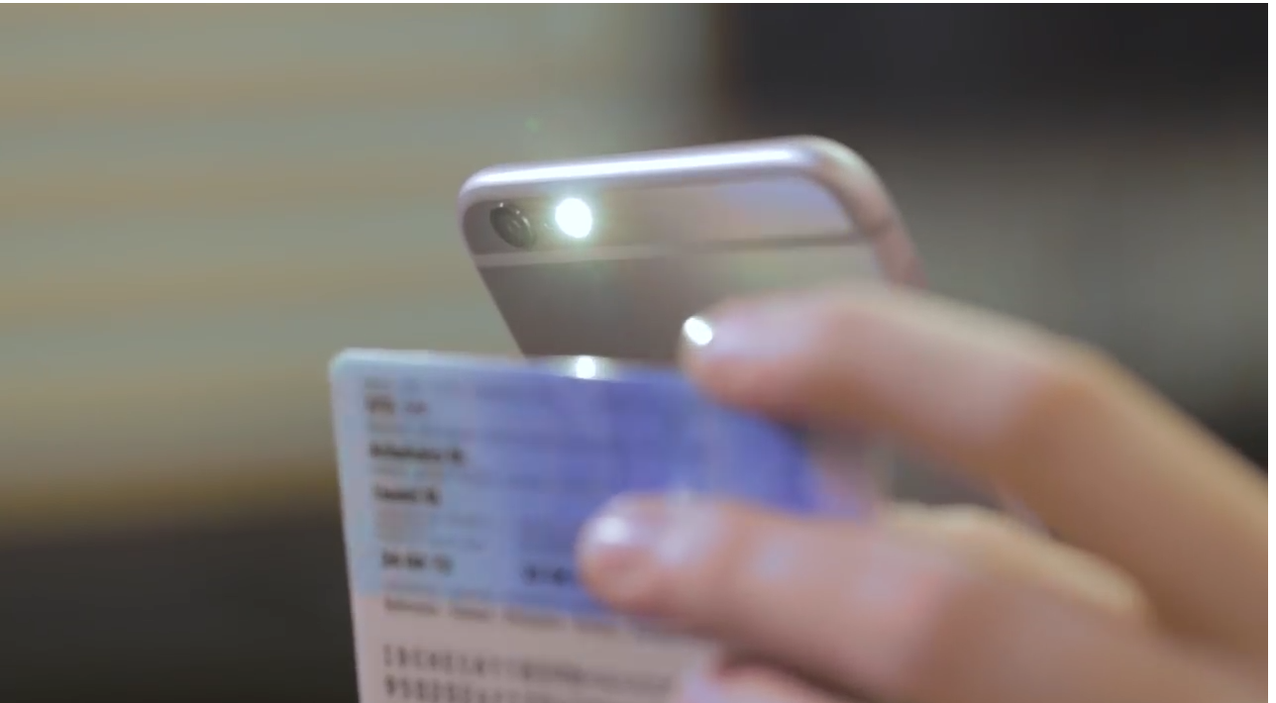
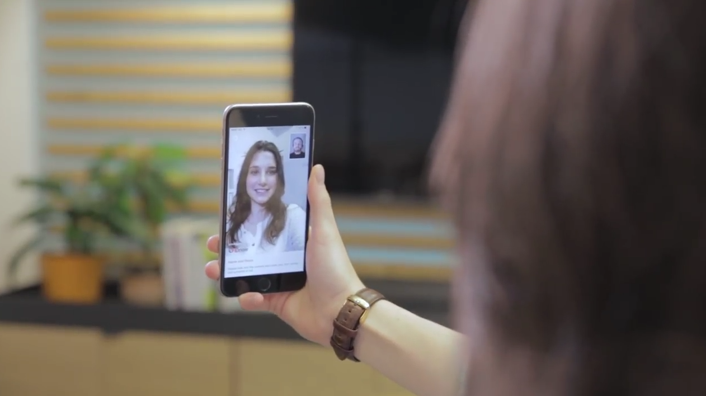
KYC
https://www.youtube.com/watch?v=H-gomrSqmu4

Slide 11





Many others!

Slide 12
Identification
Posession of phone: half the issue!
Increased use of sensors
Increased security
Lower rates and less risk
Type | 1:N match probability (optimum)
Iris | 2x: infinite
Fingerprint | 10x: near infinite 1x: ~100.000.000
Face | 1000
Voice | 1000

Slide 13
Online Banks (Fintech)
eBanking
  Increasingly: banks are accessible only through apps.
  Websites and apps are used to control an account
Evidence sources:
  Internet history
  Mobile phone apps
  Transactionds from other accounts or linked accounts (think: Paypal)
  KYC: often available as video,
  Sensor data (biometrics)

Slide 14
Online Banks (Fintech)
eBanking
  Increasingly: banks are accessible only through apps.
  Websites and apps are used to control an account
Evidence sources:
  Internet history
  Mobile phone apps
  Transactions from other accounts or linked accounts (think: Paypal, traditional banks)
  KYC: often available as video,
  Sensor data (biometrics)

Slide 15
eMoney, Mobile money
Cybercrime: Where is the money

Slide 16
eMoney, Mobile money
eMoney is a representation of money in an online acounting system
The money is not physically present but an exchange for money or goods can take place
Typical:
  Paypal
  Mobile payments
  Payment through phone bil/prepaid credits
  Prepaid “scratch” cards
  Alipay[look up other Chinese app]
Are there any such schemes in Georgia?

Slide 17
eMoney, Mobile money
Evidence sources:
  Internet history
  Purchase/Top Up of credit (prepaidcard or online)
  Delivery of goods or services stating eMoney/Mobile money as payment method
  Apps

Slide 18
eMoney, Mobile money
Evidence sources:
  Internet history
  Purchase/Top Up of credit (prepaidcard or online)
  Delivery of goods or services stating eMoney/Mobile money as payment method
  Apps

Slide 19
Crypto currencies
Cybercrime: Where is the money

Slide 20
Currencies
Means of exchange
Two types:
  Fiat currency
  Commodity currency
Difference: underlying commodity (usually: precious metal)
Most currencies – nowadays: fully convertible.
  Can be exchanged for another currency
  Exchange rate dependent on free market trade and/or regulatory standards
  Centralized (monopoly)

Slide 21
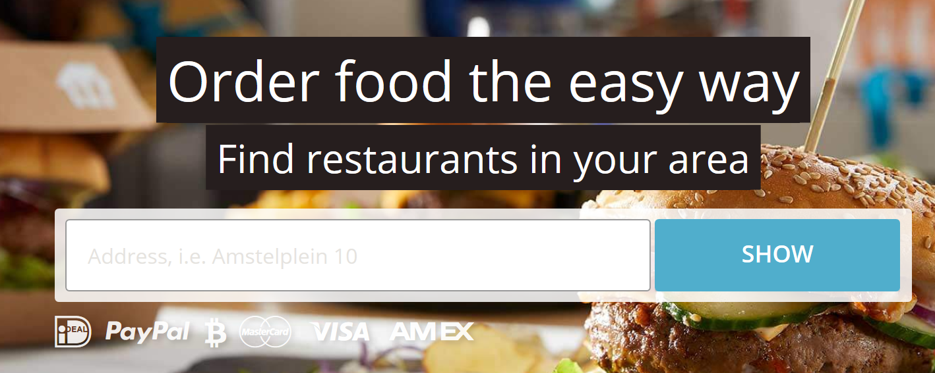
Fiat currency!

Slide 22
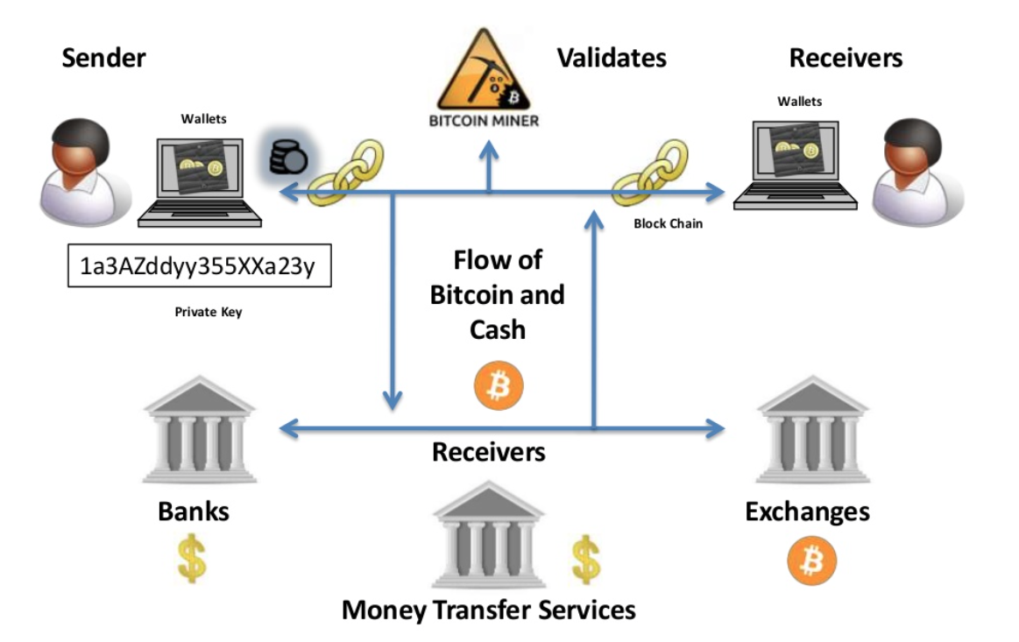
Ecosystem

Slide 23
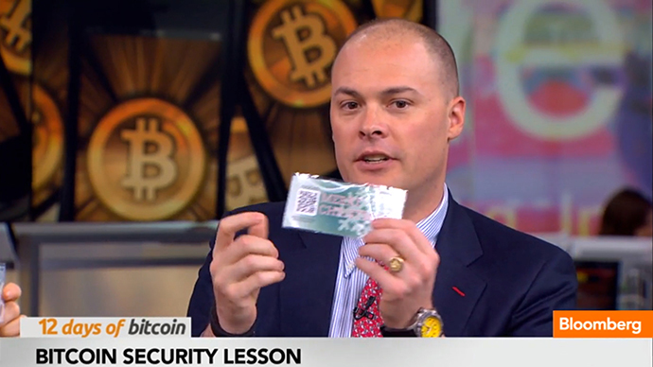
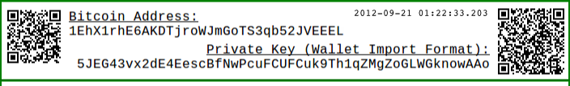
Public key cryptography
Bitcoin is not anonymous, but rather pseudonymous
It consists of a decentralised ledger, a registry of transactions (the bitcoin blockchain)
The ledger uses addresses (pseudonyms) that show as controlling a number of bitcoins
For this purpose Bitcoin uses a technology called Public Key Cryptography
  This is the technique that allows us to show a person controls a number of virtual currencies
Bitcoin also uses a technique called Hashing
  This is used, amongst others, to verify the validity of blocks and the chain of blocks of transactions that form the blockchain

Slide 24
Bitcoins:Where are they kept?
All bitcoins are kept in a wallet
A wallet contains a number of addresses that can receive and spend BTC sent to them
Wallet
Private Key
Private Key
Private Key
Public Key
Public Key
Public Key
BTC address
BTC address
BTC address

Slide 25
Wallets
Two different types of wallets
Online
  Kept by a service provider
  The public and private keys are kept on your behalf
  The service provider should be trusted with your Bitcoins!
  Transactions are authorized via the provider
  Think: like a bank (except it is not!)
A user owned wallet
  Keys and wallet are run on a local computer
  The wallet can be kept online
  Or even offline (printed)
  Transactions

Slide 26
Online wallet at exchange
Exchanges provide wallets
Provide exchange to fiat currency (usually via wire transfer)
Can provide other services
Examples:
  Coinbase
  Bitstamp

Slide 27
Mobile apps
Usually not a full wallet
Blockchain is too big for a phone
Linked to online infrastructure online exchange

Slide 28
Evidence sources
Internet history
  Online Wallets
Wallet software or app
  Traditional client: a file called wallet.dat
  EC3 manual: different traces
Applications:
  Wallet applications
Other formats
  Hardware
  Printed private key

Slide 29
Underground economy
Cybercrime: Where is the money

Slide 30
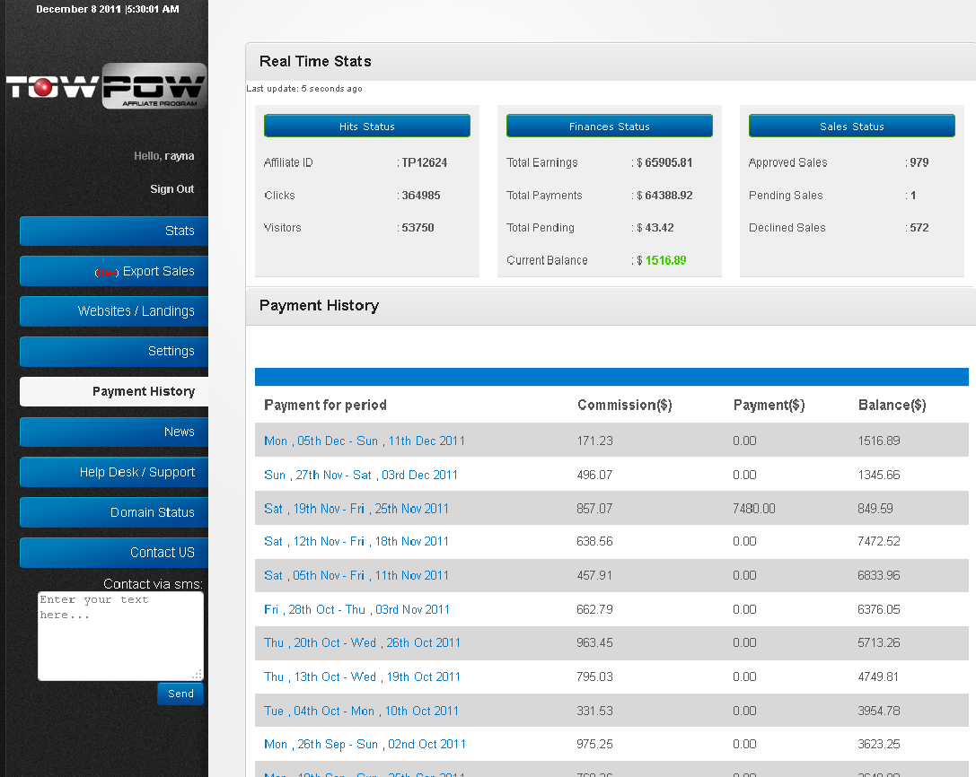
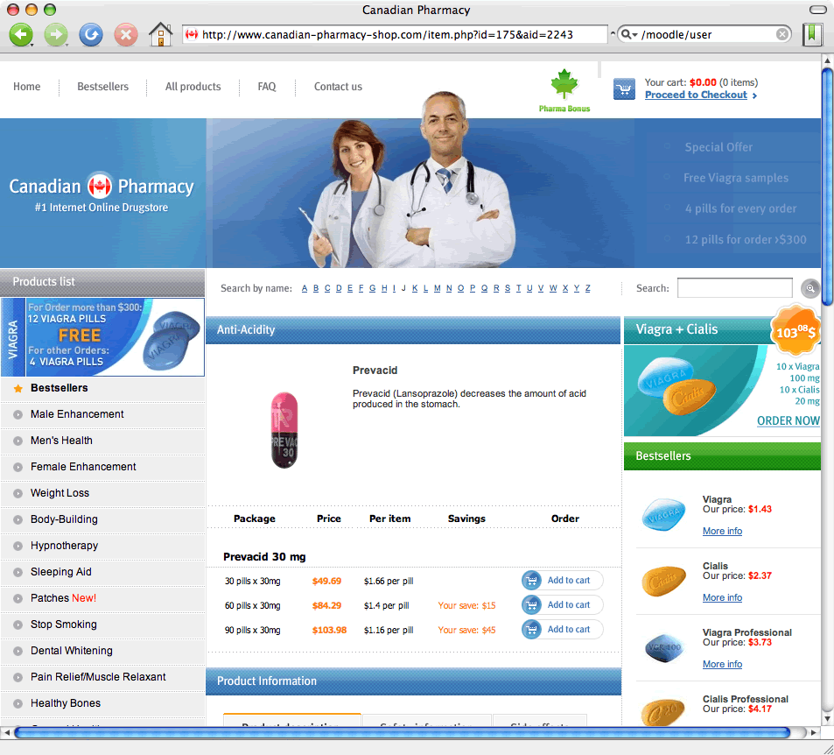


Underground economy
Product
Product
Product
Affiliates Sell for a Program
Transaction: Pay-out
Affiliates: “create traffic, trasnactions”
Programs: “product”
Affiliate Program
Affiliate
Affiliate
Consumer

Slide 31
Evidence sources
Issue: dynamic economy
  Need to know names and business case of the programs
Internet history
  Affiliate program names
  Communication with the program managers
Payouts:
  Any form of pay out (Paypal, Cryptocurrency wallet, eMoney, bank/remittance)
  Affiliate administration (online or at the program manager)

Slide 32

Questions

