Slide 1
First Responder training for Investigators on Cybercrime and Electronic Evidence
Session 23 / Part 1
Online Criminal Money Flow Typologies

Slide 2
Session Objectives
Explain the criminal money flow typologies of the use of:
  Money Remittance Providers
  Wire Transfers, Takeover/Opening of Bank Accounts
  Cash Withdrawals
  Internet Payment Services

Slide 3

Money Remittance Providers

Slide 4
DISCUSSION:
What is a money remittance provider?
Is there a problem with remittance providers?

Slide 5
Remittance Provider Typology
Individuals (both knowingly and without knowledge) are recruited as mules to the laundering scheme, often via “work at home” job offers.
Crime proceeds are transferred to the bank accounts of the mules.
The mule withdraws the cash and transfers the cash by wire transfer to a specific beneficiary.
The mule retains a payment as commission for performing this service.
Transfers are usually of an amount lower than the reporting threshold, to avoid detection.
Remittance providers are used again to move the cash to its final destination.

Slide 6
Complicit Provider Typology
Cases have been identified where extensive use of particular remittance providers has raised concerns about possible collusion or infiltration of such businesses.

Slide 7
How do we identify the use
Remittance Providers?
DISCUSSION:
What sources of evidence can be used to indicate the use of remittance providers?
What procedural powers are available/relevant to the identification/use of remittance providers?

Slide 8
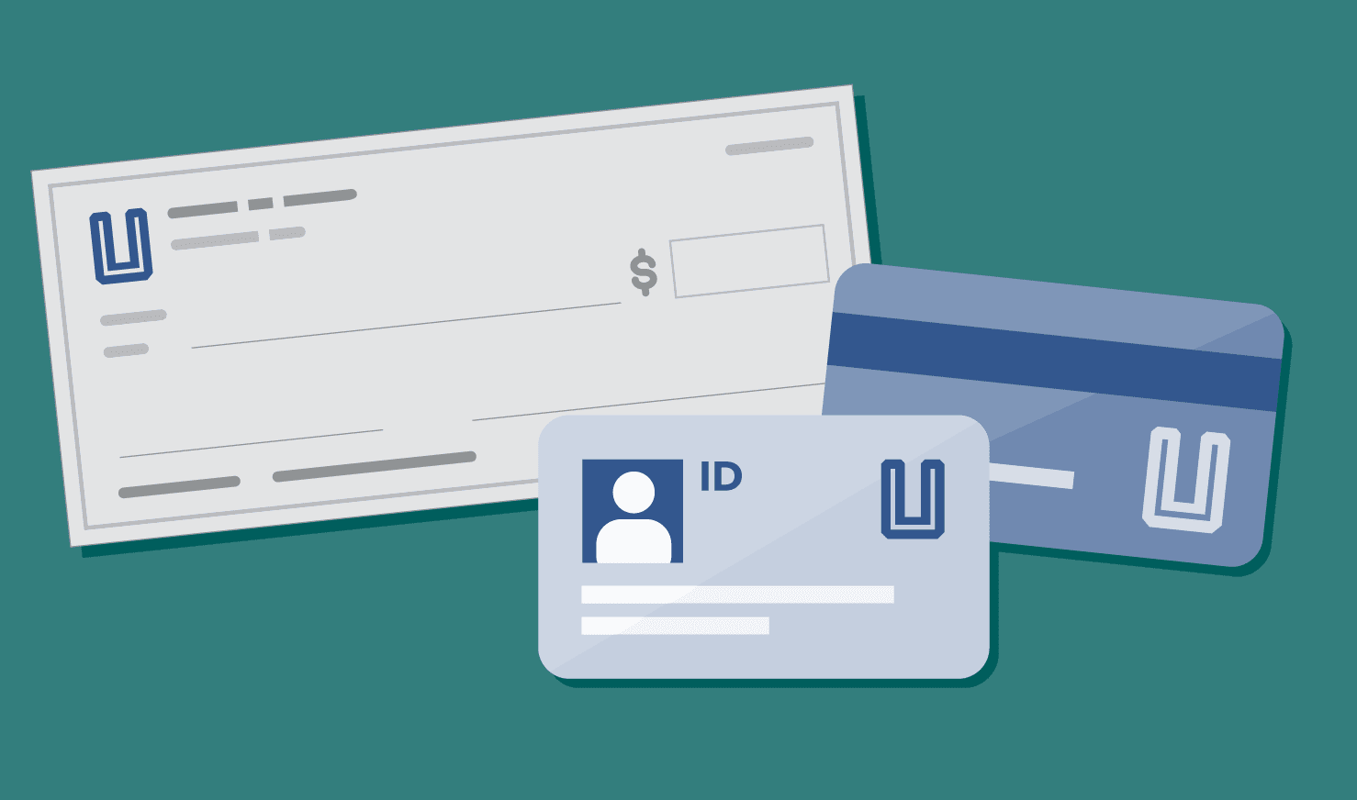
Wire Transfer, Takeover/Opening of Bank Accounts

Slide 9
Traditional Banking Services
Cybercriminals continue to rely on traditional banking services.
This is obviously particularly relevant in cases that involve extracting money from victim’s bank accounts.

Slide 10
Traditional Banking Services
DISCUSSION:
Within the traditional banking sector, what techniques can be used to obfuscate the sources of funds extracted from a victim’s bank account?

Slide 11
Wire Transfer Typology
Victim bank accounts are compromised through various cybercrime techniques (e.g. phishing, malware).
New beneficiaries are added to the victim’s bank account and funds are transferred to mule accounts.
Funds are withdrawn in cash or transferred to other destinations.
Transfers are made in small amounts to avoid reporting thresholds.
Complex structures of meaningless transfers to mule accounts are used to obfuscate the source of funds.

Slide 12
Customer Protection
DISCUSSION:
What controls do financial institutions use to prevent the misuse of customer’s compromised online banking credentials?

Slide 13
Identification of use of
Wire Transfers
DISCUSSION:
What sources of evidence can be used to indicate the use of wire transfers?
What procedural powers are available/relevant to the identification/use of wire transfers?

Slide 14
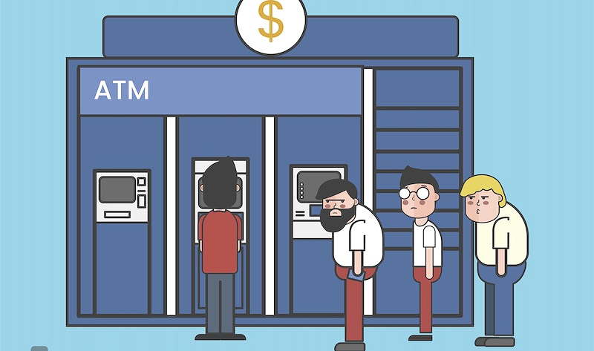
Cash Withdrawals

Slide 15
What challenges does cash present for cybercriminals?
DISCUSSION:
What do YOU think?

Slide 16
Cash Withdrawal Typology
In some instances of cybercrime, such as payment card-related crime, crime proceeds are immediately withdrawn in cash.
In other instances, crime proceeds from other types of crime are transferred to mule accounts, from which they are withdrawn.
Cash it typically re-introduced to the financial system through a variety of techniques such as:
  Purchase of pre-paid cards of various types (e.g. store credit, mobile phone credit).
  The use of money mules or compromised bank accounts.

Slide 17
Identification of Cash Withdrawals
DISCUSSION:
What sources of evidence can be used to indicate the use of cash withdrawals?
What procedural powers are available/relevant to the identification/use of cash withdrawals?

Slide 18

Internet Payment Services

Slide 19
What is an Internet Payment Service?
DISCUSSION:
What do YOU think?

Slide 20
Internet Payment Service Typology
Criminally obtained funds are transferred to an Internet Payment Service account.
Two options:
  The Internet Payment Service offers services similar to an online bank account, in which case typologies similar to “wire transfer/bank account creation or takeover” are used.
  Funds held with the Internet Payment Service are used to purchase products and services on the Internet.

Slide 21
Identification of
Internet Payment Services
DISCUSSION:
What sources of evidence can be used to indicate the use of Internet Payment Services?
What procedural powers are available/relevant to the identification/use of Internet payment services?

Slide 22
Freezing, Seizing and Confiscation of funds from Internet Payment Services
DISCUSSION:
What procedural powers are available/relevant to the freezing, seizing and confiscation of funds held by an Internet payment service provider?

Slide 23

Questions

