Slide 1



CyberEast Project:
Action on Cybercrime for Cyber Resilience in the Eastern Partnership Region
First Responder Training for Investigators
on Cybercrime and Electronic Evidence
LEPL Academy of the Ministry of Finance of Georgia
Notes:
Added for opening of course

Slide 2
Session Objectives
At the end of this session participants will be able to:
Discuss the authorities and its permission in the process of search and seizing electronic evidence.
Complete effective preparation and planning the search and seizing electronic evidence.

Slide 3
Evidence Gathering Aim
After the seizing of evidence, the prosecutor should show to the court that the evidence produced is,
no more and no less
than it was first taken into possession.
Notes:
Any person investigating criminal or other types of activities that may lead to judicial proceedings, should be aware of and consider as potential evidence, devices and equipment that may be related to electronic information, such as devices, equipment, software, hardware, or other technology that can function independently, together with, or attached to traditional computer systems. These items may be used to improve the user’s access to and expand the functionality of the computer system, the device itself, or other equipment that may or may not be present in sight of the investigator.

Slide 4
Principle 1 – Data Integrity
No action taken should change electronic devices or media, which may subsequently be relied upon in court.
When handling electronic devices and data, they must not be changed, either in relation to hardware or software.
There are circumstances where a decision will be made to access the data on a “live” computer system to avoid the loss of potential evidence.
Notes:
The person in charge is responsible for the integrity of the material recovered from the scene and thus for commencing a forensic chain of custody.
This must be undertaken in a manner, which causes the least impact on the data and by a person qualified to do so. Principles 2 to 5 should be taken into account if this course of action is found necessary.

Slide 5
Principle 2 – Audit Trail
An audit trail or other record of all actions taken when handling electronic evidence should be created and preserved. An independent third party should be able to examine those actions and achieve the same result.
It is imperative to accurately record all activities to enable a third party to reconstruct the first responder’s actions at the scene in order to ensure probative value in court. All activity relating to the seizure, access, storage or transfer of electronic evidence must be fully documented, preserved and available for review.

Slide 6
Principle 3 – Specialist Support
If it is assumed that electronic evidence may be found in the course of an operation, the person in charge should notify specialists/external advisers in time.
For investigations involving search and seizure of electronic evidence it may be necessary to consult external specialists. All external specialists should be familiar with the principles laid down in this or similar relevant documents. A specialist should have:
  Necessary specialist expertise and experience in the field,
  Necessary investigative knowledge,
  Necessary knowledge of the matter at hand,
  Necessary legal knowledge,
  Appropriate communication skills (for both oral and written explanations),
  Necessary appropriate language skills.

Slide 7
Principle 4 – Appropriate Training
First responders must be appropriately trained to be able to search for and seize electronic evidence if no experts are available at the scene.
In exceptional circumstances where it is necessary that a first responder collects electronic evidence and/or access original data held on an electronic device or digital storage media, the first responder must be trained to do it properly and to explain the relevance and implications of his/her actions.

Slide 8
Principle 5 - Legality
The person and agency in charge of the case are responsible for ensuring that the law, the general forensic and procedural principles, and the above listed principles are adhered to. This applies to the possession of and access to electronic evidence.
One of the internationally important legal documents, the Convention on Cybercrime by the Council of Europe, is currently open for signature by the Member States and the states, which have participated in its elaboration, and for accession by other states.
The principles lay the foundation for the information that is provided in the following chapters and should be considered at all stages of dealing with potential sources of electronic evidence.
Notes:
- Each Member State should take its own legal documents and regulations into consideration when interpreting the measures proposed in this document

Slide 9
First Responder
Responsible for the process of search and seizing.
Responsible for obtaining the appropriate search warrant and having in place all necessary authorities before starting the search and seizing process.
Makes decision about the methods of collecting or seizing electronic evidences.
Responsible for securing the scene, documenting the scene and the storage of evidence.
Contd….

Slide 10
First Responder Contd…
Responsible for the actions that could change the evidence.
Responsible for the state of the electronic evidence.
Responsible for identification of the all possible storage of electronic evidence.
Responsible for the activities for prevention of altering or losing the electronic evidence.

Slide 11
Investigation
Before starting the planning and preparing for a search, we should first complete the profile of the suspect and make an analysis of the situation by answering of the following questions:
Who? Who we are looking for?
What? What is the offence and what we are looking for?
Where? Where is the search taking place and what location is it?
When? When is the search planed and when should we plan it?
How? How are we going there and how are we going to perform the search?
The answers of those question give us a full picture of the situation and based on the answers we are planning our activities.

Slide 12


Exercise Q&A
From your experience, where can we search for information about a suspect person?

Slide 13
Open source suspect’s information gathering
Closed Source
Information from the ISPs or hosting companies about the suspects, we can realise that this information alone may not be sufficient to identify the suspect. We will try to find and gather more information.
Different ways to gather information. It is very useful to check the suspect’s records on our Police Databases since he/she might be known for similar offences.
but another option is to check
Open source databases: Internet.

Slide 14
Capturing
Evidence
from
the
Internet

Slide 15
Capturing Evidence on the Internet
Acquisition of evidence from publicly available information on the Internet.
Evidence from covert Internet investigations.
  requires different knowledge and skill sets;
  requires legislation and procedures.

Slide 16
Capturing Evidence on the Internet
Evidence “Mashup”
  combination
  visualization
  aggregation
All of this “Online Evidence” requires special procedures on acquisition to guarantee the admissibility of the resulting evidence.
  Not all the online information can be evidence!
Notes:
Consider a web service that stores raw data on Amazon S3, uses Facebook authentication, payments through PayPal and provides real-time “push” information on relevant activity through Twitter to its subscribed users

Slide 17
IP for Internet Protocol
The Internet Protocol (IP) is responsible for routing packets of data from the source to the destination, where both, source and destination are hosts identified by fixed length addresses.
The format of an IPv4 address is a 32-bit numeric address written as four numbers separated by periods. Each number can be 0 to 255. An example of an IP address is: 68.160.10.240
An IPv6 address consists of eight groups of four hexadecimal digits. Each group is separated by a colon (i.e. 2001:0db8:85a3:0042:0000:8a2e:0370:7334).

Slide 18
IP for Internet Protocol
The Internet Assigned Numbers Authority (IANA) regulates these IP addresses.
Among other things, its purpose is to coordinate IP addressing through regional entities located around the world known as Regional Internet Registries (RIR):
RIPE (Europe and some parts of Asia)
APNIC (Asia, and the Pacific Region)
ARIN (North America)
LACNIC (Latin America and the Caribbean)
AfriNIC (Africa)

Slide 19
IP for Internet Protocol
Role of the Internet service provider
  Range of IP addresses
  DHCP
Difference between dynamic and static IP addresses
10.0.0.0 to 10.255.255.255 – Class A
172.16.0.0 to 172.31.255.255 – Class B
192.168.0.0 to 192.168.255.255 – Class C

Slide 20
DNS for Domain Name System
The domain names are managed by Registrars that need to be accredited by the
  Internet Corporation for Assigned Names and Numbers (ICANN; http://www.icann.org/)
  Registries listed by IANA (Internet Assigned Numbers Authority).
  Generic Top Level Domains (gTLDs) such as .com, .net, .org, .biz, etc the ICANN accredits Registrars.
  Country Code Top Level Domains (ccTLFDs) like .us, .uk, .de, .ie, etc. IANA delegates the registration.
If a domain name is not registered by a privacy protection company these Registries can store valuable information about the owner of a domain name.

Slide 21
URI for Uniform Resource Identifier
The World Wide Web (WWW) is a system of linked documents that can be accessed through the Internet.
These documents are not regular text documents but hypertext ones, known as Web Pages.
Hypertext makes it possible to link documents that can be stored in different computers around the world.
Web pages are usually written in what is known as HTML code and may contain different types of information.
Web pages are usually grouped on what is known as Websites.
structure of the URI : http://iptv.ge/en/tv/
structure of the URL : http://mof.ge/
Notes:
An example of some of the acronyms you'll hear are URIs and URLs. While they are used interchangeably, there are some subtle differences. For starters, URI stands for uniform resource identifier and URL stands for uniform resource locator.
Most of the confusion with these two is because they are related. You see, a URI can be a name, locator, or both for an online resource where a URL is just the locator. URLs are a subset of URIs. That means all URLs are URIs. It doesn't work the opposite way though.
Not all URIs are URLs because a URI could be a name instead of a locator. Here's an illustration of the difference between the two:
difference between a uri and a url
Your name could be a URI because it identifies you, but it couldn't be a URL because it doesn't help anyone find your location. On the other hand, your address is both a URI and a URL because it both identifies you and it provides a location for you.
In the web dev world, you might be trying to get different resources by name so you'll have different URIs that have distinct URLs. And that's how the confusion started. Now that you know the difference, hopefully it won't be as hard for you to figure out what you need and where to find it when people start talking about resources.
Remember, a URL is the locator of a resource. The URI is the identifier of the resource and it can just happen to be a locator. I hope this helped clear up some of the jargon we use!

Slide 22
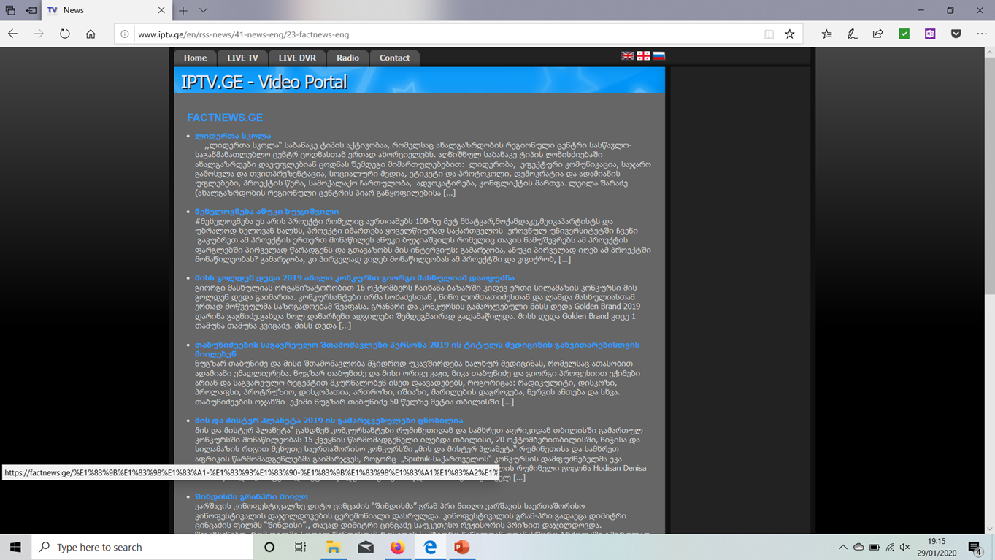
URI for Uniform Resource Identifier
Method - http
defines how to access resource
http://www.iptv.ge/en/rss-news/41-news-eng/23-factnews-eng
URI = http://iptv.ge/en/rss-news/41-news-eng/23-factnews-eng
Or
http://www.iptv.ge/en/rss-news/41-news-eng/23-factnews-eng
Notes:
Lets look at a full URI. A URI can be a name, locator, or both for an online resource where a URL is just the locator. URLs are a subset of URIs. That means all URLs are URIs. It doesn't work the opposite way though.
A URL is the locator of a resource. The URI is the identifier of the resource and it can be a locator.

Slide 23

URL for Uniform Resource Locator
http://iptv.ge will show in browser as http://www.iptv.ge or www.iptv.ge
Notes:
A URL is the locator of a resource, in the human world it is a name.
Consider finding a sentence in a book, Harry Potter and the Philosopher's Stone by Rowling, J. K.
Library, Book, ISBN no: 13: 9780747532743, Page 73, Paragraph 2, first sentence

Slide 24
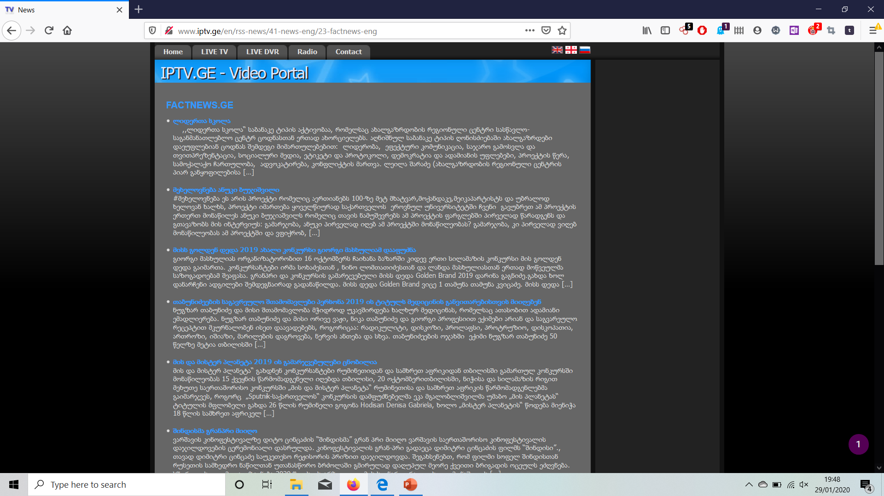
URN for Uniform Resource Name
http://www.iptv.ge/en/rss-news/41-news-eng/23-factnews-eng
Notes:
In this example this is the resource

Slide 25
Exercise
Look up the following URL
http://mof.ge/
Research the links to identify, URI, URL and resource.

Slide 26
IP & DNS records in online investigations
www.dnsstuff.com
www.domaintools.com
www.centralops.net
Whois Lookup
Reverse Whois
IP Lookup
DNS records can change from time to time
available information associated to a given IP address
  who the Registrar is;
  Country, Reverse DNS and IP block range it belongs to;
  country it is physically on;
  Geolocation (not always true) and provide;
  City, latitude and longitude.

Slide 27
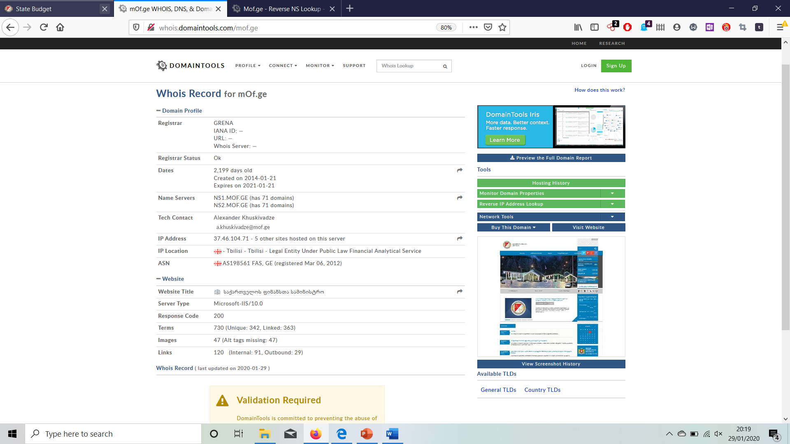

www.mof.ge
Technical contact:
Alexander Khuskivadze
a.khuskivadze@mof.ge
IP Address
37.46.104.71

Slide 28
National ISP’s
Gathering information from National ISP’s
Subscriber information (the registered owner of the connection, the connection address, billing information, telephone number, etc.).
Transactional information (connection times, connection dates, and IP address used).
Content (this is not always available), most ISP’s provide free mail accounts, different services. E-mail messages or other services can be obtained from ISPs.

Slide 29
International ISP’s
Information from ISP
  IP addresses;
  Location of First use;
  Location of last use;
  Logs of activities;
  Other;
  How we are obtaining this information?
    Budapest Convention for Cybercrime
    Using the Court order or MLA

Slide 30
Data held by third parties
Independent data holders.
Fostering cooperation between independent data holders and law enforcement.
Data preservation.
Receiving informational reports on cybercrime.

Slide 31
Online Sources of Information
Plain Web Site
  Source Code
  Code Comments
  Hidden Fields
  External site references
  Online Ads
  Domain Authentication Codes
  WebSense / AdSense / SearchSense Codes
  Metadata (ex. creation / last modification)
  Previous versions at archive.org

Slide 32
Online Sources of Information
Social Networking Sites
  Source Code
  Internal IDs
  Chat Subsystem
  WebSense / AdSense / SearchSense Codes
  Metadata (ex. creation / last modification)

Slide 33
Online Sources of Information
Blogging Sites
  Internal IDs (blogID, userID, …)
  Domain Authentication Codes
  Mashup: Twitter
  Mashup: Facebook
  Mashup: Twitter
  Mashup: Picasa / Flickr
  Mashup: URL-Short URL
  Metadata (ex. creation / last modification)

Slide 34
Online Sources of Information
Social Networking Sites
  Internal IDs. These sites make extensive use of IDs to track everything (users, pictures, chats, sessions, groups, likes/dislikes, etc.) and these IDs relate most of the time to internal IDs available to the service provider.
  Chat. These sites usually offer chat services and those tend to provide information of great quality if processed adequately. The key element in all web-interactive elements the investigator will want to secure is to gather as much data as possible and not only the results which get finally rendered by the web browser.
Contd….
Notes:
Demonstrate https://www.facebook.com/4 https://www.facebook.com/zuck

Slide 35
Online Sources of Information
Social Networking Sites Contd…
  Pictures. Even though high profile sites have been introducing “cleaning” filters to uploaded pictures, the investigator may still come across some social sites and other types of web sites out there that directly publish uploaded pictures and extract all relevant EXIF metadata.

Slide 36

Facebook

Slide 37
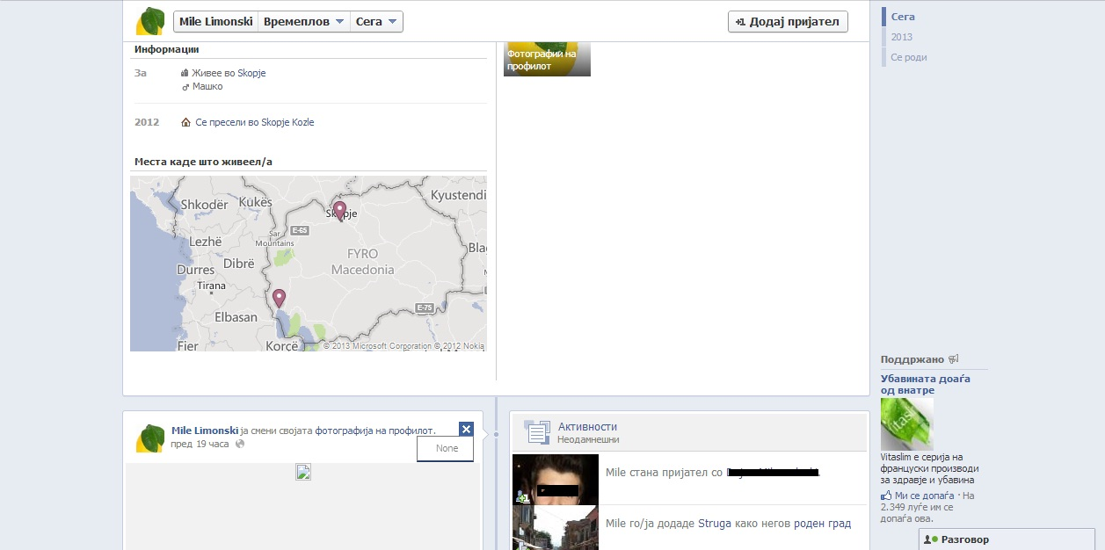
Facebook

Slide 38
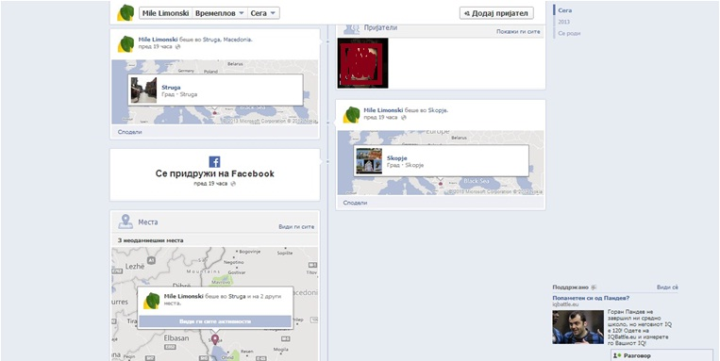
Facebook

Slide 39
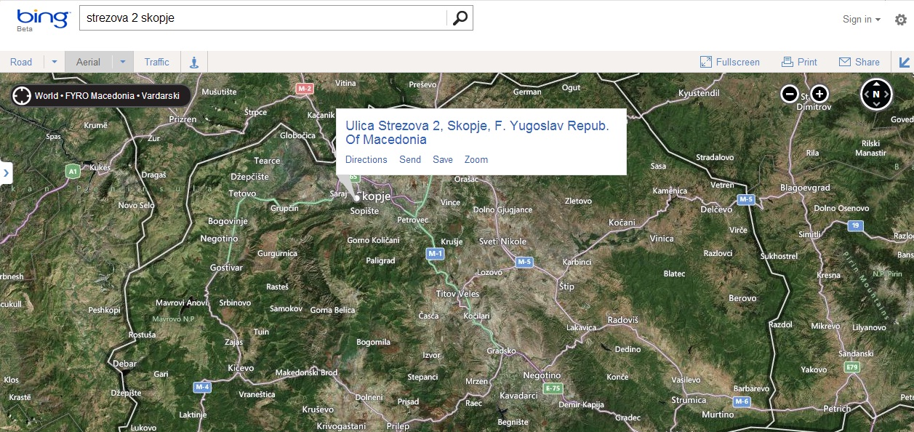
Bing maps

Slide 40
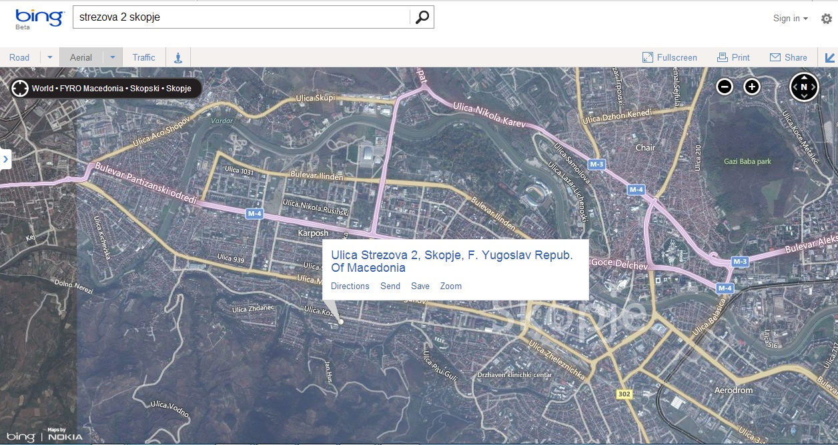
Bing maps

Slide 41
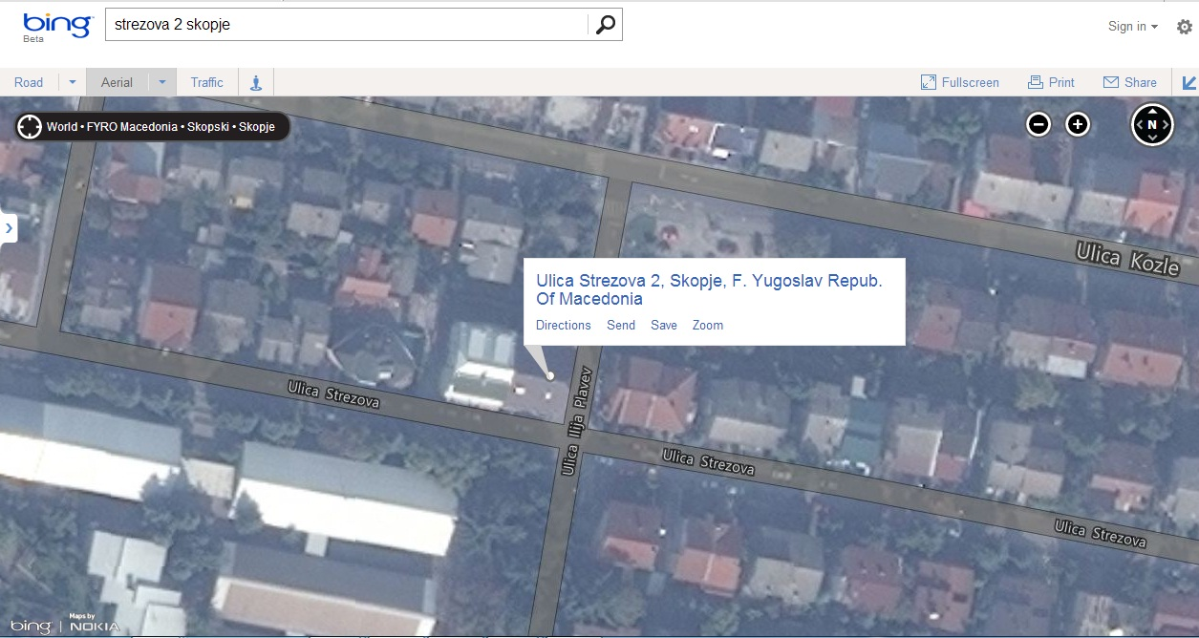
Bing maps

Slide 42
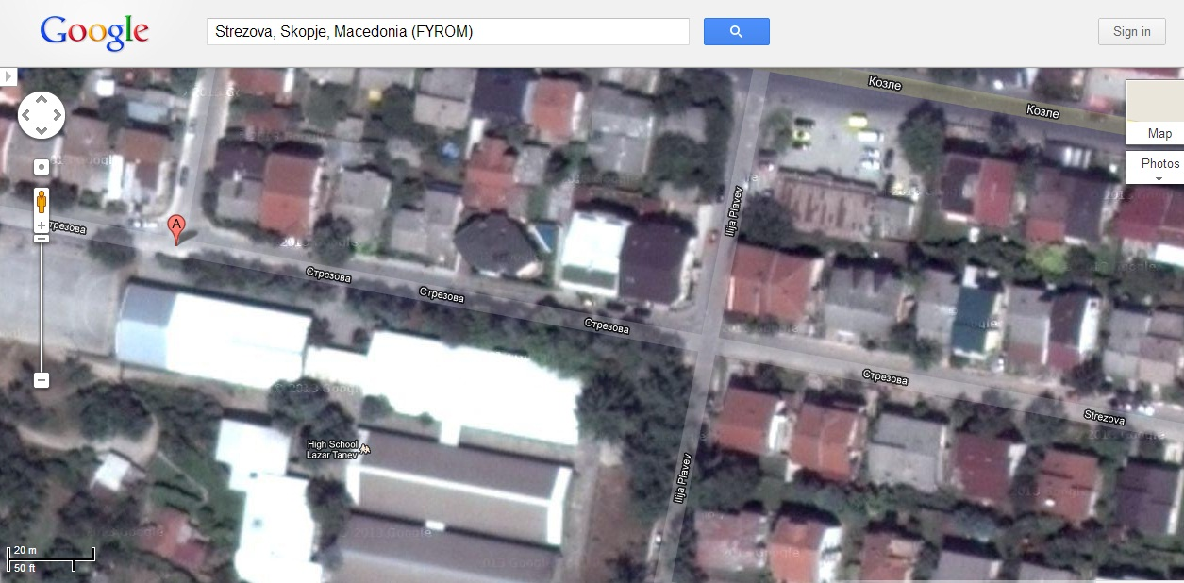
Google maps

Slide 43
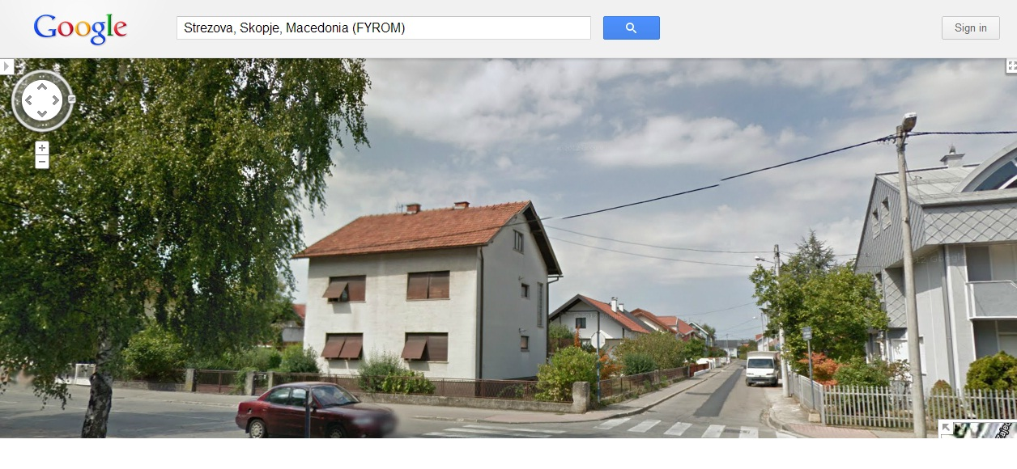
Street view

Slide 44
Preparation
and
planning

Slide 45
Exercise
From your experience, how would you prioritise the following in order to preserve computer based evidence:
- Record everything that is done to the electronic evidence.
Ask the suspect to search the information that you are looking on his computer.
Ask the suspect to close the computer system down for you.
Make sure that all the work is done by qualified personnel.
Try to not take any unnecessary activities on the computer.
Notes:
Q&A

Slide 46
Things to consider
A system with potential evidence on it must be protected from alteration, potential evidence cannot be changed.
Are there exceptional circumstances which require action other than standard seizing procedure.
Are there some time limitation of the process.
Are there some obstacles or possible appearing limitation of the process.

Slide 47
Overall Methodology
Pre-search planning.
Search information in National databases.
Open source intelligence.
On side observation and analysis.
Implementation of data captures procedures.
Securing data capture for authentication purposes.
Compile an Audit trail of decision and actions.

Slide 48
Operation plan
Prepare an Operation plan during the preparation process in the office.
Description of the nature of the crime.
Description of the role of the electronic evidence in the crime.
Description of the responsibility for each person (task list).
Description of the way of handling the electronic evidence.
Description of the limits of the search and seizing.
Prepare for the unexpected situation !

Slide 49
Planning
Based on the information that we have about the suspect, we plan and decide when the search will start.
Briefing and delivering of responsibility:
  Search team
  Forensic team

Slide 50
Planning
Search team gets responsibility of:
obtaining the relevant court order (Search Warrant) for entering, search and examination of equipment found in the apartment;
entering and searching computer and storage that has evidence, secure them from being altered or damaged;
identification of the storage media;
containment and securing the electronic environment;
searching persons present and seizing items found;
complete the necessary documentation;
report of every step and every situation during the entering and search of the apartment;
arrest the person.

Slide 51
Planning
The forensics team has a responsibility to prepare all necessary equipment and tools for reporting the computer state and perform live data forensics, that cover:
  Tools media – CD, USB, Laptops computers.
  Live CD for live data forensic and empty USB for the information from the live forensics.
  USB for dump of the RAM memory of the computer.
  Hot plug supplier (for permanent supplying of power in the case of encrypted computer).
  Storage media (must be clean and `sterilized` devices).
The forensic team is responsible for defining a procedure of examination and also testing all of the tools that we are planning to use and they must be prepared on the clean and secure storage.

Slide 52
Preparation and planning
Careful preparation and planning for an activity is essential and should take into account a range of considerations including those that follow:
Where is the data hosted?
How sophisticated is the suspect?
Are there alternative sources for obtaining the same evidence, complementary sources to strengthen the evidence?
Tactical decision to recover data from the suspect or the alternative data holder

Slide 53
Preparation and planning
Where is the data hosted?
It is not unusual for data to be hosted in a location other than where the equipment is present. It is necessary to consider where data that is of interest, may be stored. The reasons for this are that:
access to the data may require additional legal authority, especially if it is stored in a different jurisdiction.
additional technical requirements may be necessary to ensure the integrity of the evidence is maintained and this can be proved.

Slide 54
Preparation and planning
How sophisticated is the suspect?
gather as much intelligence about that person, his capabilities and skills;
usage of encryption software;
usage of remote storage;
gather intelligence about his usual internet activities.
Notes:
Is the suspect the target of the planned activity? If so, it is necessary to gather as much intelligence about that person and their capabilities as possible, as they may have implemented procedures that may interfere with the seizure of equipment or the capture of data. For example, they may have all their data storage devices encrypted or set single key data wiping on their computers. If this is the case, it will be necessary to act in such a manner as to negate the impact of these facilities. The suspect may also store data that may be evidence in the cloud or in some other online resource, so that no data is stored on their equipment.

Slide 55
Preparation and planning
Are there alternative sources for obtaining the same evidence, complementary sources to strengthen the evidence?
Consider if there are other sources of evidence
  Other party to an online transaction such as an exchange of email;
  Third party data holder such as an Internet Service Provider (ISP);
  Online service provider;
  Use of the cloud, the same data may be recoverable from such a third party source.
Notes:
Before embarking on activities that may involve direct contact with a suspect and seizure of their equipment and capture of their data, the planning phase should consider if there are other sources from which the same information may be obtained, for example the other party to an online transaction such as an exchange of email, or a third party data holder such as an Internet Service Provider (ISP) or an online service provider. With greater use of the cloud, the same data may be recoverable from such a third party source.

Slide 56
Preparation and planning
Tactical decision to recover data from the suspect or the alternative data holder:
- Consider obtaining the data/evidence from third parties;
- Legal procedures for recovering data;
- Consideration which sources of evidence is important for the investigation.
Notes:
Having established that there may be sources other than the suspect, from which data may be recovered, it is necessary to decide whether to approach the third party or the suspect. In some jurisdictions, third parties are required by law to notify their customer of any request for data access and this may alert a suspect. Other considerations may include whether the legal procedure for recovering data from third parties, especially if they are abroad, would impact on the effectiveness of an investigation; and whether a delay in approaching the suspect may also negatively affect an investigation. It is also important to consider which source of evidence is the best for the purpose of the investigation and which is most likely to support any legal proceedings that may be taken.

Slide 57
What authority do you need?
Authority that will be needed for the activity to take place.
  person fully understands the implications of giving consent;
  national legislation through to judicial orders and warrants.
Other levels of authority will depend on whether the matter under investigation is a civil or criminal matter and whether those seeking authority are from law enforcement or prosecution services, civil investigators or lawyers acting for clients or other categories in both types of proceedings.
  No activity for the seizure of equipment or the capture of data should be undertaken without the correct level of authority being obtained in advance of the activity.
Notes:
The first consideration in planning for any activity is to establish the authority that will be needed for the activity to take place. Authority may take a number of forms. The simplest of these is where consent is obtained from the person in charge of the equipment and/or the data to be captured. This should always be obtained in writing while ensuring that the person fully understands the implications of giving consent, although national legislation and customs have to be taken into consideration.
Other levels of authority will depend on whether the matter under investigation is a civil or criminal matter and whether those seeking authority are from law enforcement or prosecution services, civil investigators or lawyers acting for clients or other categories in both types of proceedings. The levels of authority required will vary from those able to be given by individuals according to legislation through to judicial orders and warrants.
No activity for the seizure of equipment or the capture of data should be undertaken without the correct level of authority being obtained in advance of the activity.

Slide 58
Session Objectives
At the end of this session participants will be able to:
  Discuss the authorities and its permission in the process of search and seizing electronic evidence.
  Complete effective preparation and planning the search and seizing electronic evidence.

Slide 59

Questions

Slide 60

Exercise
Why use external specialist witnesses in investigations?
What roles can they undertake?
As the case officer what would be your role and responsibility.

Slide 61
Digital forensics specialist witnesses
Specialist expertise
This is the skill or competence to do a particular job, to include such issues as:
The individual’s relevant qualifications.
The skill of the person at this particular job.
The specific skills that he or she has.
Whether the skill is based on technical qualifications or length of experience, or both.
Notes:
The investigator or the prosecutor may need to retain a forensic specialist during an investigation. This may be necessary because a specific type of specialism is required, for example knowledge of a particular operating system or Internet application.
The key question to be answered in selecting a witness is whether they have the required knowledge that has been acquired by study or experience to render their opinion of value in resolving the issues.
Some form of accreditation can be helpful, because it enhances the credibility of forensic witnesses called by both the prosecution and the defense, as well as providing an objective and independent assessment of the credentials of the experts that the court will rely on.
Early consultation between the investigating officers, the forensic witness and the prosecutor is essential for a successful investigation and prosecution. Police and prosecutors should ensure that the forensic examiner is given clear instructions. Investigators must provide detailed and proper schedules.
The selection of external consulting witnesses, particularly in the more unusual or highly technical areas, can be a problem for the investigator. The process of selection should not be haphazard, but active and structured from the start. Computer crime units may be able to offer more advice on the criteria for selection.
The following guidance should be included when making a selection and the following areas are considered to be the foundation of independent consulting witness skills.

Slide 62
Digital forensics specialist witnesses
Specialist experience
The nature of the experience of this type of work the individual has.
  The number of cases he or she been involved with.
  The type of cases the individual was involved with.
  The length of time the individual has been working in this area.
  Evidence to prove their experience.

Slide 63
Digital forensics specialist witnesses
Investigative knowledge
Understanding the nature of investigations in terms of confidentiality, relevance and the distinction between:
  Information
  Intelligence
  Evidence

Slide 64
Digital forensics specialist witnesses
Contextual knowledge
Understanding the different approaches, language, philosophies, practices and roles of the police, the law, and the technical knowledge of Information.
Technology is essential to guarantee the viability of electronic evidence at Court. Fundamental to this is the understanding of probability in its broadest sense and differences between scientific proof and legal proof.

Slide 65
Digital forensics specialist witnesses
Legal knowledge
Understanding of relevant aspects of law such as legal concepts and procedures in relation to:
Statements;
Continuity;
Court procedures;
A clear understanding of the roles and responsibilities of the expert witness is essential.

Slide 66
Digital forensics specialist witnesses
Communication skills
The ability to express and explain in ordinary language, both verbally and in writing:-
  Nature of specialism;
  Techniques and equipment used;
  Methods of interpretation;
  Strengths and weaknesses of evidence;
  Alternative explanations.

Slide 67
Digital forensics specialist witnesses
General
Cleared to appropriate security level to handle the evidential material.
Made aware of any relevant Child Abuse Images guidelines.
Made aware of the effect on members of staff of such material and risk assess appropriately.
Ensured that the specialist has no conflict of interest.

Slide 68
Session Objectives
This session has provided participants with a knowledge of:
The role of the external specialist witnesses.
The skills required by an external witness.
The responsibilities of the Officer in Charge when deploying an external specialist as a witnesses.

Slide 69
Questions

