Slide 1



CyberEast Project:
Action on Cybercrime for Cyber Resilience in the Eastern Partnership Region
First Responder Training for Investigators
on Cybercrime and Electronic Evidence
LEPL Academy of the Ministry of Finance of Georgia
Notes:
Added for opening of course

Slide 2
Session Objectives
At the end of this session participants will be able to:
Identify sources of electronic evidence based on shown scenarios
Describe Standard Operation Procedures for packaging, transport and storage of electronic evidence
Differentiate different SOPs based on the type of the device
Discuss techniques to check the power status of a computer system
Apply general seizure instructions for electronic devices

Slide 3
Handling
of
Electronic
Evidence

Slide 4
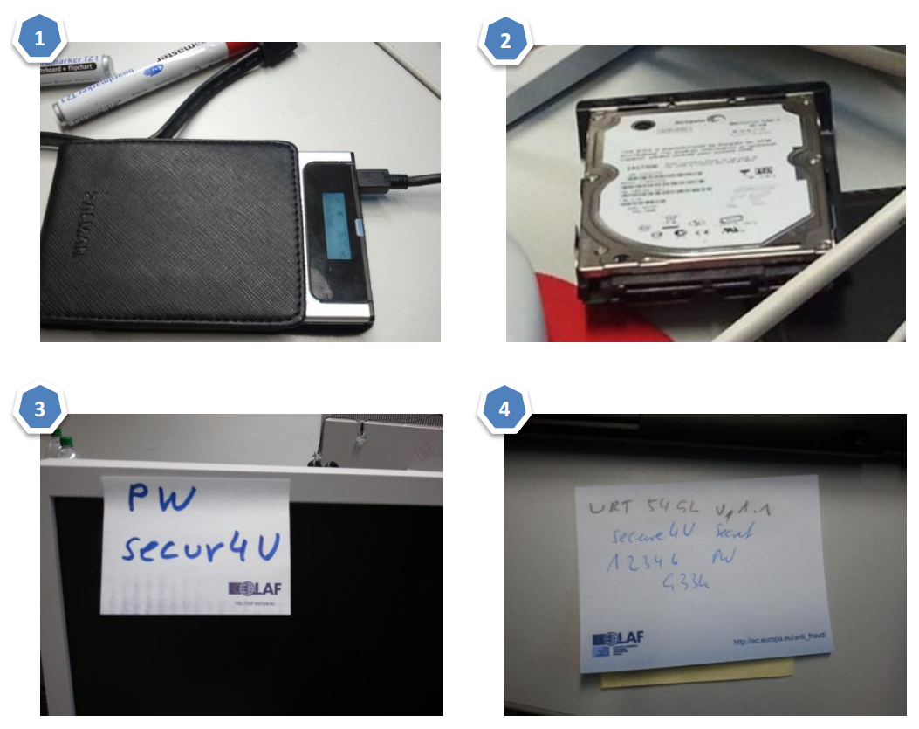
Handling of Electronic Evidence
Electronic evidence must be handled carefully and in a manner that preserves its evidential value.
Certain types of e-evidence require special collection, packaging, and transportation.
Do not forget traditional
evidence: fingerprints, DNA,
written notes, printouts, etc..

Slide 5
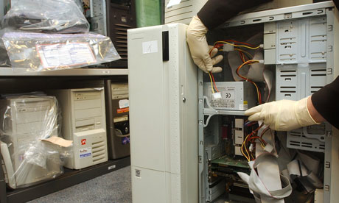
Tagging
Tag all devices and cable connections
Do not affix adhesive labels on the surface of storage media. Use boxes, bags and envelopes for packaging and tagging of storage media

Slide 6
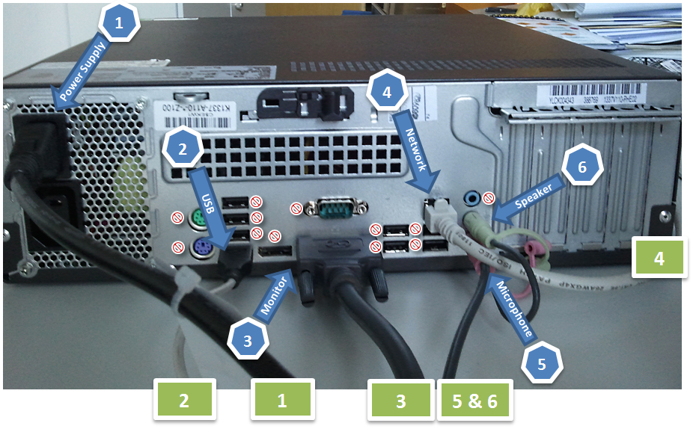

Slide 7
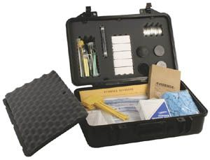
Packaging and Transport
Electronic Evidence can be sensitive to temperature, humidity, physical shock, static electricity, magnetic sources, and even to some actions (e.g., switching on/off).
E-Evidence must be handled with care and appropriate bags und boxes must be used to seize the devices.

Slide 8
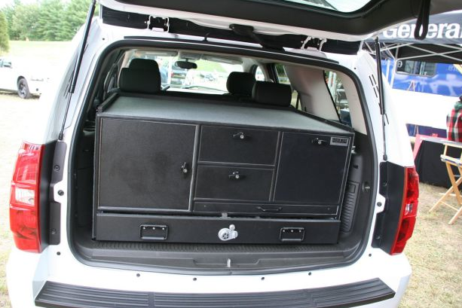
Transport
Keep electronic evidence away from magnetic sources (e.g. Radio transmitters, speaker magnets, heated seats)
  Ensure that the equipment is protected from shock and bumps (i.e., mechanical damage), heat, and humidity.

Slide 9
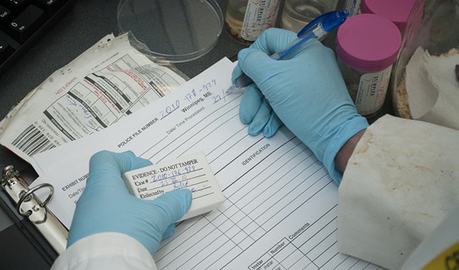
Storage
  Ensure that evidence is inventoried in accordance with the relevant policies.
  Store evidence in a secure area, away from extreme temperature and humidity.
  Protect it from magnetic sources, moisture, dust, and other harmful particles or contaminants.

Slide 10
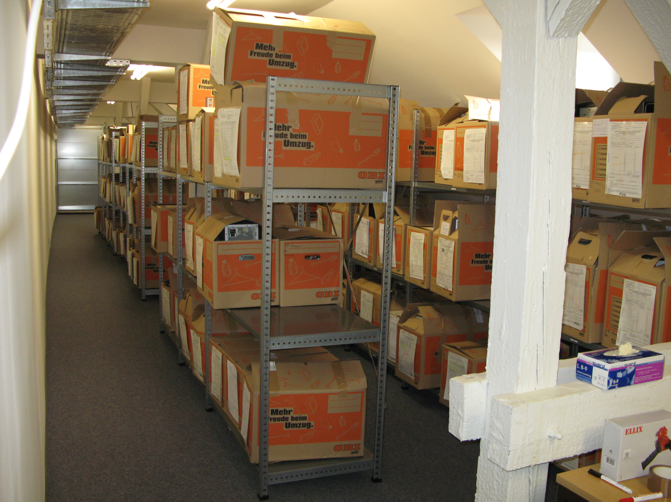
Storage facilities
  Use an adequately secure store
  room with appropriate
  access control,
  fire protection (e.g., alarm, fire extinguishers, no smoking in the storage area or in the vicinity),
  temperature and humidity, and
  protection from magnetic sources (e.g., far from directional radio devices).

Slide 11
Seizing
Electronic
Evidence

Slide 12
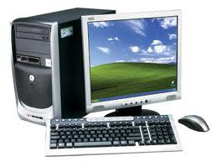
Computer Systems
Computer Systems consist of:
a main unit,
a monitor,
a keyboard,
a mouse,
cables,
power supply units (e.g., power packs, and spare batteries),
possibly additional components and
network devices

Slide 13
Computer Systems
When seizing a computer system
Observe the computer system and determine whether it is on or off
Document the computer system, all connections and the scene continuously and record all actions you take and any changes that you observe in the monitor, computer, printer, or other devices as a result of your actions a monitor,
Do not follow any unverified advice from a potential suspect.
If a computer network is encountered, contact a forensic computer specialist in your agency or an external expert identified by your agency for assistance.

Slide 14


Group Task
How to determine that a computer is on/off?
What to do when PC is OFF?
What should you be doing when the PC is ON?
  as First Responder
  as Forensic Specialist
20
Min

Slide 15
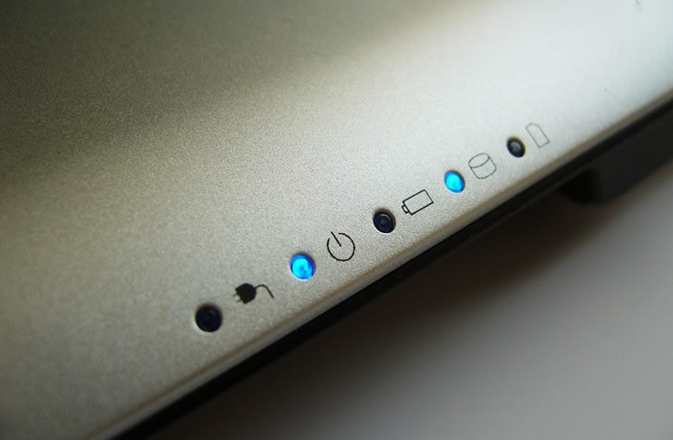
Checking the power status
Check for indicator lights
Check for noise
Check the temperature
Consider standby mode, especially for portable computers

Slide 17
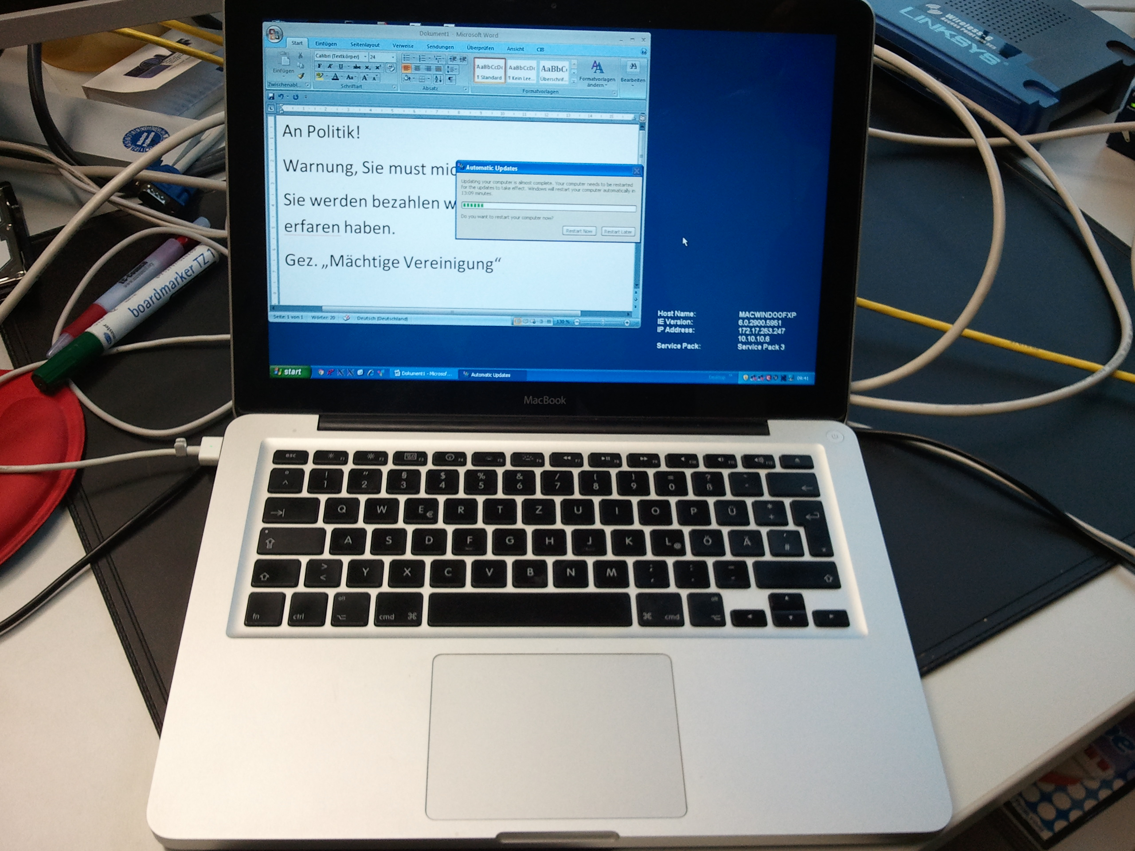
Observing the monitor
Situation 1:
Monitor is on and work product and/or desktop is visible.
  Document the details of the monitor at the time of intervention
  Proceed to “Situation B” on the next slides.

Slide 18
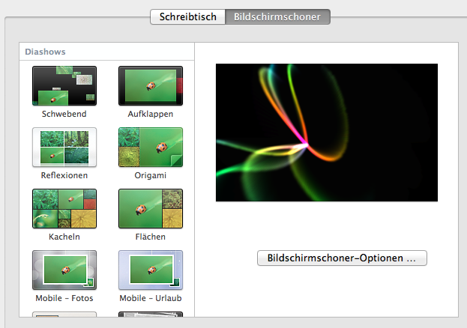
Observing the monitor
Situation 2:
Monitor is on and screen is blank (sleep mode) or screen saver (e.g., a picture) is visible.
  Move the mouse slightly (without pushing buttons). The screen should change and show work product or request a password.
  If mouse movement does not cause a change in the screen, do not perform any other keystrokes or mouse operations.
  Document the details of the monitor at the time of intervention
  Proceed to “Situation B” on the next slides.

Slide 19

Observing the monitor
Situation 3:
Monitor is off.
  Make a note of "off" status.
Turn the monitor on, then determine if the monitor status is as described in either Situation 1 or 2 above and follow those steps.

Slide 20

Situation A – Computer is Off
You have determined that system is
switched off; do not switch it on!
Remove the power supply cable from the target equipment (do not switch it off at the wall socket) and record the time of doing so.
If dealing with a portable device, also remove the battery pack.

Slide 21
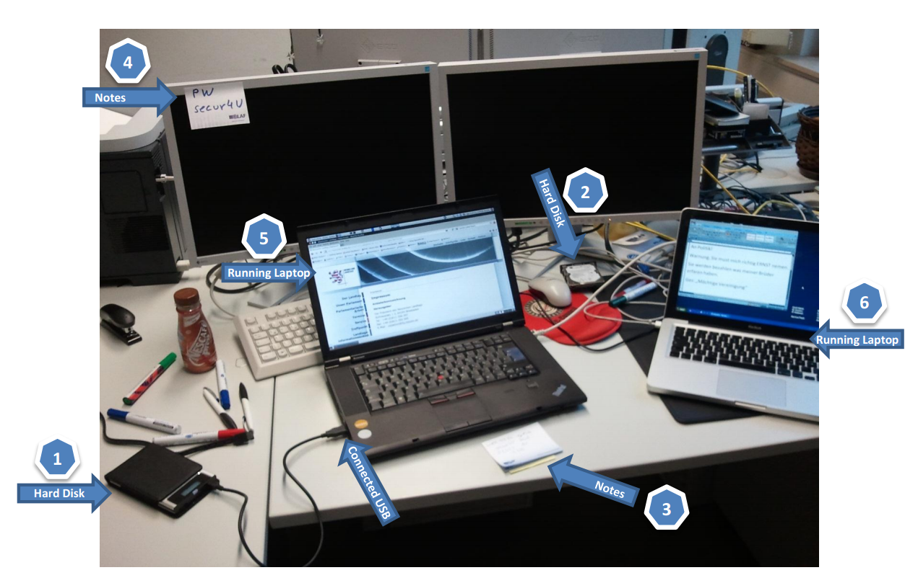
Situation B – Computer is On
You have determined that the system is switched on; do not switch it off!
Try to contact a specialist.
  If a specialist is available, follow their advice.
  If no specialist is available, continue with the next instruction.
Do not touch the keyboard or other input devices.
Proceed with steps described in in the “Live Data Part” of the presentation

Slide 22
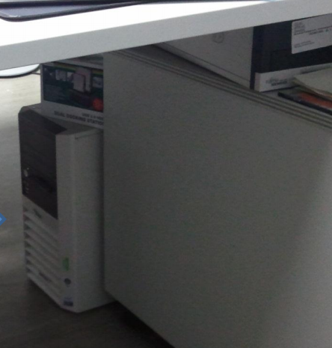
Situation C – You cannot determine
You cannot determine whether the system is switched on or off.
Assume that it is switched off. Do not press the switch.
Remove the power supply cable from the target equipment (do not switch it off at the wall socket) and record the time of doing so.
If dealing with a portable device, also remove the battery pack.

Slide 23
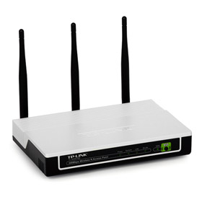
Computer Networks
If you encounter a computer network, contact a forensic computer specialist in your agency or an external specialist recommended by your agency for assistance.
Indications for networks:
  multiple computer systems
  network components (router, hubs, switches, etc.)
  network interface cards
  network cables
  antennas of Wi-Fi devices
  servers
Label all cables and devices and document the connections

Slide 24
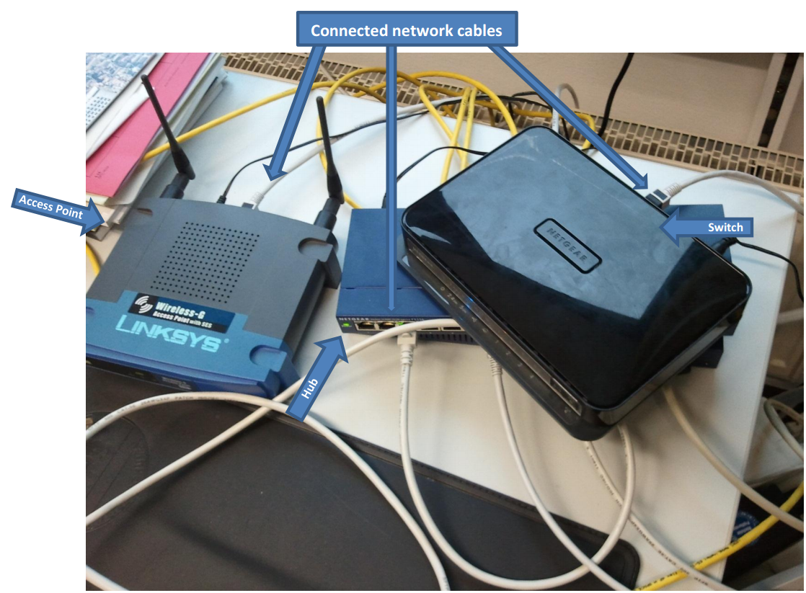

Slide 25
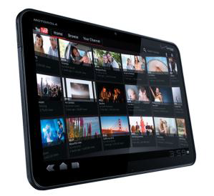
Mobile Phones / Tables
If powered on
  do not turn off the device
  document the screen
  if applicable turn device into flight-mode
  consider using a faraday bag
If powered off
  do not turn on the device
Search for further information regarding the device (manual, power supply, etc) and the SIM card (letter from telecom company, PIN, PUK, etc)

Slide 26
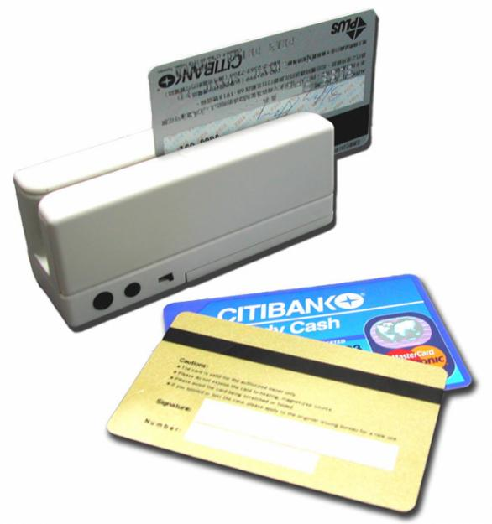
Smart / magnetic stripe cards
Do not fold the card.
Do not expose it to extreme temperatures.
Do not touch the electrical contact plate.
Protect from scratches, liquids, magnetic influences, etc..
Try to get hold of the PIN. Do not attempt to gain access to the data/functions on the card.
Photograph/note/copy the information from the imprint on the card body.
If applicable, seize smart card readers too.

Slide 27
Other electronic evidence
Seizure instructions for electronic evidence:
If the device is switched on, do not switch it off
  Photograph the display (if applicable) and record the information displayed.
  Remove all power supply cables.
  Do not try to access the internal memory or any storage media.
If it is switched off, do not switch it on
Collect/record important information
  Collect manuals and other instructions if available.
Record the relevant data (e.g., phone number).

Slide 28
Summary of Session Objectives
At the end of this session participants are able to:
Identify sources of electronic evidence based on shown scenarios
Describe Standard Operation Procedures for packaging, transport and storage of electronic evidence
Differentiate different SOPs based on the type of the device
Discuss techniques to check the power status of a computer system
Apply general seizure instructions for electronic devices

Slide 29

Questions

Slide 30
Live
Data
Forensics

Slide 31
Session Objectives
At the end of this session participants will be able to:
Define the terms “Volatile Data“, “Transient Data“ and “Live Data Forensics“
Explain the value of volatile data for investigations
List at least four types of data that would get lost without Live Data Forensics
Perform measures of first response when facing a running computer system.
Name at least four tools to acquire volatile data including Live Response and Boot-DVDs
Describe the challenges of encryption and the chances of Live Data Forensics in scenarios involving encryption
Discuss the challenges and different legal frameworks in scenarios where data is stored remotely, e.g. cloud services.
Define the term „Cloud Computing“
Compare at least three cloud services

Slide 32
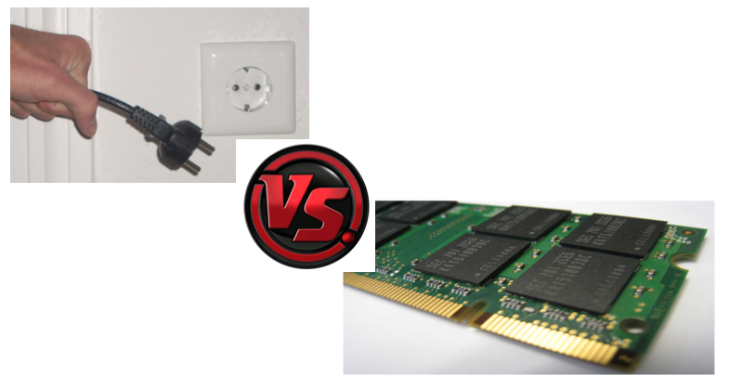
Notes:
Compared to

Slide 33
What is Live Data Forensics?
Live Data Forensics deals with situations where it is necessary to capture volatile data from devices before they are turned off or disconnected from networks or power supplies.
It requires a higher level of specialism than the procedure in the search and seizure of dead boxes because the possibility of altering or even overwriting evidence is very high.

Slide 34

What is volatile data?
Volatile Data is data, digitally stored in a way that the probability is very high for the contents to be deleted, overwritten or altered in a short amount of time by human or automated interaction.

Slide 35

Examples for volatile data?
Notes:
Board blast Q&A session or group task

Slide 36
Examples for volatile data
Caches (e.g. arp- and dns-caches)
Unsaved documents
Running processes
Passwords and encryption keys
Open network connections
System information
Logged in users
Temporarily connected remote storage
Malware binaries only stored in RAM

Slide 37

Two types of volatile data
Volatile Data on the Physical Computer like open network connections, running processes and services, arp- and dns caches.
Transient Data that are not volatile in their nature but are only accessible on scene. Encrypted volumes as well as remote resources are examples for this kind of data. The characteristic of these data is that the contents of the data might get inaccessible, altered or deleted after the search, if the investigator is not be able to acquire them.

Slide 38
Requirements
Requirements for Live Data Forensics:
Specialist with specific training for Live Data Forensics
Hands-on practical experience
A set of validated forensic tools for Live Data Forensics
If no specialist is available, pulling the plug makes more sense than tampering with the evidence resulting in a possible contamination of the evidence and making it unfeasible for use in court.

Slide 39
If you have
physical
access to
the data

Slide 40

First Responder
As a first responder you can protect volatile data by running the following steps:
Identify, secure, document, and photograph each device containing volatile data
Observe potential suspects and other persons to prevent them from altering or destroying the evidence
Preserve the running state by preventing screensaver, standby and sleep modes
Observe IT components to prevent altering or destroying the evidence.

Slide 41

Indications on the screen
Check the display screen for signs that digital evidence is being destroyed. E.g. "delete," "format," "remove," "copy," "move," "cut," or "wipe“
Document which windows are opened
Look for indications of encryption being used (see next slides).
Look for indications of cloud services being used (see next slides).
Look for signs of active or ongoing communications with other computers or users such as instant messaging windows or chat rooms.
Look for signs that cameras or Web cameras (Web cams) are active.

Slide 43
Let us
see some examples

Slide 44
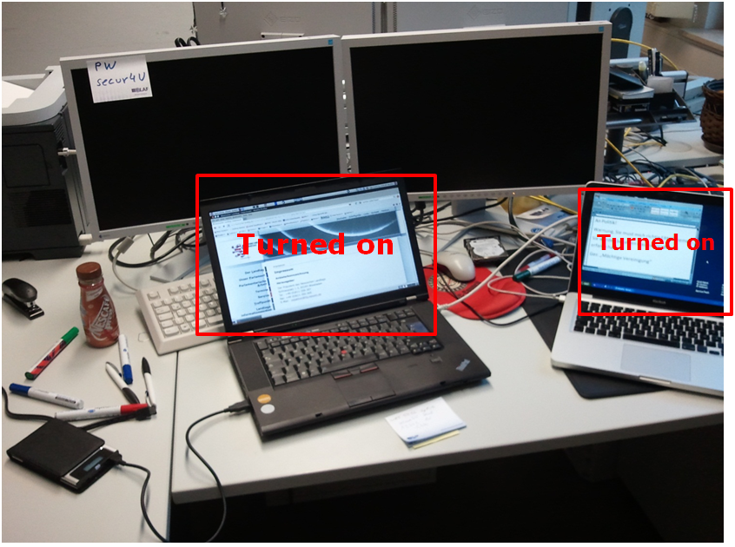

Slide 45
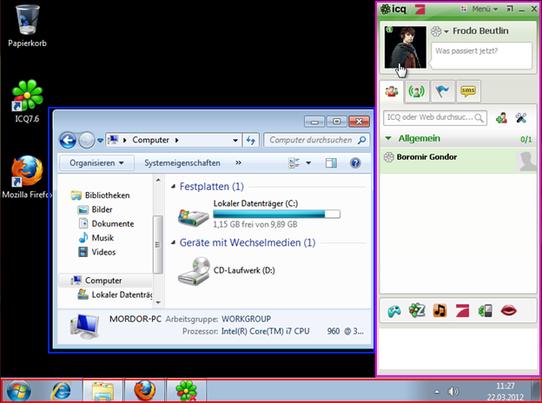

Slide 46
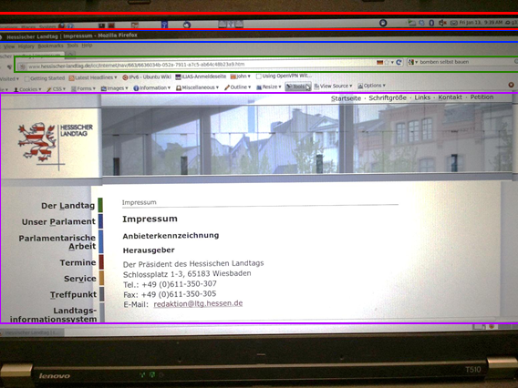

Slide 47
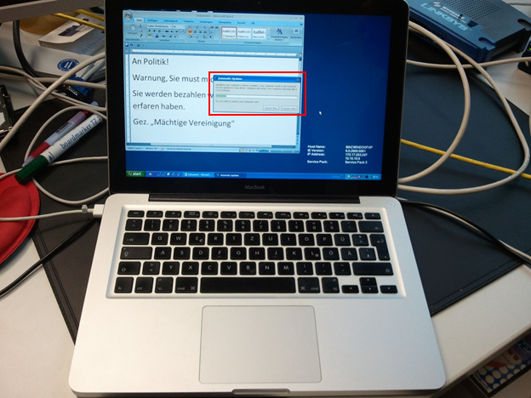
(Slide Heading)

Slide 48
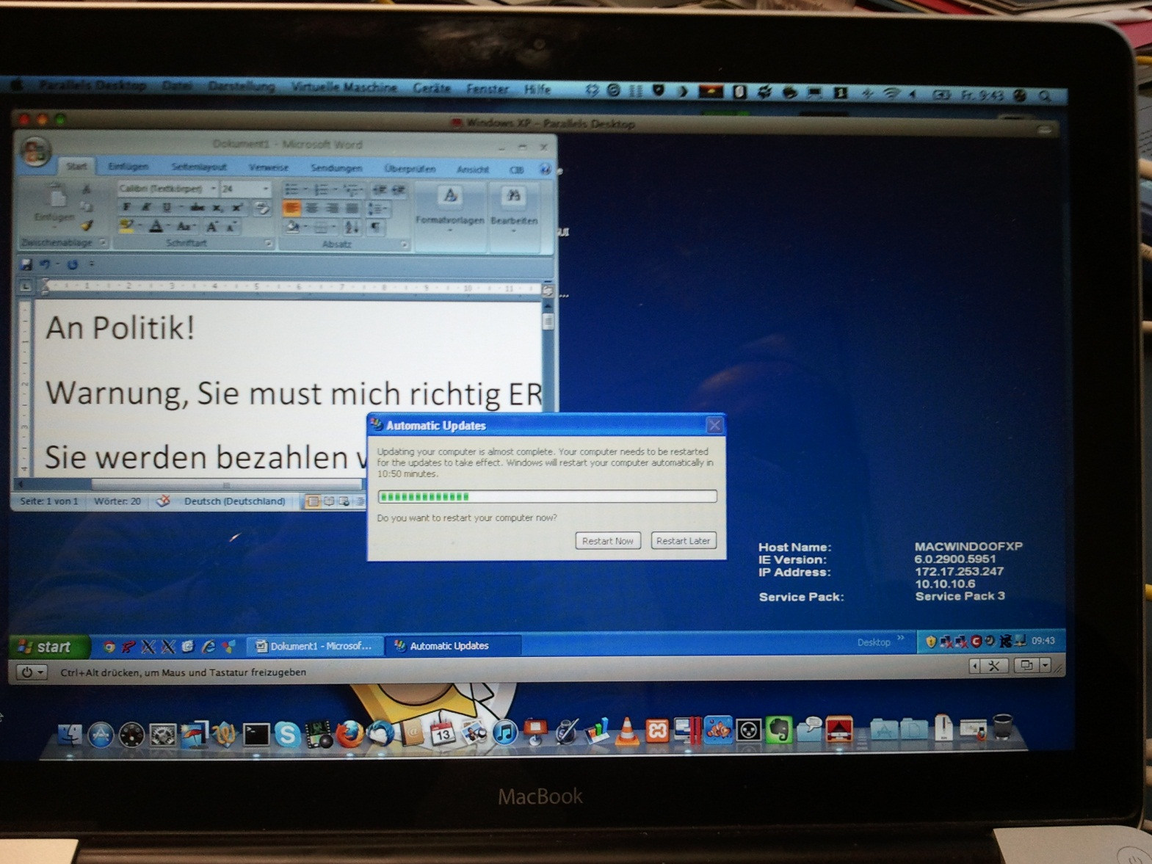
(Slide Heading)

Slide 49

Tools for more experienced users
When composing a set of live data forensics tools the investigator should consider:
Only select tools with the least impact on the system.
The tool should come with its’ own executable and libraries.
Only use tools and scripts whose functionality you can explain in court.
The tool/script should be automated.
Consider triage functionality for urgent cases or security incidents.
The tool should only gather data that are volatile.

Slide 50
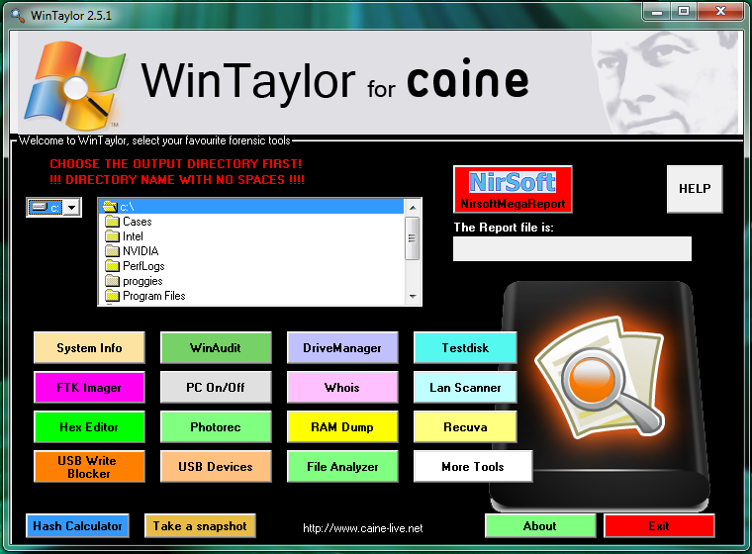
Live Forensics DVDs

Slide 51
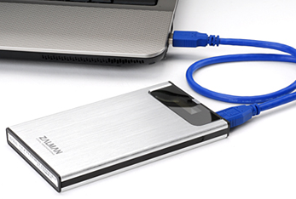
External storage media
USB Sticks: Very fast and reliable, big capacities needed as the amount of RAM is growing quickly
External Hard Disks: Whenever acquisition of a large amount of files is needed. Search for models with a range of possible connectors (USB/eSATA/FW).
Live DVDs: Ideal for live data forensics tools. The write protection of DVD-Rs protects the trusted binaries from being altered.
External HDDs with virtual DVDs:
Combine advantages of both: fast
accessible, reliable storage of external
hard-drive and write protection of DVD-Rom.

Slide 52



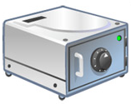

Encryption
Examples for encryption software:
Microsoft Bitlocker
TrueCrypt
Steganos Safe
PGP
FileVault
More: http://en.wikipedia.org/wiki/Comparison_of_disk_encryption_software

Slide 53
Remote
Storage

Slide 54
Remote Storage
Data is not always stored locally
Especially in companies you find data stored remotely in other offices, collocated at hosting companies, etc
It is important to acquire remotely stored data
Acquisition is dependent on your legislation

Slide 55
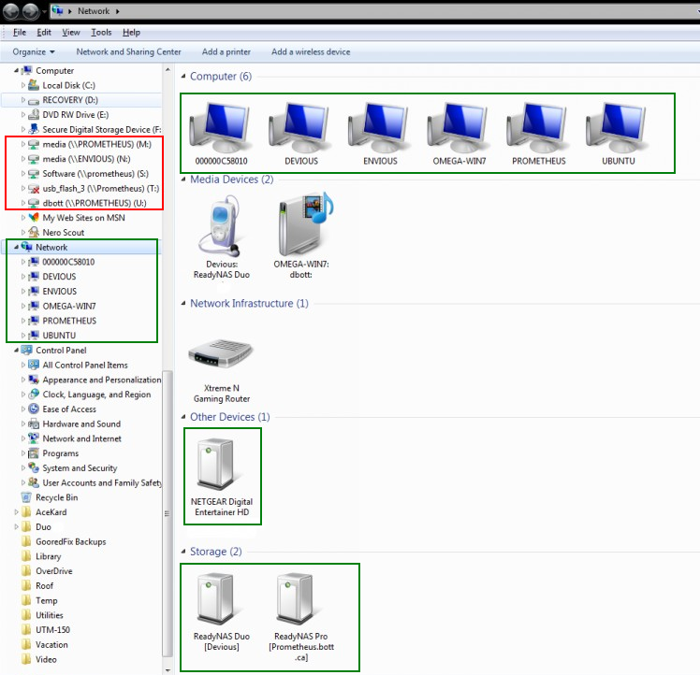
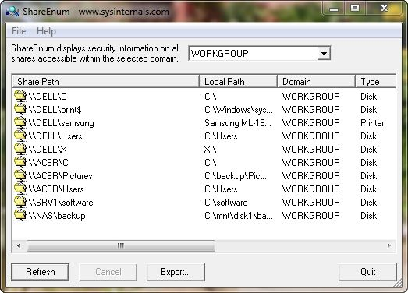
Examples of remote storage
Shared folders on other
network computers
Mapped network drives from
a server
E-Mails stored on an IMAP
or Exchange server
Cloud services and
online storage

Slide 56
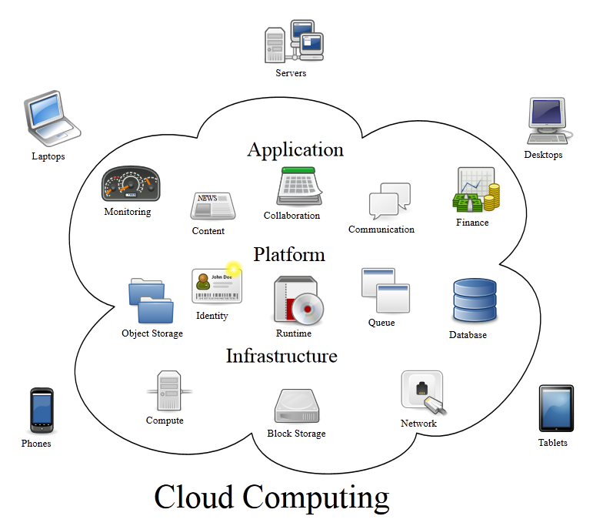
Data stored in the cloud
Source: Created by Sam Johnston, Wikipedia.com

Slide 57
Cloud computing
Cloud computing is a model for enabling ubiquitous, convenient, on-demand network access to a shared pool of configurable computing resources (e.g., networks, servers, storage, applications, and services) that can be rapidly provisioned and released with minimal management effort or service provider interaction.[…]
Source: Mell and Grance, NIST, 2011, http://csrc.nist.gov/publications/PubsSPs.html#800-145

Slide 58
Common cloud providers
More: http://en.wikipedia.org/wiki/Comparison_of_online_backup_services

Slide 59
What to do with remote storage?
Identification:
Tray icons
Control the installed software
Process list
Network shares and mapped network drives
Observe the network traffic
List open and listening sockets for suspicious activity.
Acquire any data that appears to be stored remotely.

Slide 60
Session Summary
At the end of this session participants are able to:
Define the terms “Volatile Data“, “Transient Data“ and “Live Data Forensics“;
Understand the value of volatile data for investigations and the types of data that would get lost without Live Data Forensics;
Perform measures of first response when facing a running computer system.
Understand the challenges of encryption and the chances of Live Data Forensics in scenarios involving encryption
Awareness of the challenges and different legal frameworks in scenarios where data is stored remotely, e.g. cloud services.
Define the term “Cloud Computing“ and identify cloud services.

Slide 61
Questions

