Slide 1
Introductory Cybercrime Training for Judges and Prosecutors
iPROCEEDS
Project on targeting crime proceeds on the Internet in South-eastern Europe and Turkey
Sessions 1.1.3
Introduction to technology
Notes:
Technology for Judges and Prosecutors
This session is intended to provide trainers with a framework for developing training material to be delivered as part of a wider programme. It cannot be comprehensive as technology changes so rapidly that any detailed technical specifications would be out of date almost as soon as the document is published. Ensuring that Judges and prosecutors have sufficient understanding of technical issues as they relate to matters before them is essential to the fair running of any judicial system. This session provides an overview of the relevant aspects of technology and its relevance to the criminal justice system. A PowerPoint presentation is provided as a resource for trainers to use if considered appropriate.
An additional resource in the form of the video clip Warriors of the Net is provided to give the delegates a good and clear understanding of how networks function. The video is available from www.warriorsofthe.net and is available in the following languages: English, German, French, Hebrew, Dutch, Swedish, Italian, Portuguese, Danish, Norwegian, Hungarian, Czech, Spanish and Ukranian.
This session provides information about technology that will be encountered by Judges and prosecutors during their work and which is used by criminals to commit crime and law enforcement to detect it.

Slide 2
Agenda
1.
The Internet
2.
Internet Services
3.
Internet Applications
4.
Internet Crimes
Notes:
Agenda
The agenda slides list the parts of the session and the trainer should go through these elaborating where necessary on specific aspects that have emphasis for particular groups of students. The trainer should explain how the materials will be delivered and that there will be time for interaction and questions. The trainer should emphasise that this training is designed to be interactive and that delegates will be expected to participate throughout. The trainer should explain whether there is an assessment and what form that would take, including details of any pass mark that is applied. (For this pilot programme, no assessment is included).

Slide 3
Agenda
Part One: How The Internet Works
    Typical Software
    Internet Basics
    The Internet – how it works
Part Two: Internet Services
    World Wide Web
    Domain Names and IP Addressing
    Traces
    E-Mail
Notes:
Agenda
The agenda slides list the parts of the session and the trainer should go through these elaborating where necessary on specific aspects that have emphasis for particular groups of students. The trainer should explain how the materials will be delivered and that there will be time for interaction and questions. The trainer should emphasis that this training is designed to be interactive and that delegates will be expected to participate throughout. The trainer should explain whether there is an assessment and what form that would take, including details of any pass mark that is applied. (For this pilot programme, no assessment is included).

Slide 4
Agenda
Part Three: Other Relevant Internet Applications
    Online Storage
    “Dead Letter” Box
    Newsgroups
    Social Networking
    Online Gaming
    Virtual currencies
    Internet Anonymity
      Proxies / TOR network
      E-Mail
    Internet of things
Part Four: Internet Crimes
Summary
Notes:
Agenda
The agenda slides list the parts of the session and the trainer should go through these elaborating where necessary on specific aspects that have emphasis for particular groups of students. The trainer should explain how the materials will be delivered and that there will be time for interaction and questions. The trainer should emphasis that this training is designed to be interactive and that delegates will be expected to participate throughout. The trainer should explain whether there is an assessment and what form that would take, including details of any pass mark that is applied. (For this pilot programme, no assessment is included).

Slide 5
Session Objectives
At the end of this session participants will be able to:
Identify different computer operating systems
Explain the basics of how networks function
Describe the functions of the Internet
Identify at least 5 major Internet applications
Explain how the Internet has developed from its beginning to today
Differentiate between different Internet applications
Describe the difference between the Darknet and the Deepweb
Explain the basics of virtual currencies
Identify how criminals use the various Internet applications
Notes:
Session Objectives
It is important that the delegates should understand what the objectives of the lesson are. These should be “SMART” objectives and explained in detail to the delegates before the session begins, using the information on the slide.
It is also important to point out that the main aim of this session is to make the audience familiar with some technologies that can play a role in their cases. However, this session is not intended to provide them with information about which electronic evidence can be gathered from those technologies. There is another session on day 3 of this training covering the evidential aspects of the devices.

Slide 6
Famous last words
“There will never be a market for more than 5 computers in the world”.
Thomas Watson - Chairman of IBM - 1943
“There will never be a reason anyone would want a computer in their home”.
Ken Olson, Founder of DEC - 1977
“A PC will never need more than 640K of memory”.
Bill Gates - Founder of Microsoft - 1981
Notes:
The purpose of this slide is to show that even the most technology literate people could not have envisaged the changes that technology would bring. The delegates are not alone in perhaps not understanding the impact that technology has on their role and the quotes on this slide may encourage them to believe that technology in the criminal justice system should not be feared but embraced with all the necessary safeguards in place.

Slide 7
Computer Development
Original computers were truly standalones
  In all senses of the term
Dumb terminals on mainframes
  Not a network as we would think of one now
Networking was afterthought
Linking different types of machine ?
  Apple – IBM PC – Mainframe
  Initially not a real possibility
Notes:
The trainer should provide a brief explanation of the development of computers from them being standalone, through mainframe terminals into the world of networking, as an introduction to beginning the explanation of computer components.

Slide 8
Part One
How The Internet Works
Notes:
This session provides basic information about the history, functioning and services available on the Internet as well as providing information that allows the participants to differentiate and clearly define the components of the Internet and understand how it impacts on the criminal justice system. Trainers should ensure that examples of a practical nature are introduced to add value to the technical data that is included in the presentation.

Slide 9

Typical Software

Slide 10
Operating Systems
An operating system is a software programme that allows the hardware to communicate with software programmes. Without an operating system the computer would not be able to function. There are different types of operating system depending on the type of computer or other digital device.
Most applications developed for computers are written for specific operating systems although it is now more common for them to be available for more than one platform.

Slide 11
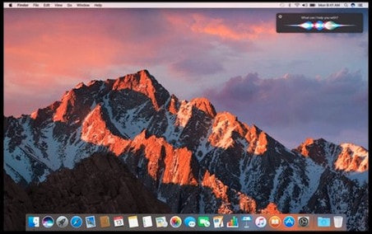
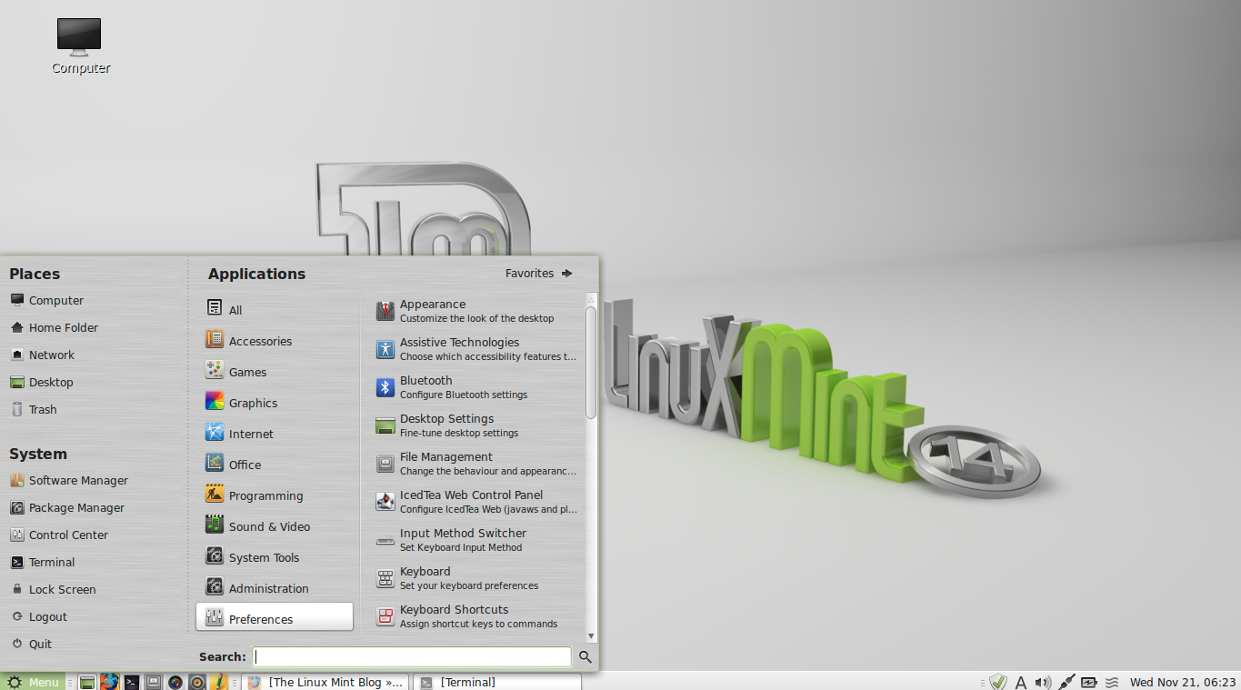
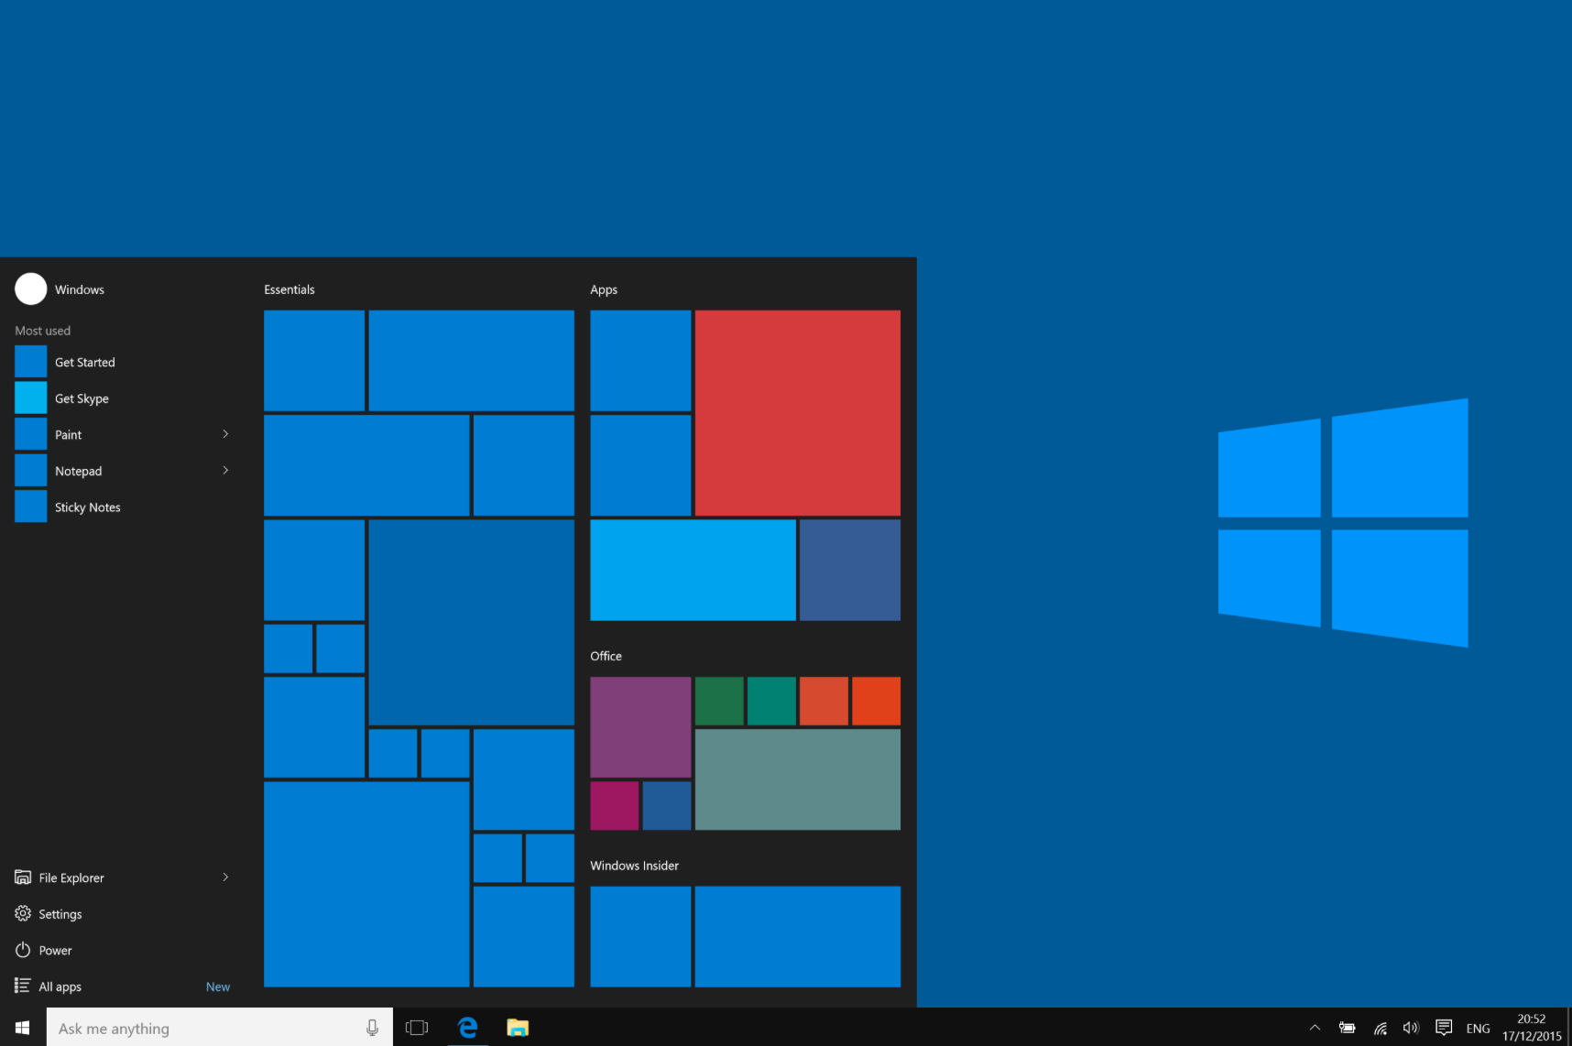
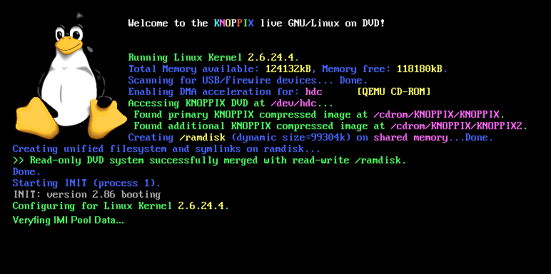
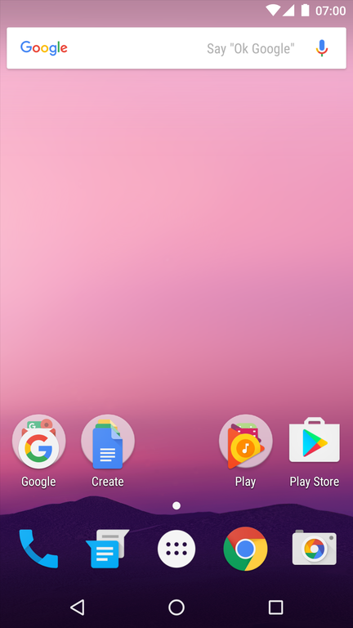

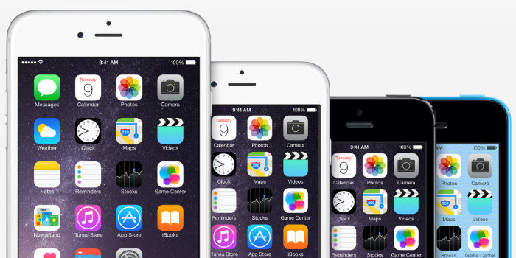
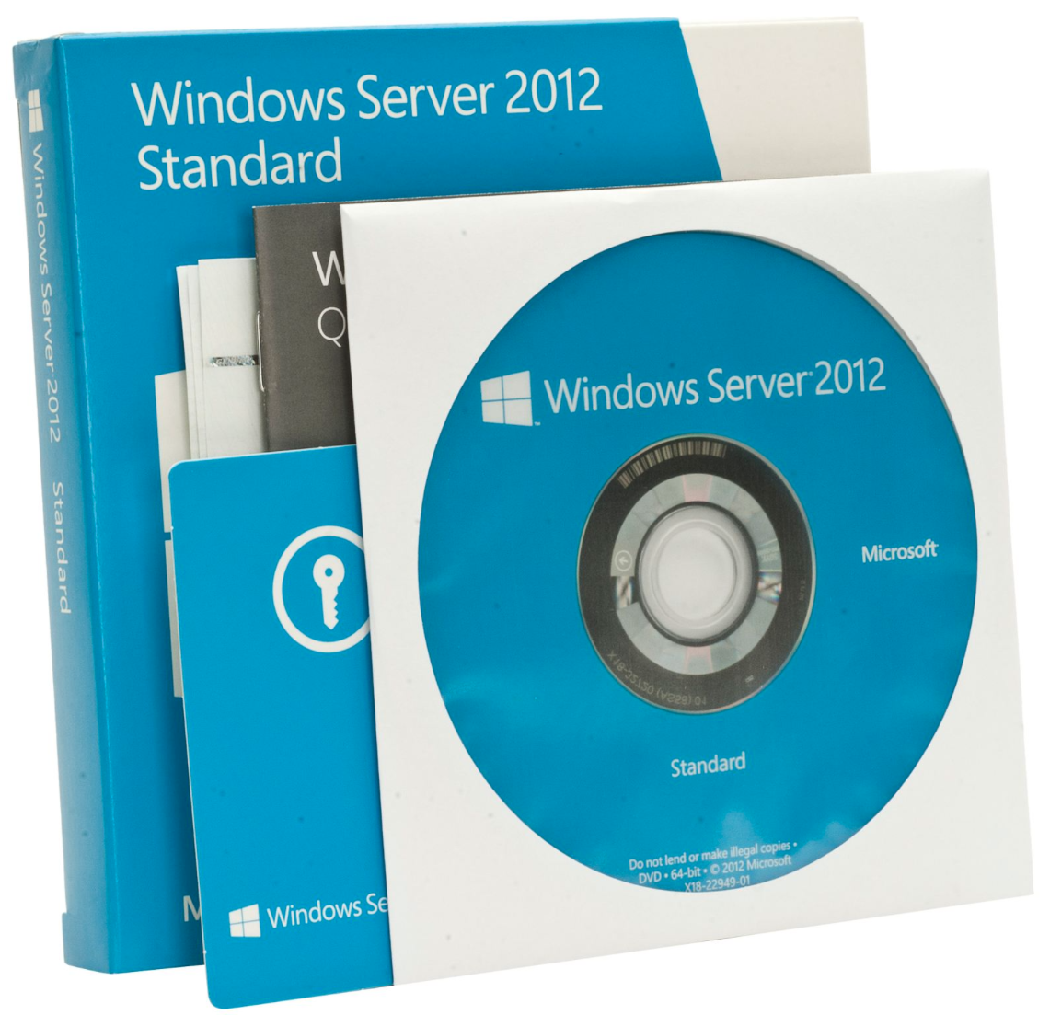
Operating Systems
Notes:
The trainer could ask the audience about which operating systems they know.
Some examples of the most populare OS’s are shown in the next slide.

Slide 12
Operating Systems statistics
January 2010
1 | Windows XP | 55.08%
2 | Windows Vista | 20.80%
3 | Windows 7 | 9.11%
4 | Mac OS X | 7.87%
5 | Linux | 1.63%
6 | Windows 2003 | 1.10%
7 | iPhone | 0.72%
8 | Windows 2000 | 0.47%
9 | Android | 0.10%
10 | WAP | 0.08%
January 2017
1 | Windows 7 | 18.45%
2 | Windows 10 | 13.79%
3 | Android 6 | 12.14%
4 | Android 5 | 12.11%
5 | Android 4 | 10.12%
6 | iOS 10 | 9.96%
7 | Windows 8.1 | 4.54%
8 | Mac OS X | 4.45%
9 | Linux | 3.80%
10 | iOS 9 | 2.64%
Source: http://www.w3counter.com/globalstats.php

Slide 13
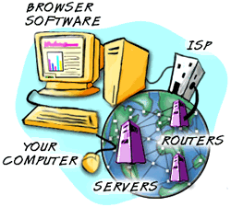











Web Browsers
Software Program
Designed to locate and display web pages
The most common are:
  Internet Explorer
  Mozilla Firefox
  Google Chrome
  Safari
  Opera

Slide 14
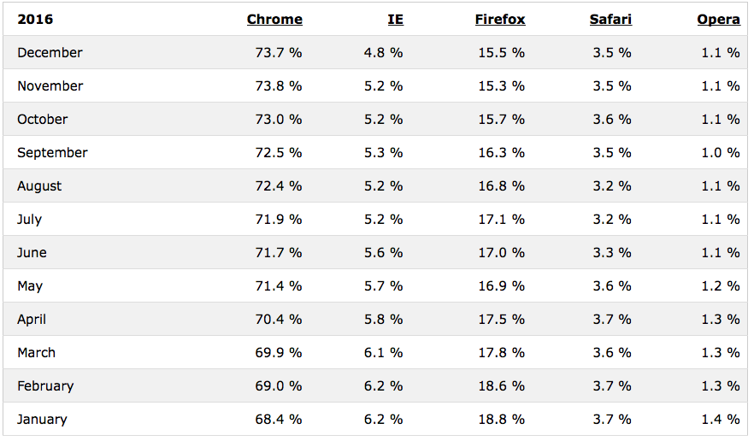
Browser statistics
Source : http://www.w3schools.com/browsers/browsers_stats.asp

Slide 15

E-Mail Clients
E-Mail clients are software programs that help the user to create, view, receive, send and manage e-mail messages from their e-mail servers.
Notes:
E-Mail clients are software programs that help the user to create, view, receive, send and manage e-mail messages from their e-mail servers.

Slide 16
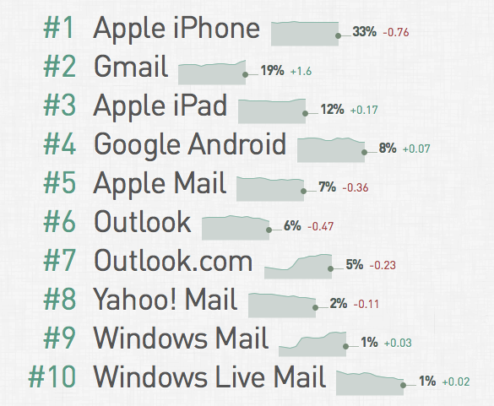
Mail client statistics
December 2016
Source : http://emailclientmarketshare.com
Notes:
This statistic shows the most popular mail clients. It is an overall statistics of desktop, mobile and webmail clients and is calculated from 1,44 billion emails. One thing to notice is how e-mail has shifted from a typical desktop application (by using clients such as Outlook or Thunderbird) into a mobile and web driven application. The typical desktop clients (Outlook, Apple Mail, Windows (Live) Mail) make less then 15% of usage.

Slide 17




Other Applications
Notes:
The trainer might ask the audience which other typical applications of a computer they could think of. The pictures on the slides show mainly office applications such as Microsoft Office (animation 1), LibreOffice (animation 2), Mac Pages/Keynote/numbers (animation 3) and Adobe PDF (animation 4). Of course other software like anti-virus, games, photo-/video playing and editing software and many many more are available.

Slide 18

Questions
Notes:
The trainer should give participants an opportunity to ask any questions that they may have in relation to part One of the lesson.

Slide 19

The Internet
The term
INTERNET
comes from
INTERconnected NETwork
Notes:
The term INTERNET comes from the contraction of the words INTERconnected NETwork. Many criminal activities involve the use of the Internet and this includes particular types of crime such as hacking, distribution of viruses and phishing attacks as well as more traditional crimes such as fraud. In order for Judges to effectively manage such cases that appear before them, it is necessary for them to understand the fundamentals of the Internet and its applications such as the World Wide Web and email. The following provides an introduction to the subject and provides the template for a successful training module.

Slide 20
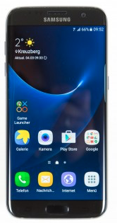
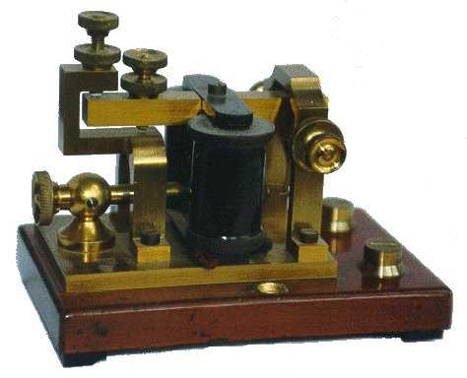
The Internet
Communication is always evolving
Notes:
This slide is simply to demonstrate how communications are constantly changing.

Slide 21
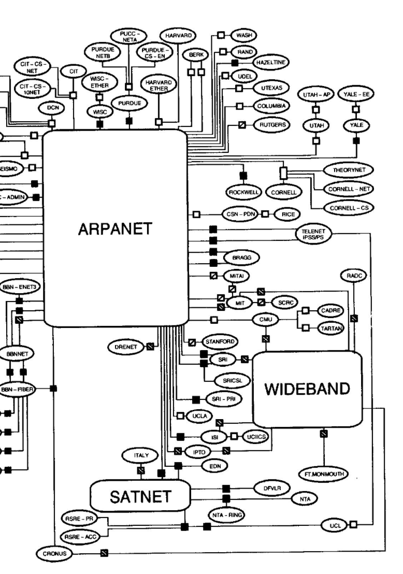
The first INTERNET
Early 1960’s
Advanced Research Project Agency development – US Dept of Defence
Keep working in event of war / disaster
No single point of failure
Interconnect variety of systems + protocols
Notes:
The Internet began its life as the ARPANET in the 1960’s. The relevance of this information may not be immediately apparent; however, the fact that the Internet was never designed to be secure may explain why it is comparatively easy for criminals to abuse the systems. The first physical links were created in 1969 with 4 nodes being universities. The first email was sent in 1972 and the following year a new communications protocol TCP/IP was created, which now forms the basis upon which Internet communications take place. The development of the Internet as we now know it was low key in the beginning as there were disjointed separate networks, served only by limited gateways between them. This led to the application of packet switching to develop a protocol for internetworking, where multiple different networks could be joined together into a super-framework of networks.
This enabled further interconnection, which began to occur more quickly across the advanced networks of the western world, and then began to penetrate into the rest of the world. The disparity of growth between advanced nations and the developing world led to a digital divide that still exists today.
There followed the commercialisation of the Internet and the introduction of privately run Internet Service Providers in the 1980s. These enabled more popular access, which really developed in the 1990’s. The Internet has had a huge impact on commerce as well as culture. There now exists near instant communication by electronic mail (e-mail) social networking sites, text based discussion forums, and the World Wide Web. The Internet continues to grow, driven by commerce, greater amounts of online information and knowledge. The advent of Web 2.0 is upon us.

Slide 22
A Brief History
4 Universities
  UCLA
  Stanford Research Institute
  UC Santa Barbara
  University of Utah
Different protocols for different systems
1973 – Stanford – early form of TCP
1982 – US DoD – TCP/IP now standard
Mid 1990s WWW became a viable entity

Slide 23
Limitations of a Network
Networks are limited:
  By the number of users that can belong to them
  By the maximum geographical distance the network can span – such as an Ethernet or Wireless network
  The availability of the network to certain environments
The Internet allows connection of these small networks into a one who’s size is virtually unlimited
It also doesn’t care what sort of network – so long as TCP/IP is accepted as a communications medium
Notes:
The trainer should ensure that information is provided to the participants that will enable them to understand the basics of networking and its limitations. They should be able to differentiate between local and wide area networks. These slides provide that basic information. Trainers should consider giving examples and encouraging participants to discuss different types of networks and how the Internet has developed. An explanation of some common relevant networking terms such as Ports and Bandwidth should be provided at this stage. Delegates should be encouraged to consider their own personal experiences; for example through their Internet access at home or at work.

Slide 24
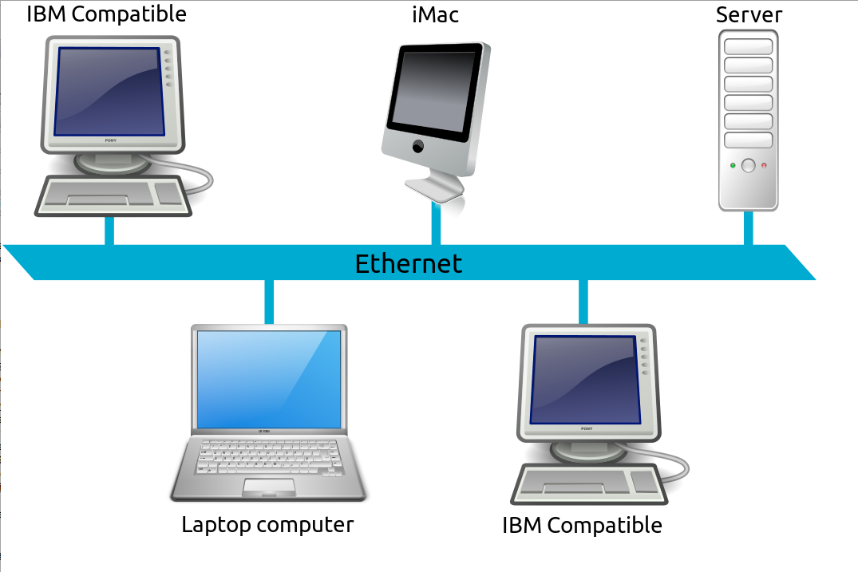
Network Terms
Local Area Network
Local Area Network (LAN)
A computer network covering a small geographic area, like a home, office, or group of buildings e.g. a school. The defining characteristics of LANs, include their much higher data-transfer rates, smaller geographic range, and lack of a need for leased telecom lines.
Notes:
Local Area Network (LAN) – is a computer network covering a small geographic area, like a home, office, or group of buildings e.g. a school. The defining characteristics of LANs, include their much higher data-transfer rates, smaller geographic range, and lack of a need for leased telecom lines.

Slide 25
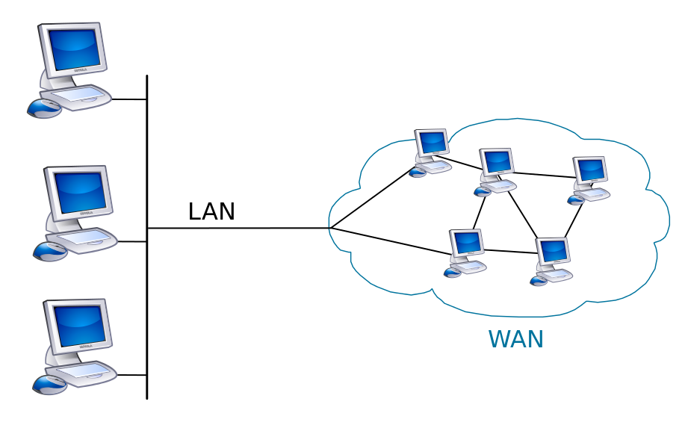
Network Terms
Wide Area Network
(WAN)
A computer network that covers a broad area (i.e., any network whose communications links cross metropolitan, regional, or national boundaries). Or, less formally, a network that uses routers and public communications links.
The largest and most well-known example of a WAN is the INTERNET.
Notes:
Wide Area Network (WAN) – is a computer network that covers a broad area (i.e., any network whose communications links cross metropolitan, regional, or national boundaries). Or, less formally, a network that uses routers and public communications links.
Contrast with personal area networks (PANs), campus area networks (CANs), or metropolitan area networks (MANs) which are usually limited to a room, building, campus or specific metropolitan area (e.g., a city) respectively. The largest and most well-known example of a WAN is the INTERNET.

Slide 26
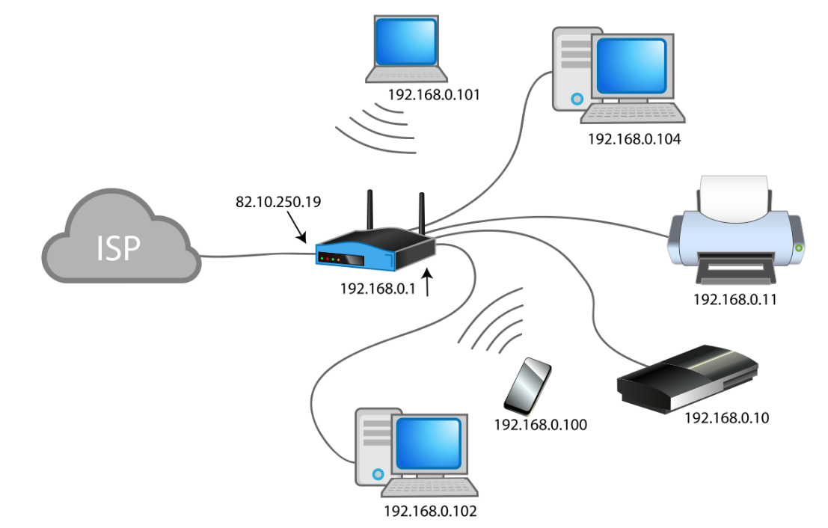
Network Terms
Network address translation (NAT)
Method of remapping one IP address space into another by modifying network packets while they are in transit across a traffic routing device.
Typically used by routers to connect all computers in a LAN to the Internet while only having one public IP address
Notes:
Network Address Translation – is a technique where the source and/or destination IP address is re-written as it passes through the firewall or router. It is most common to find it used for multiple hosts on a private network to access the Internet on a single IP address.
The trainer should point out that NAT can be seen in the picture at the point where the router in the middle of the pictures connects the devices in the LAN (right hand side) to the ISP.
The trainer can explain to the students that they will get more information on IP addresses in a few minutes and that they will see the flow of data from a LAN to a WAN in the upcoming video.

Slide 27
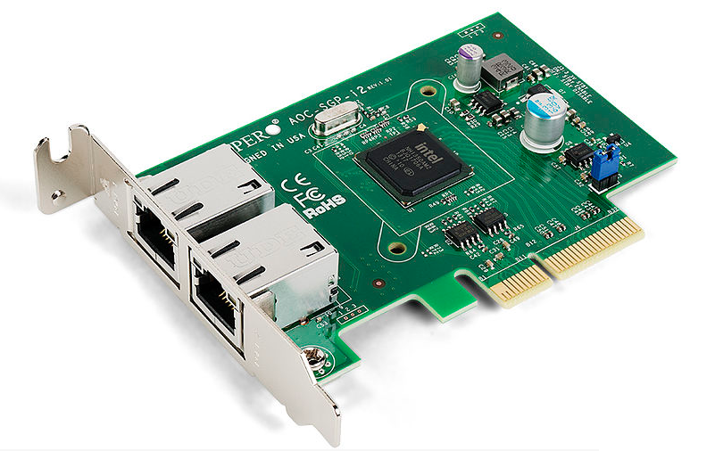
Other Networking Terms
Network Interface Controller (NIC) – is a circuit board or card installed into a computer that allows it to connect to a network
Media Access Control (MAC) address – is a quasi-unique identifier assigned to most network adapters or network interface cards (NICs) by the manufacturer for identification and which provides a unique value.
Notes:
Network Interface Controller (NIC) – is a circuit board or card installed into a computer that allows it to connect to a network
Media Access Control (MAC) address – is a quasi-unique identifier assigned to most network adapters or network interface cards (NICs) by the manufacturer for identification and which provides a unique value.

Slide 28
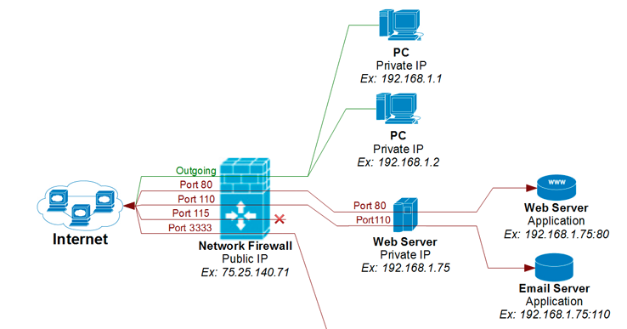
Other Networking Terms
PORTS
Represents an endpoint or "channel" for network communications
Port numbers allow different applications on the same computer to utilise network resources without interfering with each other
Ports are ‘virtual’ – NOT the socket you plug into!
Look out for the 65,365 holes on the back of your computer!
Notes:
Ports – are an endpoint or "channel" for network communications. Port numbers allow different applications on the same computer to utilise network resources without interfering with each other. Ports are ‘virtual’ – NOT the socket you plug into!
The picture can be used to describe how the PCs on the top right of the pictures can community to the Internet via outgoing ports, while incoming traffic is limited to only the traffic coming in through ports that are allowed by the firewall (ports 80, 110 and 3333 in this case). All traffic coming in through these allowed ports is then forwarded to specific computers within the network (e.g. port 80 and 110 to the webserver within the network).

Slide 29

Other Networking Terms
Server – is a computer or device that provides information or services to other computers on a network. Given the right software, any network connected computer can be configured as a server. In most cases, a dedicated powerful computer designed to be “always available”. One computer can run several services – e.g. web server, email server, file server, print server etc.
Notes:
Server – is a computer or device that provides information or services to other computers on a network. Given the right software, any network connected computer can be configured as a server. In most cases, a dedicated powerful computer designed to be “always available”. One computer can run several services – e.g. web server, email server, file server, print server etc. In a business reality it often makes sense to run different services on different machines for reasons of security and to minimise the impact of any failure.

Slide 30
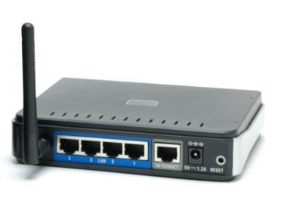
Other Networking Terms
Network Hub - or concentrator is a device for connecting multiple twisted pair or fibre optic Ethernet devices together, making them act as a single network segment.
Network Switch - is a computer networking device that connects network segments.
Router - is a device that determines the next network point that a packet should be forwarded towards its destination. It must be connected to at least 2 networks.
Notes:
Network Hub - or concentrator is a device for connecting multiple twisted pair or fibre optic Ethernet devices together, making them act as a single network segment. Hubs work at the physical layer (layer 1) of the OSI model, and the term ‘layer 1 switch’ is often used interchangeably with hub. The device is thus a form of multi-port repeater. Network hubs are also responsible for forwarding a jam signal to all ports if it detects a collision.
Network Switch - is a computer networking device that connects network segments. In the past, it was faster to use Layer 2 techniques to switch, when only MAC addresses could be looked up in content addressable memory (CAM). With the advent of ternary CAM (TCAM), it was equally fast to look up an IP address or a MAC address.
Router - is a device that determines the next network point that a packet should be forwarded towards its destination. It must be connected to at least 2 networks. It is intelligent and works on routing tables. It is located at the gateway to a network. The term ‘layer 3 switch’ often is used interchangeably with router, but a switch is really a general term without a rigorous technical definition.

Slide 31
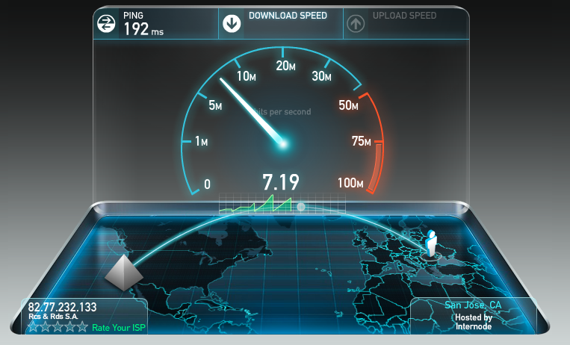
Other Networking Terms
BANDWIDTH
The amount of information that can be carried through a phone line, cable line, satellite feed, and so on
The greater the bandwidth, the greater the speed of your connection and the more your Internet experience approaches a more instant-download, TV-style experience
Notes:
Bandwidth – is the amount of information that can be carried through a phone line, cable line, satellite feed, and so on. The greater the bandwidth, the greater the speed of your connection and the more your Internet experience approaches a more instant-download, TV-style experience.

Slide 32
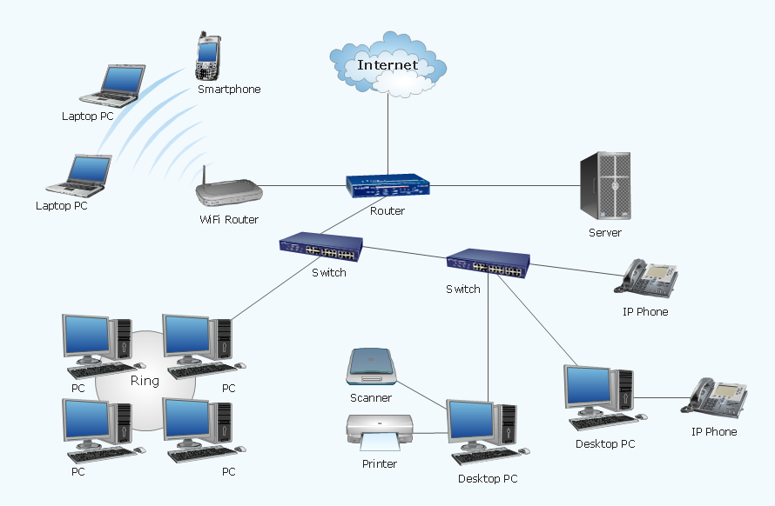
The overall picture
Notes:
This slide can be used to give the audience an overview over:
which devices can be connected to a network
how the devices are connected together (switch)
how the router connects the local network to the Internet
It can also be used by the trainer to explain the flow of data when one of the client computer from a local network sends a request to the switch, which forwards it the router, which then forwards it to a server on the Internet.

Slide 33
Internet Basics
Notes:
The Internet can be thought of as the infrastructure over which many different applications can be run simultaneously. If any part of the Internet malfunctions or is destroyed, communication can still continue. No-one owns the Internet – no organisation, no corporation, no government. It is largely self regulated. It all uses the same connection technology.
Most modern data networks, like the Internet, are described as “connectionless” or “packet switched”. Traffic is split into small packets which make their own way from sender to receiver. They do not all follow the same route and are joined together again when they reach their destination.
Most people connect to the Internet through an Internet Service Provider (ISP). These are commercial organisations that rent out space. They keep records…but for how long? There are national and international legal data protection or privacy issues that impact on how long data may be retained by ISP’s. This of course has an impact on the ability of criminal justice officials to secure evidence from these sources. Connection is normally made by one of the following methods; Dial-up, Broadband (ADSL), ISDN, Cable, Wireless hotspot or Satellite.

Slide 34

Warriors of the Net
Notes:
An excellent resource for explaining the Internet is a movie called “Warriors of the Net”. It is the perfect tool for introducing Internet to novice users. It helps the newcomers visualise how the Net works. The movie is 12 minutes long. It is about an IP packets journey through net past routers, firewalls and transatlantic cables. It is available for free download for non-commercial use from http://www.warriorsofthe.net/movie.html and is currently available (Jan 2017) in the following languages:
English. Subtitles in Russian, Chinese, Croatian and Polish
Spanish
Portugese (Brazilian)
German
French
Hebrew
Dutch
Swedish
Danish
Italian
Norwegian
Hungarian
Czeck
Ukranian
A further useful resource in order to establish the level in Internet penetration and growth in countries or regions may be found at http://www.internetworldstats.com/ It is recommended that an element of statistical information is provided within training to ensure that delegates are able to assess the impact of the Internet on their own country.
As the video already explains quite some network devices and terms, the following slides should be seen as suplimentary for the video.

Slide 35
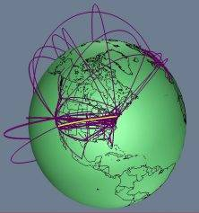
Principles of the Internet
If any part of the Internet malfunctions or is destroyed, communication can still continue
No-one owns the Internet – no organisation, no corporation, no government
It is largely self regulated
It all uses the same connection technology INTERNET PROTOCOL
Notes:
The underlying principle of the Internet is that it was designed as we will see shortly, to withstand war and disaster, and still enable communication. The background to the design was military communication, and the need for it to continue in times of national emergency.
As we will go on to see later, the Internet is made up of networks of computer from all around the world, all of which can communicate easily and with resilience. Indeed someone sending an e-mail to another part of the world would probably find that the parts of that message would all go in different routes to reach the same place – and in the blink of an eye.
The Internet has evolved globally over the years – it is not owned, unlike many other computing ideas and systems, by one company. No government owns the Internet – although the US seem to take most of the responsibility for it and claim most of the success in its development. And later we will see that the French tried to legislate to stop the Internet – and failed. In fact the Afghans are the only ones we know have stopped it almost completely – by banning it in its totality.
There is no Internet police force, and although we are now trying to find ways of stopping illegality that takes place either on or through the Internet there are problems of technology and of local, national and trans-national borders and jurisdictions to overcome.

Slide 36

What belongs to the Internet?
WWW
E-mail
Peer
2
Peer
FTP
Social
Networking
IRC
Instant
Messenger
VOIP
INTERNET
Notes:
Or looking at it another way.

Slide 37
Internet Protocols
There are quite a few of these of which the most important is the Internet Protocol (IP).
Each computer connected to the Internet MUST use it.
An IP Address is your Internet ‘telephone number’ and without an IP Addresses you would not be able to use the Internet.
Different applications and services use different protocols to communicate across networks, some are: HTTP – HyperText Transfer Protocol; SMTP – Simple Mail Transfer Protocol; FTP – File Transfer Protocol; NNTP – Network News Transfer Protocol.
Notes:
Internet Protocols –
All of the services/parts of the Internet that were shown on the previous slide have to follow a certain set of rules, the protocols. The protocols define stadards of how data packets have to be formed in order to be sent and received by any sender/receiver over the world.
There are quite a few of these protocols of which the most important is the Internet Protocol (IP). Each computer connected to the Internet MUST use it. An IP Address is your Internet ‘telephone number’ and without an IP Addresses you would not be able to use the Internet. Different applications and services use different protocols to communicate across networks, some are: HTTP – HyperText Transfer Protocol; SMTP – Simple Mail Transfer Protocol; FTP – File Transfer Protocol; NNTP – Network News Transfer Protocol. These are said to run “over” IP (not instead of).

Slide 38
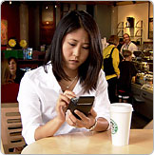
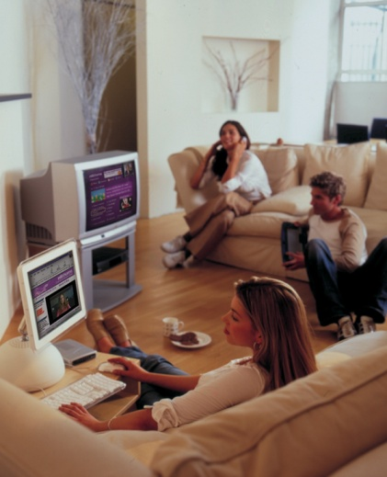
Connecting to the Internet
Most people connect through an ISP
How do they connect?
  Dial-up
  Broadband (xDSL)
  Fiber
  ISDN
  Cable TV
  Wireless hotspot
  Satellite
Notes:
Information should be provided about how connections are made to the Internet and participants encouraged to discuss their own experiences. It should be explained that ISPs do keep records but data protection legislation restricts how long they can keep hold of them.
The role of the IPS should be explained, explaining their legal status and numbers. This is a good opportunity to discuss the importance of relationship with ISP’s in relation to accessing data and conducting lawful interception.
The simple terminology is that ISP’s rent out their access to the Internet to people – whether they are individuals or organisations.
Each ISP will keep certain information about their customers. The details and amount of it will depend on the ISP involved, and it will only last for so long – hours or days depending what is needed.
It should be possible to get –
Name, address & other info used for registration
Date registered, and how the person registered
Specific e-mail addresses or screen names unique to the user
Financial details like credit cards used to sign up to the ISP
Possibly some software detail about the user
Most importantly, detail of the history of the user’s on-line activity – dates, times & duration
TIMES ARE VITAL (Time zone issues are dealt with later in this session)
It should be pointed out that it is possible to use false details to obtain an account.
Can an ISP intercept suspect Internet traffic – YES – but depends on special equipment to record usage and monitors what is happening – so need manpower to do – costs? Also, we have to consider the authority needed to do it. In any event it is necessary to contact the ISP very early into an investigation.

Slide 39
Internet Service Provider (ISP)
Commercial organisations
Rent out access to the Internet
Approximately 14,000 + worldwide
They keep records
  But how long?
  Interception?
Notes:
The role of the ISP should be explained, explaining their legal status and numbers. This is a good opportunity to discuss the importance of relationship with ISP’s in relation to accessing data and conducting lawful interception.
The simple terminology is that ISP’s rent out their access to the Internet to people – whether they are individuals or organisations.
Each ISP will keep certain information about their customers. The details and amount of it will depend on the ISP involved, and it will only last for so long – hours or days depending what is needed.
It should be possible to get –
Name, address & other info used for registration
Date registered, and how the person registered
Specific e-mail addresses or screen names unique to the user
Financial details like credit cards used to sign up to the ISP
Possibly some software detail about the user
Most importantly, detail of the history of the user’s on-line activity – dates, times & duration
TIMES ARE VITAL (Time zone issues are dealt with later in this session)
It should be pointed out that it is possible to use false details to obtain an account.
Can an ISP intercept suspect Internet traffic – YES – but depends on special equipment to record usage and monitors what is happening – so need manpower to do – costs? Also, we have to consider the authority needed to do it. In any event it is necessary to contact the ISP very early into an investigation.

Slide 40
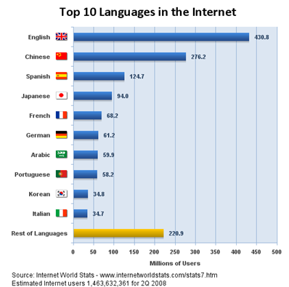
Global Internet Facts - 2008
Notes:
The extent of the use of the Internet on a global basis is an important feature. The two slides provided here, demonstrate the infiltration of different languages into Internet usage and the changes over a period of 8 years. As with other time relevant information, the trainer will need to ensure that the information is as up to date as possible and sources acknowledged.

Slide 41
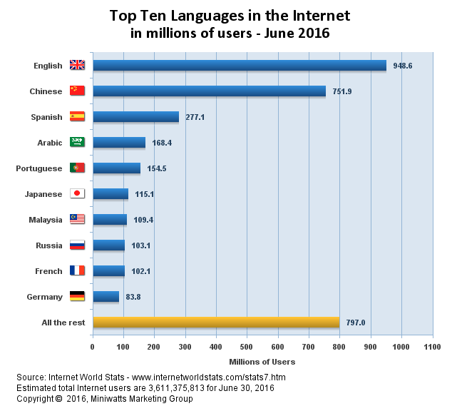
Global Internet Facts - 2016
Notes:
The slides giving a comparison between 2008 and 2016 are both included so that the trainer may use the data to draw conclusions about the extent that different languages are used on the Internet as well as the increase of people with access to the internet (note the different scale on the x-axis, 500 million compared to 1100 million). Trainers should consider gathering information about their country and/or region to see the changes in their own Internet usage.

Slide 42
IP Addressing
Notes:
This session is designed to allow the delegates to gain an understanding of how data is passed around the Internet. The information is very basic as required for this particular audience.

Slide 43
IP Addressing
Each computer in a network needs to have an address in order to send and receive data. This address is called “IP address”.
There are two types of IP addresses:
IPv4 addresses and
IPv6 addresses
IPv4 addresses are running out. That is why IPv6 are becoming more popular nowadays.

Slide 44
IP Addresses
How does an IPv4 address look like?
8.8.8.8
193.21.83.9
10.0.0.1
192.168.0.1
Notes:
The teacher can use this slide to give examples of some random IP addresses and to point out that there are private IP address ranges which are internal to lan area network and thus do not allow asking ISPs for subscriber data.
The red examples are private IP addresses. The ranges are:
10.0.0.0 - 10.255.255.255
172.16.0.0 - 172.31.255.255
192.168.0.0 - 192.168.255.255

Slide 45
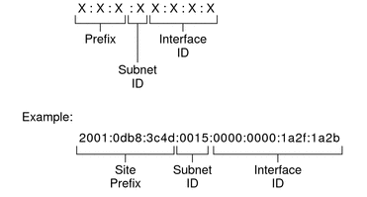
IP Addresses
How does an IPv6 address look like?
Notes:
The teacher can point out how an IPv6 address looks different to the IPv4 addresses shown just a few slides before. It may also be pointed out that there are portions of the IPv6 address that belong to a site/customer and other portions that can be allocated to interfaces/devices on that site/in that LAN. A further explanation will probably go beyond the scope of this course.

Slide 46
IPv4 versus IPv6
IPv4 (32 bit or 4 octets)
  254x254x254x254 = 4.1x10⁹
  or 4,162,314,256 addresses
IPv6 (128 bit or 16 octets)
254x254x254x254x254x254x254x254x254x254x254x254x254x254x254x254
= 3.4x10³⁸
or 340,000,000,000,000,000,000,000,000,000,000,000,000 addresses
Notes:
IPv4 (32 bit or 4 octets)
254x254x254x254 = 4.1x10⁹
or 4,162,314,256 addresses
IPv6 (128 bit or 16 octets)
254x254x254x254x254x254x254x254x254x254x254x254x254x254x254x254
= 3.4x10³⁸
or 340,000,000,000,000,000,000,000,000,000,000,000,000 addresses
So it will be not 4 but 16 Blocks of 8 SWITCHES
If the address space of IPv4 is compared to 1 millimetre, the address space of IPv6 would be 80 times the diameter of the entire galactic system

Slide 47
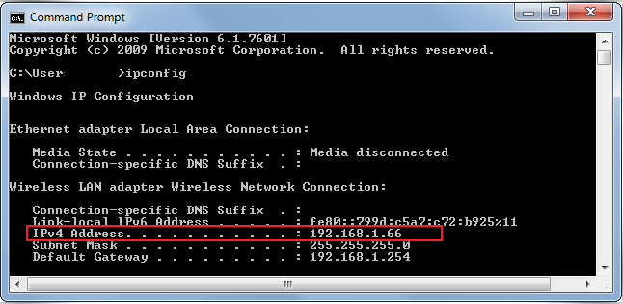
IP Addresses
What is my actual IP address?
1.) On the local network
Notes:
The teacher can point out how an IPv6 address looks different to the IPv4 addresses shown just a few slides before. It may also be pointed out that there are portions of the IPv6 address that belong to a site/customer and other portions that can be allocated to interfaces/devices on that site/in that LAN. A further explanation will probably go beyond the scope of this course.
The teacher can demonstrate the „ipconfig“ command on the current system.

Slide 48
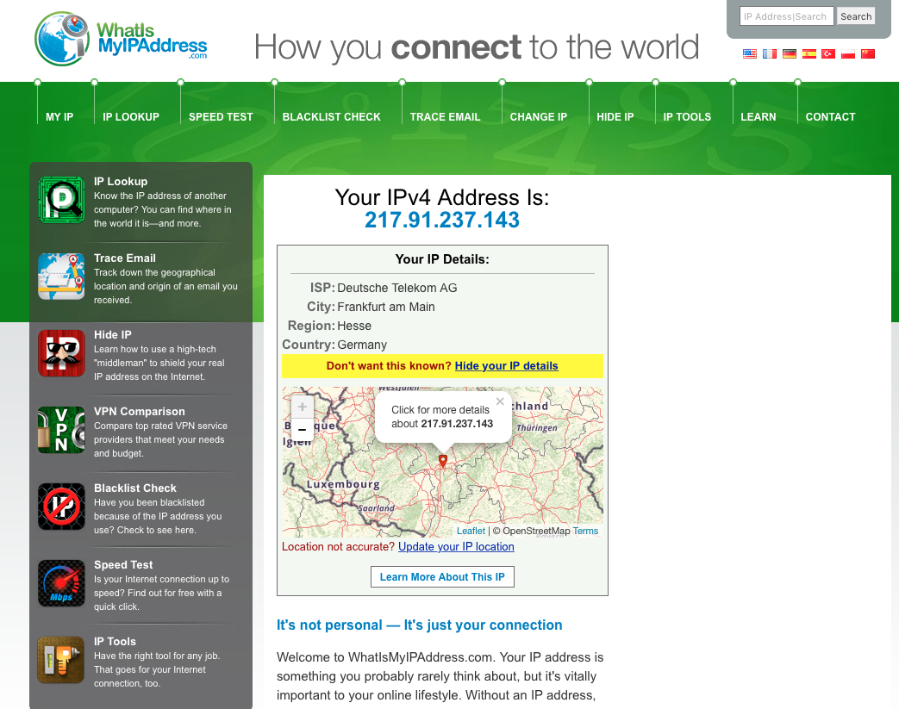
IP Addresses
What is my actual IP address?
2.) On the Internet
Notes:
The teacher can point out how an IPv6 address looks different to the IPv4 addresses shown just a few slides before. It may also be pointed out that there are portions of the IPv6 address that belong to a site/customer and other portions that can be allocated to interfaces/devices on that site/in that LAN. A further explanation will probably go beyond the scope of this course.
The teacher can demonstrate one of the webpages:
whatismyip.com
whatsmyip.org
ip-adress.eu
myipaddress.com/show-my-ip-address/
ip-lookup.net

Slide 49
IP Addresses
WARNING
An IP address is not always an exact means of identification –
IP addresses SHOULD fall into two categories :
STATIC – should always be the same
DYNAMIC – should vary each time you go on line
Exact times of the internet access are essential information including time zone
Notes:
[This slide is animated.]
Static IP addresses are permanently allocated and effectively always on line.
Dynamic IP addresses are allocated each time you go on line, however, seconds after logging off, the IP address may be reallocated. Dynamic IP addresses are typically allocated by the ISP using the Dynamic Host Configuration Protocol (DHCP). DHCP can also be used by a router in a LAN to dynamically allocate internal IP addresses to the clients in the LAN.
Further explanation should be given of the difference between static and dynamic IP addresses and the effect this may have on investigations. An explanation of the changes in IP Version 6 should be given and the need for the change in version being that the Internet is running out of IP addresses.
Most ISPs have less IP addresses than customers – rely on the fact that not all will be connected at the same time. Use dynamic IP address allocation to recycle addresses.
As the same IP address is quite likely to be used by different people on the same day, time and date (and timezone) are critical when doing ISP checks against suspects. It is for this reason that the exact time of internet access is essential.
ISPs will offer static IP addresses (which are clearly a requirement for a website for example) – but at a higher cost

Slide 50
IP Addresses
What can we learn from an IP address?
The public IP address is owned by a company (e.g. an Internet Service Provider (ISP))
Depending on the data rentention legislation in place the ISP keeps logs about which IP address and port was assigned to which subscriber at a certain point of time.
When requesting such information from ISPs the correct IP address, port number (if available), date, time and timezone need to be provided.
The address of the subscriber does not necessarily need to be the physical location of the Internet
Notes:
[This slide is animated.]
What can we learn from an IP address?
The public IP address is owned by a company (e.g. an Internet Service Provider (ISP))
Depending on the data rentention legislation in place the ISP keeps logs about which IP address and port was assigned to which subscriber at a certain point of time.
When requesting such information from ISPs the correct IP address, port number (if available), date, time and timezone need to be provided.
The address of the subscriber does not necessarily need to be the physical location of the Interne

Slide 51
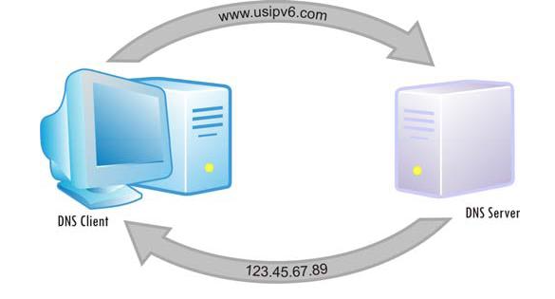
Domain Name System (DNS)
Every computer on the Internet needs to have an IP address
These IP addresses are not easy to remember
Webservers typically serve their data on certain domains, e.g. the Google webservers serve the contents of the Google Website on the domain google.com.
However, another computer on the Internet cannot request data from a domain. It can only request data from an IP address.
The Domain Name System (DNS) was invented to easily resolve domain names to IP addresses.
Notes:
Every computer on the Internet needs to have an IP address. These IP addresses are not easy to remember. Webservers typically serve their data on certain domains, e.g. the Google webservers serve the contents of the Google Website on the domain google.com.
However, another computer on the Internet cannot request data from a domain. It can only request data from an IP address.
The Domain Name System (DNS) was invented to easily resolve domain names to IP addresses.
The Domain Name System (DNS) is a hierarchical distributed naming system for computers, services, or any resource connected to the Internet or a private network. It associates various information with domain names assigned to each of the participating entities. A Domain Name Service resolves queries for domain names (which are easier to understand and utilize when accessing the internet) into IP addresses for the purpose of locating computer services and devices worldwide. An often-used analogy to explain the Domain Name System is that it serves as the phone book for the Internet by translating human-friendly computer hostnames into IP addresses. For example, the domain name www.example.com translates to the addresses 192.0.43.10 (IPv4) and 2620:0:2d0:200::10 (IPv6).

Slide 52

Whois information
In order to identify the owner of a domain name or the ISP of a certain IP address whois services can be used
Whois information for domains include data about the registrar, registrant, registration dates as well as administrative and technical contact details
To date, Whois information for IP addresses include data about the owning/managing company and their administrative and technical contact details
Notes:
In order to identify the owner of a domain name or the ISP of a certain IP address whois services can be used
Whois information for domains include data about the registrar, registrant, registration dates as well as administrative and technical contact details. However, these data can be anonymised by using anonymising registration services, e.g. https://ititch.com
Whois information for IP addresses include data about the owning/managing company and their administrative and technical contact details.
NB: Upcoming Privacy regulations will limit the information that will be possible to retrieve publicly from the Whois, and law enforcement officers will have to request that same information to the service provider through a court order.
The trainer can demonstrate those whois queries at a service like: https://www.ultratools.com/tools/

Slide 53
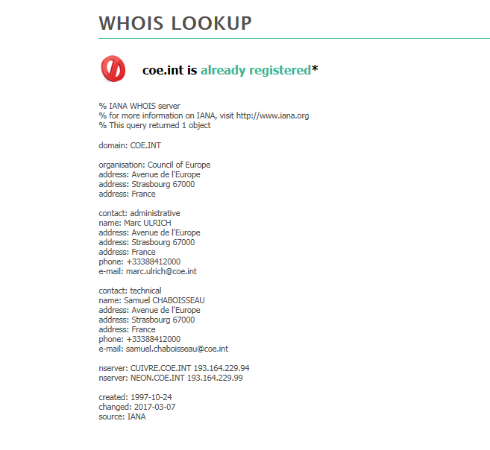
Whois Lookup

Slide 54
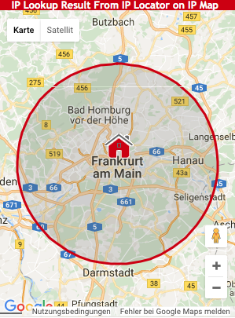
IP Geolocation
IP addresses can be mapped to a physical area by using IP-geolocation services
This can give an indication about the physical location of the subscriber using the IP address
However, IP geolocation is not precise and can easily be spoofed.
Notes:
IP addresses can be mapped to a physical area by using IP-geolocation services. One such service is http://www.ip-tracker.org . This service can be used by the trainer to demonstrate IP geolocation
This can give an indication about the physical location of the subscriber using the IP address
However, IP geolocation is not precise and can easily be spoofed.

Slide 55
The Future of the Internet
15 years ago we could not have predicted how dependant we have now become on the Internet in real life
At that time, we could not have known how much it would affect criminal investigators
What we know is:
Bandwidth will continue to grow to meet the demands of multimedia – Voice over IP, Radio, video, TV
Commerce will keep using it – large businesses depend on it for online trading, communications, sales & service
Wireless Internet is increasing – Bluetooth, IEEE802.11, and wide area or ‘cloud’ (City Centre) wi-fi schemes
Notes:
Examples of how the Internet is changing and the affect these changes will make to how investigations are conducted and managed should be provided that are relevant to the particular audience. The effects on bandwidth, commerce and wireless are provided as such examples.

Slide 56
Questions
Notes:
The trainer should give participants an opportunity to ask any questions that they may have in relation to part Two of the lesson.

Slide 57
Part Two
Internet Services
Notes:
This session goes into more detail about the services that are available on the Internet, in particular the World Wide Web and Email.

Slide 58

Critical Infrastructures
Gas & Oil Storage/Delivery
Water Supply System
Banking & Finance
Transportation
Electrical Energy
Telecommunications
Emergency Services
Government Operations
Notes:
Before going into detail about the services available on the Internet, it is worth reflecting on how much countries now rely on those services at the national level. Trainers should provide an overview of the critical national infrastructure in their own countries to ensure that delegates understand how important the Internet has become in national infrastructure security issues in a short space of time.

Slide 59
World Wide Web

Slide 60

World Wide Web
Effectively born in 1991 when HTML – Hyper Text Markup Language was invented by Sir Tim Berners-Lee
HTML provided the platform to combine words, pictures and sounds on web pages
Web standards created
by World Wide Web
Consortium (W3C)
Notes:
The World Wide Web (WWW) was effectively born in 1991 when HTML – Hyper Text Markup Language was invented by Sir Tim Berners-Lee. HTML provided the platform to combine words, pictures and sounds on web pages. Web standards are created by World Wide Web Consortium (W3C). The following explanation goes someway to explaining the name.
“The W3 world view is of documents referring to each other by links. For its likeness to a spider's construction, this world is called the Web.” (Tim Berners-Lee, Robert Cailliau; World­Wide Web; Sept 1992

Slide 61

What is HTTP?
Hyper-Text Transfer Protocol
  Common Language that Web Browsers and Web Servers use to communicate with each other on the Internet.

Slide 62

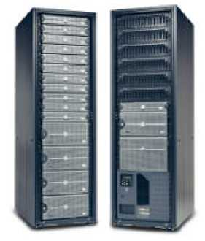
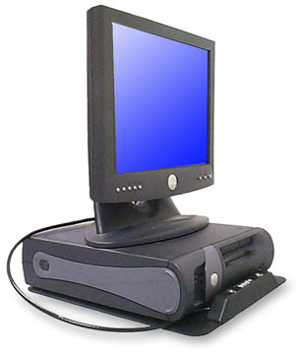
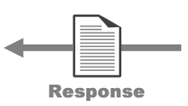
HTTP Request / Response

Slide 63
Domain Names & IP Addressing
Notes:
This section is designed to provide delegates with a basic understanding of IP addresses and what they mean, without going in to great detail about how IP addresses and domain names relate to each other. The technical detail is considered beyond the scope of this course. It is important that the trainer makes this aspect as easy to explain as possible. The presentation material provided seeks to identify how that may be achieved.

Slide 64
Uniform Resource Locators - URL
http://www.coe.int
Indicates the Internet process being used (hypertext transfer protocol)
Indicates the top-level domain being used (often with a country code)
Indicates a World Wide Web server
Domain name – normally based on who owns the site

Slide 65
Explanations
Domain names
www.google.com.qa
Host server Organisation Top-level domain Country code
IP Address
74.125.91.104
Notes:
An explanation of the protocols used on the internet.
Domain names and IP addresses are interchangeable, if you knew the IP address you should be able to enter that on the address line and be connected to the same site.
In practice what normally happens is that you enter the user friendly domain name www.google.com.qa and servers within the internet system translate it for you and send you to the correct site.
In Internet Protocol Addresses the domain name is converted in a unique 32 bit number, normally written in a Dotted Quad notation, a series of four 8 bit numbers written in decimal and separated by periods. As above 212.140.189.10, all numbers in this sequence must range between 0 and 255 (actually 256 alternatives). Obviously in the example given the last number should read 010, however, convention allows this to be shortened to 10 only.

Slide 66
Traces
Notes:
An important aspect of dealing with cybercrime is understanding what traces may be left by investigators using the Internet to conduct investigations. This is relevant not only to the investigator but also to the prosecutor that may order investigations and to judges form the perspective of the admissibility of evidence. This section should seek to provide the basic knowledge that will allow participants to understand the risks that going online may bring to an investigation.

Slide 67
Web Servers
Examining Web access statistics
In order to connect to a web site you must log on. All computer systems keep records of connections. They know :
Your identity (IP address)
Date and time you accessed
What you looked at
How long you looked at it
Your browser
Your operating system
How you got to the page
Notes:
The information provided on the presentation slides gives basic information that should be imparted to the delegates, working through the slides to show what information is left behind by anyone, including investigators who visit web sites. This should be linked to the importance of ensuring that investigators protect their identity in these circumstances and identifying that in some jurisdictions, there may be legal conditions to be fulfilled in order for such investigations to take place.

Slide 68
Web Server Logs
192.220.98.177 - - [07/Jan/2017:21:09:27 -0400] "GET / HTTP/1.0" 206 1729 "-" "Servmon::Monitor::apache/1.03" 216.128.130.126 - - [07/Jan/2017:21:30:02 -0400] "GET /pgp/ HTTP/1.0" 200 1871 http://dir.yahoo.com/Computers _and_ Internet /Security_and_Encryption/PGP___Pretty_Good_Privacy/" "Mozilla/4.0 (compatible; MSIE 6.0 [en] Win NT 5.1; U)" 66.196.73.20 - - [07/Jan/2017:21:33:35 -0400] "GET /pgp/pgpdoc2/pgpdoc2_65.html HTTP/1.0" 200 7185 "-" "Mozilla/5.0 (Slurp/cat; slurp@inktomi.com; http://www.inktomi.com/slurp.html)" 63.229.162.177 - - [07/Jan/2017 :21:34:31 -0400] "GET /stephen/singers/ HTTP/1.1" 200 1936 "http://www.dosado.com/callers/default.htm " "Mozilla/4.0 (compatible; MSIE 5.5; Windows 98; Win 9x 4.90)" 138.162.0.41 - - [07/Jan/2017:21:36:27 -0400] "GET gallery/Colorado 02?&page=2 HTTP/1.0" 200 19649 "http://www.google.com/search?q=st+malo+chapel+colorado&hl=en&lr=&ie=UTF-8&start=20&sa=N" Mozilla/4.76 [en] (Windows NT 5.0; U)" 138.162.0.42 - - [07/Jan/2017:21:36:29 -0400] "GET /gallery/css/embedded_style.css.default HTTP/1.0" 200 1901 "-" "Mozilla/4.76 [en] (Windows NT 5.0; U)" 66.196.73.15 - - [07/Jan/2017:21:43:09 -0400] "GET /stephen/home.html HTTP/1.0" 200 11104 "-" "Mozilla/5.0 (Slurp/cat; slurp@inktomi.com;http://www.inktomi.com/slurp. html)" 66.196.72.107 - - [07/Jan/2017:21:44:19 -0400] "GET /ftp/logs/error_log HTTP/1.0" 404 277 "-" "Mozilla/5.0 (Slurp/ cat; slurp @inktomi.com; http://www.inktomi.com/slurp.html)" 12.255.212.29 - - [07/Jan/2017:21:51:42 -0400] "GET /cgi-bin/formmail .cgi?recipient=lharleyren49@aol.com&subject=http://www.gildea. com/cgi-bin/formmail.cgi&body=48462427 &email =uqizakzbi@aol.com HTTP/1.1" 404 291 "-" "Mozilla/4.0 (compatible; MSIE 5.0; Windows 98; DigExt)"64.156.198.78 - - [07/Jan/2017:21:52:53 -0400] "GET /wang-center/schedules/wang.html HTTP/1.1" 200 1438 "-" "Mozilla/5.0 (X11; Linux i686; en-US; rv:1.0rc5; OBJR)" 163.139.58.174 - - [07/Jan/2017:21:54:29 -0400] "GET /sd/ HTTP/1.1" 304 - "-" "Mozilla/4.0 (compatible; MSIE 6.0; Windows NT 5.1; .NET CLR 1.0.3705)"205.188.209.51 - - [07/Jan/2017:21:57:23 -0400] "GET / HTTP/1.0" 200 1729 "http://aolsearch.aol.com/dirsearch.adp?query=Gildea"
What is this?

Slide 69
Web Server Logs
Examining Web access statistics – web logs
192.220.98.177 - - [07/Jan/2017:21:09:27 -0400] "GET / HTTP/1.0" 206 1729 "-" "Servmon::Monitor::apache/1.03"
216.128.130.126 - - [07/Jan/2017:21:30:02 -0400] "GET /pgp/ HTTP/1.0" 200 1871 "http://dir.yahoo.com/Computers_and_Internet/Security_and_Encryption/PGP___Pretty_Good_Privacy/" "Mozilla/4.0 (compatible; MSIE 6.0 [en] Win NT 5.1; U)"
66.196.73.20 - - [07/Jan/2017:21:33:35 -0400] "GET /pgp/pgpdoc2/pgpdoc2_65.html HTTP/1.0" 200 7185 "-" "Mozilla/5.0 (Slurp/cat; slurp@inktomi.com; http://www.inktomi.com/slurp.html)"
63.229.162.177 - - [07/Jan/2017:21:34:31 -0400] "GET /stephen/singers/ HTTP/1.1" 200 1936 "http://www.dosado.com/callers/default.htm " "Mozilla/4.0 (compatible; MSIE 5.5; Windows 98; Win 9x 4.90)"
138.162.0.41 - - [07/Jan/2017:21:36:27 -0400] "GET /gallery/Colorado02?&page=2 HTTP/1.0" 200 19649 "http://www.google.com/search?q=st+malo+chapel+colorado&hl=en&lr=&ie=UTF-8&start=20&sa=N" "Mozilla/4.76 [en] (Windows NT 5.0; U)"
138.162.0.42 - - [07/Jan/2017:21:36:29 -0400] "GET /gallery/css/embedded_style.css.default HTTP/1.0" 200 1901 "-" "Mozilla/4.76 [en] (Windows NT 5.0; U)"
66.196.73.15 - - [07/Jan/2017:21:43:09 -0400] "GET /stephen/home.html HTTP/1.0" 200 11104 "-" "Mozilla/5.0 (Slurp/cat; slurp@inktomi.com; http://www.inktomi.com/slurp.html)"
66.196.72.107 - - [07/Jan/2017:21:44:19 -0400] "GET /ftp/logs/error_log HTTP/1.0" 404 277 "-" "Mozilla/5.0 (Slurp/cat; slurp@inktomi.com; http://www.inktomi.com/slurp.html)"
12.255.212.29 - - [07/Jan/2017:21:51:42 -0400] "GET /cgi- bin/formmail.cgi?recipient=lharleyren49@aol.com&subject= http://www.gildea.com/cgi-bin/formmail.cgi&body=48462427&email=uqizakzbi@aol.com HTTP/1.1" 404 291 "-" "Mozilla/4.0 (compatible; MSIE 5.0; Windows 98; DigExt)"
64.156.198.78 - - [07/Jan/2017:21:52:53 -0400] "GET /wang-center/schedules/wang.html HTTP/1.1" 200 1438 "-" "Mozilla/5.0 (X11; Linux i686; en-US; rv:1.0rc5; OBJR)"
163.139.58.174 - - [07/Jan/2017:21:54:29 -0400] "GET /sd/ HTTP/1.1" 304 - "-" "Mozilla/4.0 (compatible; MSIE 6.0; Windows NT 5.1; .NET CLR 1.0.3705)"
205.188.209.51 - - [07/Jan/2017:21:57:23 -0400] "GET / HTTP/1.0" 200 1729 "http://aolsearch.aol.com/dirsearch.adp?query=Gildea"

Slide 70
Examining a single Web server log entry
Date and time of access
GET command
IP address
User at
Optilink Comms Inc
GA, US
Note the time zone!
- 0400 – most probably South America
216.128.130.126 - - [07/Jan/2017:21:30:02 - 0400] "GET /pgp/ HTTP/1.0" 200 1871 "http://dir.yahoo.com/Computers_and_Internet/Security_and_Encryption/PGP___Pretty_Good_Privacy/" "Mozilla/4.0 (compatible; MSIE 6.0 [en] WinNT 5.1; U)"
System information
Mozilla/4.0 compatible; MSIE 6.0 – browser
[en] – English
WinNT 5.1 – XP Operating System
U – browser supplier
Site linked from
http://dir.yahoo.com/Computers_and_Internet/Security_and_Encryption/PGP___Pretty_Good_Privacy/
PGP section of Yahoo Directory

Slide 71
Questions
Notes:
The trainer should give participants an opportunity to ask any questions that they may have in relation to the topics discussed so far in part Three of the lesson.

Slide 72
E-Mail

Slide 73
How E-mail works
It appears that E-mail is passed directly from the sender's machine to the recipient's
Joe
Jane
Notes:
Electronic Mail or Email is a method of exchanging digital messages.
To the user, It appears that E-mail is passed directly from the sender's machine to the recipient's; however each message typically passes through at least four computers during its lifetime.

Slide 74
How normal E-mail works
Typically an E-mail passes through at least four computers during it’s lifetime
  Message is composed on user’s own computer, then sent to ISP's outgoing SMTP mail server* (Simple Mail Transfer Protocol or SMTP)
  Outgoing ISP forwards e-mail onto recipient’s ISP SMTP mail server (SMTP – SMTP)
  Recipient’s mail server finds recipient's incoming mail server (Post Office Protocol or POP3) and delivers message to ‘recipient’s post box’
  Recipient logs onto account and message is retrieved into recipient’s inbox, normally deleting it from the mail server in the process
* Mail server – dedicated computer used to handle mail
Notes:
A Message is composed on user’s own computer, then sent to ISP's outgoing SMTP mail server* (Simple Mail Transfer Protocol or SMTP)
Outgoing ISP forwards e-mail onto recipient’s ISP SMTP mail server* (SMTP – SMTP)
Recipient’s mail server finds recipient's incoming mail server (Post Office Protocol or POP3) and delivers message to ‘recipient’s post box’
Recipient logs onto account and message is retrieved into recipient’s inbox, normally deleting it from the mail server in the process
* Mail server – dedicated computer used to handle mail

Slide 75
Joe sends Jane an E-mail
Internet
Joe’s ISP then directs the E-mail out onto the Internet
The mail is forwarded to the POP3 server of Jane’s ISP
POP3
Server
SMTP
Server
SMTP
Server
POP3
Server
When Joe presses SEND his E-mail is moved from his computer to his Internet Service Providers outgoing SMTP server
The next time Jane connects to her ISP the E-mail is downloaded to her computer
Joe
Jane

Slide 76



Showing it in another way
Joe
Jane
INTERNET
Jane’s ISP
Joe’s ISP
Mailserver
Mailserver
Notes:
Alternatively – the user may choose to use a mail server elsewhere on the net… ie hotmail or they may have a domain, in which case the mail will be handled by the web providers mail servers

Slide 77
Different types of E-mail
E-mail
The traditional Outlook type mail – sent via SMTP – retrieved via POP3 and once downloaded resident on your own machine
Web-based mail
POP3 mail – for instance using Outlook Express – when you log in you normally download all new mail into you inbox resident on your machine
IMAP mail – ‘true’ web-mail – viewed via your machine but still resident on a remote server – can be organised into folders, etc. but only visible when online.
Notes:
There are different types of electronic mail;
E-mail - The traditional Outlook type mail – sent via SMTP – retrieved via POP3 and once downloaded resident on your own machine
Web-based mail - POP3 mail; for instance using Outlook Express – when you log in you normally download all new mail into you inbox resident on your machine; IMAP mail – ‘true’ web-mail – viewed via your machine but still resident on a remote server – can be organised into folders, etc. but only visible when online.

Slide 78
E-Mail Headers

Slide 79
Compare it to a Normal Letter
An E-mail message has a
header part (the envelope) and
a body part (the letter itself) with attachments
Notes:
It is often easier to compare email to a letter when explaining email. E-mail messages have a header part (the envelope), and a body part (the letter itself) with attachments. The message header is the primary focus for investigators as it contains information about sender, recipient, IP-addresses, mail servers, time-stamps etc. This information is used to assist the tracing of the sender of a message where it is not immediately apparent, for example in the case of a ransom demand issued via email. The full or extended header is vital to tracing the source of a message and it is important that Judges appreciate the difference between the headers seen when a message is delivered and the extended header that contains all the relevant information.
Email is one of the most common applications that will be encountered by Judges and training designers should ensure they include the most up to date information on different types of email and how evidence about them is correctly obtained from messages themselves as well as the Internet Service Providers through who services the messages pass.
Further information about email works that may be of use to training designers may be found at http://www.learnthenet.com/english/html/20how.htm

Slide 80
Header and Body
HEADER (envelope)
Our primary focus. Contain information about sender, recipient, IP-addresses, mail servers, time-stamps etc.
BODY (letter)
Content of the mail and attachments
FULL OR EXTENDED HEADERS EXIST IN ALL E-MAILS BUT THERE IS NO STANDARD METHOD TO REVEAL THEM – EACH CLIENT OR WEB UTILITY HAS A DIFFERENT LOCATION AND SETTINGS

Slide 81
Extended E-mail headers
[G-mail ]
Microsoft Mail Internet Headers Version 2.0
Received: from xproxy.gmail.com ([66.249.82.197]) by exchange1.coe.int with Microsoft SMTPSVC(6.0.3790.0); Tue, 07 Jan 2017 09:44:54 +0100
Received: by xproxy.gmail.com with SMTP id h28so988094wxd
for <jane@coe.int>; Tue, 07 Jan 2017 00:44:31 -0800 (PST)
DomainKey-Signature: a=rsa-sha1; q=dns; c=nofws;
s=beta; d=gmail.com;
h=received:message-id:date:from:to:subject:in-reply-to:mime-version:content-type:references;
b=RY8mK69lgiScvczLvTJmfvlXoZa1zUskwWsukAn3jlzblALGzxF
pzpDKyrEnIDyZrKp8VnthCyCgyHOfi7KCHhaseAXG4UAQO8zIbSFDxw6uVN0jUVYQx0a60pjkFBxmdzL/PCDEllSFEExVQB+m0WD
lcGQEgGmecYV1nRmy8=
Received: by 10.70.100.14 with SMTP id x14mr6330299wxb; Tue, 07 Jan 2017 00:44:30 -0800 (PST)
Received: by 10.70.122.16 with HTTP; Tue, 07 Jan 2017 00:44:30 -0800 (PST)
Message-ID: <95ecf0550603280044n7a18048fs8e37cf2c2ea3a3d8@mail.gmail.com>
Date: Tue, 07 Jan 2017 09:44:30 +0100
From: ”Joe" <joe@gmail.com>
To: ”Jane" <jane@coe.int>
Subject: Re: test
In-Reply-To: <42675D880C511048AE555539A210615607A281@exchange1.coe.int>
MIME-Version: 1.0
Content-Type: multipart/alternative;
boundary="----=_Part_21605_28805312.1143535470923"
References: <42675D880C511048AE555539A210615607A281@exchange1.coe.int>
Return-Path: joe@gmail.com
X-OriginalArrivalTime: 07 Jan 2017 08:44:54.0322 (UTC) FILETIME=[E283E920:01C65243]
Notes:
If the trainer wants to demo the analysis of an e-mail header it is important to stress that the headers are read from the bottom to the top and that the “Received by” fields are relevant.

Slide 82
Questions
Notes:
The trainer should give participants an opportunity to ask any questions that they may have in relation to part Three of the lesson.

Slide 83
Part Three
Other Relevant Internet Applications
Notes:
This section of the course is designed to give the participants an overview of the applications on the Internet that are not included in the previous sections. These are necessary as they will be encountered in the normal course of the activities of the target audience. This information will support the objectives of the course. The level of detail provided is considered suitable for the level of teaching that is required. Care should be taken by the trainers not to provide too much in depth knowledge as this will be included in the advanced course that is being developed.

Slide 84
Online Storage

Slide 85
Cloud computing
Cloud computing is a model for enabling ubiquitous, convenient, on-demand network access to a shared pool of configurable computing resources (e.g. networks, servers, storage, applications, and services) that can be rapidly provisioned and released with minimal management effort or service provider interaction.
Notes:
Cloud computing is a model for enabling ubiquitous, convenient, on-demand network access to a shared pool of configurable computing resources (e.g. networks, servers, storage, applications, and services) that can be rapidly provisioned and released with minimal management effort or service provider interaction.
Mell and Grance from the National Institute of Standards and Technology (NIST) identify three service models for Cloud Computing.
Software as a Service (SaaS): The consumer is provided with the capability of using the provider’s applications running on a cloud infrastructure. The applications are accessible from various client devices through either a thin client interface, such as a web browser (e.g. web-based email), or a program interface. The consumer does not manage or control the underlying cloud infrastructure (including the network, servers, operating systems or storage) or even individual applications, with the possible exception of limited user-specific application settings.
Platform as a Service (PaaS): The consumer is provided with the capability of deploying consumer-created or acquired applications onto the cloud infrastructure created using programming languages, libraries, services, and tools supported by the provider. The consumer does not manage or control the underlying cloud infrastructure (including the network, servers, operating systems, or storage), but does have control over the applications deployed and possibly over the configuration settings for the application-hosting environment.
Infrastructure as a Service (IaaS): The consumer is provided with processing, storage, network, and other fundamental computing resources and is able to deploy and run arbitrary software (including operating systems and applications). The consumer does not manage or control the underlying cloud infrastructure, but has ‘broad freedom to choose’ operating systems, storage, and deployed applications; and possibly limited control of select networking components (e.g. host firewalls).
Mell and Grance, NIST, 2011, http://csrc.nist.gov/publications/PubsSPs.html#800-145

Slide 86
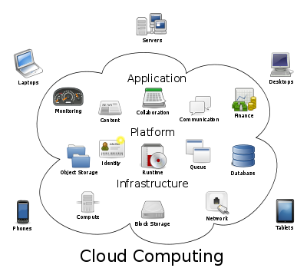
Cloud Computing Logical Diagram

Slide 87
Recently on Google.com
Search for ‘online storage’ provided 83,100,100 results in 2017 (up from 68,600,000 in 2009)
“The storage solution for the mobile professional”
There are basically two types of storage
  Free service
  May be supplied as an additional service from your ISP or e-mail supplier
  Lots available on a simple sign-up basis in various jurisdictions
  Subscription service
  Sign-up online – only verification by method of payment
Notes:
Information may be provided by the trainer about the prevalence of online storage and as an example the number of Google searches and the increase over a period of time, gives an idea of the interest that there is in such storage. Information should be provided about the different types of online storage differentiating between free and paid for services. The fact that criminals may use this type of storage should be made clear (see next slide).

Slide 88
Online Storage
LEGITIMATELY –
  online storage provides a service, particularly useful for business and travelling as the storage facility can be accessed on the Internet and files can be retrieved or shared
CRIMINALLY –
exactly the same applies files, folders, images or any other data type can be retrieved by any computer connected to the Internet and shared by anyone who has the log-on information
Notes:
The fact that criminals may use this type of storage in the same way it can be used for legitimate purposes should be made clear.

Slide 89
The Internet of Things

Slide 90
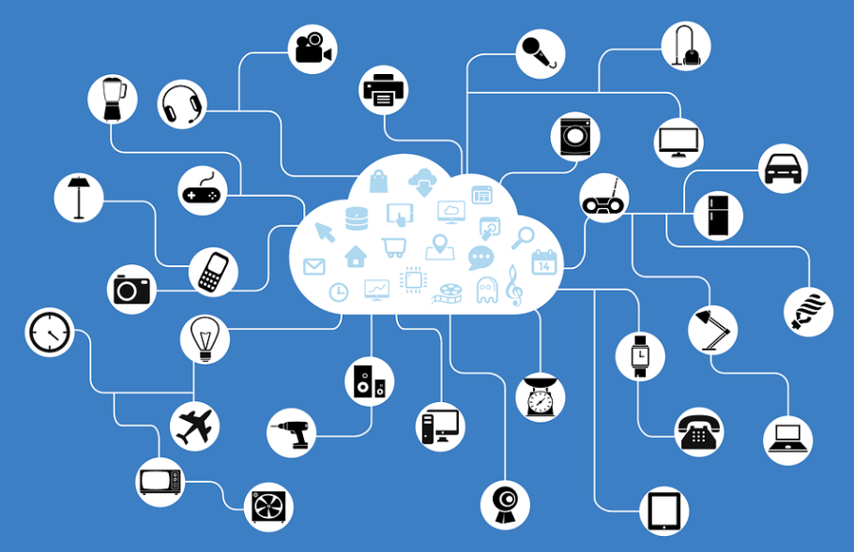
IoT – Internet of things
Every device is connected to the Internet and addressable
via its’ own IP(v6) address
Devices communicate with their owners and with each others

Slide 91
IoT – Internet of things
Challenges:
  Devices become targets
  -> almost impossible to secure all devices
  Masses of compromised devices can be used as botnets (e.g. Mirai)
Notes:
The Mirai Botnet:
The incident (December 2016) took offline some of the most popular sites on the web, including Netflix, Twitter, Spotify, Reddit, CNN, PayPal, Pinterest and Fox News – as well as newspapers including the Guardian, the New York Times and the Wall Street Journal.
The cause of the outage was a distributed denial of service (DDoS) attack, in which a network of computers infected with special malware, a “botnet”, are coordinated into bombarding a server with traffic until it collapses under the strain.
Unlike other botnets, which are typically made up of computers, the Mirai botnet was largely made up of so-called “internet of things” (IoT) devices such as digital cameras and DVR players.
Because it has so many internet-connected devices to choose from, attacks from Mirai could be much larger than what most DDoS attacks could previously achieve.
It was estimated that the attack had involved “100,000 malicious endpoints”, and there had been reports of an extraordinary attack strength of 1.2Tbps, roughly twice as powerful as any similar attack on record.

Slide 92
The “Dead Letter” Box

Slide 93
Hotmail ‘dead letter box’
Open up your Hotmail /Livemail account (or indeed any free web-mail)
Type a message including the ‘secret’ info
Add attachments – if you need to
Don’t send it, just save it as a draft
Now share your log-on details with someone else
They log on, read the message and delete it
It was never sent, for a time was just a insignificant draft in your folder – so virtually untraceable
Notes:
Different ways in which criminals use the Internet services should be of interest to the participants. One such use is by was of a “dead letter box”. This may be explained by the trainer as it is fairly easy to understand how this method of communication may be used with little risk of capture.
Depending on the time and resources available, this exercise can done by all participants or only be shown/explained by the trainer.

Slide 94
Peer-to-Peer

Slide 95
Peer to Peer
Peer to Peer services have for many years allowed the transfer of illegal files as well as files that are subject to intellectual property rights.
Peer to peer clients have been popular among criminal groups involved in these activities.
First generation peer-to-peer architecture worked on the principle of using a centralised server to which people connected in order to download files. This made identification of those offering illegal services fairly easy to locate and close down.
Second generation peer to peer clients use different methods of connectivity from those that hold lists of available files to make searching easier to those that act as supernodes that identify where files are available.
Notes:
Peer to Peer services have for many years allowed the transfer of illegal files as well as files that are subject to intellectual property rights. Peer to peer clients have been popular among criminal groups involved in these activities. First generation peer-to-peer architecture worked on the principle of using a centralised server to which people connected in order to download files. This made identification of those offering illegal services fairly easy to locate and close down. Second generation peer to peer clients use different methods of connectivity from those that hold lists of available files to make searching easier to those that act as supernodes that identify where files are available.
Judges will need to be aware of peer to peer activity as it may be relevant to many types of criminal and civil trial. An in depth knowledge is not necessary and training designers should consider using sites such as http://ezinearticles.com/?How-Peer-to-Peer-(P2P)-Works&id=60126 to provide up to date information.

Slide 96
Newsgroups

Slide 97
Usenet News
Usenet stands for "User's Network“ often referred to as “newsgroups“
Usenet consists of thousands of virtual bulletin boards on different subjects
  Available on the Internet around the world
Anyone with access to the Internet can:
  Post a message to any Usenet newsgroup
  Read any message
  Post a response to any message
Notes:
The term Newsgroup is somewhat of a misleading description as they tend to host discussions. They are technically different but function in a similar way to discussion forums hosted on the World Wide Web. Newsgroup servers are hosted by various organisations who agree with others that they will synchronise their information on a regular basis. This allows users to post messages to one server and be seen by a larger audience.

Slide 98
File Transfer Protocol

Slide 99
File Transfer Protocol
FTP is a powerful protocol that allows the transfer of files from one computer to another.
It works on a client/server basis with an FTP programme installed on the client allowing the user to interact with a server in order to gain access to the services and information on the server.
When a user wishes to transfer a file a TCP connection is create to the target system. User ID and password are allowed to be transmitted and the user is allowed to specify the files and the action required.
When approval is given for the file transfer, another TCP connection is created for data to be transferred.
Notes:
Why do Judges need to know of the existence of FTP services? The answer is that they may encounter the use of such files in cases where criminals are exchanging files with each other or where FTP is used as the method of transfer by other protocols such as Internet relay Chat (IRC).

Slide 100
Internet Relay Chat

Slide 101
Internet Relay Chat
Internet Relay Chat (IRC) is in effect a teleconferencing system that is somewhat dated but still used by criminals to communicate and exchange files.
It works by a series of servers connecting to each other and sharing messages that are posted in “Channels”, which are text based, virtual meeting rooms.
The discussion topics are listed and users who have an IRC client may connect to one or more channels at any time to engage in discussion with likeminded people.
IRC is not the most user friendly service on the Internet and is mostly used by those who are more experienced and potentially older users.
Notes:
It is a protocol used by criminals and a rudimentary knowledge of its functions is required by Judges and prosecutors.

Slide 102
Social Networking
Notes:
Instant Messaging and Social Networking have taken over as the communications tool of choice in recent years with many well known examples providing instant and user friendly access to other users throughout the world. The main feature of these sites is the ability to create a personal profile and share information about yourself and to meet new people. It is possible to share photos music and videos. The amount of personal information that is posted by individuals can make them a target for criminals for example those involved in identity theft and those wishing to groom children. Further information that may assist in the development of training materials may be found at http://communication.howstuffworks.com/how-social-networks-work.htm . Instant messaging is a form of real time direct chat between two or more individuals using shared clients. This type of chat involves contact between known person as opposed to other types of chat that allow communication between unknown persons. Criminals are known to use instant messaging as a method of communication.

Slide 103
Social Networking
Instant Messaging and Social Networking have taken over as the communications tool of choice in recent years with many well known examples providing instant and user friendly access to other users throughout the world.
The main feature of these sites is the ability to create a personal profile and share information about yourself and to meet new people. It is possible to share photos music and videos.
The amount of personal information that is posted by individuals can make them a target for criminals for example those involved in identity theft and those wishing to groom children.

Slide 104
Social Networking
Social Networking sites are a very useful vehicle for law enforcement to gather information about suspects and illegal activities
Instant messaging is a form of real time direct chat between two or more individuals using shared clients.
This type of chat involves contact between known person as opposed to other types of chat that allow communication between unknown persons. Criminals are known to use instant messaging as a method of communication.

Slide 105
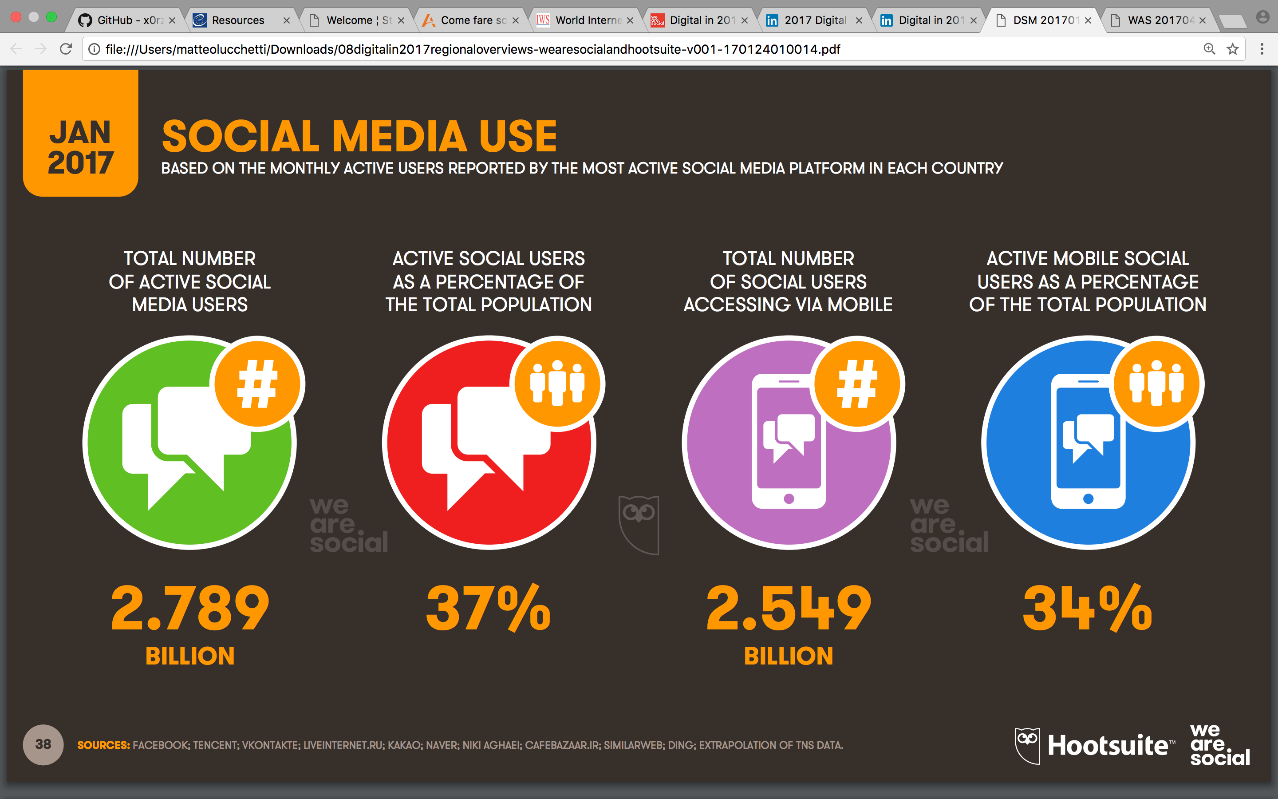
How Prevalent is Social Networking
Source: statista.com
Notes:
Further information may be provided by the trainer in the form of statistical data about the increase in the use of social networking. Examples of the growth of specific sites and the global impact are provided as examples.
A note should be done on the use of mobile to connect to social networks

Slide 106
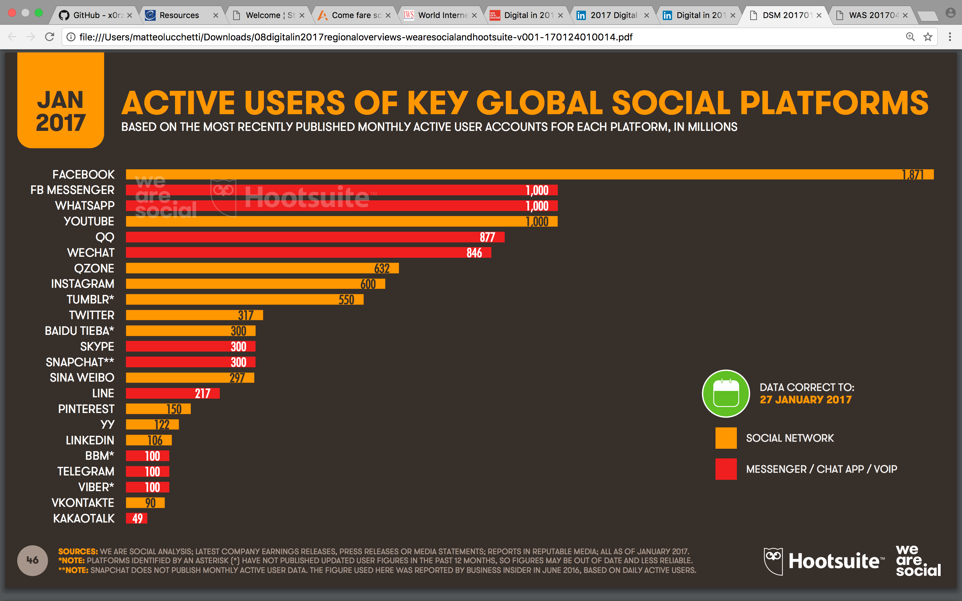
Key Global Social Platforms
Source: statista.com
Notes:
Further information may be provided by the trainer in the form of statistical data about the increase in the use of social networking. Examples of the growth of specific sites and the global impact are provided as examples.
A note should be done on the use of mobile to connect to social networks

Slide 107
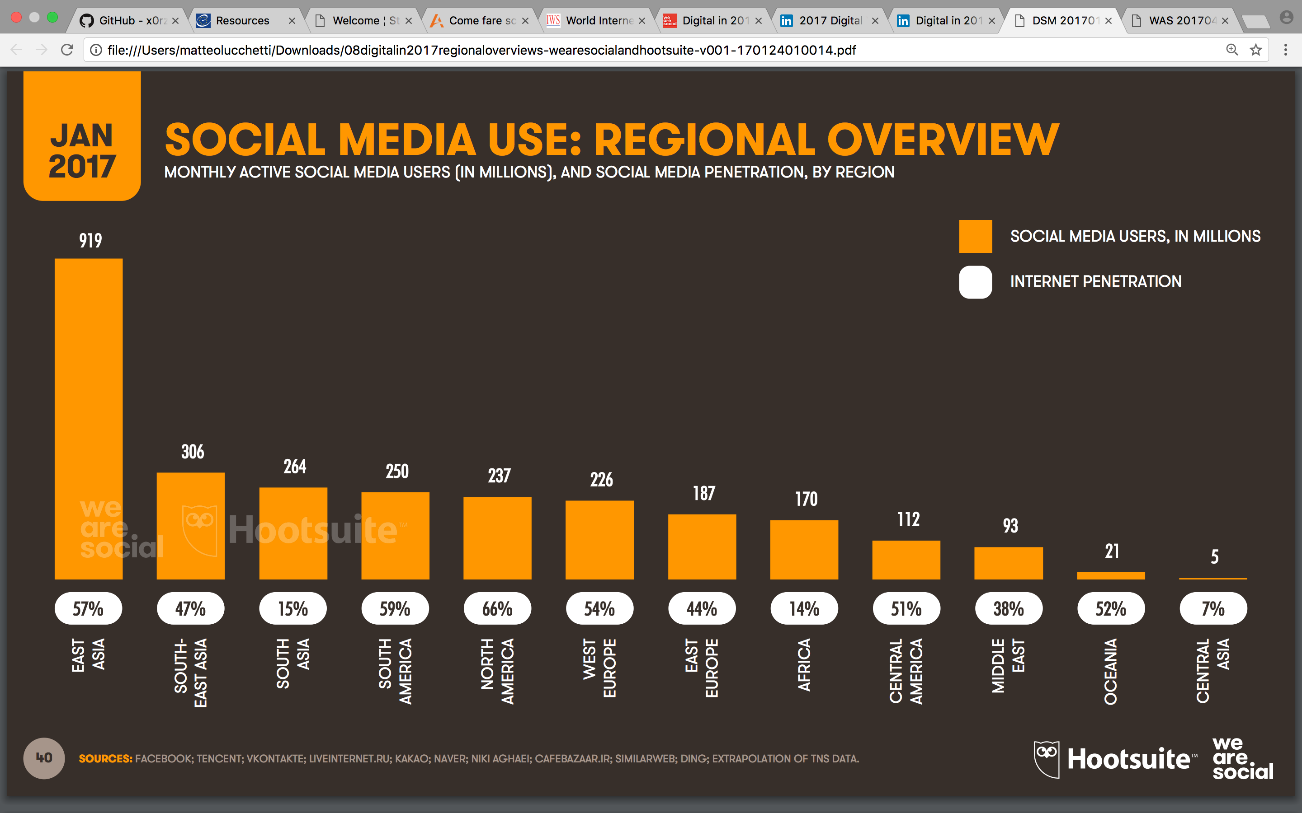
Social Network Use by Region 2017
https://www.slideshare.net/wearesocialsg/digital-in-2017-global-overview

Slide 108
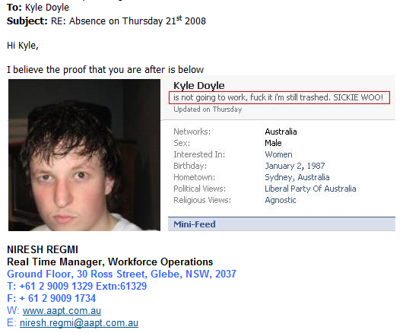
Post and be damned! aka “I didn’t expect it to be read by you!!”
Social networking site Friendster sacks employee over blog
Writing about site's "pokey" performance at issue...
Friendster, known for breaking new ground in online social networking and promoting self-expression among peers, fired one of its employees on Monday for her personal web log, or online diary.
Joyce Park, a web developer living in Sunnyvale, California, said her managers told her on Monday that she stepped over the line with her blog, Troutgirl. They declined to elaborate, except to say that it was CEO Scott Sassa's ultimate decision, Park said.
Park, 35, said: "I only made three posts about Friendster on my blog before they decided to fire me, and it was all publicly available information. They did not have any policy, didn't give me any warning, they didn't ask me to take anything down."
Friendster spokeswoman Lisa Kopp said that the company does not comment about employee matters.
Sacked for calling job ‘boring’ on Facebook
By Daily Telegraph Reporter
A TEENAGER has been sacked after calling her office job “boring” on Facebook.
Kimberley Swann, 16, said she was taken into the manager’s office and told her employment would be terminated because of her comments on the social networking website.
She was handed a letter that read: “ Following your comments made on Facebook about your job and the company we feel it is better that as you are not happy and do not enjoy your work we end your employment with …”
Students' trial by Facebook
Oxford University staff are logging on to Facebook and using evidence they find on student profiles to discipline students.
Photos on the social networking website of undergraduates celebrating the end of their exams have been emailed to students by the proctors, Oxford's disciplinary body, as evidence of breaches of the University's code of conduct.
Students now face fines of up to £100 after proctors collected evidence of students celebrating the end of exams by "trashing" their friends, covering them with champagne, confetti, flour, and even foodstuffs including raw meat and octopus.
Students may be unable to graduate until the disciplinary hearings are resolved.
Notes:
The trainer should consider providing examples of the types of information that is available to investigators. Some examples are provided in the presentation that may be of use, although trainers should try to find examples relevant to the geographical location of the participants.

Slide 109
Online Gaming

Slide 110
What is Online Gaming
An online game is a game played over some form of computer network. This almost always means the Internet or equivalent technology, but games have always used what technology was current; modems before the Internet and hard wired terminals before modems.
The expansion of online gaming has reflected the overall expansion of computer networks from small local networks to the Internet and the growth of Internet access itself.
Online games can range from simple text based games to games incorporating complex graphics and virtual worlds populated by many players simultaneously.
Many online games have associated online communities, making online games a from of social activity beyond single player games
Source: www.wikipedia.com

Slide 111
Cybercrime in online gaming
Decades ago, “crime” in relation to gaming might have meant stealing a game or gaming console from a store in a shopping centre. Now, with online gaming, there are many more ways for criminals to lie, cheat, and steal for their own advantage, or to take down other players.
Examples:
Hacking - Some cyber criminals may try to lure you to give information about yourself so they can hack your personal or gaming accounts
Phishing - They may tell you they can help you get more game currency or level up faster.
Gold-farming - Some cyber criminals use botnets to generate in-game assets—such as “gold”, “coins”, or “gems”—which they may try to sell to other players, typically at a discount.
Cyberbullying - Part of the fun in online gaming is the competiveness between players. However, there is a difference between harmless competition and cyberbullying
Notes:
Additional information can be retrieved here:
https://www.getcybersafe.gc.ca/cnt/blg/pst-20161017-en.aspx
And here:
https://www.cybrary.it/2016/10/cybercrime-gaming-industry/

Slide 112

Chinese man stabbed over
'theft' of virtual sword
Virtual reality turned into murder in China after a spat between gamers ended with a man being stabbed to death for 'stealing' a weapon that existed only in an online role playing game.
Qui Chengwei, 41, from Shanghai, had won the 'dragon sabre' in the Internet game Legend of Mir III, but decided to lend it to his fellow player Zhu Caoyuan. The row flared when Caoyuan sold the virtual weapon to another gamer for about £500 without Chengwei's consent.
Chengwei's pleas to local police fell on deaf ears as it was decided that no theft had legally been committed because the sword did not exist in the physical world. After hearing this ruling Chengwei broke into Caoyuan's home and stabbed him in the chest.
Chengwei was found guilty of murder and given a suspended death sentence but will spend the rest of his life in prison.
Source - vnunet.com, 9th June 2005

Slide 113
Streaming

Slide 114

Media streaming
Streaming media is multimedia that is constantly received by and presented to an end-user while being delivered by a provider
Typically audio and video signals are streamed
It is an alternative to file downloading, a process in which the end-user obtains the entire file for the content before watching or listening to it.
Notes:
Streaming media is multimedia that is constantly received by and presented to an end-user while being delivered by a provider
Typically audio and video signals are streamed
It is an alternative to file downloading, a process in which the end-user obtains the entire file for the content before watching or listening to it.

Slide 115
Media streaming
Legislation varies when it comes to streaming. In some countries streaming copyright protected material is considered illegal since part of the data might be temporarely buffered/stored on the user’s computer (depending of the streaming client).
However, depending on the client that is used for streaming there might be no evidential data on the suspect’s computer.
Notes:
Legislation varies when it comes to streaming. In some countries streaming copyright protected material is considered illegal since part of the data might be temporarely buffered/stored on the user’s computer (depending of the streaming client).
However, depending on the client that is used for streaming there might be no evidential data on the suspect’s computer.

Slide 116
Internet Anonymity & Traceability
Notes:
Internet anonymity is an important subject to be covered at the basic level on this course. These terms will be encountered by judges and prosecutors on a regular basis. Examples of anonymous services should be given with an explanation of how they work. The difference between anonymous and transparent transmission should be explained. The slides provided in the presentation may assist trainers in developing their own materials.

Slide 117
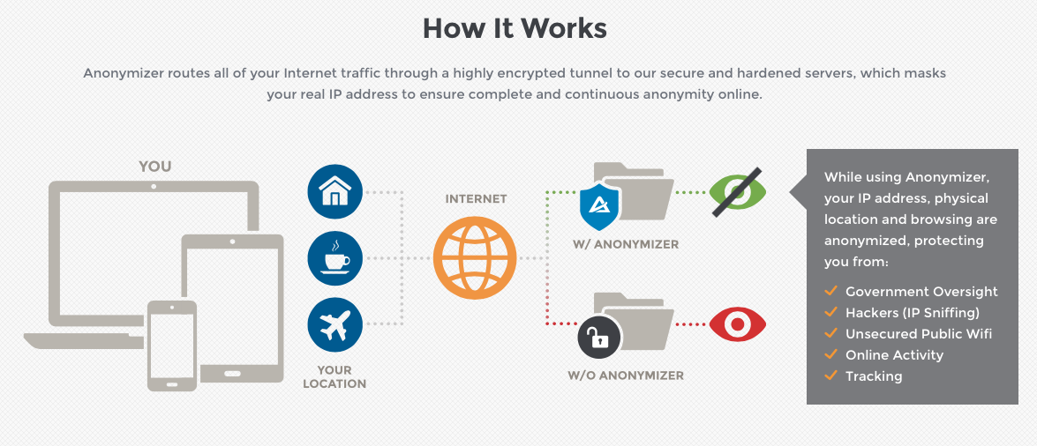

Anonymised surfing
By using service providers such as http://www.anonymizer.com/
By using “bulletproof” VPN-
or Proxy providers, e.g.
Notes:
The purpose of anonymity on Internet – conceal the user’s identity or to spoof a certain geolocation.
What can be the scope of application?
Free speech without fear;
Ability to access media from all over the world without any restriction;
Securing communication;
and anonymity is an obvious advantage for an offender.

Slide 118


Proxy Servers
Any traffic routed through a proxy (server) will appear to come from its IP address, not your computer’s.
If ‘Anonymous’ then recipient sees
218.12.171.14 and -
If ‘Transparent’ then recipient sees
218.12.171.14 but
ALSO 212.99.110.242
True IP Address
212.99.110.242
True IP Address
218.12.171.14
Anonymous: 218.12.171.14 - [07/Jan/2017:16:08:43+0100] “GET/test.html HTTP/1.0” 200 1921 www.coe.int “-” “Mozilla/4.0 (compatible; MSIE 7.0; Windows NT 6.0)” “-”
Transparent: 218.12.171.14 – [07/Jan/2017:17:08:51+0100] “GET/test.html HTTP/1.0” 200 1921 www.coe.int“-” “Mozilla/4.0 (compatible; MSIE 7.0; Windows NT 6.0)” “212.99.110.242

Slide 119
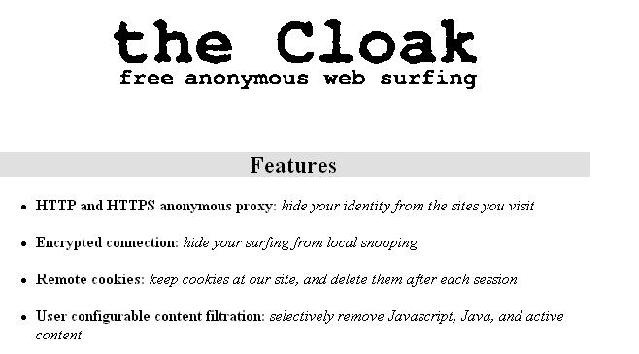
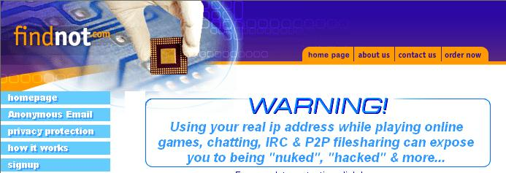
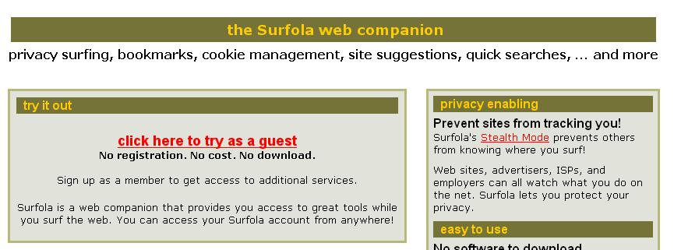

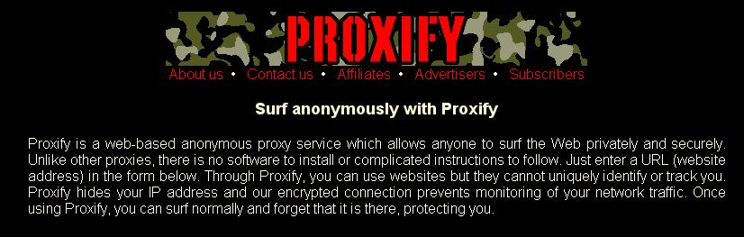
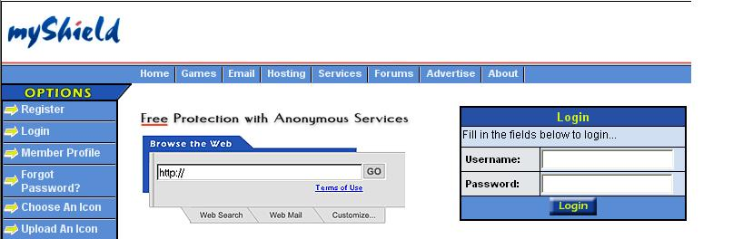
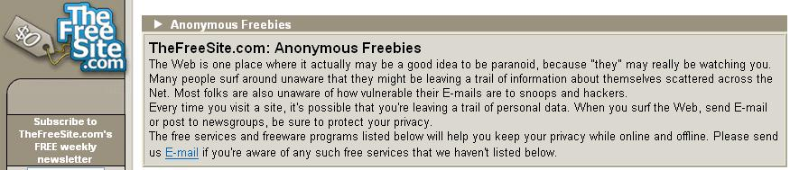
Lots of people want to be anonymous

Slide 120
The Darknet

Slide 121
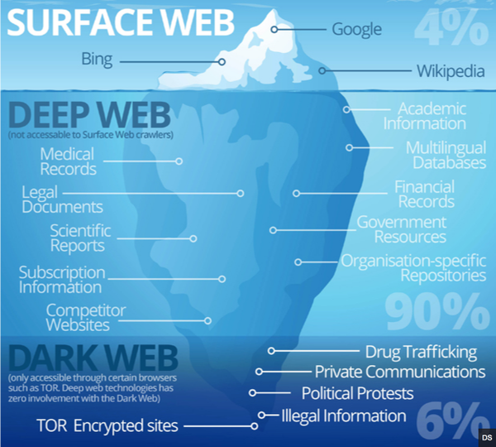
Surface web vs. Deep web vs. Dark web
Notes:
While the Internet is a place where service and information providers typically want to publish and share data with the general public, there is also a demand for more private areas accessible to a restricted group of people for exclusive purposes. Some of these areas are public places that can only be found by people who have the correct address. Take for example, the couple that want to share photographs of their wedding with their family and friends. They would not want every user of the Internet to see the photos. In this case they could upload the pictures to a cloud service and share the link to the gallery only with personal friends and family. Of course this is not a very secure way to share private data, but it is easy and since the photos would not be regarded as highly confidential this solution might be enough for most people.
There are also other hidden areas of the Internet for which login credentials are needed. A typical bulletin board and a normal webmail account are just two examples of private areas that cannot be found by a search engine or accessed because of their login requirement. Besides the sites that are intentionally hidden from public search engines, there are also websites and databases which cannot be indexed by the search engines because their contents cannot be understood or analysed by them.
The collective name for all those areas of the Interne that are hidden from search engines is called the “Deep Web” (other names are “Hidden Web”, “Invisible Web” or “Deepnet”).
Besides the websites, databases and documents that are not indexed by the search engines there is another layer of the Deep Web: the so-called “Darkweb”. The Dark Web, cannot be searched by the standard search engines. However, while Deep Web websites can be accessed by a normal web browser if the visitor knows the address or the login credentials this is not true for Dark Web websites.
The Dark Web is constituted from Dark nets that are small peer-to-peer networks, as well as large popular networks like Freenet, I2P and ToR.

Slide 122

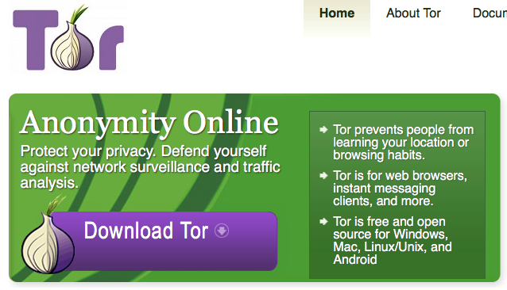
TOR – The Onion Router
TOR – The Onion Router – It’s an anonymous communication system over the Internet
Mid 1990’s
Main goal – military use, but also
  A way to circumvent censorship
  Suitable to gather anonymous reports/ data/ information by journalists
Notes:
TOR – The Onion Router – It’s an anonymous communication system over the Internet
Created in mid 1990’s for military use, it has been used with time as
A way to circumvent censorship
Suitable to gather anonymous reports/ data/ information by journalists
Traffic encryption makes it resistant to eavesdropping and traffic analysis
A specific browser (the TOR browser) is needed to access websites on the Darknets, not accessible otherwise through usual browsers such as Firefox, Explorer, Chrome, Opera, etc.

Slide 123

TOR – How does it work?
Notes:
Explanation should be given of the decoupling mechanism effected by the Middle relay and on the fact that information passes through a series of consecutive encryption steps, so that the address of the source is not detectable at the destination.

Slide 124
TOR hidden services
Hidden TOR Services include:
Directories, portals, and information
Search engines
File storage
Peer-to-peer file sharing
Social media
Email
Instant messenger
Marketplaces (especially for illegal materials and services)
News, whistleblowing and archives of document archives
Pornography

Slide 125



TOR hidden services
Domain .onion

Slide 126
Relevance of the Darknet
The anonymity of the Darknet has attracted merchants and customers trading in illegal material and services such as:
  weapons
  drugs
  counterfeit money
  fake ID cards, stolen identities
  botnets, hacking services
  child-abuse material, even child-abuse „services“
  contract killers and many more...
Notes:
The Deep Web and in particular the Darknet are relevant to law enforcement investigations because the anonymity of the Darknet has attracted merchants and customers trading in illegal material and services such as weapons, drugs, counterfeit money, fake ID cards, stolen identities, botnets, hacking services, child-abuse material, even child-abuse services and contract killers. The most prominent example of such a marketplace is the “Silk Road”.
Investigation into the Deep Web and the Darknet is a specialist task that goes beyond the scope of this basic course. However the following reading list might point readers into the right direction:
A beginner’s guide to exploring the Dark Net: http://electronician.hubpages.com/hub/A-Beginners-Guide-to-Exploring-the-Darknet
Deep Web Links: http://deepweblinks.org
Deep Web Directories and search engines: http://www.thehiddenwiki.net/deep-web-directories-search-engines/
Guide to TOR hidden services and elements of the TOR network: http://en.wikibooks.org/wiki/Guide_to_Tor_hidden_services_and_elements_of_the_Tor_ network
An Adaptive Crawler for Locating Hidden-Web Entry Points, Luciano Barbosa, University of Utah, http://www.cs.utah.edu/~juliana/pub/ache-www2007.pdf

Slide 127
Investigate challenges
Anonymity is the biggest challenge
No indexing of hidden services → No search tool
High volatility of hidden markets
Almost impossible to track back the traffic

Slide 128
Anonymous E-mail

Slide 129
Anonymous e-mail services
Offer the facility to send anonymous mail:
Service is completely anonymous. The service does not check and accordingly does not store the data on you
  Copies of letters and any files are not stored on the server
  Service is completely free-of-charge
Examples:
  cotse.com
  anonymizer.com
  hushmail.com

Slide 130

Free anonymous e-mail services

Slide 131
Hushmail headers
Microsoft Mail Internet Headers Version 2.0
Received: from smtp3.hushmail.com ([65.39.178.135]) by exchange1.coe.int with Microsoft SMTPSVC(6.0.3790.0);
Tue, 07 Jan 2017 11:31:55 +0100
Received: from smtp3.hushmail.com (localhost.hushmail.com [127.0.0.1])
by smtp3.hushmail.com (Postfix) with SMTP id 7F7E4A3330
for <jane@coe.int>; Tue, 07 Jan 2017 02:31:32 -0800 (PST)
Received: from mailserver2.hushmail.com (mailserver2.hushmail.com [65.39.178.21])
by smtp3.hushmail.com (Postfix) with ESMTP;
Tue, 07 Jan 2017 02:31:31 -0800 (PST)
Received: from mailserver2.hushmail.com (localhost.hushmail.com [127.0.0.1])
by mailserver2.hushmail.com (8.12.6/8.12.3) with ESMTP id k2SAVUZ3082938;
Tue, 07 Jan 2017 02:31:30 -0800 (PST)
(envelope-from shiftyone@hushmail.com)
Received: (from nobody@localhost)
by mailserver2.hushmail.com (8.12.6/8.12.3/Submit) id k2SAVUAI082935;
Tue, 07 Jan 2017 11:31:30 +0100 (GMT)
Message-Id: <200603281031.k2SAVUAI082935@mailserver2.hushmail.com>
Date: Tue, 07 Jan 2017 11:31:29 +0100
To: <jane@coe.int>
Cc: <joe@gmail.com>
Subject: Test
From: <shiftyone@hushmail.com>
Content-type: text/plain; charset="UTF-8"
Return-Path: shiftyone@hushmail.com
X-OriginalArrivalTime: 07 Jan 2017 10:31:55.0904 (UTC) FILETIME=[D6139000:01C65252]

Slide 132
Virtual Currencies

Slide 133
Definition of virtual currencies
Real currency
A virtual currency is a digital representation of value that can be digitally traded and functions as
a medium of exchange;
a unit of account; and/or
a store of value,
but does not have legal tender status in any jurisdiction. (Financial Action Task Force )
Virtual currencies means a digital representation of value that is neither issued by a central bank or a public authority, nor necessarily attached to a fiat currency, but is accepted by natural or legal persons as a means of payment and can be transferred, stored or traded electronically.
FIAT money
Alternative currency
Digital currency
Crypto currency
(Proposal for a DIRECTIVE OF THE EUROPEAN PARLIAMENT AND OF THE COUNCIL amending Directive (EU) 2015/849 on the prevention of the use of the financial system for the purposes of money laundering or terrorist financing and amending Directive 2009/101/EC)
Notes:
Widely acknowledged definitions of virtual currencies/digital currencies refer to the work done by the Financial Action Task Force (FATF), an inter-governmental body developing and promoting policies to combat money laundering and terrorist financing.
According to FATF, A virtual currency is a digital representation of value that can be digitally traded and functions as
1. a medium of exchange;
2. a unit of account; and/or(3) a store of value, but does not have legal tender status in any jurisdiction.
According to FATF, Digital currency can mean a digital representation of either virtual currency (non-fiat) or e-money (fiat). The term digital currency provides a term by which it is possible to refer to digital representations of both fiat and non-fiat currencies.
A crypto currency is a digital currency in which encryption techniques are used to regulate the generation of units of currency and verify the transfer of funds, operating independently of a central bank. Crypto currencies are a subset of alternative currencies, or specifically of digital currencies.
Definition given by the European Court of Justice: “49. Transactions involving non-traditional currencies, that is to say, currencies other than those that are legal tender in one or more countries, in so far as those currencies have been accepted by the parties to a transaction as an alternative to legal tender and have no purpose other than to be a means of payment, are financial transactions.
52. In the case in the main proceedings, it is common ground that the ‘bitcoin’ virtual currency has no other purpose than to be a means of payment and that it is accepted for that purpose by certain operators.
55. It is common ground that the ‘bitcoin’ virtual currency is neither a security conferring a property right nor a security of a comparable nature.” (European Court of Justice Judgment C-264/14 October 22nd 2015)
[The trainer can ask the participants if they ever heard of crypto currency. If nobody answers the trainer can continue asking if anybody ever heard of „Bitcoin“. Depending on the answers the trainer can continue engaging the audience by asking if they ever had a case involving crypto currency.]

Slide 134
Characteristics of crypto currency
Global
No borders at all
Decentralised
Easy to set up
Anonymous
Transparent
Transaction fees are low
Fast transfers
!! Irreversible transactions
Notes:
[This slide is animated.]
„All of you know your real currency and crypto currency might be something completely new for you. You might ask yourself how someone could spend real money to buy something completely virtual. But think about it: In former times, the currency was bound to the gold-standard which meant that every money bill in your wallet represented the promise that you could go to a bank and exchange that money for a certain amount of physical gold. That meant that there was only as much money circulated as there was gold in the stocks of the central banks. Now that the major currencies are not bound to the gold-standard anymore your „real“ money bills basically only have the value of the paper they are printed on. Of course this is not entirely true, but basically the value of the bill relies on the trust that you can buy certain goods for exactly this amount of money. Inflation and deflation can have a big impact on the value of your currency.
Going one step further, most of your money is stored and transferred on bank accounts. You do not see the money bills anymore, it‘s just binary digits on computer systems. So each and every month you work hard only to get a certain amount of digits transferred to your account. The real value of those digits comes with the acceptance of them in a variety of shops and persons like your landlord.
Crypto currency is very similar to those digits. It is just stored in another form of account and has one big disadvantage at the moment: It is not publicly accepted by everybody.
In addition to that, crypto currencies have some characteristics that distinguish them from traditional currency:
1. decentralised
The networks of crypto currencies are not controlled by one central authority. Every machine that mines coins and processes transactions makes up a part of the network, and the machines work together. That means that, in theory, one central authority can’t tinker with monetary policy and cause a meltdown – or simply decide to take people’s bitcoins away from them, as the Central European Bank decided to do in Cyprus in early 2013. And if some part of the network goes offline for some reason, the money keeps on flowing.
2. easy to set up
Setting up a bank account at a conventional banks requires you to fill out an array of forms and to pass certain requirements. Setting up merchant accounts for payment is another Kafkaesque task, beset by bureaucracy. However, you can set up a bitcoin address in seconds, no questions asked, and with no fees payable.
3. anonymous
Sending and receiving money in a virtual wallet instead of a real bank account seems to offer a higher anonymity. There is no need to proof your identity when setting up a wallet. A single user can hold multiple bitcoin addresses, and they aren’t linked to names, addresses, or other personally identifying information. However…
4. completely transparent
…bitcoin stores details of every single transaction that ever happened in the network in a huge version of a general ledger, called the blockchain. The blockchain tells all.
If you have a publicly used bitcoin address, anyone can tell how many bitcoins are stored at that address. They just don’t know that it’s yours.
There are measures that people can take to make their activities more opaque on the bitcoin network, though, such as not using the same bitcoin addresses consistently, and not transferring lots of bitcoin to a single address.
5. Transaction fees are low
Your bank may charge you a 10 EUR fee for international transfers. Bitcoin doesn’t – there are only very low transaction costs that are used to reward the work and costs of the miners.
6. Fast transfers
You can send money anywhere and it will arrive minutes later, as soon as the bitcoin network processes the payment.
7. Irreversible transactions
When your bitcoins are sent, there is no getting them back, unless the recipient returns them to you. They are gone forever.
„

Slide 135

Types of Virtual Currencies
Notes:
The usual classification of Virtual Currencies refers to the work done by the FATF, which distinguishes four classes of Virtual Currencies as depicted in the Taxonomy illustrated on the slide.

Slide 136







Crypto currency in the news
Notes:
[This slide is animated.]
This slide shows some examples of crypto currencies in the news and also indicated why they are relevant to law enforcement.

Slide 137




Types of crypto currencies
Notes:
There are over 640 different crypto currencies (07/2015). A nice overview can be found here: http://coinmarketcap.com/all/views/all/
The by far most important and most well-known crypto currency is Bitcoin which was invented in late 2008 by „Satoshi Nakamoto“. However, it is important to know that there are also other crypto currencies as well. Some of them were created because Bitcoin became too „heavy“ – meaning that it is not really handy to pay transactions. Others were created to overcome weaknesses of Bitcoin, e.g. DASH (the X11 Logo; formerly known as Darkcoin) to allow fully anonymous transactions or Litecoin to allow faster transactions as well as smaller transactions.
Most of the currency are based on the same approach: A peer-to-peer network to mine coin and validate transactions and a pre-defined, limited supply of the currency.

Slide 138

The theory behind Bitcoin
Notes:
[ A recommendation would be to show the video found on https://bitcoin.org/ (https://youtu.be/Gc2en3nHxA4)]
Here is a simplified example of how Bitrcoin works:
The sender and receiver both have a wallet for a certain crypto currency (in this case Bitcoin). The wallet has a certain address – similar to your bank account number. Now the sender advises his Bitcoin client to send a certain amount of Bitcoins to the receiver. He authenticates himself with his private key. Only when the private key is correct, the transaction will be started. Once the transaction is created the whole network of miners now starts to solve an extremely complex mathematical exercise to validate this exact transfer. The miners get a small transaction fee for their work. This guarantees that there are enough miners there and that all the transactions get validated. Once the transaction is validated it gets written to the blockchain, a register that records all transactions ever made. The blockchain is stored at every single client in the Bitcoin network.
As the graphic shows there are also other receivers of Bitcoin than just private persons. A sender can also send his Bitcoins to Banks, money transfer services and exchanges to exchange Bitcoins to real money or other crypto currencies. And of course: there are also a number of shops, both on the internet and in real life, that accept Bitcoin as payment for their products and services.

Slide 139

The theory behind crypto currency
A wallet is loosely the equivalent of a bank account. The wallet actually contains the owner‘s private keys which allow him to spend coins allocated to his address in the block chain (comparable to a PIN).
A Miner is a person who uses computer hardware to process mathematical calculations for the crypto currency network. Those calculations are used to confirm transactions.
The block chain is a public record of all transactions in the network of the crypto currency. They are stored in chronological order. The block chain is shared between all users of that network and is used to verify the balance of wallet addresses.
The private key is a secret piece of data that proves your right to spend coins from a specific wallet address through a cryptographic signature. Each wallet address has ist own unique private key.
Notes:
Here are some explanations for vocabulary that is frequently used when talking about crypto currencies:
The Wallet: A wallet is loosely the equivalent of a physical wallet on a crypto currency network. The wallet actually contains the owner‘s private keys which allow him to spend coins allocated to his address in the block chain.
The Miner: Mining is the process of making computer hardware do mathematical calculations for the crypto currency network to confirm transactions.
The block chain: The block chain is a public record of all transactions in the network of the crypto currency. They are stored in chronological order. The block chain is shared between all users of that network and is used to verify the balance of wallet addresses.
The private key: The private key is a secret piece of data that proves your right to spend coins from a specific wallet address through a cryptographic signature. Each wallet address has ist own unique private key.

Slide 140
Use of crypto currency to launder money
Mixers
  Coins deriving from criminal transactions get mixed with coins of other users at a central Mixer address.
  The Mixer sends back individual transactions.
Tumblers
  Coins deriving from criminal transactions are sent to a tumbler service.
  The Tumbler will mix coins, transfer them through different other wallets in different amounts.
  The Tumbler will send the coins back in a variety of transactions with different amounts.
Notes:
[This slide is animated.]
The fact that all transactions in the network are publicly trackable in the block chain could prove that certain amounts of coins have been exchanged between certain users at a certain point of time over even over and over again. That could prove relationships between accounts or even connections to certain crimes. That is why different solutions were created to better protect privacy and to better disguise tracks in an open system like a crypto currency network. The two main solutions that are of interest for money launderers are:
- Mixers
Coins deriving from criminal transactions get mixed with coins of other users at a central Mixer address.
The Mixer sends back individual transactions.
- Tumblers
Coins deriving from criminal transactions are sent to a tumbler service.
The Tumbler will mix coins, transfer them through different other wallets in different amounts.
The Tumbler will send the coins back in a variety of transactions with different amounts.

Slide 141








Investigation techniques
Notes:
[This slide is animated.]
[If Internet is available, it might be a good idea to show www.blockchain.info live.]
We already discussed that crypto currencies are not traded anonymously because all transactions are stored publicly in the block chain. You can access information from the block through either a client or different websites. One of those websites is blockchain.info.
Using the information that you can see in the following pictures you can search for a certain transaction (the one relevant for your case) and you can get further information about this transaction, e.g. which wallet address sent which amount to which receiving wallet address, or even the IP address that started that transaction. That could be a first hint. Another option is to request information about a certain wallet address (the one that is interesting for your case) from the big exchange platforms and markets, e.g. btc-e.net or even local bitcoin markets like bitcoin.de. Some of these platforms even require the users to verify their identity with their ID and to provide a validated bank account (to buy coins).
Those are the kind of traces that can help our investigations. Nevertheless – investigations on crypto currencies remain challenging.

Slide 142

Challenges for investigations
“follow the money”, “follow the goods” alone will not work
Technically more sophisticated
Not anonymous, yet oftentimes difficult to track
Heavily dependent on service provider information
Lack of SOPs for seized crypto currencies
Notes:
[This slide is animated.]
As you can imagine, crypto currencies put up some challenges for law enforcement & judiciary. Those challenges include but are not limited to:
The “follow the money”, “follow the goods” approach alone (!) will not work anymore. We still have to follow the (virtual) money but that will lead us traces that need further investigations (e.g. IP addresses).
Investigating crypto currencies is technically more sophisticated. Law enforcement and judiciary need to be trained.
Even though crypto currencies are not anonymous, it is oftentimes difficult to track the suspect when mixers/tumblers are used
The investigation of a suspect heavily relies on information from service providers (wallet services, exchange services, ISP, etc).
Lack of SOPs for seizing crypto currencies as criminal proceed.
The picture on the slide should shown how criminal marketplaces accept bitcoin as option for payment.

Slide 143
Questions
Notes:
The trainer should give participants an opportunity to ask any questions that they may have in relation to part Four of the lesson.

Slide 144
Part Four
Internet Crimes
Notes:
As the final substantive section of the lesson, the trainer should seek to identify ways in which the technology that has been explained is used in the commission of criminal offences. The session starts out with some statistics that should give the audience an idea about typical cyber crime cases.

Slide 145
Example Statistics (US)
Year | Complaints Received
2015 | 288,012
2014 | 269,422
2013 | 262,813
2012 | 289,974
2011 | 314,246
2010 | 303,809
2009 | 336,665
2008 | 275,284
2007 | 206,884
2006 | 207,492
2005 | 231,493
2004 | 207,449
2003 | 124,515
Source - US Internet Crime Complaint Center – Jan 10, 2017

Slide 146

Cybercrimes per continent
Source – UNODC – Comprehensive study on cybercrime (2012)

Slide 147

Most significant cybercrime
Source – UNODC – Comprehensive study on cybercrime (2012)

Slide 148
Access to Data Case Studies
Cybercrime Case Studies
Pointing out
challenges

Slide 149

Access to Data Case Studies
Case 1:
A „typical“ cybercrime investigation

Slide 150









Typical cyber crime investigations
Suspects have deployed ransomware on victim’s machines
All data encrypted
Victims report this crime
Victim computers are analysed by LE
Ransomware shows behaviour to communicate to certain IP addresses
Notes:
If there is something like a “typical” cyber crime investigation it will probably fall into the categories of online fraud (e.g. BEC/CEO fraud or “just” ebay fraud) or ransomware being used for cyber extortion.
Ransomware is malware that typically enables cyber extortion for financial gain. Criminals can hide links to ransomware in seemingly normal emails or web pages. Once activated, ransomware prevents users from interacting with their files, applications or systems until a ransom is paid, typically in the form of an anonymous currency such as Bitcoin.
Ransomware is a serious and growing cyber threat that often affects individuals and has recently made headlines for broader attacks on businesses. Payment demands vary based on targeted organisations, and can range from hundreds to millions of dollars.
Once infected, a victim has little recourse. If they do not pay the ransom, they suffer business down time, loss of sensitive information or any other penalty specified by the attacker. And even when they do pay the ransom, they remain vulnerable to attack from the same attacker or a new one, and reward attackers for their successful tactics.
In those cases as described the victims report this crime. The victim computers are then analysed by LE. Most ransomware shows behaviour to communicate back to their servers (in order to check for successful payment to decrypt the user data).

Slide 151
Typical cyber crime investigations
Challenge:
Subscriber information needed!
Directly from service providers
Budapest Convention 24/7 POC
MLA requests
Police / Prosecution networks
Bulletproof hosters being used
Hijacked servers being used
Payment via virtual currency
Notes:
If there is something like a “typical” cyber crime investigation it will probably fall into the categories of online fraud (e.g. BEC/CEO fraud or “just” ebay fraud) or ransomware being used for cyber extortion.
Ransomware is malware that typically enables cyber extortion for financial gain. Criminals can hide links to ransomware in seemingly normal emails or web pages. Once activated, ransomware prevents users from interacting with their files, applications or systems until a ransom is paid, typically in the form of an anonymous currency such as Bitcoin.
Ransomware is a serious and growing cyber threat that often affects individuals and has recently made headlines for broader attacks on businesses. Payment demands vary based on targeted organisations, and can range from hundreds to millions of dollars.
Once infected, a victim has little recourse. If they do not pay the ransom, they suffer business down time, loss of sensitive information or any other penalty specified by the attacker. And even when they do pay the ransom, they remain vulnerable to attack from the same attacker or a new one, and reward attackers for their successful tactics.
In those cases as described the victims report this crime. The victim computers are then analysed by LE. Most ransomware shows behaviour to communicate back to their servers (in order to check for successful payment to decrypt the user data).

Slide 152

Access to Data Case Studies
Case 2:
Phishing case

Slide 153
Phishing case
Current, ongoing cases
Massive phishing attacks for online banking credentials via spoofed banking e-mails
Wiretapping ongoing → Credentials to a mail account
LE has access to the mail account
Mail account being used as a draft account
Challenge:
No other possibilities to investigate on the criminals than to copy mails from the account:
—> Even tough the mail account has a certain TLD that is not considered enough to exclude the possibility that data might be within own territory
—> Even though there is an order for wiretapping already there, there is no direct communication between the criminals because of the usage of the draft mail account
Notes:
Current, ongoing cases. Massive phishing attacks for online banking credentials via spoofed banking e-mails. Analysis of e-mail headers and subsequent investigations have let to a suspect. A wiretapping have been ordered on that suspect’s DSL line. While the suspect uses encrypted communication for most of the time, one session could be recorded that was unencrypted and included credentials Credentials to a mail account. LE has access to the mail account and reports that the mail account being used as a draft account.
The trainer could ask and exchange experience with the audience if their legislation allows them to produce an order for accessing and copying the data that mail account even if it was not clear whether the mail server is physically located within the territory of their country.

Slide 154

Access to Data Case Studies
Case 3:
SQL Injection
Notes:
In general terms, SQL Injection (SQLi) refers to an injection attack wherein an attacker can execute malicious code that control a web application’s database.
Since an SQL Injection vulnerability could possibly affect any website or web application that makes use of an SQL-based database, the vulnerability is one of the oldest, most prevalent and most dangerous of web application vulnerabilities.
By leveraging an SQL Injection vulnerability, given the right circumstances, an attacker can use it to bypass a web application’s authentication and authorization mechanisms and retrieve the contents of an entire database. SQL Injection can also be used to add, modify and delete records in a database, affecting data integrity.

Slide 155
SQL Injection case
Current, ongoing case
Hacking case involving several suspects
One or more main suspect(s) being the provider of a server specialised in conducting SQL injections on other servers
One of their customers got arrested for carrying out these injections.
This customer gave out the credentials of the server
LEA imaged the hard drive to potentially get hold of the main suspect(s)
Notes:
Current, ongoing case. Hacking case involving several suspects. One or more main suspect(s) being the provider of a server specialised in conducting SQL injections on other servers.
One of their customers got arrested for carrying out these injections.This customer gave out the credentials of the server. LEA imaged the hard drive to potentially get hold of the main suspect(s). The trainer could ask and exchange experience with the audience if their legislation allows them to produce an order for imaging the data on the remote server even if it was not clear whether the server is physically located within the territory of their country.

Slide 156
Some More Examples
Notes:
The trainer should seek to identify relevant cases from the region in which the course is being held and use these as examples. At the end of the session, the trainer should encourage the participants to share their own knowledge and experience of internet crimes.

Slide 157
Examples of cyber scams
Investment schemes
Using the Internet to solicit financial support for high tech schemes such as virtual shopping sites or new service providers
Credit-card schemes
Using unlawfully obtained credit card details to purchase high value goods over the Internet
Business Opportunities/Work at Home Schemes
Internet used to advertise business opportunities whereby victim pay up front for information or products associated with work-at-home schemes

Slide 158
Examples of cyber scams
419 Frauds
West African frauds – means of delivery has changed – it’s now electronic mail instead of traditional mail or fax requests otherwise nothing changes – potentially vast access by spamming.
Internet Banking
Simply copy a banks web-site, change the web-address slightly, provide links to legitimate bank services and just one or two links to high yield investments that require transfers of significant sums to ensure inclusion in a truly unbelievable investment opportunity.

Slide 159
Examples of cyber scams
Disaster Charity Appeals
Within 1 hour of Far East Tsunami, web-sites appealing for aid to the victims had arrived on the Web, many (if not all at this time) were bogus
Herbal Viagra
In the area of alternative medical treatments on-line, spammed to ‘customers’, most of the products have no beneficial effects (if delivered at all), some are just outright dangerous

Slide 160

Examples of cyber scams
Russian Brides
Sites offering contacts with beautiful East European women and cheap visits to Russian states

Slide 161
Examples of cyber scams
Lottery Wins
Request for payment to claim lottery winnings or assistance to win (often foreign lotteries)
Phishing
E-mail messages pretending to be from well-known source (such as bank, or an internet service provider) asking to confirm personal information

Slide 162
Why does this seem so familiar?
From: KAILASH [yuvraj@london.com]
Sent: Friday, 25 January 1980 6:42 a.m.
To:
Subject: URGENT
CONFIDENTIAL U.K. FAX NUMBER: 44-870-1357604
Dear Sir,
Pardon me for starting this great proposal this way as it might surprise you. My name is Yuvraj Kailash a native of Nepal and attorney to the late king of Nepal who died as a result of loss in temper caused by an argument between him and his family, as they were against him marrying his fiancie .You were recommended by a close confidant. Who assured us of your capability and reliability to assist us. We seek the assistance of someone who is genuinely interested in entering into a business relationship with long term focus, and willingness of a kind heart to help.
If you are conversant with events in Nepal in May/June last year 2001, (June 1 2001), the media was filled with reports that Crown Prince Dipendra of Nepal had shot and killed several members of the Nepalese Royal Family, among whom were his parents King Birenda and Queen Aiswarya, before trying to kill himself.
Prior to the late kings death (Prince Dipendra), he kept aside a secret amount of money, for his fiancie (Miss Divyani Rana) worth over US$30,000,000.00 (Thirty million United States Dollars). This was made in the heat of misunderstanding between him and members of his family. The money was kept away in such a way to prevent any member of his family from having any access or trace to the funds, which was just a part of his wealth, this was like a gift to his fiancie and a further affirmation to her that he was surly going to marry her, even though, his family was against their marriage. We have kept this a secret for sometime now and feel this is the right time to execute this transaction.
The death of my late boss, left us stranded, we have therefore been searching for a genuine and reliable person or company of trust and with whom the Nepalese Royal Family have never had any previous, personal or business relationship with. That person will assist in the transfer and business re-investment of this money. We cannot do it alone due to our present social status. We also intend to give you a reasonable share of the funds for your assistance. These funds have been hidden away, known only to his fiancie and myself. We would want you to safeguard this fund from being clamped down by any body or agencies.
As soon as we receive your letter of acceptance/acknowledgement, I shall give you more highlights on this transaction.
THIS IS A RISK FREE TRANSACTION AND MUST NOT BE REVILED TO ANYONE NOT EVEN YOUR LAWYER, ATTORNEY, FAMILY, FRIENDS ETC. If you are capable and trust worthy and can keep to our instructions to make the above Proposal a reality. Then CONTACT US IMMEDIATELY ONLY THROUGH OUR CONFIDENTIAL U.K FAX NUMBER: 44-870-1357604 AS INDICATED ABOVE DO NOT REPLY US BY EMAIL. Please indicate in your reply your PERSONAL/CONFIDENTIAL TELEPHONE NUMBERS, CELLULAR OR MOBILE NUMBER, CONFIDENTIAL FAX NUMBER AND YOUR CONFIDENTIAL EMAIL ADDRESS when replying.
GOD BLESS YOU.
Yuvraj Kailash

Slide 163
And again....
Date: 06:52:47 -0700 (PDT)
From: Joseph Almadaaj <josephkuwait405@yahoo.com
Subject: PERSONAL PRIVATE DONATION.
To:
Home Address
Salhia Complex,
Fahed Al-Salem Street,
Safat 13126, Kuwait.
Dear,
How are you and your family, I got your church contact when I visited the church website and it took me so much time, before I decided to contact you and I pray you will not disappoint me for the offer I am about to give to you.
I am Abdul Moshen Madaaj Al-Madaaj from Kuwait. I am 83 years old; I lost my wife four years ago. Before her death we were happily married for 50 years and we were blessed without a child. I am an industrialist but I retired from active business 6 years ago because I am infected with prostrate cancer and now my condition is so bad that my doctor told me I won't live up to three months. I have been a Moslem since I was born, my late father was a Sheikh but last year I have converted myself to be a Christian and my new Christian name is Joseph. I have accepted Christ as my only Saviour, and I know our Lord Jesus Christ has accepted me. During my time as an Industrialist I acquired a lot of wealth running into millions of dollars and I have realised that wealth without Christ is vanity upon vanity. I have decided to donate part of my wealth to be used for the development of your church and also for the lest privileged children and I will want you to use the money for the said purpose. I am donating the sum of $1,000,000.00 Dollars to your church. I have already transferred the money to Offshore Payment Security Company in Europe. Where you will go and sign for the money. I will forward to you the name of the security company, telephone, fax number and transfer security code numbers which I used in transferring the money from my bank in Kuwait. I am sending this mail to you from my sick bed in a private hospital. Please I will want you to receive this money from me before I die, I want you to always pray for me because I am in a very bad state and also
you must promise me that you must use the money for the said purpose.
Alleluia, Alleluia.
The Lord Jesus Christ said, if you have to die, keep fit and I will give you the crown of life.
Alleluia, Alleluia.
I await your urgent response.
God Bless.
Joseph Al-Madaaj

Slide 164
Questions
Notes:
The trainer should give participants an opportunity to ask any questions that they may have in relation to part Five of the lesson.

Slide 165
Part Six
Summary
Notes:
This lesson has sought to provide some guidance as to the type and level of technology knowledge that is required by Judges and prosecutors to fulfil their role effectively. It does not purport to be a complete analysis of the issues and where relevant indicates where further information may be obtained.
It is recommended that training developers ensure that the material they prepare is as up to date and incorporates the latest technology issues as they impact on criminal behaviour; its impact on the legal, procedural and evidential rules within the jurisdiction where the training is to be delivered. There are technological changes that will affect the criminal justice system, such as solid state storage of data and Web 2.0. These will be important issues to include in training programmes and require inclusion as they become more prevalent.
As with any other programme, any training course developed for Judges should have clear objectives, which are SMART (Specific, Measurable, Achievable, Relevant and Time Bound). This is essential to be able to ensure the objectives are met. Avoid use of objectives with words such as “understand” or “know” as these do not meet the criteria. For example how do you measure if the objective of “knowing” a subject is achieved? It is better to use words such as list or identify, which are measurable. A guide to setting SMART objectives may be found at www.sheffield.ac.uk/.../Guide%20to%20setting%20objectives.doc
The use of case studies to inform the learning is considered suitable for this type of training and is more in keeping with adult learning styles than purely didactic teaching.
The key role of the training developer is to ensure the overall aim of any learning event and the specific objectives are achieved. This chapter provides some information to assist that process.

Slide 166
Session Objectives
At the end of this session participants will be able to:
List the component parts of a computer system
Identify different types of data storage device
Consider the criminal justice implications of exponential data storage capacity
Identify different computer operating systems
Explain the basics of how networks function
Describe the functions of the Internet
Identify at least 5 major Internet applications
Explain how the Internet has developed from its beginning to today.
Differentiate between different Internet applications
Describe the difference between the Darknet and the Deepweb
Explain the basics of virtual currencies
Identify how criminals use the various Internet applications
Notes:
Review of Session Objectives
The trainer should recap / test knowledge on the following objectives to ensure they have been met during the session:
- List the component parts of a computer system
- Identify different types of data storage device
- Consider the criminal justice implications of exponential data storage capacity
- Identify different computer operating systems
- Explain the basics of how networks function
- Describe the functions of the Internet
- Identify at least 5 major Internet applications
- Explain how the Internet has developed from its beginning to today.
- Differentiate between different Internet applications
- Describe the difference between the Darknet and the Deepweb
- Explain the basics of crypto currencies
- Identify how criminals use the various Internet applications
This may be achieved by way of group discussion, questioning of the participants, a quiz or other recognised methods.
This lesson has sought to provide some guidance as to the type and level of knowledge of electronic evidence that is required by Judges and prosecutors to fulfil their role effectively. It does not purport to be a complete analysis of the issues and where relevant indicates where further information may be obtained.
It is recommended that training developers ensure that the material they prepare is as up to date and incorporates the latest issues as they impact on criminal behaviour; its impact on the legal, procedural and evidential rules within the jurisdiction where the training is to be delivered. There are technological changes that will affect the criminal justice system, such as solid state storage of data and Web 2.0. These will be important issues to include in training programmes and require inclusion as they become more prevalent.

Slide 167
Questions
Notes:
The trainer should give participants an opportunity to ask any questions that they may have in relation to the lesson.
Practical Exercises (if applicable)
No practical exercises are envisaged for this particular session as there is no guarantee that the level of technology and Internet access to deliver such exercises will be available at all venues.
Trainers may in the future seek to supplement to learning by adding exercises, where the training is delivered in an environment where the facilities are suitable. Examples for such exercises are: Whois queries, IP-geolocation lookups, Bitcoin Blockchain demonstrations, etc.
Knowledge Check
No specific knowledge check is currently envisaged for this course. No official assessment has been requested

