Slide 1
iPROCEEDS
Project on targeting crime proceeds on the Internet in South-eastern Europe and Turkey
Introductory Cybercrime Training for Judges and Prosecutors
Session 1.1.4 Identifying Suspects on the Internet

Slide 2
Session Objectives
Refresher: Know what an IP address is.
Describe how you can find a suspect IP address.
Describe how you can associate a suspect IP address with a real person.
List three technical challenges to identification of suspects on the Internet.

Slide 3
IP Address (version 4)
IP address consists of four numbers between 0 and 255, separated by full-stops/periods.
E.g.
  1.2.3.4
  200.4.0.188
There is also a newer form of IP addresses (version 6) which will not be discussed here.

Slide 4
IP Address (version 4)
Some IP addresses are not valid on the Internet, only for private (internal) use:
  10.x.x.x
  192.168.x.x
  172.16.x.x-172.31.x.x

Slide 5
Identifying Suspect IP Address

Slide 6
Online Activity
A user’s online activity might generate records.
These records might contain the IP address of the user’s communication.
This can be an important piece of information for identifying a suspect.
  Necessary but not sufficient!

Slide 7
Case Study: Web Browsing Activity
Web browsing activity involves a user sending requests to a web server and the web server sending responses back to the user.
The format of the requests and responses is described using a protocol known as Hypertext Transfer Protocol (HTTP).
By default, a web server will log all incoming requests, including the IP address from which the request was received.

Slide 8
Case Study: Web Browsing Activity
192.220.98.177 - - [23/Sep/2006:21:09:27 -0400] "GET / HTTP/1.0" 206 1729 "-" "Servmon::Monitor::apache/1.03"
216.128.130.126 - - [23/Sep/2006:21:30:02 -0400] "GET /pgp/ HTTP/1.0" 200 1871 "http://dir.yahoo.com/Computers_and_Internet/Security_and_Encryption/PGP___Pretty_Good_Privacy/" "Mozilla/4.0 (compatible; MSIE 6.0 [en] Win NT 5.1; U)"
66.196.73.20 - - [23/Sep/2006:21:33:35 -0400] "GET /pgp/pgpdoc2/pgpdoc2_65.html HTTP/1.0" 200 7185 "-" "Mozilla/5.0 (Slurp/cat; slurp@inktomi.com; http://www.inktomi.com/slurp.html)"
63.229.162.177 - - [23/Sep/2006:21:34:31 -0400] "GET /stephen/singers/ HTTP/1.1" 200 1936 "http://www.dosado.com/callers/default.htm " "Mozilla/4.0 (compatible; MSIE 5.5; Windows 98; Win 9x 4.90)"
138.162.0.41 - - [23/Sep/2006:21:36:27 -0400] "GET /gallery/Colorado02?&page=2 HTTP/1.0" 200 19649 "http://www.google.com/search?q=st+malo+chapel+colorado&hl=en&lr=&ie=UTF-8&start=20&sa=N" "Mozilla/4.76 [en] (Windows NT 5.0; U)"
12.255.212.29 - - [23/Sep/2006:21:51:42 -0400] "GET /cgi- bin/formmail.cgi?recipient=lharleyren49@aol.com&subject= http://www.gildea.com/cgi-bin/formmail.cgi&body=48462427&email=uqizakzbi@aol.com HTTP/1.1" 404 291 "-" "Mozilla/4.0 (compatible; MSIE 5.0; Windows 98; DigExt)"
64.156.198.78 - - [23/Sep/2006:21:52:53 -0400] "GET /wang-center/schedules/wang.html HTTP/1.1" 200 1438 "-" "Mozilla/5.0 (X11; Linux i686; en-US; rv:1.0rc5; OBJR)"
163.139.58.174 - - [23/Sep/2006:21:54:29 -0400] "GET /sd/ HTTP/1.1" 304 - "-" "Mozilla/4.0 (compatible; MSIE 6.0; Windows NT 5.1; .NET CLR 1.0.3705)"
205.188.209.51 - - [23/Sep/2006:21:57:23 -0400] "GET / HTTP/1.0" 200 1729 "http://aolsearch.aol.com/dirsearch.adp?query=Gildea"

Slide 9
Case Study: Web Browsing Activity
216.128.130.126
-
-
[23/Sep/2006:21:30:02 -0400]
"GET /pgp/ HTTP/1.0"
200
1871
"http://dir.yahoo.com/Computers_and_Internet/Security_and_Encryption/PGP___Pretty_Good_Privacy/"
"Mozilla/4.0 (compatible; MSIE 6.0 [en] Win NT 5.1; U)”

Slide 10
Case Study: Email Activity
Email is not sent directly from one person to another.
Rather, a technique known as “store and forward” is used.
Records of the storing and forwarding of a particular email message are associated with that message.
Each person has an incoming and an outgoing mail server and email is sent and delivered as shown on the next slide.

Slide 11
Case Study: Email Activity
Email is not sent directly from one person to another.
Rather, a technique known as “store and forward” is used.
Each person has an incoming and an outgoing mail server and email is sent and delivered as shown on the next slide.

Slide 12
Internet
The mail is forwarded to the incoming (POP3) mail server of Bob’s ISP
Alice’s ISP then forwards the E-mail out onto the Internet
POP3
Server
SMTP
Server
SMTP
Server
POP3
Server
When Alice presses SEND her E-mail is moved from her computer to her Internet Service Providers outgoing mail server
The next time Bob connects to his ISP the E-mail is downloaded to his computer
ALICE
BOB

Slide 13
Case Study: Email Activity
An email consists of two parts
  Header: Contains information about who the message is from, who it is for, subject, date etc..
    …and how it has been stored/forwarded!
  Body: The actual content of the email message.
An example email with headers is shown on the next slide.

Slide 14
Microsoft Mail Internet Headers Version 2.0
Received: from xproxy.gmail.com ([66.249.82.197]) by exchange1.trl.org with Microsoft SMTPSVC(6.0.3790.0); Tue, 27 Mar 2007 09:44:54 +0100
Received: by xproxy.gmail.com with SMTP id h28so988094wxd
for <Jim.Stark@trl.org>; Tue, 27 Mar 2007 00:44:31 -0800 (PST)
DomainKey-Signature: a=rsa-sha1; q=dns; c=nofws;
s=beta; d=gmail.com;
h=received:message-id:date:from:to:subject:in-reply-to:mime-version:content-type:references;
b=RY8mK69lgiScvczLvTJmfvlXoZa1zUskwWsukAn3jlzblALGzxF/pzpDKyrEnIDyZrKp8VnthCyCgyHOfi7KCHhaseAXG4UAQO8zIbSFDxw6uVN0jUVYQx0a60pjkFBxmdzL/PCDEllSFEExVQB+m0WD/lcGQEgGmecYV1nRmy8=
Received: by 10.70.100.14 with SMTP id x14mr6330299wxb; Tue, 27 Mar 2007 00:44:30 -0800 (PST)
Received: by 10.70.122.16 with HTTP; Tue, 27 Mar 2007 00:44:30 -0800 (PST)
Message-ID: <95ecf0550603280044n7a18048fs8e37cf2c2ea3a3d8@mail.gmail.com>
Date: Tue, 27 Mar 2007 09:44:30 +0100
From: "Jim Stark" <jc.stark@gmail.com>
To: "Jim Stark" <Jim.Stark@trl.org>
Subject: Re: test
In-Reply-To: <42675D880C511048AE555539A210615627A281@exchange1.trl.org>
MIME-Version: 1.0
Content-Type: multipart/alternative;
boundary="----=_Part_21605_28805312.1143535470923"
References: <42675D880C511048AE555539A210615627A281@exchange1.trl.org>
Return-Path: jc.stark@gmail.com
X-OriginalArrivalTime: 27 Mar 2007 08:44:54.0322 (UTC) FILETIME=[E283E920:01C65243]

Slide 15
Multinational Service Provider Records
Multinational Service Providers (Facebook, Google. Etc.) might be able to tell you which IP address was used by a subscriber at a particular time.
Need to know the ID (e.g. Facebook user ID) of the suspect.
International cooperation typically required.

Slide 16
Covert Investigation Techniques
If you already have a suspect, covert investigation techniques (e.g. Wiretapping) can be used to identify the IP address(es) in use by the suspect.

Slide 17
ASSOCIATING IP Address TO Real world IDENTITY

Slide 18
Demonstration:
What is MY IP ADDRESS?

Slide 19
Why not?
IP address might allow identification of:
  Internet Service Provider
  Geolocation

Slide 20
ISP Records
Internet Service Providers will typically keep records of which subscriber was using a particular IP address at a particular time.
How long these records are retained for will depend on national legislation.
How to get access to these records will depend on national legislation.

Slide 21
ISP Records: Questions
What is involved in getting access to ISP subscriber data?
How do you know which ISP to request data from?

Slide 22
Geolocation: Questions
Where do you think the geolocation data comes from?
Absolutely no guarantees of reliability!

Slide 23
Why not?
Also, not always traceable to a specific person:
  Static vs. Dynamic IP addresses
  Network Address Translation (NAT)
The time of the activity is crucial!

Slide 24
Corporations
Corporations using Network Address Translation (NAT) may have the records to be able to associate suspect activity with a specific internal IP address.
How engagement with the company takes place will depend on national legislation.
Records seldom exist.

Slide 25
Even if you can find the computer…
Who was using the computer?
Remote control of the computer?
WiFi access point?
Use of VPNs?

Slide 26
Some MORE Technical Challenges

Slide 27
Challenges
Intentional and unintentional, legitimate and illegitimate obfuscation may take place.
Some example will be discussed.

Slide 28
Anonymising Services
Both paid and free services are available to conceal online activity.
Anonymising web proxies specifically conceal the source of web browsing activity.
Anonymising email providers specifically conceal the sender of email.
Anonymising IP proxies conceal all the source of all Internet traffic.
  Example: TOR

Slide 29
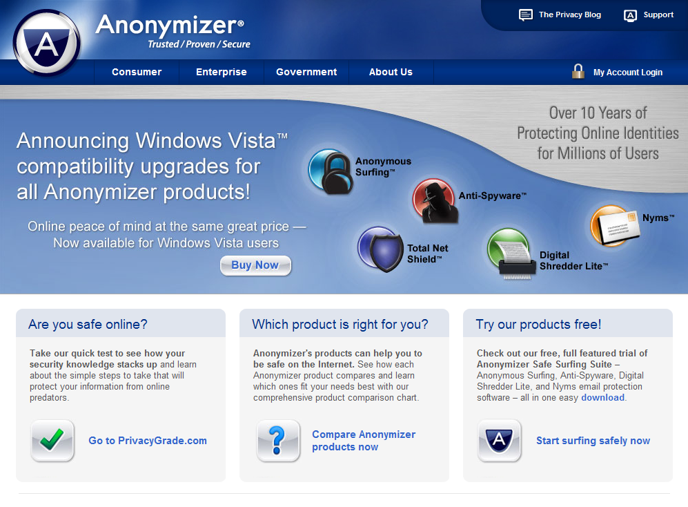

Slide 30
Encryption
It is possible that communication might be encrypted.
Either the content of the entire communication might be encrypted.

Slide 31
Carrier Grade NAT
A technique for associating a very large number of users with a single IP address.
Commonly used for Internet connectivity on mobile phone networks.

Slide 32
Summary
IP addresses are a necessary but not sufficient identifier of a person’s online activity.
Associating an IP address with a real person is extremely difficult.
Technologies are available to make tracing a person online even more difficult.
Wherever possible other sources of evidence should be used to support the IP address evidence.

Slide 33

Questions

