Slide 1

Introductory Training on Cybercrime, Electronic Evidence and Online Crime Proceeds
iPROCEEDS
Project on targeting crime proceeds on the Internet in South-eastern Europe and Turkey
Sessions 1.3.2
Electronic Evidence Practice & Procedure
Notes:
These sessions cover the subject of electronic evidence and are based very much on the content of the Council of Europe Electronic Evidence Guide. This guide forms part of the training pack. It will be necessary for the trainer to have printed copies of the flow chart appendices as they are not easily readable from the slides. The slide notes contain additional information, where appropriate to assist the trainer. It must be remembered that these slides are provided as an example of how the aims and objectives listed in the training pack may be met. It is the responsibility of each trainer to prepare materials that suit the learning styles of the students and the teaching style of the trainer. These slides may be of assistance.

Slide 2
Agenda
Part One: What is Electronic Evidence
  Definitions
Part Two: Council of Europe Electronic Evidence Guide
  Procedures and Good Practice
    Identifying, seizing and handling electronic evidence
    Types of Seizure
    Investigating and analysing electronic evidence
    Producing electronic evidence
    Admissibility of electronic evidence
Part Three: Digital Forensics
  Definition
  Traditional vs Digital Forensics
  What Forensics can do for an investigation
Notes:
Agenda
The agenda slide lists the parts of the session and the trainer should go through these elaborating where necessary on specific aspects that have emphasis for particular groups of students. The trainer should explain how the materials will be delivered and that there will be time for interaction and questions. The trainer should emphasis that this training is designed to be interactive and that delegates will be expected to participate throughout. The trainer should explain whether there is an assessment and what form that would take, including details of any pass mark that is applied. (For this pilot programme, no assessment is included).

Slide 3
Session Objectives
By the end of this session delegates will be able to:
Discuss the contents of the COE Electronic Evidence Guide
Discuss various types of electronic evidence
Explain the principles of best practice relating to the Seizure and handling of electronic evidence
Identify the challenges offered by “dead box”, “live data” and Internet sources of electronic evidence, including evidence in the “cloud”.
Discuss the admissibility of electronic evidence in judicial proceedings
Explain the proper planning and preparation of a search raid where digital evidence may be found.
Explain how a crime scene would be secured and documented, where digital evidence occur.
Notes:
It is important that the delegates should understand what the objectives of the lesson are. These should be “SMART” objectives and explained in detail to the delegates before the session begins, using the information on the slide.

Slide 4
Session Objectives
By the end of this session delegates will be able to:
Explain the term Digital Forensics
Compare Digital Forensics to traditional forensic sciences
Define at least three sub-branches of Digital Forensics
Identify the four steps in Digital Forensics examinations
Differentiate the two categories of digital traces
Describe how Digital Forensics can support investigations
Notes:
It is important that the delegates should understand what the objectives of the lesson are. These should be “SMART” objectives and explained in detail to the delegates before the session begins, using the information on the slide.

Slide 5
Part One
What is Electronic Evidence

Slide 6

Examples
Notes:
The trainer should begin a discussion with the group by identifying types of electronic evidence and encouraging the participants to give details of their knowledge of the issue. The trainer should then list the types highlighted on a flip chart or white board. The trainer should complete the list if the audience does not highlight particular types of evidence. The list should include both types of evidence e.g. dead box, live data, memory, Internet, as well as sources of evidence such as those dealt with in the technology section of the course.

Slide 7
Definitions
Notes:
All criminal proceedings depend on evidence to decide the guilt or innocence of an accused or to decide the merits of a case in civil proceedings. Traditionally and historically, evidence has been in a physical form (such as documents or photographs etc.) or the oral testimony of witnesses.
Electronic evidence is derived from electronic devices such as computers and their peripheral apparatus, computer networks, mobile telephones, digital cameras and other portable equipment (including data storage devices), as well as from the Internet. The information it contains does not
possess an independent physical form.
However, in many ways, electronic evidence is no different from traditional evidence in that the party introducing it into legal proceedings must be able to demonstrate that it reflects the same set of circumstances and factual information as it did at the time of the offence. In other words, they must be able to show that no changes, deletions, additions or other alterations have (or might have) taken place.
The intangible nature of any data and information stored in electronic form makes it much easier to manipulate and more prone to alteration than traditional forms of evidence. This has created special challenges for the justice system which requires that such data be handled in a special way
to ensure the integrity of the evidence it offers.
Given its special characteristics electronic evidence could be defined as:
Any information generated, stored or transmitted in digital form that may later be
needed to prove or disprove a fact disputed in legal proceedings.

Slide 8
General Definition of Evidence
Evidence is 'any species of proof, or probative matter, legally presented at the trial of an issue, by the act of parties and through the medium of witnesses, records, documents, exhibits, concrete objects, etc. for the purpose of inducing belief in the minds of the court or jury as their contention.' Electronic information generally is admissible into evidence in a legal proceeding.
Source: Black’s Law Dictionary
Notes:
The definition of evidence is normally prescribed in national legislation. As this is an international course a generic definition has been used. This is from Black’s Law Dictionary. Trainers should replace this with national definitions when delivering this course in country.

Slide 9
What is Electronic Evidence?
All legal proceedings rely on the production of evidence in order to take place.
Traditionally and historically, that evidence has been in a physical form such as documents, photographs etc.
Evidence that is used in judicial proceedings that emanates from electronic devices such as computers and its peripheral devices, computer networks, mobile telephones, digital cameras, other mobile devices including data storage devices as well as from the Internet are all forms of electronic evidence.
Notes:
The trainer is invited to read the slide.

Slide 10
Electronic Evidence
There is no internationally accepted definition of electronic evidence. However, in all countries there are regulations containing precepts which, in some way, refer to electronic evidence.
The “definition” in the Council of Europe Guide is:
“Any information generated, stored or transmitted in digital form that may later be needed to prove or disprove a fact disputed in legal proceedings”.
Notes:
There is no internationally accepted definition of electronic evidence. However, in all countries there are regulations containing precepts which, in some way, refer to electronic evidence.
The “definition” in the COE guide is:
“Any information generated, stored or transmitted in digital form that may later be needed to prove or disprove a fact disputed in legal proceedings”.
Once again it is the responsibility of the trainer to ensure that any national definition that may exist is included in the course for in country training.

Slide 11
What is Electronic Evidence?
Electronic evidence is no different from traditional evidence in that is necessary for the party introducing it into legal proceedings, to be able to demonstrate that it is no more and no less than it was, when it came into their possession. In other words, no changes, deletions, additions or other alterations have taken place.
Notes:
The following two slides set out in general terms, the requirements for the production of evidence and explain the differences and challenges of electronic evidence.

Slide 12
What is Electronic Evidence?
The very nature of data and information held in electronic form makes it easier to manipulate than traditional forms of data. This creates specific issues for the justice system and requires that the handling of such data is carried out in a manner that ensures the continued integrity of the information may be maintained and proved.

Slide 13
Sources and Types of Evidence

Slide 14
Sources and Types of Electronic Evidence
Sources
  Any electronic device
Types
  Static data (Dead Box)
  Live data (Memory & Servers)
  Internet data
Notes:
It is not necessary to revisit the entire lists of types and sources of evidence that were identified in the technology section of this course. The trainer should recap using the list that was created at the beginning of this session.
Sources cover any electronic device. The trainer may wish to identify at this stage the importance of electronic evidence from different devices and the role they have played in cases.
The types of evidence to be covered are those involving:
Static Data
Live Data
Internet Data

Slide 15
Sources of Evidence
A computer system will be made up of a number of different components that are likely to include:
An external case housing circuit boards, microprocessors, hard drives, memory, and
connections for other devices;
A monitor or other display device;
A keyboard;
A mouse;
Externally connected drives;
Peripheral devices;
Software.

Slide 16
Sources of Evidence
Computer systems can come in many different forms including desktops, laptops, tower computers, rack-mounted systems, minicomputers, and, mainframe computers. Other devices will commonly connect to these systems including printers, scanners, routers, external hard drives and other storage devices as well as docking stations (that allow multiple connections to be made).
Notes:
It is recommended that the trainer obtains various pieces of computer hardware to use in the following section. These should include items that will contain evidence and others that do not, such as chargers, cables etc. These may then be handed to the delegates and each one asked if the piece of equipment they hold, may or may not contain electronic evidence. It is important to emphasise during the session that in addition to electronic evidence, items may contain traditional evidence such as fingerprints or DNA. The slides depicting and describing devices are present to provide assistance to a trainer where it has not been possible to acquire physical devices for the course. The trainer may simply hide these slides where devices are used or use them for supporting materials.

Slide 17
Budapest Convention Definitions
For the purposes of the Budapest Convention, the following definitions apply:
"computer system" means any device or a group of interconnected or related devices, one or more of which, pursuant to a program, performs automatic processing of data;
"computer data" means any representation of facts, information or concepts in a form suitable for processing in a computer system, including a program suitable to cause a computer system to perform a function;
Notes:
These definitions cover the devices listed at page 17 onwards in the COE electronic evidence guide.

Slide 18
Sources of Evidence
Notes:
The following 25 slides are included, along with supporting information for trainers to use to identify sources of evidence. These may be replaced or complemented by physical equipment that is recommended for use in the trainer guide lesson plan.

Slide 19
Sources of Evidence
Notes:
Hard disk drives (HDD) are the main storage devices within computer systems. They consist of a circuit board, data and power connections. Inside the hard disk drive there are magnetically charged ceramic, metal or glass platters (i.e. plates or disks) that rotate at high speed. An arm travels across the surface of the platter like in old fashioned record players and ‘writes’ the data to the disk. It is not unusual to discover separate hard disk drives during a search that are not connected to or installed in a computer system. Usually a hard disk drive in desk top computers will measure 3.5 inches (8.9 cm) across and 2.5 inches (6.35 cm) across laptops.
Solid state disks (SSD) have a different structure to hard disks and are becoming more popular. Instead of storing data on platters, solid state disks store data using microchips and have no moving parts. As such they are less likely to be damaged when dropped or knocked and offer faster access to the data.

Slide 20
Sources of Evidence
Notes:
Compact Disk (CD), Digital Video Disk4 (DVD) and Blu-ray Disks (BD) are typically used for storage of large video or audio files. They may, however, also hold large quantities of other kinds of data that can be of evidential value. Although they look very similar, the storage capacities vary greatly.

Slide 21
Sources of Evidence
Notes:
Memory cards, also known as flash cards, are also devices for storing digital information. They are used in devices such as digital cameras, mobile phones, laptop computers, music players and games consoles. They retain data without power and can store huge amounts of data while being easy to conceal.

Slide 22
Sources of Evidence
Notes:
Universal Serial Bus (USB) is the name given to a set of rules or ‘protocol’ used for communication, connection and power supply for devices that connected to computers. The range of devices using this protocol has grown enormously since it was introduced in the 1990s. Some examples of the more usual USB devices are shown below.

Slide 23
Sources of Evidence

Slide 24
Sources of Evidence
Notes:
Data stored on tape is more likely to be encountered in a business rather than a domestic setting. The most common type used now is the ‘Linear Tape-Open’ (LTO) technology developed in the 1990s as an open-format9 standard. Tapes are normally used for backup and therefore may be useful in cases where an historical analysis is required or where the original computer is not available.

Slide 25
Sources of Evidence
Notes:
Peripherals are devices that are not an integral part of the computer, but connect to it to increase its range of functions. Examples of peripheral devices are: scanners; printers; tape drives; webcams; loudspeakers; microphones; calculators; fax machines; answering machines; and card readers. Many of these devices have their own data storage capacity and may be relevant to particular types of investigation (for example, the presence of a card reader may be relevant in a credit card cloning investigation). Here are some images of just a few of the types of peripherals that might be encountered:

Slide 26
Sources of Evidence
Notes:
A tablet computer is a device that is operated by touching the screen rather than using a keyboard or mouse. It is normally larger than a mobile phone or Personal Digital Assistant (PDA). Tablets may store data in the form of a hard disk or flash memory, but , increasingly, user-generated data are stored in the cloud. Tablets have become very popular in recent years. They run their own operating systems and are often connected to the Internet via a Wireless Local Area Network (WLAN), Third Generation Mobile Telecommunications (3G) (now slowly becoming Fourth Generation or 4G) or Long Term Evolution (LTE)12 networks.

Slide 27
Sources of Evidence
Notes:
The time when a telephone was used simply for making and receiving calls is long past. Nowadays, mobile or ‘cell’ phones are used for many other tasks: sending and receiving text or multimedia messages; accessing the Internet and email; playing games; listening to music; and, taking photographs. Many modern mobile phones are really computers, although their connectivity requires them to be handled in a somewhat different manner. It is important to note that different phones have different capabilities and the way they connect (their ‘connection interfaces’) can require specialist equipment in order to capture evidence.

Slide 28
Sources of Evidence
Notes:
Digital cameras take still or video photographs in the form of thousands of small dots of light called pixels. Most modern digital cameras can also record sound as well as pictures. Digital cameras can store thousands of images on small “memory cards” (see 2.1.1.3 above) or on the camera itself. For investigations involving photographs it may be possible to prove which camera took a specific photograph because certain metadata are often stored with the image15. Examples of common types of digital camera are shown below, along with some cameras disguised as other devices.

Slide 29
Sources of Evidence
Notes:
A digital video camera also often stores its images on removable media, but can also record to a hard disk contained within the camera itself. In some cases these cameras look very similar to digital still cameras (bearing in mind that digital still cameras can usually also take video and a digital video camera can take still photographs). Some examples of video cameras are shown below.

Slide 30
Sources of Evidence
Notes:
Video recorders are usually found in the domestic setting and used to record TV programmes or other locally based activity. They are also used to playback prerecorded films, music and other data. The Video Home System (VHS) recorders were prominent from the 1970s until overtaken by digital versions. VHS was recorded and played back using large cassette tapes that may still be found under some circumstances. Certain kinds of optical discs were also produced, but did not become mainstream. Instead, the Digital Versatile Disk (DVD) became the standard. DVDs and their later evolution, Blu-ray discs, are still used today, but some modern video recorders store their recording on built-in hard drives.

Slide 31
Sources of Evidence
Notes:
Digital audio recorders are small handheld devices used to record sound on a memory chip to play the recording back. They come in various capacities in terms of maximum recording time and quality. Some recorders have a USB capability that allows the recordings to be uploaded to a computer and may have associated speech recognition software allowing for the creation of automatic draft transcripts.

Slide 32
Sources of Evidence
Notes:
Closed Circuit Television (CCTV) cameras are used by companies, governments and private individuals. CCTV cameras may be deployed continually or to monitor a particular activity. In some countries they have become a tool for surveillance in public places monitoring traffic or crowd flows, detecting public disorder or criminal activity. Some CCTV cameras record images onto storage media while others are only used for live monitoring. They can also be motion activated and operate in low light or under infrared conditions. They should always be considered as a potential source of electronic evidence wherever they are at or near a crime scene. Some examples of how CCTV cameras may look like are shown below.

Slide 33
Sources of Evidence
Notes:
Portable media players such as iPods or MP3 players store and play digital media. These can include music and other audio, photographs or video as well as documents and other types of file. Once again, these devices have many similarities with computers. Some of these devices use removable flash storage while others have large hard disks capable of storing many thousands of files. Some examples of portable media players are provided below.

Slide 34
Sources of Evidence
Notes:
Video games consoles have existed since the early 1970s, but have developed greatly over the years. These devices use onboard or removable storage that allows the users not only to play games, but also to visit websites and to store and play videos, photos and music. For this reason, they should never be overlooked as sources of electronic evidence even if they seem innocuous at first sight. Major console producers include Sony, Nintendo and Microsoft and these companies currently hold the majority of the market for consoles and games.

Slide 35
Sources of Evidence
Notes:
When two or more computers are linked by data cables or by wireless connectivity a ‘network’ is established. Computers in a network are able to share data and other resources between them and will often be connected to additional hardware components that extend their scope and the functions available. Computer networks can be limited such as those found in the home (e.g. where members of a family establish a network sharing an Internet modem) or as extensive as those used by major corporations or governments linking hundreds or even thousands of computers together.
Local Area Network (LAN) – A Local Area Network is a computer network covering a limited ‘local’ area like a home, an office, or a group of buildings (such as a school). Defining characteristic of LANs include the much higher speed they can achieve for transferring data between computers on the network, the limited geographic range and the fact that they do not
need to rent lines from telecommunications companies.
Wide Area Network (WAN) – A Wide Area Network is a computer network that covers a broader area and will include any network that crosses metropolitan, regional, or national boundaries. The term implies a network that uses routers24 and public communications links. Contrast these with personal area networks (PANs), campus area networks (CANs), or
metropolitan area networks (MANs) which are usually limited to a room, building, campus or specific metropolitan area respectively. The largest and most well-known example of a WAN is the Internet.
Some of the terminology and devices that may be encountered when dealing with networks are:
Port – There are two types of ports: computer or hardware ports and network or internet ports. A computer port is a connection point between a computer and another device where information comes in and out (examples include USB, Ethernet and parallel ports by which devices can be attached). A network port is located in the software at the point where the software connects to internet or network services. A common analogy would be the doors and windows to a building. Each port is allocated a different number in computer programming. The number identifies the port’s role and function and is set according to common standards.
Bandwidth – Like the diameter of a pipe, the size of the bandwidth indicates the maximum volume of information that can be carried along a phone line, cable line, satellite feed etc. The
greater the bandwidth, the faster the potential speed for downloading and uploading data. Media Access Control (MAC) address – The MAC address is a unique reference code assigned
by the manufacturer to most network adaptors or network interface cards (NICs). MAC addresses function as an address on a network so that devices can be identified and the appropriate data can be forwarded to it.
Network Attached Storage (NAS) – A NAS is similar to an external hard-drive with the difference that it provides storage space for a whole network rather than just a single PC. NAS can
often offer a lot more than just data storage. A NAS can be used as an automatic downloading server (e.g. uTorrent) and even as a small webserver. Many NAS devices house more than one hard drive and offer ‘RAID’ functionality.
A so-called ‘Redundant Array of Independent Disks’ (RAID) is a way of arranging the storage of data (a data ‘configuration’) using multiple disk drives. Data is stored across the individual disks to ensure the best level of performance and/or data reliability. The operating system will access the RAID as though it were a single hard disk. The access is controlled and coordinated either by software or by a hardware RAID controller. Standalone RAIDs are commonly found in network configurations and may contain huge amounts of electronic evidence.

Slide 36
Sources of Evidence
Notes:
Network Interface Controller (NIC) – is a circuit board or card installed in a computer that allows it to connect to a network.

Slide 37
Sources of Evidence
Notes:
Network Hub – A network hub or concentrator is a device for connecting multiple computers or Internet devices together so that they act together as a single part or ‘segment’ of a network. All computers in this segment are able to communicate with each other A hub transmits any data received from the network and broadcasts it to all the other devices connected to it. For an
investigator it can be hard to distinguish between hubs and switches because they basically look the same, but hubs have been largely replaced by network switches. The main difference is that a hub broadcasts all packets to all ports while a switch sends it only to the target port.

Slide 38
Sources of Evidence
Notes:
Network Switch – A network switch is very similar to a hub. Switches are mainly used to connect groups of network devices to each other. In contrast to hubs they use internally stored databases to remember which MAC address has used which port of the switch. This allows a switch to route data packets to a specific device rather than to all devices.

Slide 39
Sources of Evidence
Notes:
Router – A router is like a sorter in a post room. It is a device that identifies the destination to which a parcel or packet of data is addressed and then sends that packet on to the next point in the network nearest to where it needs to go. Although a router must be located at the gateway between networks it does not necessarily have to be linked to the Internet. Routers are commonly used in the home to connect a house to a broadband connection. In such a situation it will often serve multiple purposes acting as a switch, access point, firewall, router and gateway all together.

Slide 40
Sources of Evidence
Notes:
Server – A server is a computer or device that provides information and/or services to other computers on a network. Given the right software, any network-connected computer can be
configured as a server. In most cases, a server will be a dedicated powerful computer designed to be “always available”. One computer server can run several services (e.g. web server, email server, file server, print server etc.). In business it often makes sense to run different services on different machines for reasons of security and to minimise the impact of any failure.

Slide 41
Sources of Evidence
Notes:
Firewall – A firewall is a hardware device or software service that is used to increase the security of a network by preventing unauthorised access. For instance a firewall may be configured (set up) to detect and block any attempt to enter a network using multiple ports except for those ports that have been configured to allow incoming traffic. In homes, it is more common to find a software firewall, but in business settings the investigator is more likely to come across hardware firewalls.

Slide 42
Sources of Evidence
Notes:
Wireless Access Point – Wireless Access Points connect Wireless LAN devices to the rest to the network. In every WLAN infrastructure an access point is necessary whenever there are more than two devices. Modern routers can often function as an Access Point. A computer’s NIC or even a mobile phone can also be configured to act as an Access Point.
While the network devices listed above can be standalone devices as shown in the photographs, it is very likely that a single device will serve multiple purposes. Routers in the home often function as a modem, firewall, switch and access point and a Networked Attached Storage (NAS) system may also serve as a Virtual Private Network , E-Mail and Webserver with switching as well as access point capabilities.

Slide 43
Sources of Evidence
Potential Evidence on These Devices
Computer hardware and software, as well as the networks and systems to which a device is connected, can hold important data that have been created either automatically by the device itself or by the user. User-generated data would include documents, photos, image files, e-mails and their attachments, databases and financial information.
Computer generated data would include the Internet browsing history, chat logs, event logs and data about other services, computers and networks to which the device has been connected.
Notes:
The following slides take the trainer from the descriptions of devices to the discussion about the characteristics and considerations of electronic evidence that may be present on these devices.

Slide 44
Unique characteristics
It is invisible to the untrained eye
It may need to be interpreted by a specialist
It is highly volatile
It may be altered or destroyed through normal use
It may be copied without limits
Notes:
Electronic evidence shares most properties with traditional forms of evidence, but possesses some unique characteristics that distinguish it:
It’s invisible to the untrained eye: Electronic evidence is often found in places where only specialists would search or locations reachable only by means of very specific tools. Just as a scanning electron microscope allows an entomologist to identify key morphologic features of fly eggs, specific tools exist in digital forensics to examine and analyse data found in computers.
It may need to be interpreted by an specialist: Information found on computers is of little use to a non-specialist as he will not be able to extract the properties or the related evidence that assures that the relevant information is truthful and has not been manipulated or tampered with. In some cases, just as in blood spatter pattern analysis, highly specialised knowledge must be applied.
It is highly volatile: Sometimes, electronic evidence is found on devices in which the state (0 or 1 per bit) of their memory gets overwritten every time a specific event happens. In some cases it might be the loss of power, in other cases it could be that an automated system overwrites old information in order to leave spaces to store new information. Devices on which electronic evidence might reside must be preserved as soon as possible.
It may be altered or destroyed through normal use: Devices constantly change the state of their memories, be it on user request (“save this document”, “copy this file”) or automatically by the computer operating system (“allocate space for this program”, “temporarily store information to swap it between devices”). This characteristic highlights the importance of handling the electronic device in an appropriate way from the moment it is identified as relevant for an investigation.
It can be copied without limits: digital information can be copied indefinitely and each copy will be exactly like the original. This unique attribute allows multiple, exact copies of the original to be distributed and analysed by different specialists at the same time. It also allows electronic evidence to be presented as-is in a court along with the specialist witness report.

Slide 45
Considerations for Electronic Evidence
Handling by specialists
Rapid evolution of electronic evidence sources
Use of proper procedures, techniques and tools
Admissibility
Authenticity
Completeness
Reliability
Believability
Proportionality
Notes:
Handling by specialists: Each electronic device has specific characteristics, so specific procedures must be strictly followed to access its memory where electronic evidence could be stored. In the case of electronic evidence, one of the most prominent risks is the unintentional modification of part of the evidence. This could raise doubts about the specific changes, and whether the incriminating or exonerating evidence has been tampered with, which could in turn raise admissibility problems in Court.
Rapid evolution of electronic evidence sources: New technologies develop very quickly and there is a need for constant update not only of the new technologies themselves but also of the procedures and techniques that have to be applied in order to seise their content and analyse it.
Use of proper procedures, techniques and tools: As in more traditional forensic disciplines, digital forensic specialists require, besides the specialist knowledge, specific tools to undertake their job properly, such as to capture all original information from advice. It is imperative that adequate techniques and tools are used, and that procedures are traceable and repeatable by other specialists, so that the captured information is of evidentiary value.
Admissibility: Since the ultimate goal is the use of acquired and analysed evidence to support a case in court, electronic evidence must be obtained in compliance with existing legislation and best practice procedure to be admissible in a trial. Although the details differ depending on national legislation, the following basic criteria must generally be taken into account.
Authenticity: It must be possible to positively tie evidentiary material to the investigated incident.
Completeness: It must tell the whole story and not just a particular perspective.
Reliability: There must be nothing about how the evidence was collected and subsequently handled which causes doubt about its authenticity and veracity.
Believability: It must be readily believable and understandable to a judge and/or the members of a jury.
Proportionality: its application to Digital Forensics establishes that the whole investigative process must be adequate and appropriate: the benefits that are to be gained by using a specific measure must outweigh the harms for the party or parties affected by the measure.

Slide 46

Questions
Notes:
The trainer should give participants an opportunity to ask any questions that they may have in relation to this part of the lesson.

Slide 47
Part Two
Council of Europe
Electronic Evidence Guide

Slide 48
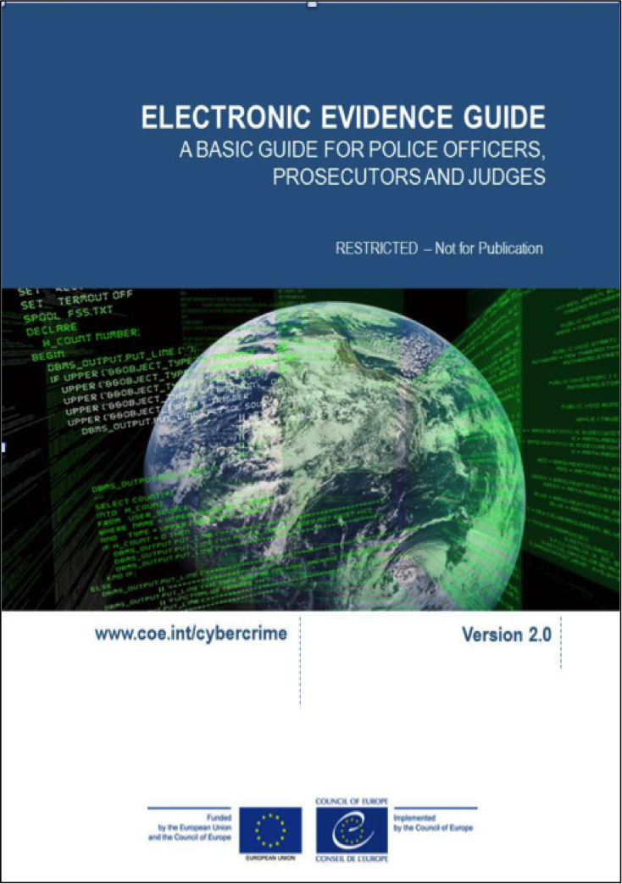

Slide 49
Preface To Using The Guide
The guide may be applied to all cases in which electronic evidence should be seized.
Each country should take its own legal documents and regulations into consideration when interpreting the measures proposed in this document. In addition, each country should add its own expert units’ contact information.
An organisation or agency wishing to apply the recommended procedures should determine the responsibilities for individual steps/actions according to its internal structure.
Notes:
This slide is a simple introduction to the guide. It is important that for national training, the trainer includes the national legislation and any guidelines that may be available. It is recommended that a comparison between national and COE guidelines would be useful as an indication of the compatibility of national standards with those applied internationally.

Slide 50

Background Of The Guide
The need: Requests made by participants in many activities organised under the different cybercrime projects of the Council of Europe, including joint projects with European Union pointing out on the need for more guidance in dealing with electronic evidence.
The Cybercrime@IPA project in cooperation with the global Project on Cybercrime supports the ongoing development of a guiding paper on electronic evidence
It provides an important tool for law enforcement and judges in their efforts to investigate, prosecute and adjudicate cybercrimes.
Notes:
The following 14 slides provide an explanation of the background to the guide, its purpose, audience and the way in which the guide should be used. They are self explanatory and it is recommended that the trainer is conversant with the guide before attempting to deliver this session.

Slide 51

Purpose Of The Guide
The purpose: provide support and guidance in the identification, handling, and examination of electronic evidence.
It is not intended to be a manual of instruction with step-by-step directions as to how to deal with electronic evidence through all the phases of an investigation.
It is primarily a basic level document however; some are more detailed sections that provide very practical advice for specialists.

Slide 52
  Who the Guide is for
This guide has been prepared for use by countries that are developing their response to cybercrime and establishing rules and protocols to deal with electronic evidence.
Most of the existing guides have been created for the law enforcement community.
This guide is for a wider audience and includes also judges, prosecutors and others in the justice system such as private sector investigators, lawyers, notaries and clerks.

Slide 53
  How the Guide Should be Used
This guide is for use by those encountering sources of electronic evidence during their work and intending to use the information acquired from those sources in the justice system of their country or for use in the justice system of another jurisdiction.
This guide is to be seen as a template document that can be adapted and customised by countries based on their legislation, practice and procedure.

Slide 54
How the Guide Should be Used
The guide sets out some overarching principles to guide the reader. These principles are in accordance with those generally accepted internationally as good practice in dealing with electronic evidence.

Slide 55
How the guide should be used
The reader should ensure that they are fully conversant with the laws in their own country that deal with electronic evidence and its admissibility.
The national law is the primary source of reference in all circumstances. It is not expected that advice given in the guide is likely to contravene any national legislation in terms of the practicalities of dealing with such evidence.

Slide 56
How the guide should be used
The guide is broken down into chronological sections that aim to provide support for any person dealing with electronic evidence.
These cover all stages from the initial identification of sources of potential evidence, to search and Seizure of data including capture from the Internet, and on to analysis, preparation and reporting of evidence.
There then follows specialist sections for law enforcement, prosecutors, judges, and the private sector investigator, lawyers, notaries and clerks.

Slide 57






Document Symbols
Information
Important
Information
Highly Technical
Information
Basic
Knowledge
Advanced
Knowledge
Specialised
Knowledge

Slide 58
Guide Structure and Content
Introduction
Evidence Sources
Search and Seizure – Onsite / Suspect
Capturing Evidence from the Internet
Data Held by Third Parties
Analysing Evidence
Preparation and Presentation of the Evidence
Jurisdiction
Role Specific Considerations
Cases
Glossary
Further Information
Appendices

Slide 59
Appendices
Appendix A – Search and seizure law enforcement flowchart
Appendix B – Live forensics flowchart
Appendix C – Private sector preparation flowchart
Appendix D – Private sector search and seizure flowchart
Appendix E – Acquisition of digital evidence flowchart
Appendix F – Chain of custody record
Appendix G – Custodian Questionnaire
Appendix H – Template exhibit labels
Appendix I – Acquisition sheet

Slide 60
The Budapest Convention
The Budapest Convention offers many provisions to enhance investigations where electronic evidence is involved. Some of these are mentioned in this guide; however this is not a guide to the Convention and the reader should always refer to the authoritative documents available from the Council of Europe when seeking to use these provisions.

Slide 61
Precedence
In circumstances where the reader is not sure what course of action to take, they should refer back to the principles in order to take the most effective course of action.
The reader should use the advice that is relevant to the types of evidence they are dealing with and seek specialist assistance where the issues they are dealing with go beyond the scope of the guide.

Slide 62
Validity of the Guide
This guide and the information contained within are considered valid until 31st December 2017.
It is intended that the guide will be updated before that date to take into account any relevant changes in technology, procedures and practices that are relevant to the content of this guide.
Any person or organisation wishing to use the guide after the above date should contact the Council of Europe to obtain the latest version.

Slide 63
Electronic Evidence Principles
Notes:
All criminal proceedings depend on evidence to decide the guilt or innocence of an accused or to decide the merits of a case in civil proceedings. Traditionally and historically, evidence has been in a physical form (such as documents or photographs etc.) or the oral testimony of witnesses.
Electronic evidence is derived from electronic devices such as computers and their peripheral apparatus, computer networks, mobile telephones, digital cameras and other portable equipment (including data storage devices), as well as from the Internet. The information it contains does not
possess an independent physical form.
However, in many ways, electronic evidence is no different from traditional evidence in that the party introducing it into legal proceedings must be able to demonstrate that it reflects the same set of circumstances and factual information as it did at the time of the offence. In other words, they must be able to show that no changes, deletions, additions or other alterations have (or might have) taken place.
The intangible nature of any data and information stored in electronic form makes it much easier to manipulate and more prone to alteration than traditional forms of evidence. This has created special challenges for the justice system which requires that such data be handled in a special way
to ensure the integrity of the evidence it offers.
Given its special characteristics electronic evidence could be defined as:
Any information generated, stored or transmitted in digital form that may later be
needed to prove or disprove a fact disputed in legal proceedings.

Slide 64

Principles
Data Integrity
Audit Trail
Specialist Support
Appropriate Training
Legality
Notes:
The set of principles that are included in the following five slides and in accordance with the generally accepted practice internationally. The actual principle is listed in bold italic and the explanatory note follows. The trainer should familiarise themselves with the principles and also research any guidelines that apply locally before delivering this presentation.

Slide 65
Principle #1 – Data Integrity
No action taken should change electronic devices or media, which may subsequently be relied upon in court.
When handling electronic devices and data, they must not be changed, either in relation to hardware or software. The person in charge is responsible for the integrity of the material recovered from the scene and thus for commencing a forensic chain of custody.
There are circumstances where a decision will be made to access the data on a “live” computer system to avoid the loss of potential evidence. This must be undertaken in a manner, which causes the least impact on the data and by a person qualified to do so. Principles 2 to 5 should be taken into account if this course of action is found necessary.

Slide 66
Principle #2 – Audit Trail
An audit trail or other record of all actions taken when handling electronic evidence should be created and preserved. An independent third party should be able to examine those actions and achieve the same result.
It is imperative to accurately record all activities to enable a third party to reconstruct the first responder’s actions at the scene in order to ensure probative value in court. All activity relating to the Seizure, access, storage or transfer of electronic evidence must be fully documented, preserved and available for review.

Slide 67
Principle #3 – Specialist Support
If it is assumed that electronic evidence may be found in the course of an operation, the person in charge should notify specialists/external advisers in time.
For investigations involving search and Seizure of electronic evidence it may be necessary to consult external specialists. All external specialists should be familiar with the principles laid down in this or similar relevant documents. A specialist should have:
  Necessary specialist expertise and experience in the field,
  Necessary investigative knowledge,
  Necessary knowledge of the matter at hand,
  Necessary legal knowledge,
  Appropriate communication skills (for both oral and written explanations)
  Necessary appropriate language skills.

Slide 68
Principle #4 – Appropriate Training
First responders must be appropriately trained to be able to search for and seise electronic evidence if no experts are available at the scene.
In exceptional circumstances where it is necessary that a first responder collects electronic evidence and/or access original data held on an electronic device or digital storage media, the first responder must be trained to do it properly and to explain the relevance and implications of his/her actions.

Slide 69
Principle #5 - Legality
The person and agency in charge of the case are responsible for ensuring that the law, the general forensic and procedural principles, and the above listed principles are adhered to. This applies to the possession of and access to electronic evidence.
Each Member State should take its own legal documents and regulations into consideration when interpreting the measures proposed in this document.

Slide 70
Questions
Notes:
The trainer should give participants an opportunity to ask any questions that they may have in relation to this part of the lesson.

Slide 71
Identifying, Seizing and Handling Electronic Evidence

Slide 72
Types of Seizure
There are three options regarding which type Seizure should be performed:
Seizure of electronic evidence (Dead Box)
Live examination and/or capture of live data
A combination of both
Notes:
Such decision will be finalised at the scene (things are clearer)
However as much information we have is always better.

Slide 73
Initial Considerations
If it is suspected that e-evidence might be found, the search team should include members specially trained in that function as well as an independent specialist if necessary.
If the system is administered or maintained by an external company or administrator, you might consider involving them as an expert witness (if he/she other conflict of interest).
Those dealing with electronic evidence (and ideally everyone present) should have received basic training in identifying and collecting potential sources of such evidence.
Where possible each group tasked with seising electronic evidence should consist of at least two officers so that there are witnesses for every action.
All team members should know the principles to apply when handling e-evidence as well as those used for handling other physical evidence.
They should also know that in certain situations they must contact a specialist unit and should have this contact information ready if they have not involved specialists in the search.
Notes:
If it is known or suspected that e-evidence might be found at the scene, the search team should include members specially trained in that function as well as an independent specialist if necessary. If the system is administered or maintained by an external company or administrator, the investigator might consider involving them as an expert witness (of course if he/she is not considered a suspect and has no other conflict of interest). At a minimum those dealing with electronic evidence (and ideally everyone present) should have received basic training in identifying and collecting potential sources of such evidence. Where possible each group tasked with seising electronic evidence should consist of at least two officers so that there can be two witnesses for every action. All team members should know the principles to apply when handling e-evidence as well as those used for handling other physical evidence. They should be aware of any special measures required (e.g. not to use aluminium powder for collecting fingerprints from electronic devices). They should also know that in certain situations they must contact a specialist unit and should have this contact information ready if they have not involved specialists in the search.

Slide 74
Planning and Preparation

Slide 75
Planning and Preparation
The planning and preparation process should be sufficiently rigorous to identify the level of forensic support that will be required at the scene. Where the need for digital forensic expertise has been identified the person in charge of the search should inform the local forensic unit and/or external specialists as soon as possible to ensure the necessary support is available.
Notes:
Because digital forensics are so complex and so many different disciplines are involved, a digital forensics examiner tends to specialise in one area of electronic evidence. This means an investigator or prosecutor may sometimes need to retain the services of a digital specialist to assist with particular technical situations. When selecting a specialist it can be helpful to see some form of formal accreditation awarded by a respected academic or professional body. Accreditation represents a certain level of educational attainment and provides an independent assessment of his or her credentials when his or her expertise is scrutinised in court. Similarly, a track record of publication in recognised peer reviewed journals, experience in previous cases and a professional reputation, all help to enhance that confidence.
The process of selection should not be haphazard, but active and structured from the start. Computer crime units may be able to offer additional advice on the criteria for selection, however, the following criteria may help to establish the value and reputation of an internal consulting witness.
Specialist skills
a. Relevant academic and professional qualifications and accreditation;
b. Specific skills that he or she possesses relevant to the case in hand;
c. Involvement in any relevant specialist professional institutes or associations;
d. An acknowledged reputation for his or her activity in the required area of expertise (for instance does the specialist hold any awards for his or her work?).
Specialist experience
a. The length and nature of experience of this type of work;
b. Level and seniority attained;
c. The number of court cases in which he or she has been involved;
d. The type and complexity of cases in which the specialist was involved;
e. Evidence to prove level and quality of experience (for instance participation as an invited speaker at reputable events; publications in respected peer review journals, official and
honorary appointments relevant to the specialism).
Knowledge of investigation
An understanding of the nature and needs of an investigation in terms of confidentiality, relevance and the distinction between information, intelligence and evidence.
Contextual knowledge
An understanding of the difference between the approaches, language, philosophies, practices and roles of the police and the law, and the requisite technical knowledge of Information Technology as well as familiarity with the concept of probability in its broadest sense and knowing the difference between scientific and legal standards of proof.
Legal knowledge
An understanding of relevant aspects of the law in relation to:
a. Statements;
b. Continuity;
c. Rules of evidence;
d. Court procedures (including the differences in the roles of the defence and prosecution);
e. A clear understanding of the roles and responsibilities of the expert witness.
Communication skills
The ability to express and explain in ordinary language:
a. The nature of the specialism;
b. The techniques and equipment used in the examination;
c. The methods of interpretation used;
d. The strengths and weaknesses of the evidence;
e. Any possible alternative explanations for the facts uncovered.
General
a. The expert may need to be security cleared to the appropriate security level to handle the evidential material;
b. The expert should sign a Non-Disclosure Agreement (to ensure whatever knowledge acquired during the examination remains confidential);
c. Where relevant, the expert should be made aware of any relevant guidelines on material related to paedophilia including the effect of such material on others involved and be required to risk assess the same appropriately;
d. The specialist should have no conflict of interest and should be required to make a declaration to that effect.

Slide 76
Planning
Advance considerations
Where is the data actually stored?
How sophisticated is the suspect?
Are there alternative sources of the same evidence?
Notes:
Where is the data hosted (i.e. actually stored)?
It is not unusual for data to be hosted in a location other than where the equipment is present. If you arrive at a search without first considering this possibility you may find that further legal authorisation may be required (especially if the data is stored in a different jurisdiction) or additional technical skills or equipment may be necessary.
How sophisticated is the suspect?
It is wise to gather as much intelligence about the suspect as possible. A suspect skilled in computers may have implemented anti-forensic procedures to interfere with the Seizure of equipment or the capture of data (for example they may have encrypted all their data storage devices or installed single key data wiping on their computers). If this is the case, it will be necessary to have countermeasures pre-prepared. The suspect may also have stored data in the cloud or using some other online resource so that no data will be found on their equipment.
Are there alternative or complementary sources of evidence?
Before embarking on any action that may involve direct contact with a suspect, Seizure of their equipment or capture of his or her data, it should considered during the planning phase whether there are other, more preferable, sources from which the same
information might be obtained. For example, you might consider contacting other parties to an online transaction (such as an exchange of email), a third party such as an Internet Service Provider (ISP) or an online service provider. With greater use of the cloud, the same data may be recoverable from such a third party source. It is a tactical decision whether to recover data from the suspect or from the alternative data holder. In some jurisdictions, third parties are required by law to notify their customer of any request for data access which may inconveniently alert a suspect and prompt him or her to conceal or destroy evidence. The investigator or prosecutor in charge will have to consider how the procedure for recovering data from third parties might impact on the effectiveness of an investigation (especially if the data are held in another jurisdiction). It will also be important to decide which source of evidence is best for the purposes of the investigation and most valuable for its eventual outcome.

Slide 77
Planning
Some questions for the planning process would include:
What computer hardware/operating system/ software/ applications and storage media, communication and network related equipment (ISP, phone, facsimile, modem, LAN network equipment, etc.) is likely to be found?
Who is responsible for the computer system and/or network (e.g. is there a local administrator or is the system administered by an external company)?
How much equipment is there likely to be?
How much data may need to be copied?
Is there a system backup available on storage media?
Notes:
The lists provided on the following slides are not inclusive and it is recommended that before moving on to the specific requirements for preparation and planning, the trainer asks the delegates what the considerations are and record them on a white board or chalk board. This list provided can be used as a reference during thee discussion. The delegates may of course make suggestions that are relevant but not foreseen in the list provided.

Slide 78
Preparation
Once the initial planning and thinking has been done, the preparation for the actual entry and search should include the following steps:
Check that the entry to the premises and Seizure of e-evidence has been properly authorised in law (e.g. obtain a search warrant or other authorisation in accordance with applicable laws);
Ensure that rapid and safe means of entry are available and have been arranged;
Choose the team members (including external specialists if necessary);
Assign individual tasks to the team members;
Brief the team members about how to perform their tasks (they should have passed the corresponding basic training); and,
Supply the necessary Seizure tools and equipment.

Slide 79
External Consulting Witnesses
Considerations
Specialist Skills
Specialist Experience
Knowledge of Investigations
Contextual Knowledge
Legal Knowledge
Communication Skills
Notes:
Because digital forensics are so complex and so many different disciplines are involved, a digital forensics examiner tends to specialise in one area of electronic evidence. This means an investigator or prosecutor may sometimes need to retain the services of a digital specialist to assist with particular technical situations. When selecting a specialist it can be helpful to see some form of formal accreditation awarded by a respected academic or professional body. Accreditation represents a certain level of educational
attainment and provides an independent assessment of his or her credentials when his or her expertise is scrutinised in court. Similarly, a track record of publication in recognised peer reviewed journals, experience in previous cases and a professional reputation, all help to enhance that confidence. The process of selection should not be haphazard, but active and structured from the start. Computer crime units may be able to offer additional advice on the criteria for selection, however, the following criteria may help to establish the value and reputation of an independent consulting witness (these criteria are the same as those presented under slide 79 in relation to internal consulting witness).
Specialist skills
a. Relevant academic and professional qualifications and accreditation;
b. Specific skills that he or she possesses relevant to the case in hand;
c. Involvement in any relevant specialist professional institutes or associations;
d. An acknowledged reputation for his or her activity in the required area of expertise (for instance does the specialist hold any awards for his or her work?).
Specialist experience
a. The length and nature of experience of this type of work;
b. Level and seniority attained;
c. The number of court cases in which he or she has been involved;
d. The type and complexity of cases in which the specialist was involved;
e. Evidence to prove level and quality of experience (for instance participation as an invited speaker at reputable events; publications in respected peer review journals, official and honorary appointments relevant to the specialism).
Knowledge of investigation
An understanding of the nature and needs of an investigation in terms of confidentiality, relevance and the distinction between information, intelligence and evidence.
Contextual knowledge
An understanding of the difference between the approaches, language, philosophies, practices and roles of the police and the law, and the requisite technical knowledge of Information Technology as well as familiarity with the concept of probability in its broadest sense and knowing the difference between scientific and legal standards of proof.
Legal knowledge
An understanding of relevant aspects of the law in relation to:
a. Statements;
b. Continuity;
c. Rules of evidence;
d. Court procedures (including the differences in the roles of the defence and prosecution);
e. A clear understanding of the roles and responsibilities of the expert witness.
Communication skills
The ability to express and explain in ordinary language:
a. The nature of the specialism;
b. The techniques and equipment used in the examination;
c. The methods of interpretation used;
d. The strengths and weaknesses of the evidence;
e. Any possible alternative explanations for the facts uncovered.
General
a. The expert may need to be security cleared to the appropriate security level to handle the evidential material;
b. The expert should sign a Non-Disclosure Agreement (to ensure whatever knowledge acquired during the examination remains confidential);
c. Where relevant, the expert should be made aware of any relevant guidelines on material related to paedophilia including the effect of such material on others involved and be required to risk assess the same appropriately;
d. The specialist should have no conflict of interest and should be required to make a declaration to that effect.

Slide 80
Who and What to Take to the Scene

Slide 81
Team Members Tasks
Team Leader
Exhibit officer
Event Logger
Photographer
Digital Evidence Examiners
Physical Evidence Examiners
Person(s) for Suspect(s)
Evidence carrier and safety
Notes:
The trainer is recommended to use this section to ask the delegates what roles are needed for a search team and list the responses on a flip chart and then compare the responses with the list on this slide. The importance of individual roles should be emphasised.
Backup Tasks should be assigned for everyone in case they are done with their work earlier or needed elsewhere
Comment whether an Exhibit Officer and an Event Logger is needed.
If the system is administered by an external company or administrator, you might consider involving him/her as an expert witness (if he/she is not considered to be a suspect).
Two witness for every action. Some actions need two persons anyway.
Ex. No powder for fingerprints
The search might occur after hours so they might need a specialist stand-by
If it is known that e-evidence might be found at the scene, the Seizure team should include officers specially trained for the tasks of search and Seizure of IT equipment and e-evidence. In some cases it might even be necessary to consult an independent expert (For example, if the system is administered by an external company or administrator, you might consider involving him/her as an expert witness (if he/she is not considered to be a suspect). The minimum requirement is that the first responders have a basic training for collecting e-evidence.
The team members should be chosen and the tasks assigned to them by a responsible officer corresponding to the Seizure procedure phases (see also the beginning of slide 30). The phases and the corresponding tasks are described in the following sections
All team members should be adequately instructed how to perform their tasks. For example, they should know when to apply the same principles in handling e-evidence as in handling other physical evidence, and when to take some special measures (e.g., aluminium powder should not be used to collect fingerprints from electronic devices). They should also know that in certain cases they must contact an expert unit and therefore obtain this contact information in advance.

Slide 82

Equipment and Basic Toolkit
Special tools and equipment may be needed to collect e-evidence
Advances in technology may dictate changes in the tools and equipment required
Notes:
Will see in detail next
Information prior the search would help us define if we need something extraordinary

Slide 83



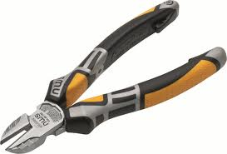

Disassembly and Removal Tools
  Screwdrivers
  Drivers
  Pliers
  Wire cutters
  Small tweezers
Notes:
Flathead and crosshead, and manufacturer-specific, e.g., Hewlett Packard, Apple
Hex-nut, star-type nut and secure-bit
Standard and needle-nose
For removal of cable ties

Slide 84

Documentation
  Search and Seizure record (see COE guide appendix)
  Labels and tape
  Cable tags
  Exhibit labels
  Other necessary forms for completion at the scene
  Indelible coloured marker pens
  Camera and/or video camera
Notes:
Property register
To mark and identify component parts of the system, including leads and sockets
------
Tie-on and adhesive
-----
To code and identify removed items
To photograph scene and any on-screen displays – A certified photographer might be needed

Slide 85

Package and transport
  Antistatic bags
  Antistatic bubble wrap
  Cable ties
  Evidence bags and tape
  Faraday bags and/or aluminium foil;
  Boxes for packaging external storage media such as USB devices DVDs, or CDs
  Packing materials
  Flat pack assembly boxes or sturdy boxes of various sizes
Notes:
Computers and related devices are fragile electronic instruments that are sensitive to temperature, humidity, physical shock, static electricity, magnetic sources, and even to some operational function (e.g. switching on/off). Special precautions should therefore be taken when packaging, transporting, and storing e-evidence. To maintain the chain of custody, the packaging, transportation, and storage should be recorded and any change of custody or condition of the seised property should be timed and noted. Inexpert handling can cause damage or destruction of e-evidence and the following precautions
should be taken:
• Packaging:
- Ensure that all collected e-evidence is properly documented and labelled before packaging;
- Whenever possible, transport the collected e-evidence in the original packaging;
- If no original packaging is available, use antistatic packaging (e.g. paper or antistatic plastic bags). Avoid using materials that can produce static electricity, such as standard plastic bags;
- Do not fold, bend, or scratch storage media such as diskettes, CD-ROMs, and tapes;
- Do not affix adhesive labels on the surface of the storage media. Use boxes or envelopes for packaging storage media whenever possible;
- Ensure that all containers holding evidence are properly labelled;
- If multiple computer systems are collected, label each system so that it can be reassembled as found.
• Leave cellular, mobile, or smart phone(s) in the power state (on or off) in which they were found.
- Package mobile or smart phone(s) in signal-blocking material such as Faraday isolation bags, radio frequency-shielding material, or wrapped in aluminum foil to prevent data messages from being sent or received by the devices. If incorrectly packaged or removed from shielded packaging the device may be able to send and receive data messages. Be aware that keeping devices in signal-blocking packaging may reduce battery life significantly. In cases of low battery power consider putting devices into “flight-mode” instead.
• Transport:
- Keep electronic evidence away from magnetic sources. Radio transmitters, speaker magnets and heated seats are examples of items that could damage e-evidence;
- Ensure that the equipment is protected from shock and bumps (i.e. mechanical damage), heat, and humidity;
- Ensure that computers and other devices that are not packaged in containers are
secured during transport to avoid shock and excessive vibrations. For example, computers should be placed on the vehicle floor and monitors placed on the seat with the screen down and secured by a seat belt;
- Do not put heavy objects on top of smaller pieces of equipment/storage media;
- Whenever possible, do not store electronic evidence in vehicles for long periods of time;
- Document the transportation of the digital evidence and maintain the chain of custody for all evidence transported.
For protection of equipment being removed such as circuit boards. Materials that can produce static such as polythene bags should be avoided.
------
For securing cables
------
-----
Materials that can produce static electricity such as styrofoam or styrofoam peanuts should be avoided
Original packaging should be used whenever available

Slide 86

Communication tools
  Mobile phone or other communication devices for obtaining advice
  Contact information for assistance
Notes:
Should not be used in the proximity of computer equipment
E.g., phone numbers of the specialist unit

Slide 87

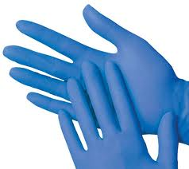
Other Items
  Small torch with a bracket
  Gloves
  Hand truck
  Large rubber bands
  Magnifying glass
  Printer paper
Notes:
Small torch with a bracket;
- Gloves;
- Hand truck (i.e. a sack barrow or 2 wheeled dolly);
- Large rubber bands;
- Magnifying glass;
- Printer paper.

Slide 88
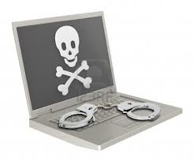
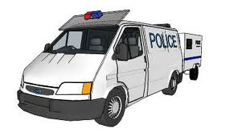
Other Items (Live Data Forensics)
  A laptop computer including all standard forensics tools
  Network cables
  Sufficient Hard-Drive capacity
  Hardware Write-Blockers
  Forensic Boot-DVDs
  Live Data forensics tools
  Transport
Notes:
A laptop computer loaded with all standard forensics tools;
- Network cables (Twisted Pair and Crossover);
- Sufficient Hard-Drive capacity (e.g., some Terabyte external Hard Disk Drives);
- Hardware Write-Blockers (for on-site imaging and triaging purposes);
- Forensic Boot-DVDs (for when officers are trained in their use, for forensic purposes);
- Live Data forensics tools (when officers are trained in their use, for forensic purposes);
- Transport (to and from the scene, for team members, Seizure tools and equipment and the seised evidence).

Slide 89
Securing the Scene

Slide 90

  Things may not be as what we expect them to be
  Readjust plans when necessary
Notes:
E.x.
15 persons instead of 1
2 Big Dogs
A newborn baby

Slide 91

Securing the Scene
  Initial Considerations
  Safety of persons
  Integrity of all evidence
  E-Evidence can be easily altered, deleted or destroyed

Slide 92
Steps to Secure the Scene
Follow jurisdictional policy for securing the crime scene
Move all persons away from the immediate area from which evidence is to be collected
Secure all electronic devices including personal and portable devices
Refuse offers of help or technical assistance from any unauthorised persons
Leave a computer or electronic device off if it is already turned off
Notes:
Securing the scene involves the following steps:
• Follow standard policy and procedure in your jurisdiction to secure the crime scene:
• Move all persons away from the proximity of any evidence to be collected (including equipment and power supply);
• Secure all electronic devices including personal and portable devices;
• Refuse offers of help or technical assistance from any unauthorised persons.
• Leave a computer or electronic device off if it is already turned off.

Slide 93
Steps to Secure the Scene
We will see later if a computer is on or the state cannot be determined
Protect volatile data physically and electronically
Identify and document related electronic components that will not be collected
Identify telephone and network lines attached to devices, document and label them
Notes:
• If a computer is on or the state cannot be determined, the investigator should follow the steps described in section 3.4.3 of the guide;
• Protect volatile data physically and electronically by following the steps described in section 3.5;
• Identify and document related electronic components that will not be collected;
• Identify telephone and network lines attached to devices, document and label them;

Slide 94
Steps to Secure the Scene
Decide if any other evidence is required from a device to be seised
  If so, follow the general handling procedures
  Postpone destructive techniques until after electronic evidence recovery is done
    Collect latent prints after e-evidence recovery is complete
    Do not use aluminium powder to collect fingerprints from the scene as this may damage equipment and data.
Notes:
• Decide if any other evidence is required from a device to be seised (e.g. DNA, fingerprints, drugs, accelerants);
- If so, follow the general handling procedures for that evidence type laid out in the relevant handbook;
- Postpone destructive techniques until after electronic evidence recovery is done;
§ Collect latent prints after e-evidence recovery is complete (since keyboards, computer mouse, diskettes, CDs, or other components may have latent fingerprints or other physical evidence that should be preserved);
§ Do not use aluminium powder to collect fingerprints from the scene as this may damage equipment and data.

Slide 95
Scene Search
Search the scene for non-electronic but related evidence, such as
  written passwords and other handwritten notes
  blank pads of paper with indented writing
  hardware and software manuals
  calendars or diaries
  text or graphical computer printouts
  photographs, or
  information about personal interests that may be useful for later password /passphrase cracking
Notes:
• Search the scene for non-electronic, but related evidence, such as:
- written passwords and other handwritten notes;
- blank pads of paper with indented writing (but do not shade with graphite pencil);
- hardware and software manuals;
- calendars or diaries;
- text or graphical computer printouts;
- photographs; or,
- information about personal interests that may be useful for later password/passphrase cracking (most passwords are directly related to the personal environment, such as licence plates, partners/children, phone numbers, hobbies, etc.);
- (Don’t forget traditional physical evidence such as fingerprints and DNA).

Slide 96

Preliminary Interviews
!!! Any interviews conducted at the scene must comply with national legislation and agency policy (for instance in the requirement to provide a caution against self incrimination or list of rights).

Slide 97

Preliminary Interviews
Separate and identify all persons at the scene and record their location at time of entry
Use a checklist to collect and record information from these individuals such as …..
Notes:
Witnesses, subjects, or others
------

Slide 98
Preliminary Interviews
  Purpose of the device/system
  Owners and/or users of devices/systems found at the scene, as well as passwords, user names, and Internet Service Provider
  Any passwords required to access the system, software, or data.
  Any unique security schemes or destructive devices
  Facebook, or other online social networking Web site account information.
  Any offsite data storage
  Any documentation explaining the hardware or software installed on the system
  Any other relevant information
Notes:
e.g, bookkeeping
-----
An individual may have multiple passwords, e.g., BIOS, system login, network or ISP, application files, encryption pass phrase such as for PGP or Truecrypt, e-mail, access token, scheduler, or contact list.
-----
----
----
----
-----

Slide 99
  Documenting the
  Scene

Slide 100
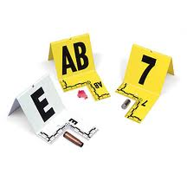
Documenting the Scene
  Documenting starts and finishes with the search
    Physical Scene
    Electronic Evidence
    Persons
Notes:
Documenting the scene is an ongoing process throughout the entire Seizure procedure. It is of crucial importance to document accurately the location and condition of computers, storage media and other electronic and conventional devices. This section gives only a summary of the information to be documented.

Slide 101
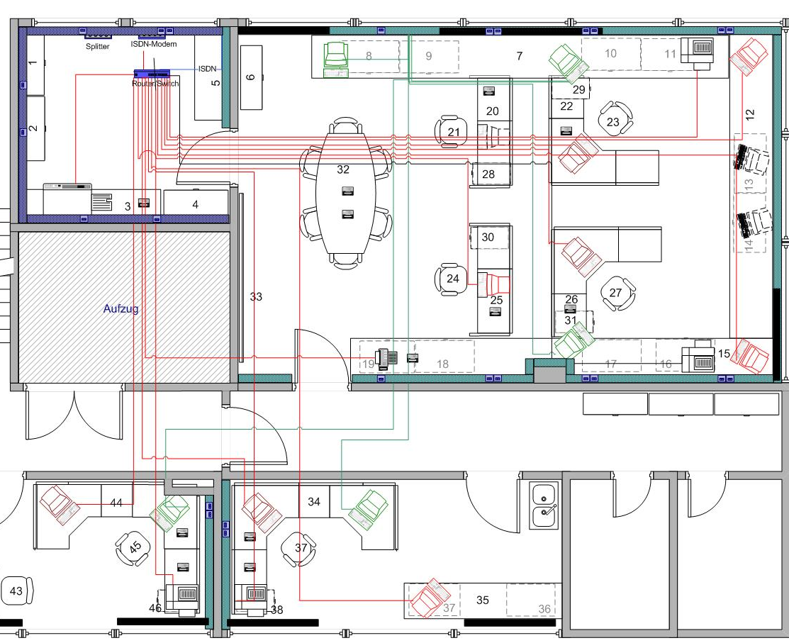
Documentation - Physical Scene
  Draw a sketch plan of the system including the position of the mouse and the location of the components
  Photograph/video/document the entire scene
  Computer systems and electronic components/ devices/equipment
Notes:
----
360 degrees of coverage, if possible
-----

Slide 102
Documentation - Electronic Evidence
  Details of all relevant equipment found
  Condition and location of each computer system containing or presenting electronic evidence, including power status of the computer
  Document all connections (cable or wireless) to and from the computer system or other devices
  Label all ports and cables to allow for exact reassembly at a later time
  Label unused connection ports as "unused." Identify laptop computer docking stations in an effort to identify other storage media.
Notes:
e.g., make, model, serial number
Is it On, off, or in sleep mode
-----
Including connections to peripheral devices
------

Slide 103
Documentation - Electronic Evidence
  Document the details of the monitor at the time of intervention.
  Photograph the front of the computer as well as the monitor screen and other components
  Make written notes of what appears on the monitor screen
  Video active programs or create more extensive documentation of monitor screen activity.
  Document relevant electronic components that will not be collected
Notes:
------
-----
-----
-----
------

Slide 104
Documentation - Persons
  Details of all persons present on the premises searched
  Details of all persons who used the relevant computer system/equipment
  Remarks, comments, and information offered by the computer users/owners/witnesses
  Actions taken at the scene
  Create audit trail/Seizure log with the description of the action taken and the exact date and time.
Notes:
------
-----
-----
-----
------

Slide 105
Examples of What May Be Encountered at the Scene

Slide 106
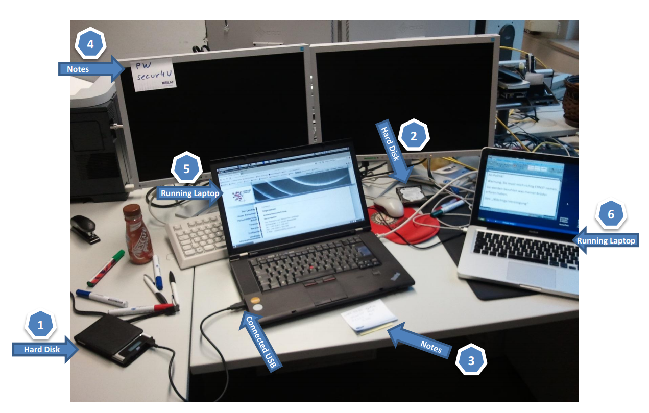
Notes:
These slides are simply visual examples of what may be found. The trainer may wish to set up the slides in a manner that the descriptors are hidden, to allow the delegates to be asked to identify sources of potential evidence from the pictures.

Slide 107
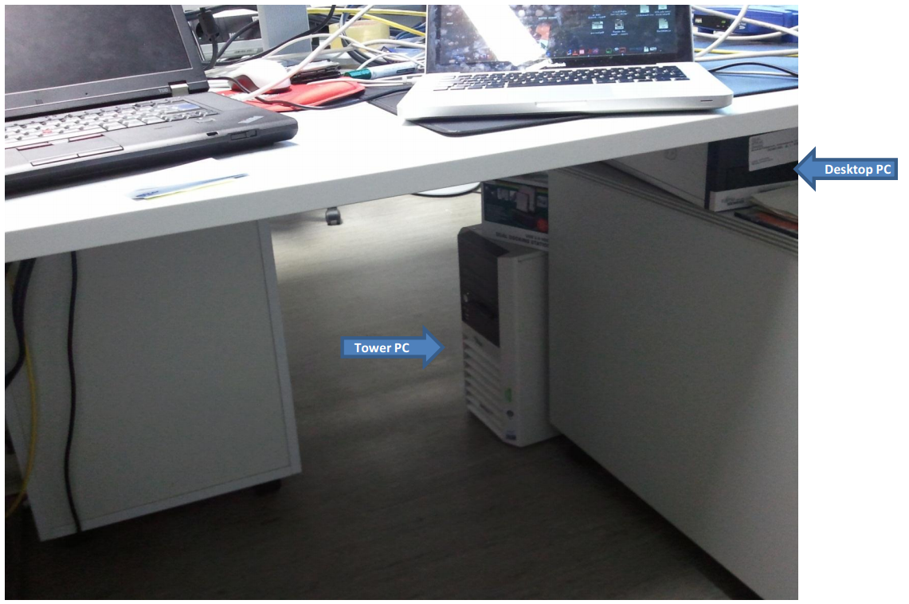

Slide 108
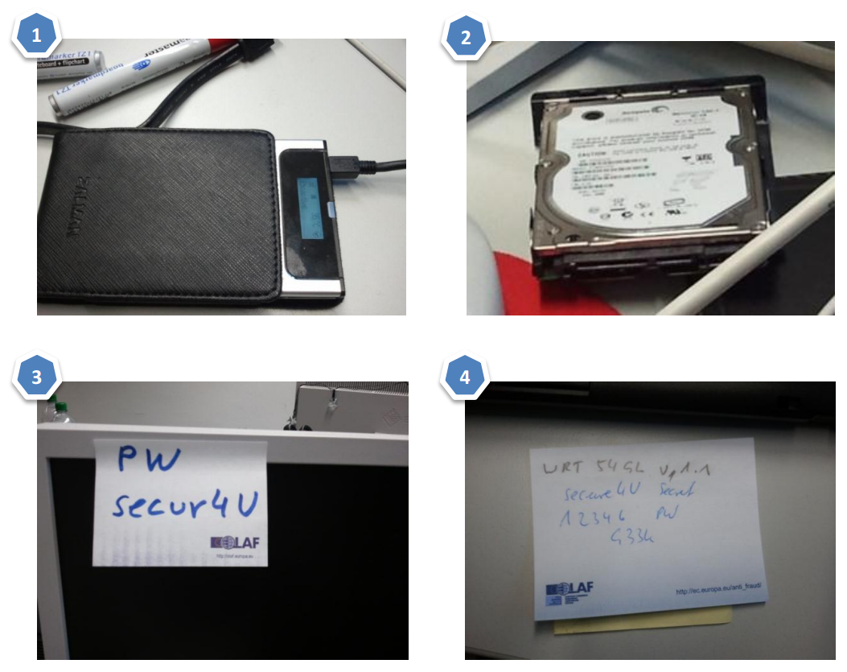

Slide 109
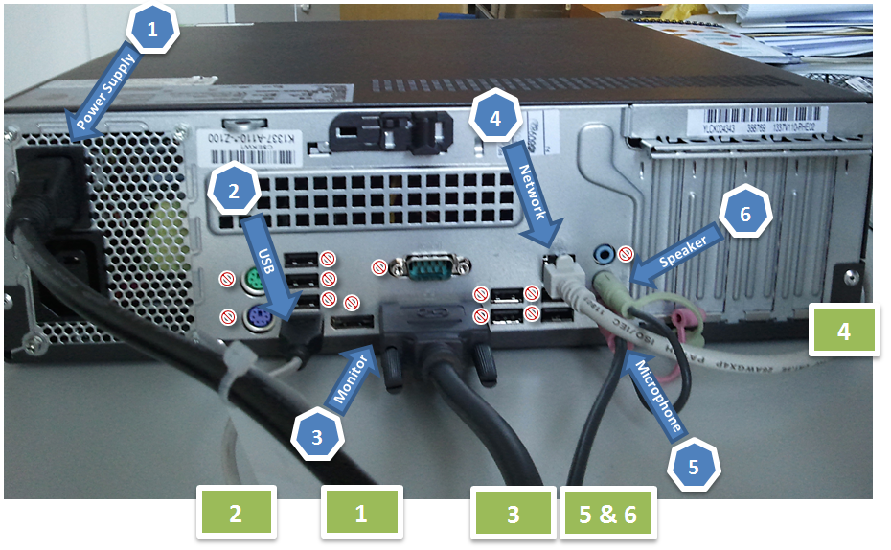

Slide 110
General Seizure Considerations
Document the scene continuously
Do not follow any unverified advice from a potential suspect
If a computer network is encountered, contact a forensic computer specialist
Beware that some devices may be connected over a wireless connection
Beware that if there is any network connection, the computer system may be accessed and manipulated during the Seizure
Notes:
Remember:
• Document the scene continuously and record all actions you take and any changes that you observe in the monitor, computer, printer, or other devices as a result of your actions.
• Do not follow any unverified advice from a potential suspect.
• If a computer network is encountered, contact a forensic computer specialist in your agency or an external expert identified by your agency for assistance.
Beware that some devices may be connected over a wireless connection (e.g. WLAN, Bluetooth, infrared);
• Beware that if there is any network connection, the computer system may be accessed and manipulated during the Seizure (i.e. whenever switched on and within the reach of the network connection).
Steps to follow to secure the scene and seise the equipment:
• Search the area for the following components/items;
- the computer system components;
- digital storage media;
- additional components;
- other electronic devices; and,
- non-electronic evidence.
• Conduct preliminary interviews;
• Observe the computer system and determine whether it is on or off (see below);
• Document all connections and components and put labels on each connection and device:
- Photograph and/or sketch a diagram of the connections to/from the computer and the corresponding cables;
- Record the evidence according to your agency’s procedures.
• Carefully remove the equipment and record any serial or identification numbers. Allow the equipment to cool down before packaging and removal.
• If transport is required, package the components.

Slide 111
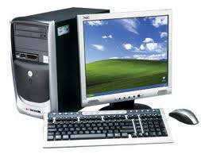
Computer Systems
Computer Systems consist of:
a main unit,
a monitor,
a keyboard,
a mouse,
cables,
power supply units (e.g., power packs, and spare batteries),
possibly additional components and
network devices

Slide 112
Computer Systems
When seising a computer system
Observe the computer system and determine whether it is on or off
Document the computer system, all connections and the scene continuously and record all actions you take and any changes that you observe in the monitor, computer, printer, or other devices as a result of your actions a monitor,
Do not follow any unverified advice from a potential suspect.
If a computer network is encountered, contact a forensic computer specialist in your agency or an external expert identified by your agency for assistance.

Slide 113

Checking the power status
Check for indicator lights
Check for noise
Check the temperature
Consider standby mode, especially for portable computers
Notes:
This section offers some advice related to the Seizure of computer equipment and storage media.
Determine whether the computer system is off or on.
Most computers have status lights that indicate when the computer is on. If fan noise is heard, the system is probably on. If the computer housing is warm, that may also indicate that it is on or was only recently switched off.
N.B. Some portable devices get activated by opening the lid.
Always consider removing the battery from portable computers and devices.
Portable computers (e.g. notebooks or laptops) usually have a battery pack in addition to the main supply. Some even have a second battery in the multipurpose bay instead of a floppy drive or CD drive. Batteries for such devices are charged when the portable computer is connected to a power supply and, if fully charged, can last several hours. It is often hard to determine whether a portable computer is turned on or off when it is in standby mode.
A computer system that appears to be switched off may be in sleep mode. If so, it could be activated and accessed remotely allowing alteration or deletion of files.
Some screen savers give the impression that the computer is switched off. Observe the monitor and try to determine whether it is on, off, or in sleep mode.

Slide 114
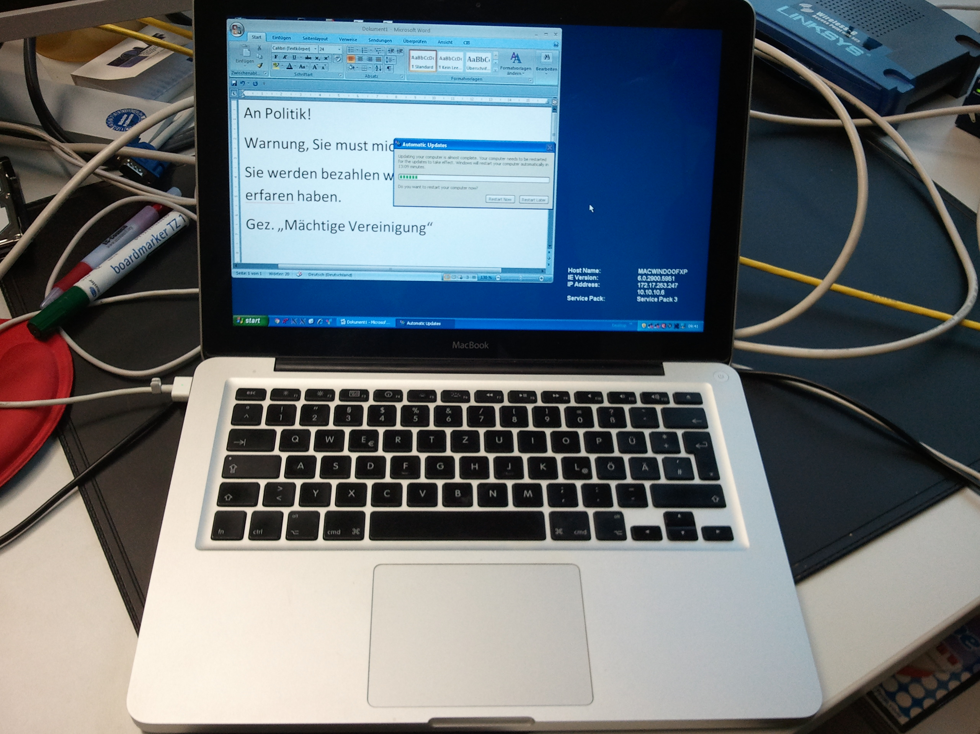
Observing the monitor
Situation 1:
Monitor is on and work product and/or desktop is visible.
  Document the details of the monitor at the time of intervention
  Proceed to “Situation B” on the next slides.
Notes:
You may encounter one of the following situations:
Situation 1: Monitor is on and work product and/or desktop is visible.
- Document the details of the monitor at the time of intervention
- Proceed to “Setting B” as described below.

Slide 115

Observing the monitor
Situation 2:
Monitor is on and screen is blank (sleep mode) or screen saver (e.g., a picture) is visible.
  Move the mouse slightly (without pushing buttons). The screen should change and show work product or request a password.
  If mouse movement does not cause a change in the screen, do not perform any other keystrokes or mouse operations.
  Document the details of the monitor at the time of intervention
  Proceed to “Situation B” on the next slides.
Notes:
Situation 2: Monitor is on and screen is blank (sleep mode) or screen saver (e.g. a picture) is visible.
- Move the mouse slightly (without pushing buttons). The screen should change and show work product or request a password.
- If mouse movement does not cause a change in the screen, do not perform any other keystrokes or mouse operations.
- Document the details of the monitor at the time of intervention
- Proceed to “Setting B” as described below.

Slide 116

Observing the monitor
Situation 3:
Monitor is off.
  Make a note of "off" status.
Turn the monitor on, then determine if the monitor status is as described in either Situation 1 or 2 above and follow those steps.
Notes:
Situation 3: Monitor is off.
- Make a note of "off" status.
- Turn the monitor on, then determine if the monitor status is as described in either Situation 1 or 2 above and follow those steps.

Slide 117

Situation A – Computer is Off
You have determined that system is
switched off; do not switch it on!
Remove the power supply cable from the target equipment (do not switch it off at the wall socket) and record the time of doing so.
If dealing with a portable device, also remove the battery pack.
Notes:
Once you have determined whether the computer is on or off, you will need to undertake one of the following:
Setting A: You have determined that system is switched off; do not switch it on!
• Remove the power supply cable from the target equipment (do not switch it off at the wall socket) and record the time of doing so.
• If dealing with a portable device, also remove the battery pack. Remove any additional battery packs, if applicable (some portable devices have a second battery in the multipurpose bay instead of a floppy drive or CD drive).
If the computer system is off, leave it off because the startup process will modify the computer data and potentially destroy the evidence.

Slide 118
Situation B – Computer is On
You have determined that the system is switched on; do not switch it off!
Try to contact a specialist.
  If a specialist is available, follow their advice.
  If no specialist is available, continue with the next instruction.
Do not touch the keyboard or other input devices.
Proceed with steps described in in the “Live Data Part” of the presentation
Notes:
Setting B: You have determined that the system is switched on; do not switch it off!
• Try to contact a specialist:
- If a specialist is available, follow their advice;
- If no specialist is available, continue with the next instruction.
• Do not touch the keyboard or other input devices.
• Proceed with steps described in 3.5.
Remember: Removing the power supply cable from the computer system will affect all currently running programs and all data currently stored in the RAM of the computer (including relevant data, such as passwords) will be lost. This would include any connection to the Internet, printing, or encryption.
Remember: When a system is turned on, it is crucial to have the suspect secured and away from fuse boxes, power switches as well as mobile communication devices. There have been cases where running systems with full-disk encryption have been powered-off during the search just because the suspect was able to reach the fuse box or to send a signal to a remotely controllable power adapter.

Slide 119
Situation C – You cannot determine
You cannot determine whether the system is switched on or off.
Assume that it is switched off. Do not press the switch.
Remove the power supply cable from the target equipment (do not switch it off at the wall socket) and record the time of doing so.
If dealing with a portable device, also remove the battery pack.
Notes:
Setting C: You cannot determine whether the system is switched on or off.
• Assume that it is switched off. Do not press the power switch.
• Remove the power supply cable from the target equipment (do not switch it off at the wall socket) and record the time of doing so.
• If dealing with a portable device, also remove the battery pack. Remove any additional battery packs if applicable (some portable devices have a second battery in the multipurpose bay instead of a floppy drive or CD drive).

Slide 120
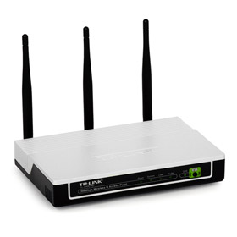
Computer Networks
If you encounter a computer network, contact a forensic computer specialist in your agency or an external specialist recommended by your agency for assistance.
Indications for networks:
  multiple computer systems
  network components (router, hubs, switches)
  network interface cards
  network cables
  antennas of wifi devices
  servers
Label all cables and devices and document the connections
Notes:
Computer network collection
Remember - If you have a good reason to believe that there is a network in place contact a computer network specialist before attending the scene. If no specialist is available, the information provided in this section may help you when seising the relevant equipment.
A computer network can be indicated by:
• The presence of multiple computer systems;
• The presence of network components such as:
o Network interface cards (NIC, or network cards) and associated cables (if not
wireless);
o Wireless Local Area Network (WLAN) devices (e.g. wireless access point);
o Routers, hubs, and switches;
o Servers; and,
o Network cables running between computers or central devices such as hubs.
• Information provided by informants or individuals at the scene.
Remember: If you encounter a computer network, contact a forensic computer specialist in your agency or an external specialist recommended by your agency for assistance.

Slide 121
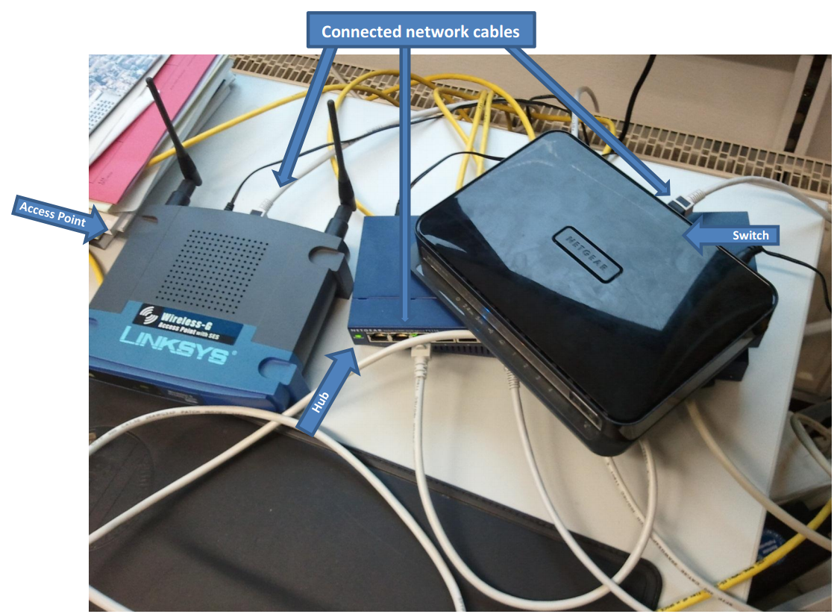

Slide 122
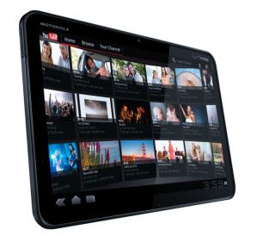
Mobile Phones / Tablets
If powered on
  do not turn off the device
  document the screen
  if applicable turn device into flight-mode
  consider using a faraday bag, which is designed to block electromagnetic fields and will prevent potential connection to the device and changes to or loss of evidence. They are used regularly in the criminal justice system to ensure the integrity of evidence.
If powered off
  do not turn on the device
Search for further information regarding the device (manual, power supply, etc) and the SIM card (letter from telecom company, PIN, PUK, etc)
Notes:
A telephone is a handset that is found either:
• On its own (as with mobile phones);
• With a remote base station (cordless), or
• Connected directly to the landline system.
A mobile phone may have some additional functionality (for instance the ability to take digital photographs). Modern mobile phones often have an operating system (such as the iOS, Android, Windows Phone) that allows the user to carry out tasks that are typically associated with traditional computer systems including receiving and sending e-mails, surfing the Internet, chatting, playing games, etc. Mobile phones with such expanded functionality are called smartphones.
A telephone may draw power from an internal battery, electrical plug-in, or directly from the telephone system. Two-way communication is established from one handset to another by using land lines, radio transmission, cellular systems, or a combination of systems. Many telephones can store names, phone numbers, and caller identification information. Many mobile telephones can
also store names, addresses, calendar information, details about incoming calls, receive e-mail, send texts, act as a voice recorder and may be used to access the Internet (so they contain Internet access data). Access to many mobile phones will require PINs, passwords or other access codes,
Tablet devices are very similar to smartphones, but have a larger screen. They come with their own operating systems based on the mobile phone versions of the operating systems. Like smartphones they offer a near endless variety of functionality and allow the user to install his or her own applications (apps).
Please refer to the information above for the general Seizure, packaging, transport and storage
instructions. Also see section 3.4. of the COE guide
The trainer should ensure that they provide sufficient information about the use and purpose of faraday bags. The audience may or may not be familiar with the use of these, so it is important for the trainer to establish the knowledge level of the audience. If available the trainer may wish to bring along a faraday bag to demonstrate their purpose. It is also possible to demonstrate, using silver foil, how signals may be blocked. This is a useful way of explaining the potential for evidence to be lost or changed. Reports in the UK revealed that in one period of time, several mobile devices were accessed remotely. In one case a police officer remotely wiped evidence from a device that was in police custody. See the below links for further information.
http://www.bbc.co.uk/news/technology-29464889
http://www.mirror.co.uk/news/uk-news/police-officer-remotely-wiped-evidence-7838193

Slide 123
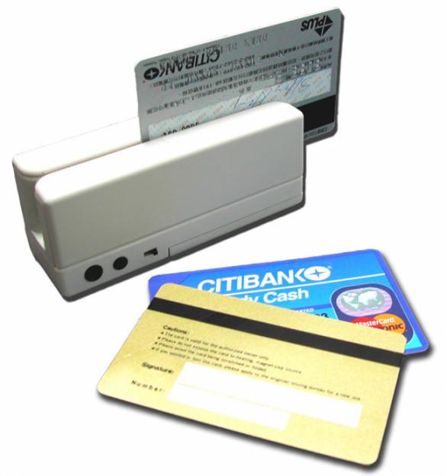
Smart / magnetic stripe cards
Do not fold the card.
Do not expose it to extreme temperatures.
Do not touch the electrical contact plate.
Protect from scratches, liquids, magnetic influences, etc.
Try to get hold of the PIN. Do not attempt to gain access to the data/functions on the card.
Photograph/note/copy the information from the imprint on the card body.
If applicable, seise smart card readers too.
Notes:
A smart card is a small handheld device that contains a microprocessor (i.e. a “chip”. It is sometimes referred to as a chip card) that is capable of storing a monetary value, encryption key or authentication information (password), digital certificate, or other information. Some smart cards are actually small computers because they also have an operating system (i.e. a smart card
operating system). Smart cards may be used for different purposes and applications for example:
• As key cards allowing physical access to restricted areas/buildings/rooms;
• Providing access control for computers or programs or functions (e.g. as an encryption key);
• Allowing cash withdrawal at ATMs;
• Acting as an electronic purse/wallet;
• As a customer loyalty card or bank card;
• As a social security or government identification card;
• As authorisation for accessing certain government services;
• For creating digital signatures;
• As a payphone card; or,
• For otherwise storing personal data, addresses, access codes.
Because of these various uses and the information that it may contain a smart card can contain potential evidence in much the same way as a computer system. According to international standards a smart card should be 85.6 x 54 x 0.76mm (i.e. format ID-1, the so-called “ATM card size") with an electrical contact plate on the front side of the card. Smart cards will also often carry a magnetic stripe on the reverse side. Other standards of chip cards also exist. For instance the ID-0 format (size 25x15x0.76mm) which are used in mobile phones (full size SIM card).
USB tokens34 contain both a chip (based on the same standards as a chip in a smart card) and chip card reader functionality. This means they are become more and more popular for two step authentication for obtaining computerised services.
Some smart cards exist that use induction technology instead of a contact plate. These cards do not require physical contact with the card reader, but need only to be placed in close proximity to the reading device. “Super” smart cards have also been developed which have an internal battery, a small LCD display and an integrated keypad. These cards have a significantly enhanced level of security.
Most smart cards data and functions are usually protected by a secret personal code (called a personal identification number or PIN) and data on the card become accessible after the correct code has been entered on the computer keyboard, on the card reader keyboard (or on the super smart card itself).
There are some rules for handling smart cards:
• Do not fold it;
• Do not expose it to extreme temperatures;
• Do not touch the electrical contact plate;
• Protect from scratches, liquids, magnetic influences, etc;
• Try to find out the PIN (look for kept with the card or ask the trustworthy user(s)).
• Do not attempt to gain access to the data/functions on the card, even when a potential suspect claims to have told you the PIN. Several attempts to enter a false PIN can result in irrevocable loss of data and the card being blocked (in some cases it is possible to unblock the card by another secret personal code called a personal unblocking key or PUK).
• Photograph/note/copy the information printed on the card (e.g. cardholder identification, account numbers, credit card companies, business contacts, etc.).
• If present, also seise any smart card readers found.

Slide 124
Other electronic evidence
Seizure instructions for electronic evidence:
If the device is switched on, do not switch it off
  Photograph the display (if applicable) and record the information displayed.
  Remove all power supply cables.
  Do not try to access the internal memory or any storage media.
If it is switched off, do not switch it on
Collect/record important information
  Collect manuals and other instructions if available.
Record the relevant data (e.g., phone number).

Slide 125
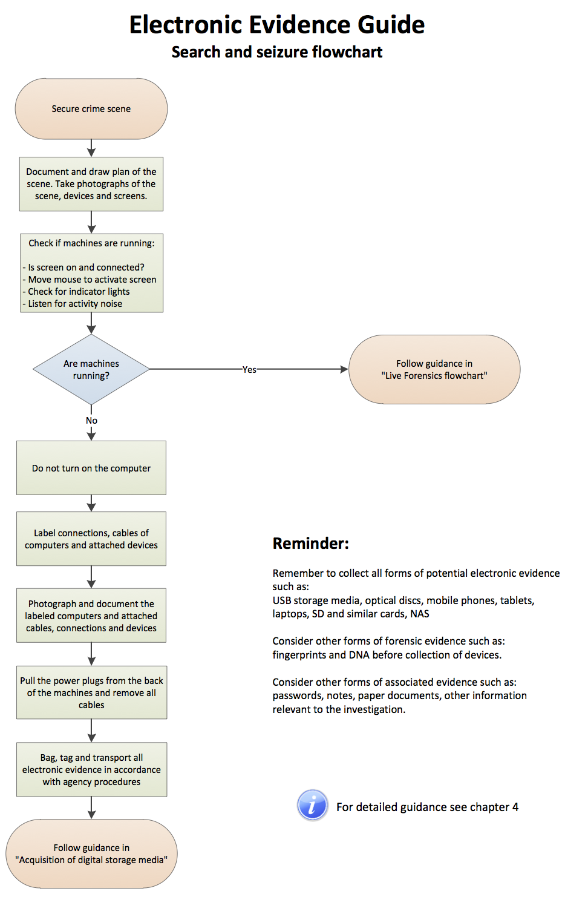
Notes:
This chart should be printed and the trainer may use it to demonstrate the processes to be followed in the Seizure of electronic evidence.

Slide 126
  Live Data Forensics

Slide 127
Live data forensics is a technical process only to be undertaken by qualified individuals who have the correct tools and equipment.
It is covered in minor detail in this course in order that judges and prosecutors are aware of its existence and the effect of its use on evidence

Slide 128
What is Live Data Forensics?
Live Data Forensics deals with situations where it is necessary to capture volatile data from devices before they are turned off or disconnected from networks or power supplies.
It requires a higher level of specialism than the procedure in the search and Seizure of dead boxes because the possibility of altering or even overwriting evidence is very high.

Slide 129

What are volatile data?
Volatile Data are data that are digitally stored in a way that the probability is very high for their contents to get deleted, overwritten or altered in a short amount of time by human or automated interaction.

Slide 130
Examples for volatile data
Caches (e.g. arp- and dns-caches)
Unsaved documents
Running processes
Passwords and encryption keys
Open network connections
System information
Logged in users
Temporarily connected remote storage
Malware binaries only stored in RAM

Slide 131

Two types of volatile data
Volatile Data on the Physical Computer like open network connections, running processes and services, arp- and dns caches.
Transient Data that are not volatile in their nature but are only accessible on scene. Encrypted volumes as well as remote resources are examples for this kind of data. The characteristic of these data is that the contents of the data might get inaccessible, altered or deleted after the search, if the investigator is not be able to acquire them.

Slide 132
Requirements
Requirements for Live Data Forensics:
Specialist with specific training for Live Data Forensics
Hands-on practical experience
A set of validated forensic tools for Live Data Forensics
If no specialist is available, pulling the plug makes more sense than tampering with the evidence resulting in a possible contamination of the evidence and making it unfeasible for use in court.

Slide 133
Remote Storage
Data is not always stored locally
Especially in companies you find data stored remotely in other offices, collocated at hosting companies, etc
It is important to acquire remotely stored data
Acquisition is dependent on your legislation

Slide 134
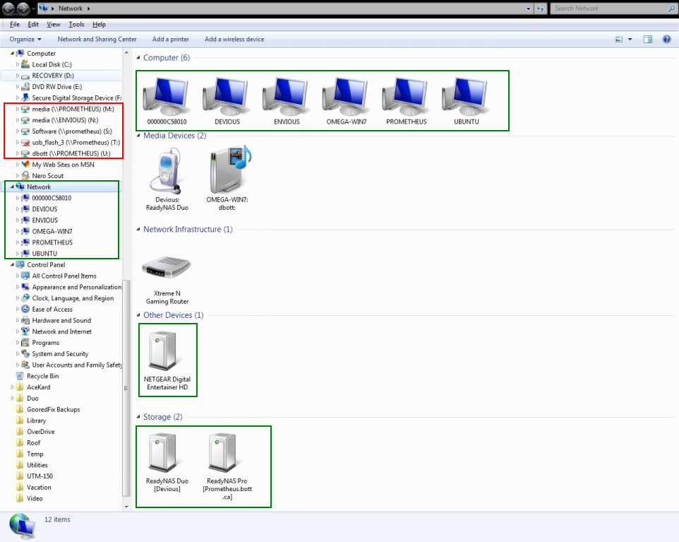
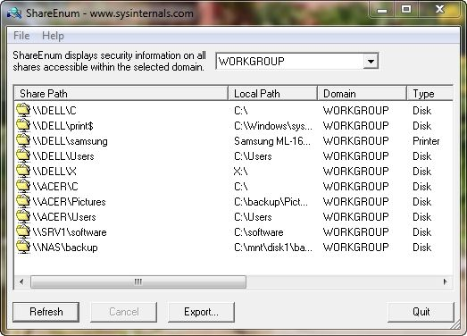
Examples of remote storage
Shared folders on other
network computers
Mapped network drives from
a server
E-Mails stored on an IMAP
or Exchange server
Cloud services and
online storage

Slide 135
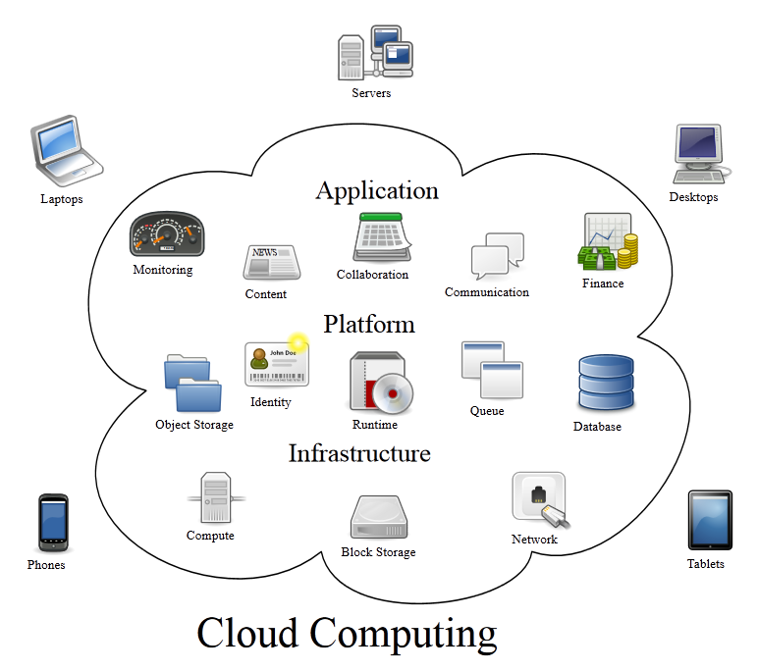
Data stored in the cloud
Source: Created by Sam Johnston, Wikipedia.com
Notes:
Cloud services and online storage is a topic that is becoming of significant importance. To be able to recognise and understand these services the investigator needs to know what cloud computing is, which kinds of services are available and how they work. The following graphic and definition give a useful overview.

Slide 136
Cloud computing
Cloud computing is a model for enabling ubiquitous, convenient, on-demand network access to a shared pool of configurable computing resources (e.g., networks, servers, storage, applications, and services) that can be rapidly provisioned and released with minimal management effort or service provider interaction.[…]
Source: Mell and Grance, NIST, 2011, http://csrc.nist.gov/publications/PubsSPs.html#800-145
Notes:
Definition of Cloud Computing
Cloud computing is a model for enabling ubiquitous, convenient, on-demand network access to a shared pool of configurable computing resources (e.g. networks, servers, storage, applications, and services) that can be rapidly provisioned and released with minimal management effort or service provider interaction. 60 Mell and Grance from the National Institute of Standards and Technology (NIST) identify three service models for Cloud Computing.
Software as a Service (SaaS):
The consumer is provided with the capability of using the provider’s applications running on a cloud infrastructure. The applications are accessible from various client devices through either a thin client interface, such as a web browser (e.g. webbased email), or a program interface. The consumer does not manage or control the underlying cloud infrastructure (including the network, servers, operating systems or storage) or even individual applications, with the possible exception of limited user-specific application settings.
Platform as a Service (PaaS):
The consumer is provided with the capability of deploying consumer-created or acquired applications onto the cloud infrastructure created using programming languages, libraries, services, and tools supported by the provider. The consumer does not manage or control the underlying cloud infrastructure (including the network, servers, operating systems, or storage), but does have control over the applications deployed and possibly over the configuration settings for the application-hosting environment.
Infrastructure as a Service (IaaS):
The consumer is provided with processing, storage, network, and other fundamental computing resources and is able to deploy and run arbitrary software (including operating systems and applications). The consumer does not manage or control the underlying cloud infrastructure, but has ‘broad freedom to choose’ operating systems, storage, and deployed applications; and possibly limited control of select networking components (e.g. host firewalls).

Slide 137
Common cloud providers
More: http://en.wikipedia.org/wiki/Comparison_of_online_backup_services
Notes:
Amazon offers a wide variety of webservices. Their Elastic Compute Cloud (EC2) is one of the biggest cloud services world-wide. They offer typical IaaS services. http://aws.amazon.com/en/ec2/
Microsoft OneDrive offers their customers large amounts of online storage with Microsoft Office integration. URL: https://onedrive.live.com
Google Docs offers large amounts of free online storage for documents. They offer multi-user Wysiwyg (what you see is what you get) editors for creating spreadsheets, text-documents, presentations etc., within the browser. URL: https://docs.google.com/
Google drive offers a limited amount of free online storage amounts of free online storage that can be upgraded by paying a monthly fee. The user can upload, sync and share all kinds of data as well as access his or her Google docs documents. URL: https://drive.google.com/
Dropbox offers a limited amount of free online storage that can be expanded by purchasing professional plans. Their specialty is the synchronisation of files among a wide range of different devices operation systems such as Windows, Linux, Mac OS X, iOS, Android, etc. URL: https://www.dropbox.com
Box is similar to Dropbox offering a limited online storage capacity that can be extended by purchasing professional plans. They also offer strong synchronisation possibilities as well as collaboration features. URL: https://www.box.com
Apple offers its customers free limited, extendible storage in the iCloud. This service is able to synchronise data among Apple devices and computers running the iTunes software. URL: https://www.icloud.com

Slide 138
What to do with remote storage?
Identification:
Tray icons
Control the installed software
Process list
Network shares and mapped network drives
Observe the network traffic
List open and listening sockets for suspicious activity.
Acquire any data that appears to be stored remotely.
Notes:
If an investigator is confronted by a running system with network access and suspects that cloud computing is involved, s/he should:
• Look for tray icons that look anything like the logos of the services mentioned above;
• Check installed software for cloud services;
• Look in the process list for names of cloud services;
• Look for network shares and mapped network drives;
• Observe the network traffic;
• Monitor the list of open or listening sockets for suspicious activity;
• Acquire any data that appear to be stored remotely. Even though an online storage service might synchronise data to the hard drive of the computer, that synchronisation should never be trusted.
After the investigator has acquired all volatile data and transient data, s/he can proceed in the following way:
• Remove the power supply cable from the target equipment and record the time of doing so (do not switch it off at the wall socket because the computer system may have an uninterruptible power supply (UPS)).
• Remove the storage media from the corresponding drives; place the media in their original boxes/jackets and label them accordingly. Insert either a Seizure disk/CD or a blank floppy disk if available. Do not remove DVDs or touch any button on the DVD
drive.
• Disconnect any modem attached (merely switching it off may not always be sufficient).
• If dealing with a portable device, also remove the battery pack. Remove the additional battery packs if applicable (N.B. Some portable devices have a second battery in the multipurpose bay instead of a DVD drive).

Slide 139
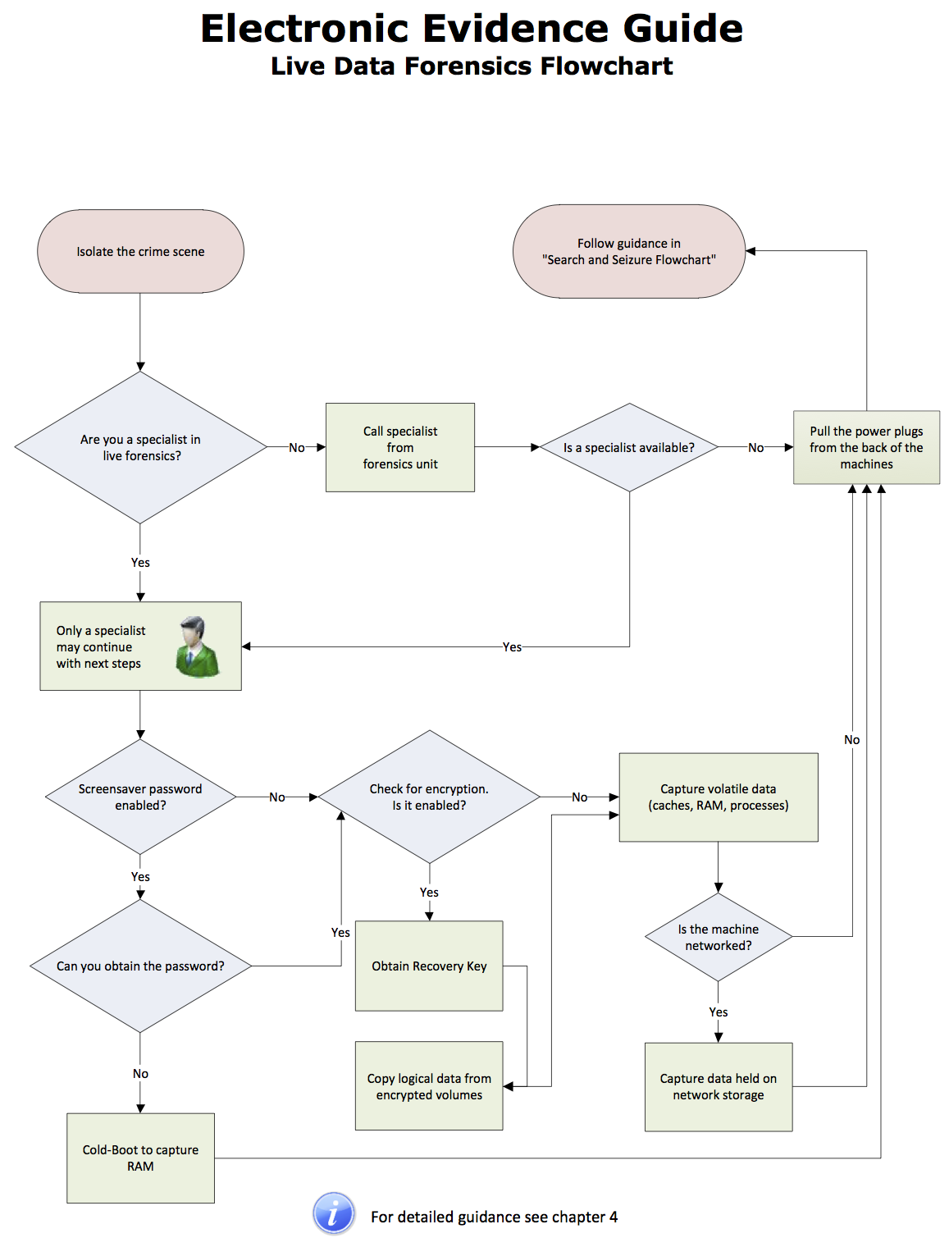
Notes:
This chart should be printed and the trainer may use it to demonstrate the processes to be followed in the Seizure of electronic evidence.

Slide 140
Labelling, Transport and Storage

Slide 141
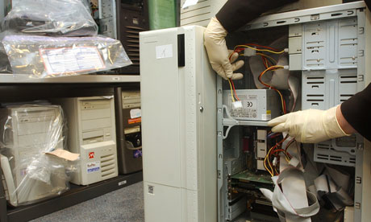
Labelling
Label all devices and cable connections
Do not affix adhesive labels on the surface of storage media. Use boxes, bags and envelopes for packaging and tagging of storage media

Slide 142
Packaging, Transport and Storage
Computers and related devices and equipment are fragile electronic instruments that are sensitive to temperature, humidity, physical shock, static electricity, magnetic sources, and even to some actions (e.g., switching on/off). Therefore, special precautions should be taken when packaging, transporting, and storing e-evidence. To maintain the chain of custody, the packaging, transportation, and storage should be adequately recorded
Notes:
Packaging, transport and storage
Computers and related devices and equipment are fragile electronic instruments that are sensitive to temperature, humidity, physical shock, static electricity, magnetic sources, and even to some actions (e.g., switching on/off). Therefore, special precautions should be taken when packaging, transporting, and storing e-evidence. To maintain the chain of custody, the packaging, transportation, and storage should be adequately recorded
Generally, all computer components and storage media must be handled with utmost care since inexpert handling can cause damage or destruction of e-evidence
Packaging
Ensure that all collected e-evidence is properly documented and labelled before packaging.
Whenever possible, transport the collected e-evidence in the original package.
If no original packaging is available, use antistatic packaging (e.g., paper or antistatic plastic bags). Avoid using materials that can produce static electricity, such as standard plastic bags.
Do not fold, bend, or scratch storage media such as diskettes, CD-ROMs, and tapes.
Do not affix adhesive labels on the surface of the storage media. Use boxes or envelopes for packaging storage media whenever possible.
Ensure that all containers holding evidence are properly labelled.
If multiple computer systems are collected, label each system so that it can be reassembled as found.
Transport
Keep electronic evidence away from magnetic sources. Radio transmitters, speaker magnets, and heated seats are examples of items that could damage e-evidence.
Ensure that the equipment is protected from shock and bumps (i.e., mechanical damage), heat, and humidity.
Ensure that computers and other devices that are not packaged in containers are secured in the vehicle to avoid shock and excessive vibrations. For example, computers should be placed on the vehicle floor and monitors placed on the seat with the screen down and secured by a seat belt.
Do not put heavy objects on the smaller pieces of equipment/storage media.
Whenever possible, do not store e-evidence in vehicles for long periods of time.
Storage
Ensure that evidence is inventoried in accordance with the relevant policies.
Store evidence in a secure area, away from extreme temperature and humidity.
Protect it from magnetic sources, moisture, dust, and other harmful particles or contaminants.
Use an adequately secure store room with appropriate
access control,
fire protection (e.g., alarm, fire extinguishers, no smoking in the storage area or in the vicinity),
temperature and humidity, and
protection from magnetic sources (e.g., far from directional radio devices).
Do not store any inflammable items in the same room or in the vicinity (e.g., cleaning chemicals, or stacks of paper).
Use suitable floor covering to avoid static charges.
Do not store e-evidence in rooms with water-pipes, especially along the ceiling.
Be aware that potential evidence such as date, time, and system configuration may be lost as a result of prolonged storage. Since batteries have a limited life, data could be lost if they fail. Therefore, appropriate personnel should be informed that a device powered by batteries (e.g., a PDA, or PC/CMOS) requires immediate attention.

Slide 143
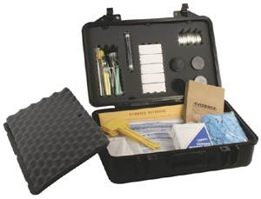
Packaging and Transport
Electronic Evidence can be sensitive to temperature, humidity, physical shock, static electricity, magnetic sources, and even to some actions (e.g., switching on/off).
E-Evidence must be handled with care and appropriate bags und boxes must be used to seise the devices.

Slide 144
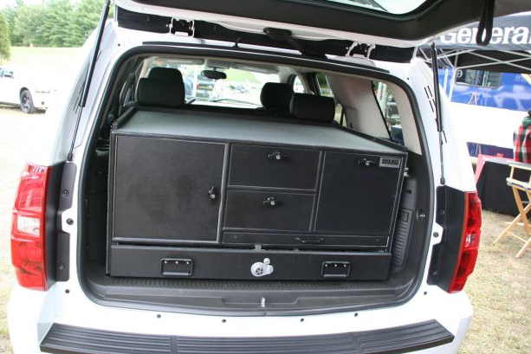
Transport
Keep electronic evidence away from magnetic sources (e.g. Radio transmitters, speaker magnets, heated seats)
  Ensure that the equipment is protected from shock and bumps (i.e., mechanical damage), heat, and humidity.

Slide 145
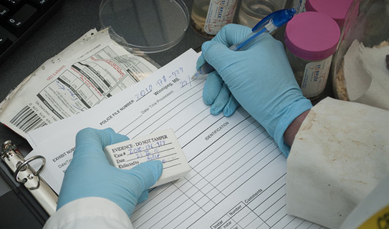
Storage
  Ensure that evidence is inventoried in accordance with the relevant policies.
  Store evidence in a secure area, away from extreme temperature and humidity.
  Protect it from magnetic sources, moisture, dust, and other harmful particles or contaminants.

Slide 146
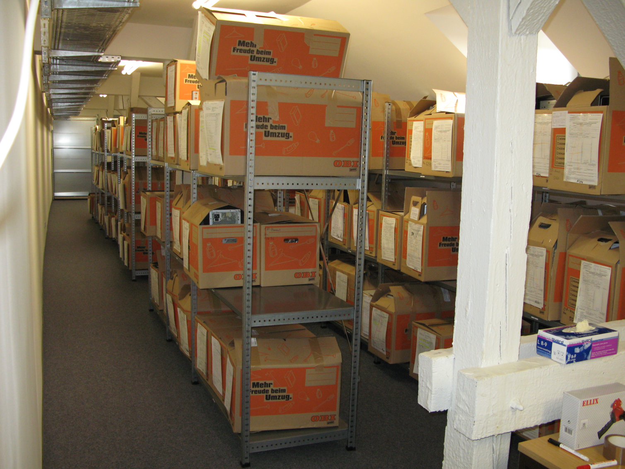
Storage facilities
  Use an adequately secure store
  room with appropriate
  access control,
  fire protection (e.g., alarm, fire extinguishers, no smoking in the storage area or in the vicinity),
  temperature and humidity, and
  protection from magnetic sources (e.g., far from directional radio devices).

Slide 147
Questions
Notes:
The trainer should give participants an opportunity to ask any questions that they may have in relation to this part of the lesson.

Slide 148
Part Three
Digital Forensics

Slide 149


Question
  Does anyone in the room have any experience in digital forensics?
Notes:
This question is designed to establish the level of prior knowledge of the students. This will allow the trainer to set the level of the training, bearing n mind that this content is at the basic level and not for those that are specialised ih the subject.
[Remember how many students had experiences in Digital Forensics]

Slide 150

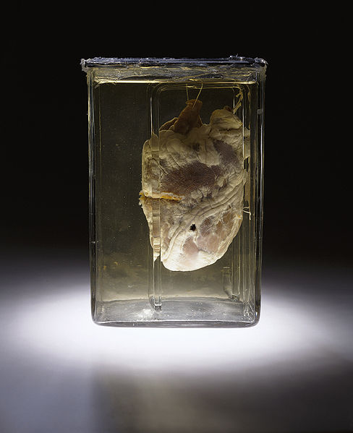

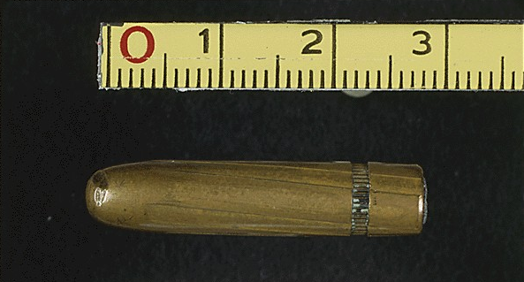
Digital Forensics
Traditional forensic sciences
Fingerprint analysis
DNA profiling
Forensic entomology
Forensic pathology
Bloodstain pattern analysis
Ballistic fingerprinting
etc
Notes:
Who in this room has had experiences in court hearings that involved any of the forensic sciences mentioned on this slide?
Ok, in the beginning we saw that X people have experience with Digital Forensics while nearly all of you have had court hearings that involved some of the more traditional forensic sciences. This underlines that Digital Forensics is a quite new science while other forensic sciences have a longer history. But let us be honest – the amount of cases that involve digital evidence is growing rapidly. So, there is a huge gap between the experience and knowledge about Digital Forensics on the one hand side and the growing occurrence of cases the involve digital evidence on the other hand side. Because of that most attorneys, prosecutors and judges need to be familiarysed with this new science. They should know what digital evidence is and how Digital Forensics can help their cases to be solved. And this is exactly what we are here for!
Let‘s look if we can find some similarities between the traditional investigation of traces and the Digital Forensics.

Slide 151

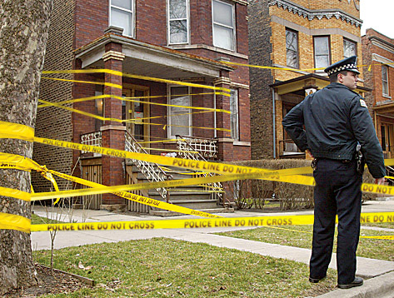
Analog vs. Digital Forensics
Analog Digital
Notes:
Note: This slide is animated
[click] In the real world you have your crime scene that needs to be secured – although I am not to sure what the colleague in this picture did ;)
In the world of Digital Forensics you can have that same crime scene as well. So the investigators need to secure that scene the same way than they would in traditional forensics. But in our Digital Forensics world we can also have a second crime scene [click]. A computer system could have been used to commit a crime. This makes it a valuable evidence for our case. But even if the computer itself was not used to commit the crime it could still hold important information about the crime, the preparation phase of the crime, documentary account spreadsheets, chat relations between the victim and the suspect or other circumstances that have to do with the crime.

Slide 152

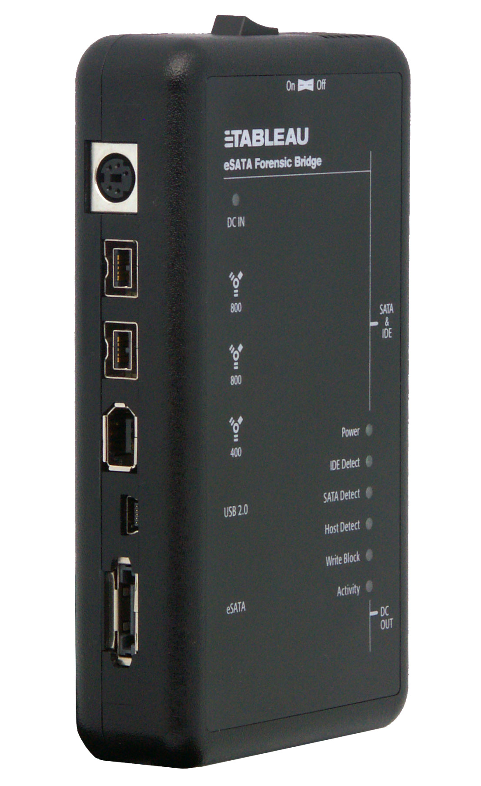
Analog vs. Digital Forensics
Analog Digital
Notes:
Note: This slide is animated
[click] Always wear your gloves when securing a crime scene – this old principle in traditional forensics is also true of Digital Forensics. The same way that you would not want your own fingerprints and DNA on the weapon that was used for a crime you would not want to leave you own traces on a digital piece of evidence such as a hard disk drive. [click]
That‘s when write-blockers come into play. There are different types of write-blockers. Some of them are just small pieces of software that try to deactivate write access to a disk (software write-blockers). And some of them are actual hardware devices that physically disable the signal that is responsible for sending write commands to a hard disk (hardware write-blockers). On this picture you can see a hardware write-blocker from the company Tableau. There are others from companies like Wiebetech or MyKey Technologies. They all have in common that there are some ports to connect a source hard drive (the exhibit) and some other ports to connect the write-blocker to the forensic machine of the examiner.

Slide 153
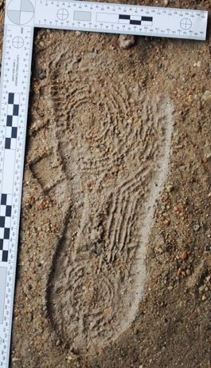
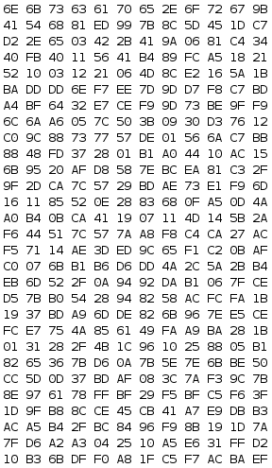
Analog vs. Digital Forensics
Analog Digital
Notes:
Note: This slide is animated
[click] In traditional forensics the crime scene investigators can find and secure footprints, fibres, DNA and other traces as evidence that may lead to the suspect. Very similar traces can be found on digital sources as well: websites, the suspect has visited, documents he created, pictures he opened or even traces of an attacker that breached into a system. Like DNA in tradition forensics, some digital traces are also not obvious to see and need special techniques to extract the evidential content from them. [click] Fragments of files in unallocated areas on discs are an example for that. Sometimes forensic examiners have to delve deep into disk structures, filesystems, slack spaces and proprietary data structures to find the evidence you need for your trial.

Slide 154


Analog vs. Digital Forensics
Analog Digital
1 to 64 Billion
MD5, SHA-1, SHA-256, SHA-512, …
1 to > 340 Billion Billion Billion Billion
Notes:
Note: This slide is animated
[click] Here is another example of similarities between traditional forensic sciences and Digital Forensics. When the investigators find fingerprints on the tool that was used in a crime they scan their database to find the exact same fingerprint. If they are successful in their search they can definitely say that the fingerprint on the tool belongs to a specific person in their database. In digital forensics there is a similar way to compare and find certain file and to prove that the file that was search for and the file that had been found match exactly. Maybe some of you have heard about such methods. Does anyone have any idea?...
[click] Maybe now? Hashing is the term I was searching for. In a hash analysis the forensic examiner calculates hash sums of a file or a disk. MD5, SHA-1, SHA-256, etc are just some of the more common example for cryptographic hash algorythms. Once this hash value, which basically is a long string of numbers and letters, has been calculated it is unique to the contents of this file. No other file will have the same hash value except it same the exact same contents. That is why examiners can use hash values to search for notable files and to verify if the contents of a forensic copy of a hard drive are the same than the ones of the original hard drive.
In terms of probability: How likely do you think it is that two people have the same fingerprint? … 1 to 64 Billion! [click] And how likely would you say it is to win the highest class at the lottery Euromillions? … 1 to 116 million! Now that you know these high numbers, how high do you think is the probability for two files having the same hash value? … Using the MD5 algorythm the probability of two files having the same value is [click] 1 to over 340 Billion Billion Billion Billion (2 with the power of 128), while the probability with SHA-1 is over one thousand Billion Billion Billion Billion Billion (2 with the power of 160). However – just for you to have it heard – researchers managed to produce hash collisions under lab conditions.

Slide 155
Forensic Sciences
  Definition, Structure and Methodology
Notes:
Now, that you have seen how Digital Forensics are similar to other traditional forensic sciences we will look at how Digital Forensics is defined and how it works.

Slide 156
Digital Forensics
Definition:
Forensic science is the study of any field as it pertains to legal matters. Forensic evidence refers more specifically to evidence which meets stringent standards of reliability and scientific integrity for admissibility in court.
Digital Forensics is a branch of forensic science related to the acquisition, processing, analysis and reporting of evidence that is stored on computer systems, digital devices and other storage media with the aim of admissibility in court.
Notes:
Definition:
Forensic science is the study of any field as it pertains to legal matters. Forensic evidence refers more specifically to evidence which meets stringent standards of reliability and scientific integrity for admissibility in court.
Digital Forensics is a branch of forensic science related to the acquisition, processing, analysis and reporting of evidence that is stored on computer systems, digital devices and other storage media with the aim of admissibility in court.

Slide 157



Digital Forensics
Digital Forensics
Computer Forensics
Mobile Forensics
Network Forensics
Post Mortem
Forensics
Live Forensics
Application Forensics
Android Forensics
iOS Forensics
Windows Phone/ Symbian/others
Live Network Forensics
Captured Packets Forensics
Others, eg. Satnav.
Malware Analysis
Other Devices Forensics: DVR, routers, game consoles, skimming devices, etc.
Notes:
There are three main categories of Digital Forensics.
Computer Forensics is the oldest of the categories. It affects personal computers, servers and storage media. There are four subcategories of Computer Forensics. They are
Post Mortem Forensics, which is all about how to acquire, process, analyse and report data stored on computer systems that are not turned on. This is the most traditional category of forensic.
Live Forensics is all about how to acquire, process, analyse and report data stored on computer systems that are turned on. Compared to Post Mortem Forensics it is a rather young subcategory but is becoming more and more important as a lot a data nowadays is stored temporarIly, remotely or encrypted.
Application forensics is the subcategory that focuses on analysing traces and artefacts left be thousands of different applications.
The last category is the forensics pertaining other hardware devices, such as digital video recorders, routers, game consoles, skimming devices and many more. A lot of these devices have their own propriotary file systems and operation systems.
The first three categories have subcategories for the different operation systems, like Windows, Linux, Mac OS X
Mobile Forensics is a rather young category but is becoming quite popular, since a lot of data that can be interesting for an investigation can be stored on mobile devices like smartphones and tablet computers. The sub-categories reflect the different operation systems. The most popular at the moment are Google Android and iOS from Mac.
The category network forensics handles electronic evidence that is transmitted over a network, be it wireless or wired, be it Internet or a local area network. In live network forensics the investigators are facing a situation where they are intercepting a network connection and need to analyse the datastreams on-the-fly. While the captured packets forensics deals with analysing files that contain recorded network traffic.

Slide 158
Steps in Digital Forensics Examinations
Acquisition
Processing
Analysis
Presentation
Notes:
Note: This slide is animated
In a case that involves Digital Forensics the standard procedure normally consists of four steps:
[click] The Acquisition: Digital evidence needs to be acquired. This can happen by collecting volatile data in a search & Seizure scenario, by acquiring a suspect‘s disk from a seized computer or in any other process during a case where the investigator needs to forensically acquire data from other sources. The acquisition step is very crucial as a lot of irreversible errors can be made at this early step. It is important to keep the chain of custody intact, to document all steps and to verify everything that was acquired.
[click] The Processing: The processing step is important whenever time, effectiveness or large data volumes are an issue. In this step forensic examiners can prioritise certain devices or data, they can apply smart, case-specific filters (Data Mining) or they can just process the image in a way that a normal investigator can do the analysis (e.g. by recovering deleted files, mounting countainers, breaking encryption, parsing application data like internet history, chat logs, etc).
[click] The Analysis: In the analysis the examiner actually searches for digital evidence on the images. This step can be very time consuming and can require a lot of expert knowledge to interpret traces and artefacts.
[click] The Presentation: After all the evidence was found in the analysis step the examiner needs to create a report for the trial. His job is to illustrate and to translate complicated technical contexts to you as judges and prosecutors in a way that you can easily understand what evidence was found, where it was found, how it was found and how it could have gotten there.

Slide 159
Digital Traces
  Categories and Examples
Notes:
Now, that you have seen how Digital Forensics are similar to other traditional forensic sciences we will look at how Digital Forensics is defined and how it works.

Slide 160
Categories of digital traces
Avoidable traces | Unavoidable traces
Thumbcaches Most Recently Used Lists Logfiles Browser Histories Browser Caches Most Used Programs Form data Pagefile.sys Hiberfil.sys Volume Shadow Copies … | Slacks Unallocated Space MFT Entries RAM some application traces
Notes:
There are two types of digital traces:
Avoidable traces: These are traces that are stored by the operation system and applications by default but can be configured not to be stored. Take your web browser as an example. You type in the URL of you favorite website. Then a day later you want to visit this website again and start to type the URL again when suddenly your browser auto-completes the URL. So there must be a place of your hard drive where exactly that information is stored. Another example are your startmenu and your Office programs; they remember which files you opened recently. There are a lot of those information stored on your hard disk. Some on them are mentioned on this slide. However you can delve into your system and program configurations and change that behaviour. So you can avoid those traces.
Unavoidable traces: In contrast to the avoidable traces the unavoidable ones cannot be configured to stop. So the probability to find unintenionally stored evidential data in these areas is quite high even if the suspect tried to clear his tracks. I will explain the term Slack and Unallocated Space to you in some moments but unfortunately we can not go into further detail at this stage.
Let‘s look at how Digital Forensics can help you with those traces.

Slide 161
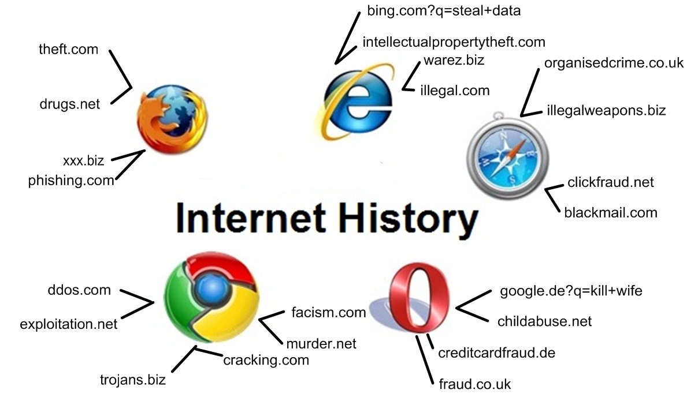
What digital forensics can do for you?
Notes:
May I ask you a question? Who of you is surfing the Internet? … Ok, and who of you is using one of the browsers shown on this slide? … Wow, ok, so I assume that all of you know that Internet browsers store a browsing history, a local cache of the websites you visited and cookie information as well as the values that you write into form fields like the google search and information about your favourite websites and downloads?
If so, this slide will tell you nothing new: All the websites that a suspect visits, fills in data and interacts with leave traces by default. Some of the browsers can be configured to not store all of this information but not all of them actually keep their word. Sometimes the history that should not be recorded is just not shown but still is recorded.
So the Internet History often is a good place to find information – even more in times where nearly everyone surfs the web and a lot of crime are commit over the Internet. If we look at some of the addresses here we can see some examples for URLs that could make an examiner at least curious. As I know our jurisdiction in Germany it can make a huge difference to a trial if it can be proven that the suspect intentionally searched and planned his crime before he committed it. How about your jurisdiction?...

Slide 162


What digital forensics can do for you?
User-specific data
Programs used, Websites visited, Searches performed, Files opened/saved
Exif data
When, where was a picture taken with with camera model, serial number
Notes:
Here are some other examples of what kind of data a Digital Forensics examination can provide you:
User-specific data
Programs used, Websites visited, Searches performed, Files opened/saved
Exif data
When, where was a picture taken with camera model, serial number

Slide 163


What digital forensics can do for you?
Application data
E-Mail clients, chat history, databases, configurations, malware analysis
Fragments
Fragment of evidential pictures, documents, histories, logfiles, …
Notes:
Application data
E-Mail clients, chat history, databases, configurations, malware analysis
Fragments
Fragment of evidential pictures, documents, histories, logfiles, …

Slide 164


What digital forensics can do for you?
Evidential documents
account statements, blackmail letters, illegal pictures, contacts, logfiles, stolen blueprints,…
Unaccessible Data
hidden files, encrypted files, deleted data,
steganized files, cloud/network storage
Notes:
Evidential documents
account statements, blackmail letters, illegal pictures, contacts, logfiles, stolen blueprints,…
Unaccessible Data
hidden files, encrypted files, deleted data,
steganized files, cloud/network storage

Slide 165
Production/Presentation
The production of a full report which includes among other issues the steps of the investigation and the methods used to obtain evidence.
The forensic experts can be expert witnesses that help the people involved in the court proceedings to understand the processes of how the evidence was created, the procedures used to collect the evidence and the evaluation of the evidence.

Slide 166
Production/Presentation
In general cases it is not necessary for witnesses producing factual evidence to have the status of expert witnesses.
However, experts can play an important role in criminal proceedings. The forensic experts help those involved in the court proceedings to understand the processes of how the evidence was created, the procedures used to collect the evidence and the evaluation of the evidence. They may also provide evidence of opinion when required to do so by the court

Slide 167
  Review of Session Objectives
Notes:
Review of Session Objectives
The trainer should recap / test knowledge on the following objectives to ensure they have been met during the session (note: this list of objectives is developed in the two next slides):
Discuss the contents of the COE Electronic Evidence Guide
Discuss various types of electronic evidence
Explain the principles of best practice relating to the Seizure and handling of electronic evidence
Identify the challenges offered by “dead box”, “live data” and Internet sources of electronic evidence, including evidence in the “cloud”.
Discuss the admissibility of electronic evidence in judicial proceedings
Explain the proper planning and preparation of a search raid where digital evidence may be found.
List the tools and items may be needed for a search raid where digital evidence may be found.
Explain how a crime scene would be secured and documented, where digital evidence occurs.
Explain the term Digital Forensics
Compare Digital Forensics to traditional forensic sciences
Define at least three sub-branches of Digital Forensics
Identify the four steps in Digital Forensics examinations
Differentiate the two categories of digital traces
Describe how Digital Forensics can support investigations
This may be achieved by way of group discussion, questioning of the participants, a quiz or other recognised methods.
This lesson has sought to provide some guidance as to the type and level of knowledge of electronic evidence that is required by Judges and prosecutors to fulfil their role effectively. It does not purport to be a complete analysis of the issues and where relevant indicates where further information may be obtained.
It is recommended that training developers ensure that the material they prepare is as up to date and incorporates the latest issues as they impact on criminal behaviour; its impact on the legal, procedural and evidential rules within the jurisdiction where the training is to be delivered. There are technological changes that will affect the criminal justice system, such as solid state storage of data IP version 6 and Web 2.0. These will be important issues to include in training programmes and require inclusion as they become more prevalent. One aspect that will be increasingly important is the legal issues surrounding the collection and obtaining evidence from “cloud” sources. The Convention TCY committee, appointed a cloud evidence group to explore the issues and make recommendations. Their final document may be found at https://rm.coe.int/CoERMPublicCommonSearchServices/DisplayDCTMContent?documentId=09000016806a495e This document also includes a draft guidance note for the TCY committee. It is recommended that trainers preparing to deliver this course in future, make themselves aware of the content of the report and once a guidance note is issued, consider incorporating relevant aspects of the guidance note in this session.
Knowledge Check
No specific knowledge check in addition to that listed above is currently envisaged for this course. No official assessment has been requested

Slide 168
Session Objectives
By the end of this session delegates will be able to:
Discuss the contents of the COE Electronic Evidence Guide
Discuss various types of electronic evidence
Explain the principles of best practice relating to the Seizure and handling of electronic evidence
Identify the challenges offered by “dead box”, “live data” and Internet sources of electronic evidence, including evidence in the “cloud”.
Discuss the admissibility of electronic evidence in judicial proceedings
Explain the proper planning and preparation of a search raid where digital evidence may be found.
Explain how a crime scene would be secured and documented, where digital evidence occur.
Notes:
It is important that the delegates should understand what the objectives of the lesson are. These should be “SMART” objectives and explained in detail to the delegates before the session begins, using the information on the slide.

Slide 169
Session Objectives
By the end of this session delegates will be able to:
Explain the term Digital Forensics
Compare Digital Forensics to traditional forensic sciences
Define at least three sub-branches of Digital Forensics
Identify the four steps in Digital Forensics examinations
Differentiate the two categories of digital traces
Describe how Digital Forensics can support investigations
Notes:
It is important that the delegates should understand what the objectives of the lesson are. These should be “SMART” objectives and explained in detail to the delegates before the session begins, using the information on the slide.

Slide 170
Questions
Notes:
The trainer should give participants an opportunity to ask any questions that they may have in relation to the lesson.

