Slide 1
iPROCEEDS
Project on targeting crime proceeds on the Internet in South-eastern Europe and Turkey
Introductory Training on Cybercrime, Electronic Evidence and Online Crime Proceeds
Session 1.4.2/Hour 3
Online Criminal Money Flow Typologies

Slide 2
Session Objectives
Explain the criminal money flow typologies of the use of:
  Purchase through the Internet
  Shell Companies
  Prepaid Cards
  Online gaming and online trading platforms

Slide 3

Purchase through the Internet

Slide 4
Purchases through the Internet?
DISCUSSION:
What do YOU think?

Slide 5
Internet Purchase Typology
Criminal acquires access to compromised card data or banking credentials.
Criminal purchases goods (e.g. airline ticket) using compromised credentials.
Criminal lists airline tickets for sale on online auction site.
Someone wins the auction and sends payment to the criminal.
Criminal sends airline tickets to winner of auction.

Slide 6
Internet Purchases
DISCUSSION:
What sources of evidence can be used to indicate the use of Internet purchases?

Slide 7
Identification of Internet Purchases
DISCUSSION:
What procedural powers are available/relevant to the identification/activity of Internet purchases?

Slide 8
Freezing, Seizing and Confiscation of Internet Purchases
DISCUSSION:
What procedural powers are available/relevant to the freezing, seizing and confiscation of Internet Purchases?

Slide 9

Shell companies

Slide 10
Shell Companies
Shell companies are already well understood to be a money laundering technique.
This laundering technique is also used in the online world, primarily in an attempt to make transactions look more legitimate.
Amounts of funds transferred to shell companies tend to be larger than amounts transferred to/by individual mules.

Slide 11
Recap: Shell Companies
Shell companies are companies with no business activity, assets or liabilities, created solely for the purpose of holding bank accounts.
Shell companies (or their bank accounts) are often located in foreign jurisdictions to the location of the predicate offence.
Shell companies give a façade of legitimacy to the transfer from the payer’s bank.

Slide 12
Shell Companies
DISCUSSION:
What additional challenges arise when shell companies are used for online crime proceeds?

Slide 13
Shell Company Typology (Example)
Criminal creates a shell company.
Criminal opens a bank account in the name of the shell company in a foreign jurisdiction.
Criminal conducts fraudulent activity and transfers funds from victim accounts into the bank account of the shell company.

Slide 14
Identification of use of Shell Companies
DISCUSSION:
What sources of evidence can be used to indicate the use of shell companies?

Slide 15
Identification of use of Shell Companies
DISCUSSION:
What procedural powers are available/relevant to the identification/use of shell companies?

Slide 16
Freezing, Seizing and Confiscation of funds from Shell Companies
DISCUSSION:
What procedural powers are available/relevant to the freezing, seizing and confiscation of funds held by shell companies?

Slide 17
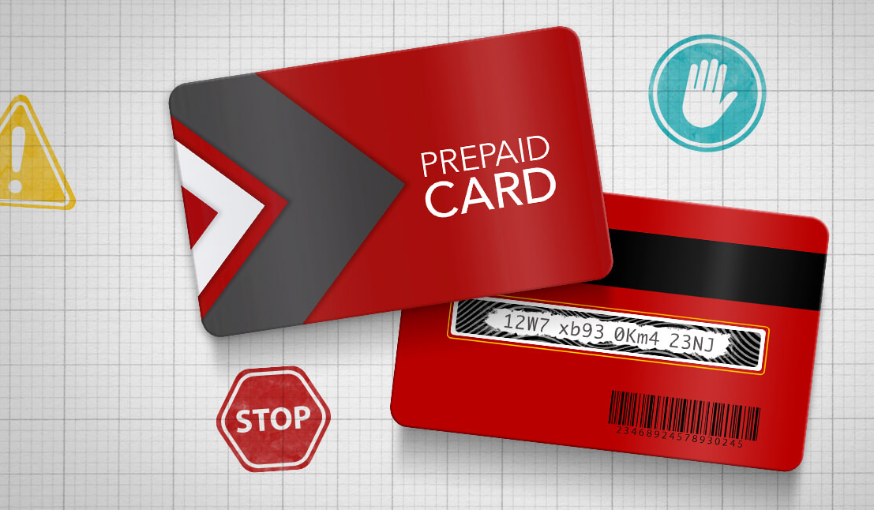
Prepaid cards

Slide 18
Prepaid Cards
Allow value to be pre-associated with a payment card.
Two types:
  Closed prepaid cards: can only be used in a particular company or store (e.g. gift cards) and can be bought and used anonymously.
  Open prepaid cards: issued by a bank, credit card or other financial institution. Can be used just like any other payment card.
The same typology applies to mobile phone top-up credit and pre-paid mobile phones.

Slide 19
Prepaid Card Typology
Criminals obtain funds, e.g. through banking malware.
Funds are transferred to a money mule.
The mule withdraws cash and uses the cash to purchase prepaid cards.
The cards are then used or sold. When sold, the cards are usually sold for less than face value.

Slide 20
Identification of use of Prepaid Cards
DISCUSSION:
What sources of evidence can be used to indicate the use of Prepaid Cards?

Slide 21
Identification of use of Prepaid Cards
DISCUSSION:
What procedural powers are available/relevant to the identification/use of prepaid cards?

Slide 22
Freezing, Seizing and Confiscation of Prepaid Cards
DISCUSSION:
What procedural powers are available/relevant to the freezing, seizing and confiscation of prepaid cards?

Slide 23

Online gaming platforms

Slide 24
Online Gaming Platforms
Allow gambling of various types online.
Typically funds are cashed in/cashed out via traditional banking sector (e.g. funds transfer, credit/debit card, etc.).
Inconsistent legal status and regulation of online gambling.

Slide 25
Online Gambling Typology (Example)
Criminals and associates have multiple stolen credit cards to monetise.
Criminal holds a prepaid card (or other card where laundered funds are to be placed) and associates hold stolen credit cards.
Criminal and associates log on to gambling platform and transfer funds to their gambling accounts.
Criminal and associates enter (for example) a poker room together.
Associates deliberately lose to criminal.
Winnings are transferred to criminal’s online gambling account.
Criminal transfers funds to the payment card in their possession, which is then used or sold.

Slide 26
Identification of use of Online Gambling Platforms
DISCUSSION:
What sources of evidence can be used to indicate the use of online gambling platforms?

Slide 27
Identification of use of Online Gambling Platforms
DISCUSSION:
What procedural powers are available/relevant to the identification/use of online gambling platforms?

Slide 28
Freezing, Seizing and Confiscation of Funds from Online Gambling Platforms
DISCUSSION:
What procedural powers are available/relevant to the freezing, seizing and confiscation of funds from online gambling platforms?

Slide 29
Summary
Explain the criminal money flow typologies of the use of:
  Purchase through the Internet
  Shell Companies
  Prepaid Cards
  Online gaming and online trading platforms

Slide 30

Questions

