Slide 1
Basic Course on the Search, Seizure and Confiscation of Online Crime Proceeds
Session 1.1.2
Introduction to Cybercrime

Slide 2
Session Objectives
Understand the definition of cybercrime as per:
  The Budapest Convention on Cybercrime
  National Substantive Criminal Law Provisions
Explain how cybercrime can be a source of criminal funds
Explain how cybercrime and financial investigations can overlap.

Slide 3
Cybercrime
DISCUSSION:
What do YOU think?

Slide 4
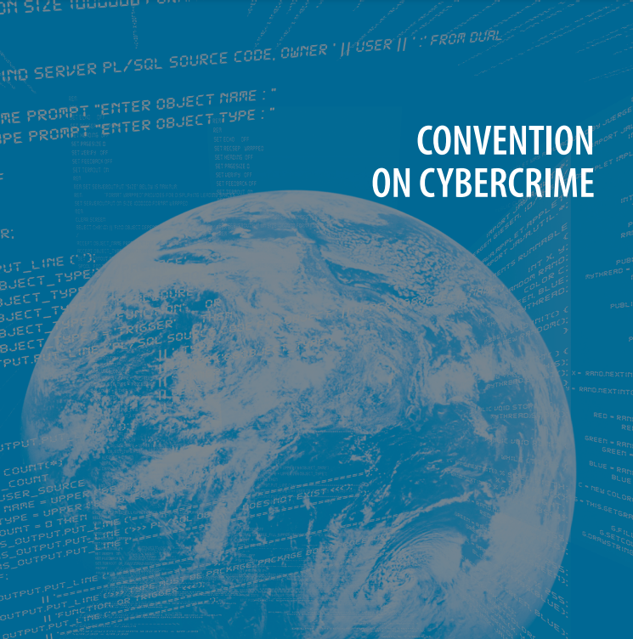
The Budapest Convention

Slide 5
Budapest Convention
The scope of the Budapest Convention includes:
  Substantial provisions, criminalising certain types of online conduct.
  Procedural provisions, such as expedited preservation of electronic evidence.
  Provisions on international cooperation, such as the creation of a network of 24/7 contact points.

Slide 6
Substantive Provisions
Intended to facilitate and develop international cooperation in criminal investigations through harmonisation of substantive law.
Defines:
  Offences against the confidentiality, integrity and availability of computer systems
  Offences carried out by means of computer systems
    Forgery and fraud
    Child pornography
    Offences related to intellectual property rights

Slide 7
Substantive Provisions
Article 2 – Illegal Access
Each Party shall adopt such legislative and other measures as may be necessary to establish as criminal offences under its domestic law when committed intentionally the access to the whole or any part of a computer system without right. A Party may require that the offence be committed by infringing security measures, with the intent of obtaining computer data or other dishonest intent, or in relation to a computer system that is connected to another computer system.

Slide 8
Substantive Provisions
Article 3 – Illegal Interception
Each Party shall adopt such legislative and other measures as may be necessary to establish as criminal offences under its domestic law when committed intentionally the interception without right, made by technical means, of non-public transmissions of computer data to, from or within a computer system, including electromagnetic emissions from a computer system carrying such computer data. A Party may require that the offence be committed with dishonest intent, or in relation to a computer system that is connected to another computer system.

Slide 9
Substantive Provisions
Article 4 – Data Interference
Each Party shall adopt such legislative and other measures as may be necessary to establish as criminal offences under its domestic law when committed intentionally the damaging, deletion, deterioration, alteration or suppression of computer data without right.
A Party may reserve the right to require that the conduct described in Paragraph 1 result in serious harm.

Slide 10
Substantive Provisions
Article 5 – System Interference
Each Party shall adopt such legislative and other measures as may be necessary to establish as criminal offences under its domestic law when committed intentionally the serious hindering without right of the functioning of a computer system by inputting, transmitting, damaging, deleting, deteriorating, altering or suppressing computer data.

Slide 11
Substantive Provisions
Article 6 – Misuse of Devices
Each Party shall adopt such legislative and other measures as may be necessary to establish as criminal offences under its domestic law when committed intentionally and without right:
  The production, sale, procurement for use, import, distribution or otherwise making available of:
    A device, including a computer program, designed or adapted primarily for the purpose of committing any of the offences established in accordance with Articles 2-5;
    A computer password, access code, or similar data by which the whole or any part of a computer system is capable of being accessed with intent that it be used for the purpose of committing any of the offences established in Articles 2-5; and
  The possession of an item referred to in paragraphs (a)(1) or (2) above, with intent that it be used for the purpose of committing any of the offences established in Articles 2-5. A Party may require by law that a number of such items be possessed before criminal liability attaches.

Slide 12
Substantive Provisions
Article 7 – Computer-related Forgery
Each Party shall adopt such legislative and other measures as may be necessary to establish as criminal offences under its domestic law when committed intentionally and without right the input, alteration, deletion, or suppression of computer data, resulting in inauthentic data with the intent that it be considered or acted upon for legal purposes as if it were authentic, regardless whether the data is directly readable or intelligible. A Party may require an intent to defraud, or similar dishonest intent, before criminal liability attaches.

Slide 13
Substantive Provisions
Article 8 – Computer-related Fraud
Each Party shall adopt such legislative and other measures as may be necessary to establish as criminal offences under its domestic law when committed intentionally and without right, the causing of a loss of property to another by:
  any input, alteration, deletion, or suppression of computer data,
  Any interference with the functioning of a computer or system,
  With the intent of procuring, without right, an economic benefit for oneself or for another.

Slide 14
Substantive Provisions
Article 9 – Offences Related to Child Pornography
Each Party shall adopt such legislative and other measures as may be necessary to establish as criminal offences under its domestic law when committed intentionally and without right the following conduct:
  Producing child pornography for the purpose of its distribution through a computer system;
  Offering or making available child pornography through a computer system;
  Distributing or transmitting child pornography through a computer system;
  Procuring child pornography through a computer system for oneself or for another;
  Possessing child pornography in a computer system or on a computer-data storage medium.
For the purpose of Paragraph 1 above “child pornography” shall include pornographic material that visually depicts:
  A minor engaged in sexually explicit conduct;
  A person appearing to be a minor engaged in sexually explicit conduct;
  Realistic images representing a minor engaged in sexually explicit conduct.
For the purpose of Paragraph 2 above, the term “minor” shall include all persons under 18 years of age. A Party may, however, require a lower age-limit, which shall be not less than 16 years.
Each Party may reserve the right not to apply, in whole or in part, paragraph 1(d) and 1(e), and 2(b) and 2(c).

Slide 15
Substantive Provisions
Article 10 – Offences Related to Infringements of Copyright and Related Rights
Each Party shall adopt such legislative and other measures as may be necessary to establish as criminal offences under its domestic law the infringement of copyright, as defined under the law of that Party pursuant to the obligations it has undertaken under the Paris Act of 24 July 1971 of the Bern Convention for the Protection of Literary and Artistic Works, the Agreement on Trade-Related Aspects of Intellectual Property Rights and the WIPO Copyright Treaty, with the exception of any moral rights conferred by such Conventions, where such acts are committed willfully, on a commercial scale and by means of a computer system.

Slide 16
Substantive Provisions
Article 11 – Attempt and aiding or abetting
Each Party shall adopt such legislative and other measures as may be necessary to establish as criminal offences under its domestic law, when committed intentionally, aiding or abetting the commission of any of the offences established in accordance with Articles 2 through 10 of the present Convention with intent that such offence be committed.
Each Party shall adopt such legislative and other measures as may be necessary to establish as criminal offences under its domestic law, when committed intentionally, an attempt to commit any of the offences established in accordance with Articles 3 through 5, 7, 8, and 9.1.a and c of this Convention.
Each party may reserve the right not to apply, in whole or in part, paragraph 2 of this Article.

Slide 17
Substantive Provisions
Article 12 – Corporate Liability
Each Party shall adopt such legislative and other measures as may be necessary to ensure that legal persons can be held liable for a criminal offence established in accordance with this Convention, committed for their benefit by any natural person, acting either individually or as part of an organ of the legal person, who has a leading position within it, based on:
  A power of representation of the legal person;
  An authority to take decisions on behalf of the legal person;
  An authority to exercise control within the legal person.
In addition to the cases already provided for in paragraph 1 of this Article, each Party shall take the measures necessary to ensure that a legal person can be held liable where the lack of supervision or control by a natural person referred to in paragraph 1 has made possible the commission of a criminal offence established in accordance with this Convention for the benefit of that legal person by a natural person acting under its authority.
Subject to the legal principles of the Party, the liability of a legal person may be criminal, civil or administrative.
Such liability shall be without prejudice to the criminal liability of the natural persons who have committed the offence.

Slide 18
Summary
Offences against the confidentiality, integrity and availability of computer data and systems
  Illegal access
  Illegal interception
  Data interference
  System interference
  Misuse of devices
Computer-related offences
  Computer-related forgery
  Computer-related fraud
Content-related offences
  Offences related to child pornography
  Offences related to infringement of copyright and related rights

Slide 19
National Substantive Law

Slide 20
Substantive Provisions
Illegal Access
Trainer to insert substantive provisions from national legislation here

Slide 21
Substantive Provisions
Illegal Interception
Trainer to insert substantive provisions from national legislation here

Slide 22
Substantive Provisions
Data Interference
Trainer to insert substantive provisions from national legislation here

Slide 23
Substantive Provisions
System Interference
Trainer to insert substantive provisions from national legislation here

Slide 24
Substantive Provisions
Misuse of Devices
Trainer to insert substantive provisions from national legislation here

Slide 25
Substantive Provisions
Computer-related Forgery
Trainer to insert substantive provisions from national legislation here

Slide 26
Substantive Provisions
Computer-related Fraud
Trainer to insert substantive provisions from national legislation here

Slide 27
Substantive Provisions
Offences Related to Child Pornography
Trainer to insert substantive provisions from national legislation here

Slide 28
Substantive Provisions
Offences Related to Infringements of Copyright and Related Rights
Trainer to insert substantive provisions from national legislation here

Slide 29
Applicable Provisions
DISCUSSION:
What do YOU think?

Slide 30
National Cybercrime Situation
Trainer to insert information on national cybercrime situation here.

Slide 31
Cybercrime as a Source of Criminal Funds

Slide 32
Example of Cybercrimes
Identity Theft
Payment Card Fraud
Online Banking Attacks, Misuse and Account Take-Over
Confidence Fraud, Including Advance-Fee Fraud and Auction Fraud
Investment Fraud, Including Stock Market Manipulation
Pyramid and Other Multi-Level Marketing Schemes
Child Abuse Materials
Sale of Counterfeit Pharmaceuticals
Violation of Copyrights and Related Rights
Online Extortion

Slide 33





Banking Malware: How does it work?
Customer PC
Online Bank
C&C Infrastructure
Criminal
Mule

Slide 34
Ransomware: How does it work?
Customer PC
Bitcoin Wallet
C&C Infrastructure
Criminal
Mule

Slide 35
Notable Feature of Many Cybercrimes
The proceeds from some types of offence are relatively small (less than EUR10,000).
  e.g. an individual ransomware payment or an individual customer bank account compromise
  These amounts, when aggregated over all the individual offences (which may take place in many jurisdictions) mean that the organisers of the crime generate large amounts of money.
On the other hand, some cybercrime offences can generate millions of euros per offence.
  E.g. Business email compromise (also known as CEO fraud) cases have been reported with losses running to millions of euros.

Slide 36
The Use of Mules
The use of money mules is a common feature when considering the funds generated in many cybercrimes and in many cases the mules are the only ones arrested.
Indeed, often the presence of mules are is only aspect of the cybercrime enterprise located in one particular jurisdiction.
The mules usually have no idea about the cybercrime components of the criminal activity.

Slide 37
Cybercrime and Financial investigations

Slide 38
Search, seizure and confiscation of proceeds of crime
Financial Investigation
Confiscation Phase
International Cooperation
Collection of evidence on the perpetrator, offence, proceeds and property.
Investigative and provisional measures
The role of the FIU (access to and analysis of financial data, postponement of suspicious transactions)
Powers to trace, freeze, seize proceeds of crime
Requests related to bank, financial, commercial records.
Special investigative techniques – undercover operations, interception of telecommunications, access to computer systems, order to produce specific documents
Decision on assessing proceeds of crime and subsequent confiscation
There may be a reverse burden of proof (extended confiscation)
Types of confiscation (confiscation of instrumentalities, confiscation of proceeds, confiscation of property)
Confiscation regimes (for victim compensation, object based confiscation, value based confiscation)
Warsaw Convention
Investigative assistance
Freezing-seizing assistance
Confiscation assistance/asset sharing

Slide 39
Application to Cybercrime
Cybercrime as a predicate offence
Financial investigation and Confiscation
International Cooperation
Cybercrime as a predicate offence
What to confiscate and where is it?
Warsaw Convention
Fraud
Extorsion
Online banking attacks
Mass-marketing fraud
Criminal money flows on the Internet
Money remittance providers
Wire transfers, account takeover, opening bank accounts
Virtual currency
Money mules
Budapest Convention
Payment card fraud

Slide 40
Cybercrime and Financial Investigations
Conduct parallel financial investigation in cybercrime to detect the proceeds (bank accounts and money flow) and the existing property of perpetrator. There are some specifics:
Who is the perpetrator and evidence of the crime?: IP ID, access to data on subscriber/user, traffic and content, cooperation with ISP, court order (traffic and content data)
What are the proceeds of crime?: often the e-money, and internet banking payments; accounts abroad, multiple transactions, often money laundering typologies; virtual currencies - bitcoin.
International cooperation and electronic evidence: also evidence on proceeds/assets.
What can be confiscated/the property of suspect?: jurisdiction: victims and perpetrators are often not in the same country.
Targeting proceeds of cybercrime (through FI or ML approach) should be considered – at least direct proceeds (extortion) and freezing bank accounts used for cybercrime.
If the perpetrator is in your country explore legal ways with other countries to be more efficient (parallel criminal investigations in two countries (several criminals, several victims).

Slide 41
Cybercrime and Financial Investigations
Conduct parallel financial investigation in cybercrime to detect the proceeds (bank accounts and money flow) and the existing property of perpetrator. There are some specifics:
Freezing order: acting fast is crucial in case of e-banking and internet world. Look for money laundering offence and use FIU powers and international links. Court order and MLA shall follow quickly. Use of Interpol channel for MLA, Warsaw convention (direct cooperation) and additional possibilities of Budapest convention, bilateral agreements and bilateral reciprocity approach.
Confiscation: question of MLA and asset-sharing. Importance of timely freezing!

Slide 42

Questions

